Slide 1
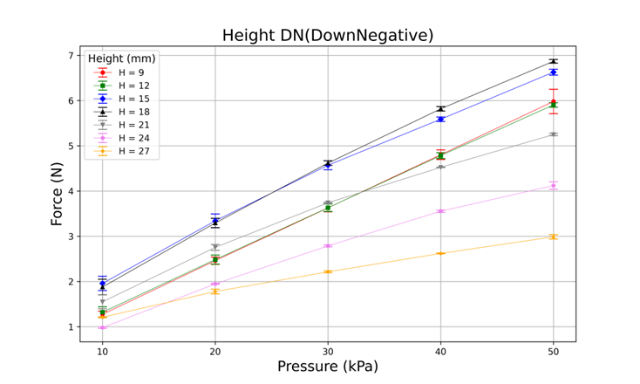
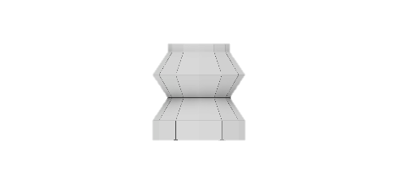
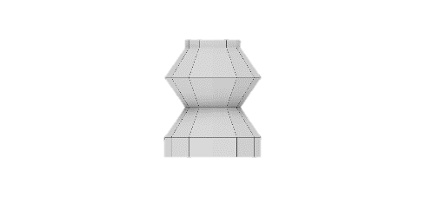
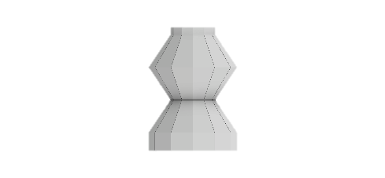
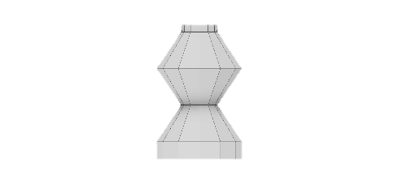
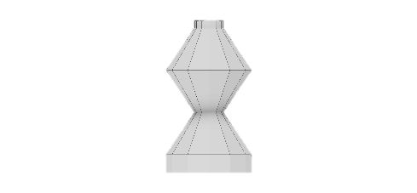
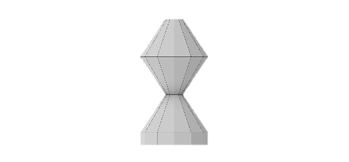
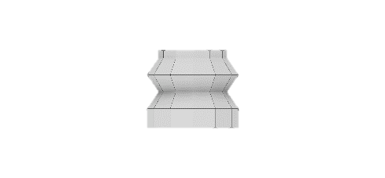
9mm
12mm
15mm
18mm
21mm
24mm
27mm

Slide 2
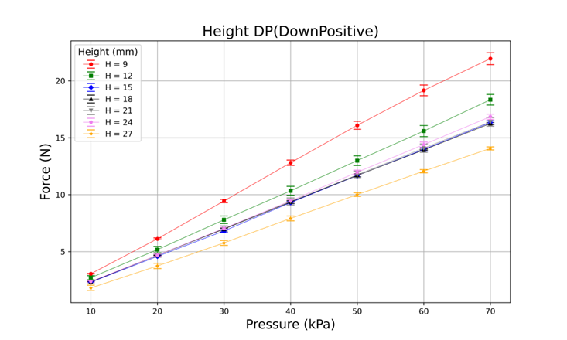
9mm
12mm
15mm
18mm
21mm
24mm
27mm

Slide 3
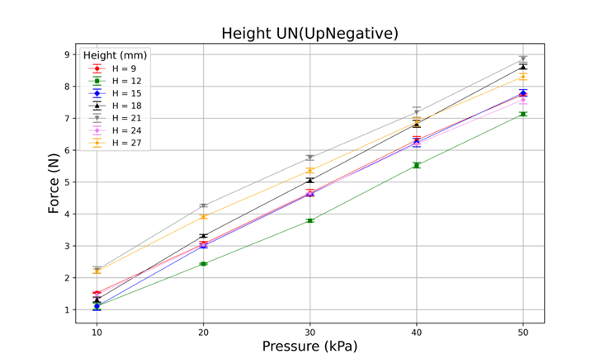
9mm
12mm
15mm
18mm
21mm
24mm
27mm

Slide 4
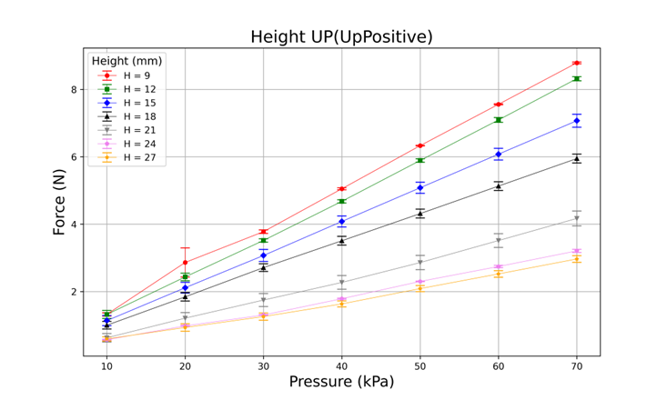
9mm
12mm
15mm
18mm
21mm
24mm
27mm

Slide 5
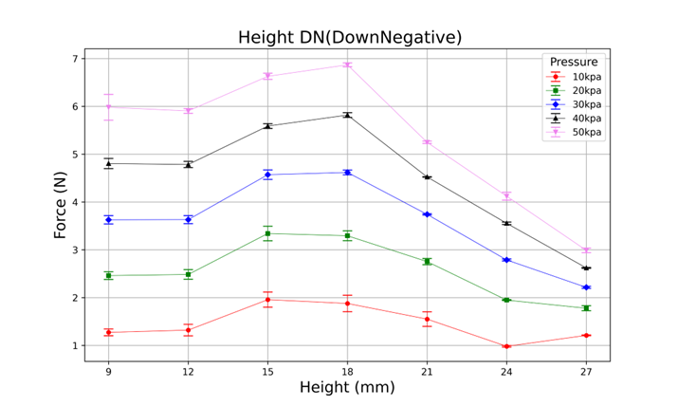
9mm
12mm
15mm
18mm
21mm
24mm
27mm

Slide 6
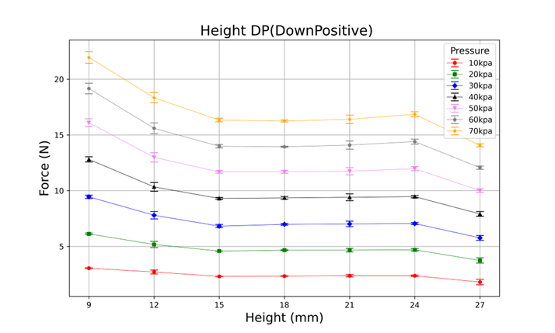
9mm
12mm
15mm
18mm
21mm
24mm
27mm

Slide 7
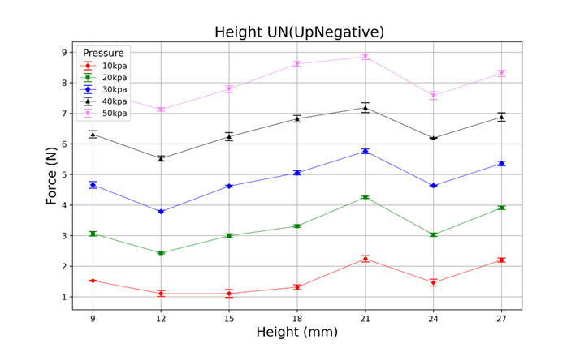
9mm
12mm
15mm
18mm
21mm
24mm
27mm

Slide 8
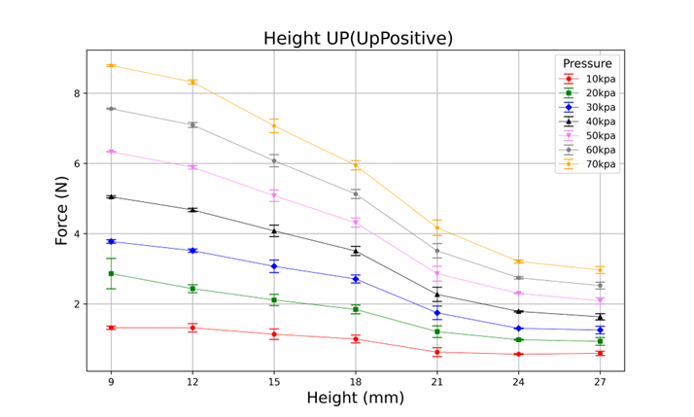
9mm
12mm
15mm
18mm
21mm
24mm
27mm

Slide 9

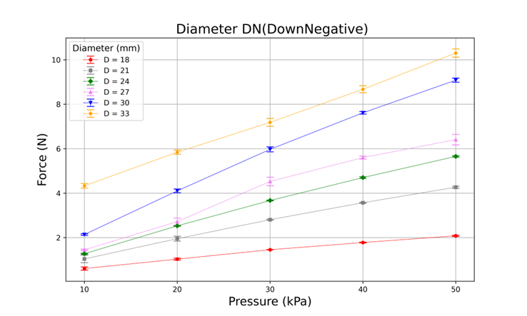

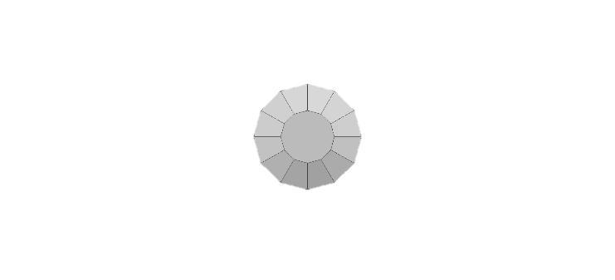
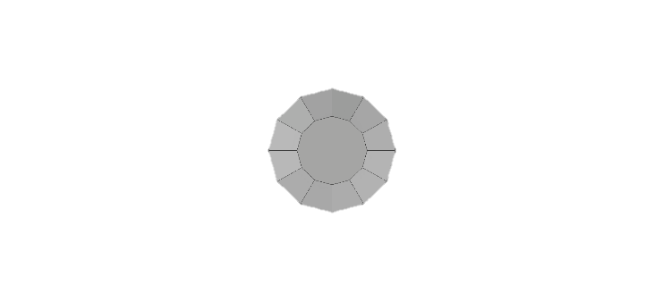
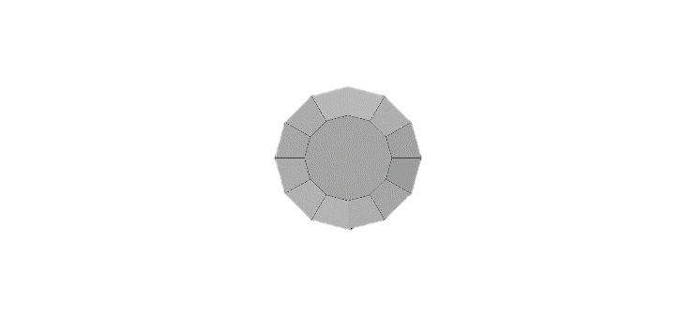
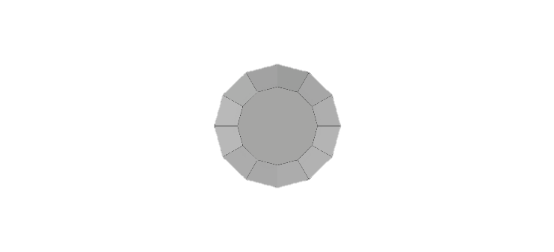
18mm
21mm
24mm
27mm
30mm
33mm

Slide 10
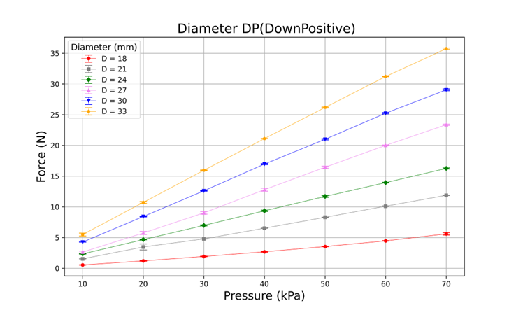
18mm
21mm
24mm
27mm
30mm
33mm

Slide 11
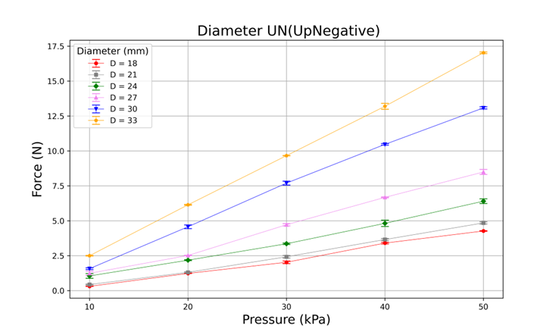
18mm
21mm
24mm
27mm
30mm
33mm

Slide 12
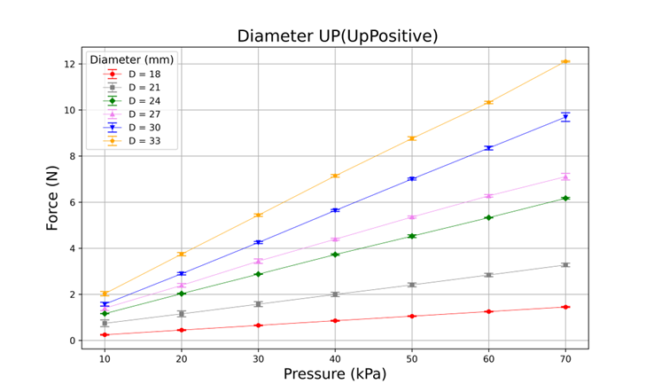
18mm
21mm
24mm
27mm
30mm
33mm

Slide 13
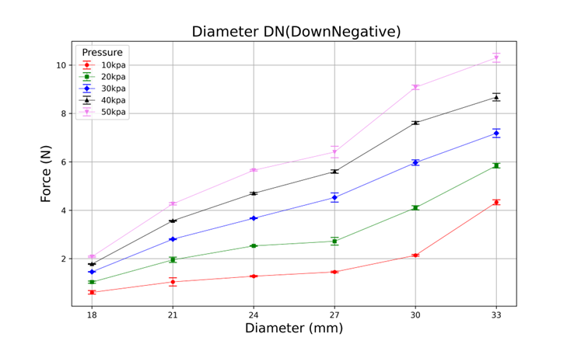
18mm
21mm
24mm
27mm
30mm
33mm

Slide 14
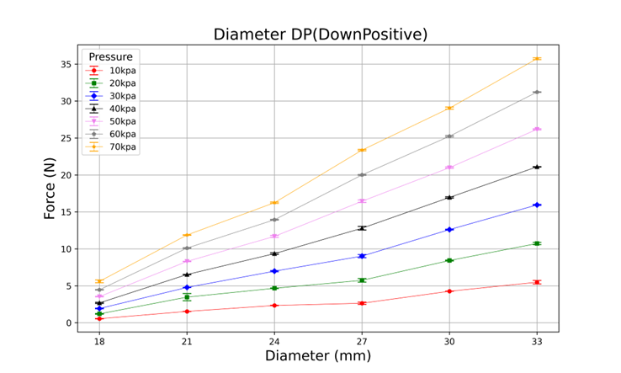
18mm
21mm
24mm
27mm
30mm
33mm

Slide 15
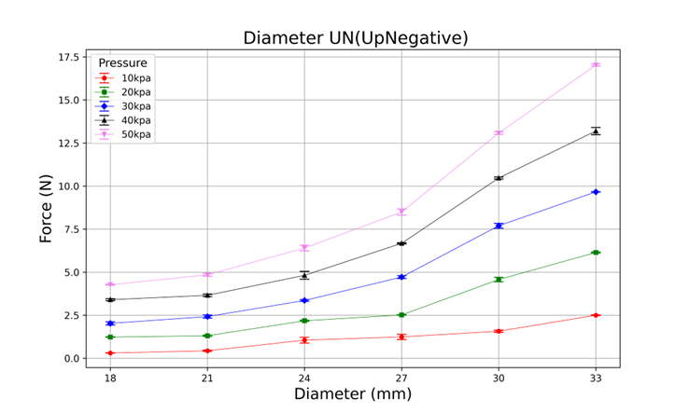
18mm
21mm
24mm
27mm
30mm
33mm

Slide 16
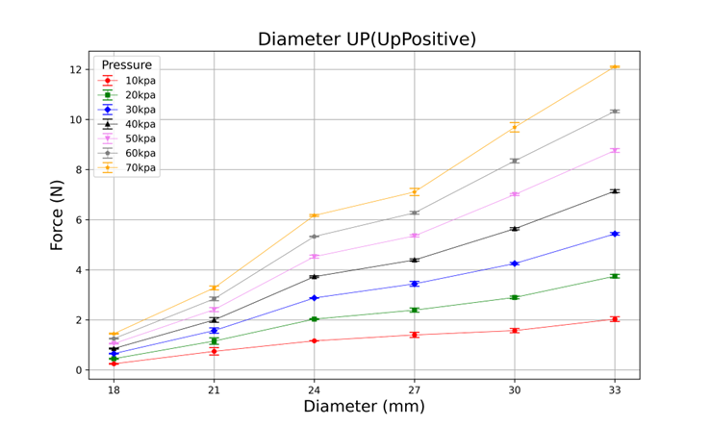
18mm
21mm
24mm
27mm
30mm
33mm

Slide 17
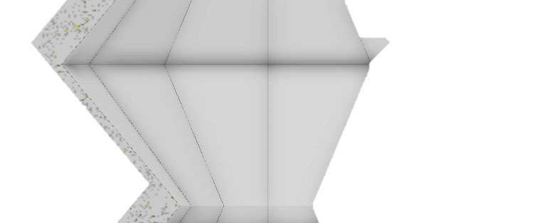
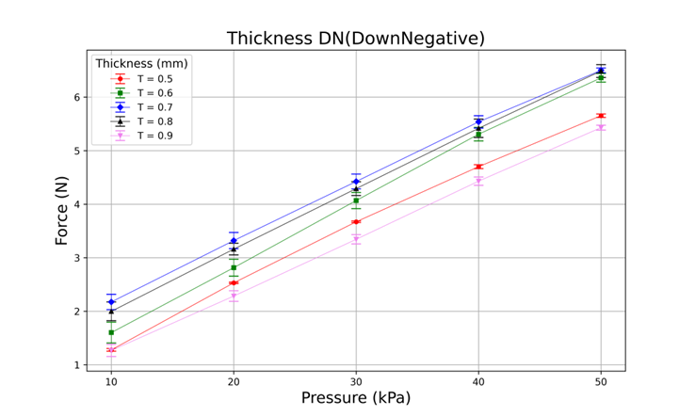
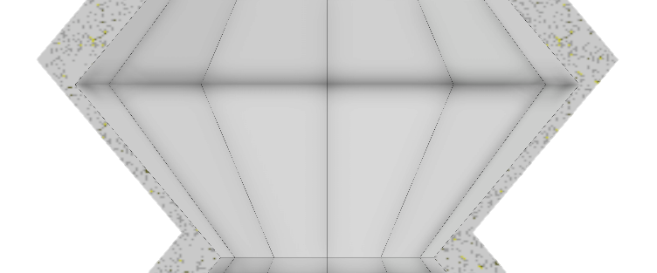
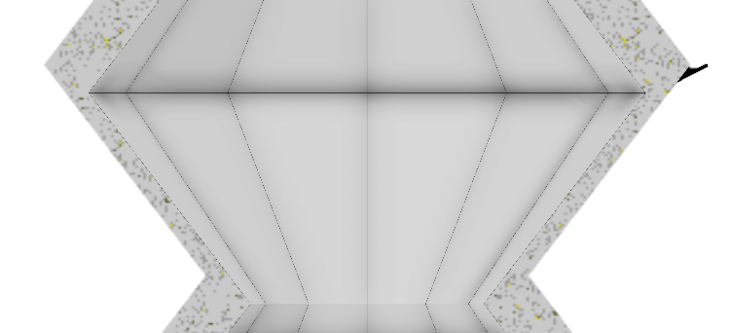
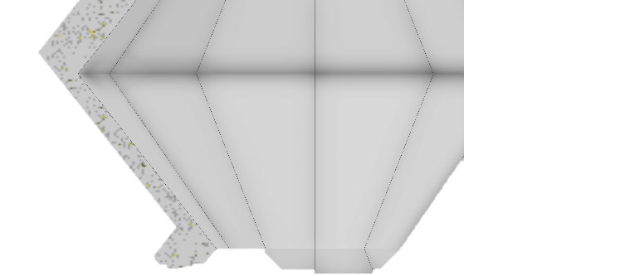
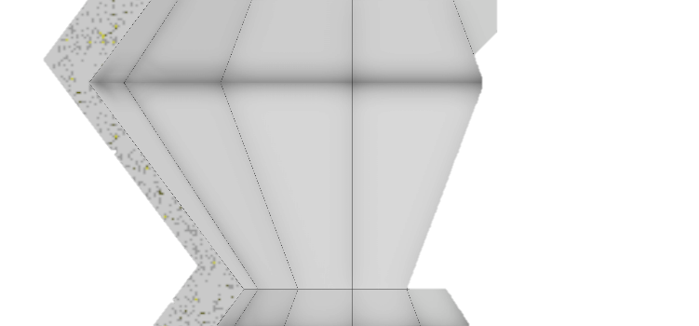
T
0.5mm
0.6mm
0.7mm
0.8mm
0.9mm

Slide 18
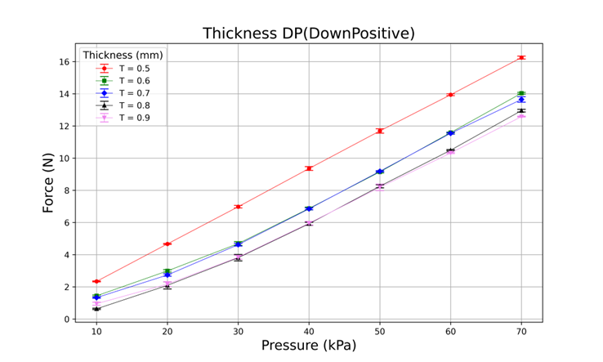
T
0.5mm
0.6mm
0.7mm
0.8mm
0.9mm

Slide 19
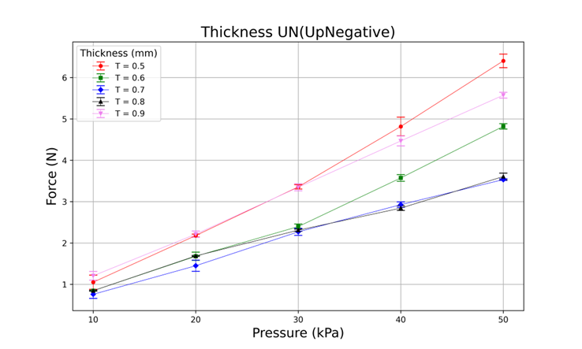
T
0.5mm
0.6mm
0.7mm
0.8mm
0.9mm

Slide 20
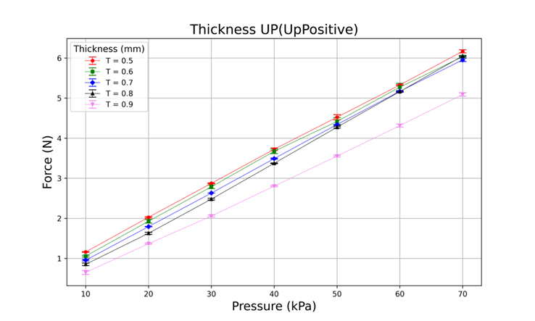
T
0.5mm
0.6mm
0.7mm
0.8mm
0.9mm

Slide 21
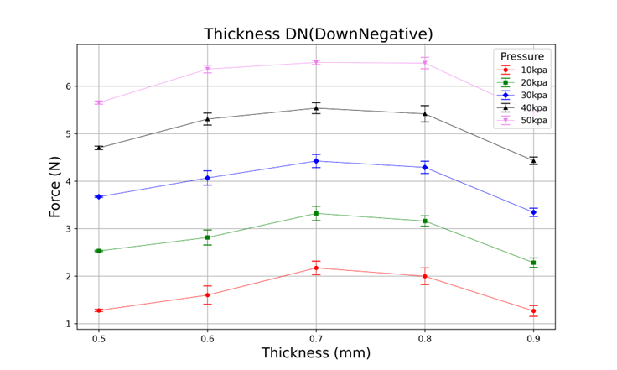
T
0.5mm
0.6mm
0.7mm
0.8mm
0.9mm

Slide 22
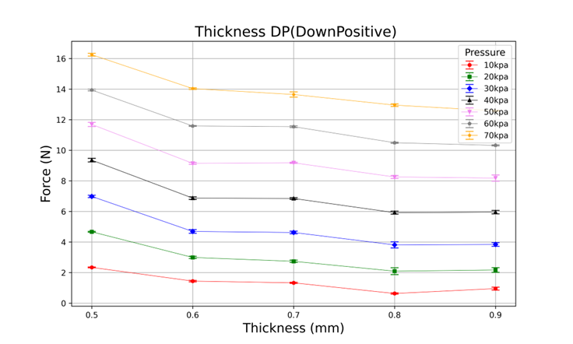
T
0.5mm
0.6mm
0.7mm
0.8mm
0.9mm

Slide 23
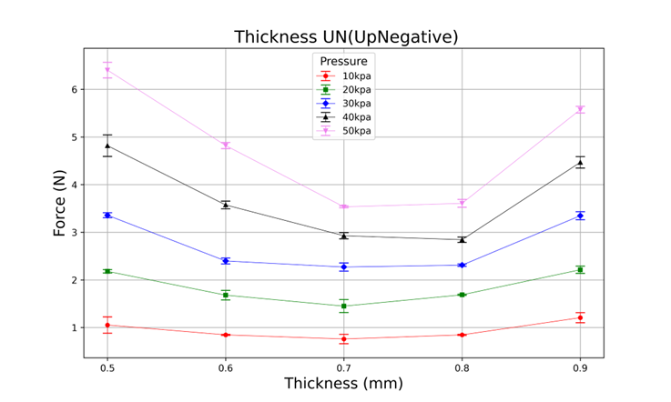
T
0.5mm
0.6mm
0.7mm
0.8mm
0.9mm

Slide 24
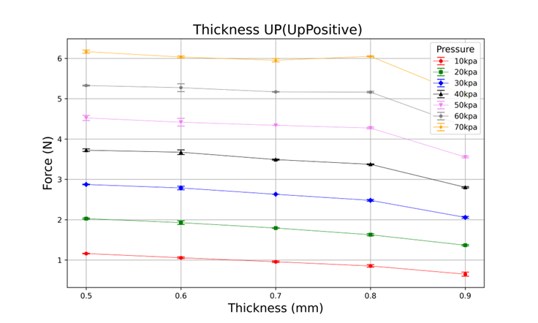
T
0.5mm
0.6mm
0.7mm
0.8mm
0.9mm

Slide 25

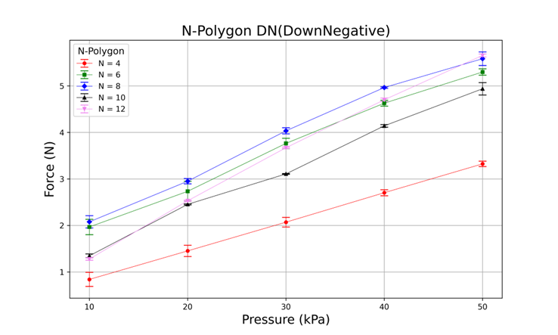


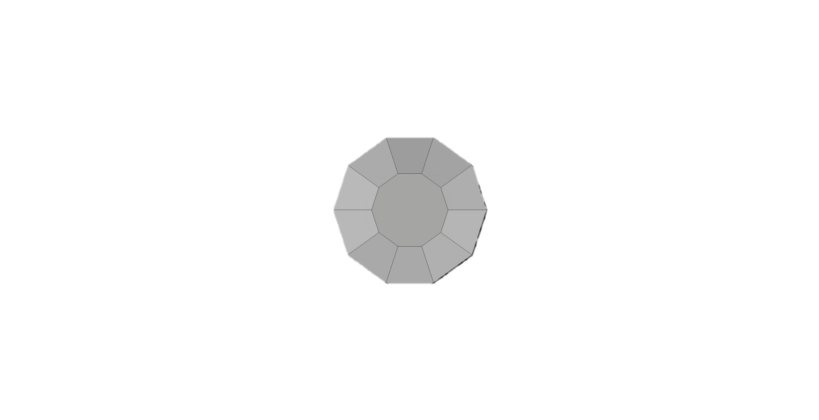
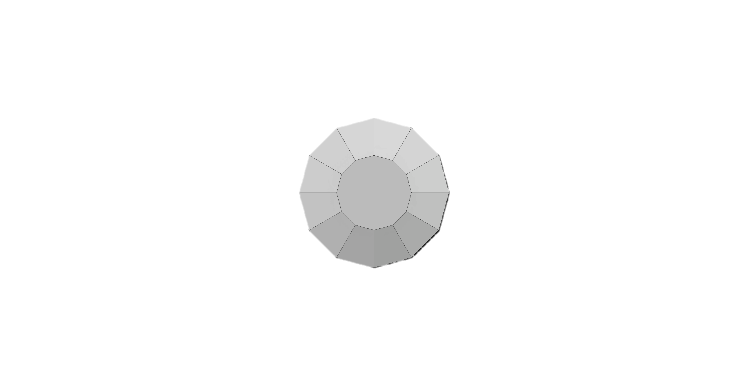
N = 4
N = 6
N = 8
N = 10
N = 12

Slide 26
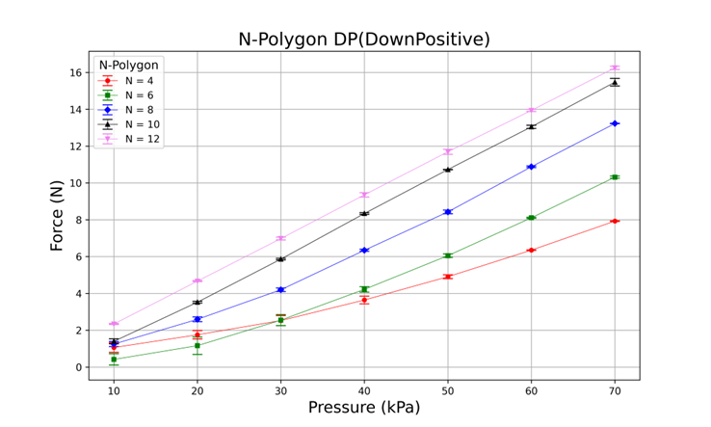
N = 4
N = 6
N = 8
N = 10
N = 12

Slide 27
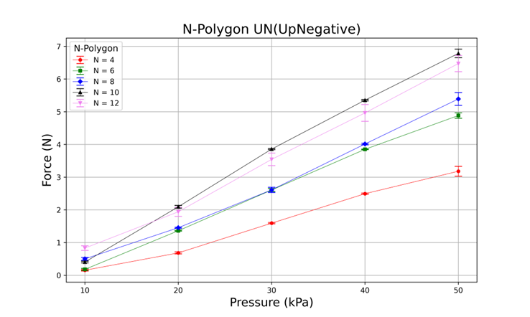
N = 4
N = 6
N = 8
N = 10
N = 12

Slide 28
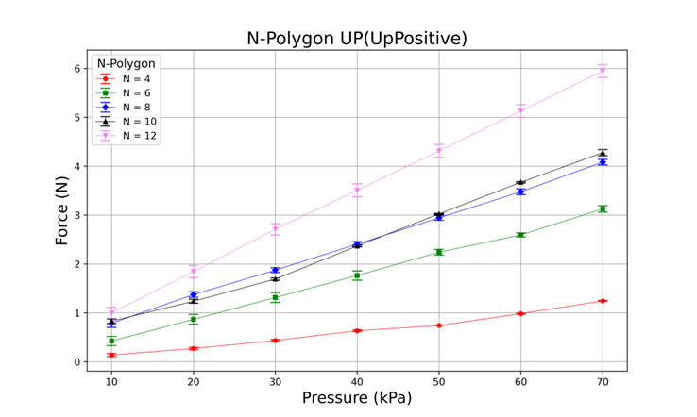
N = 4
N = 6
N = 8
N = 10
N = 12

Slide 29
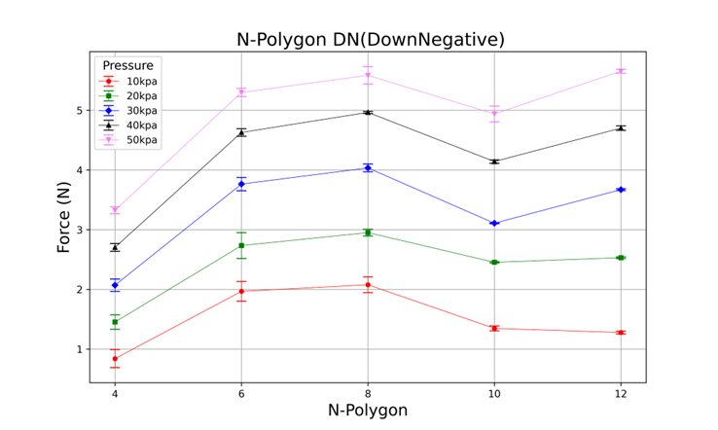
N = 4
N = 6
N = 8
N = 10
N = 12

Slide 30
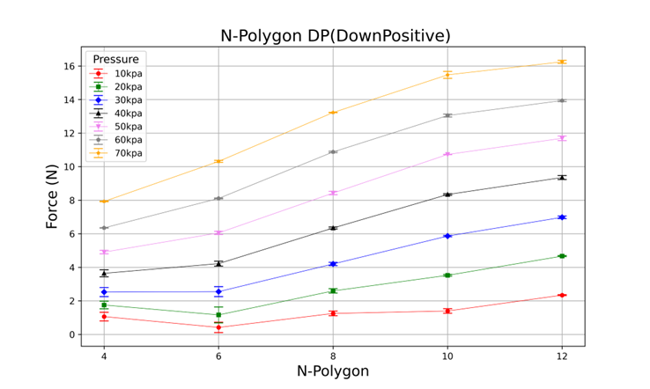
N = 4
N = 6
N = 8
N = 10
N = 12

Slide 31
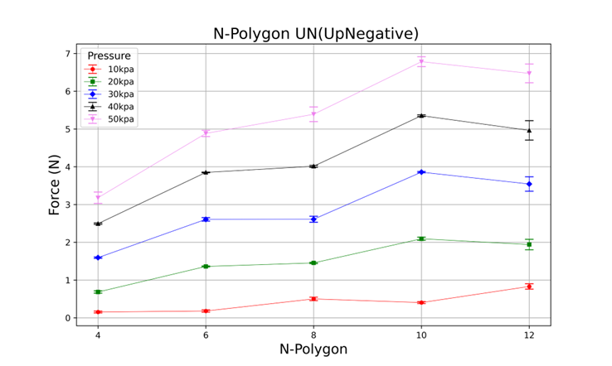
N = 4
N = 6
N = 8
N = 10
N = 12

Slide 32
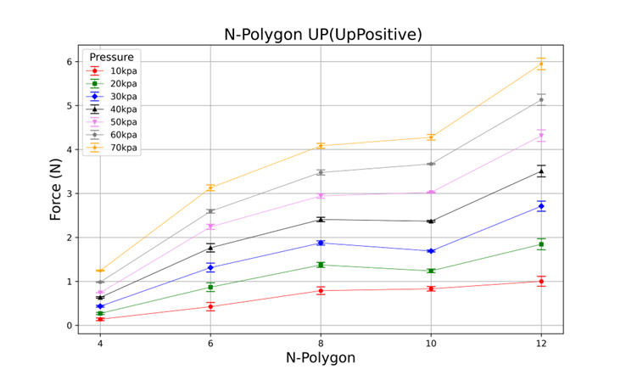
N = 4
N = 6
N = 8
N = 10
N = 12

