Slide 1
- h (핑거 높이)
- n (다각형 종류)
- D (외접원 지름)
* 작은 외접원 지름 d

Slide 2
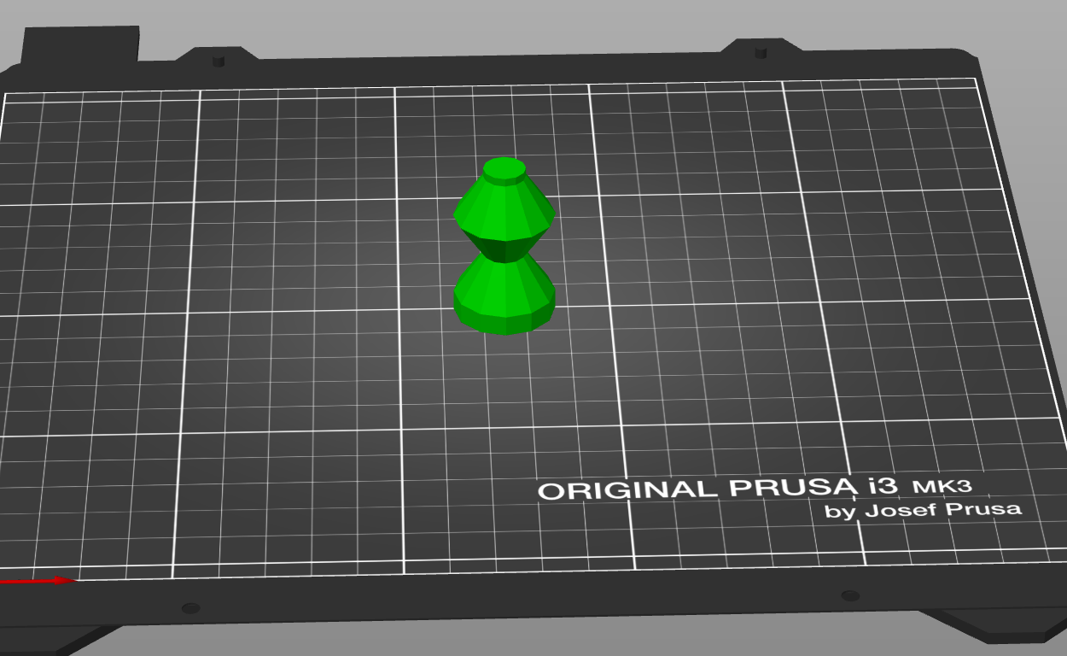
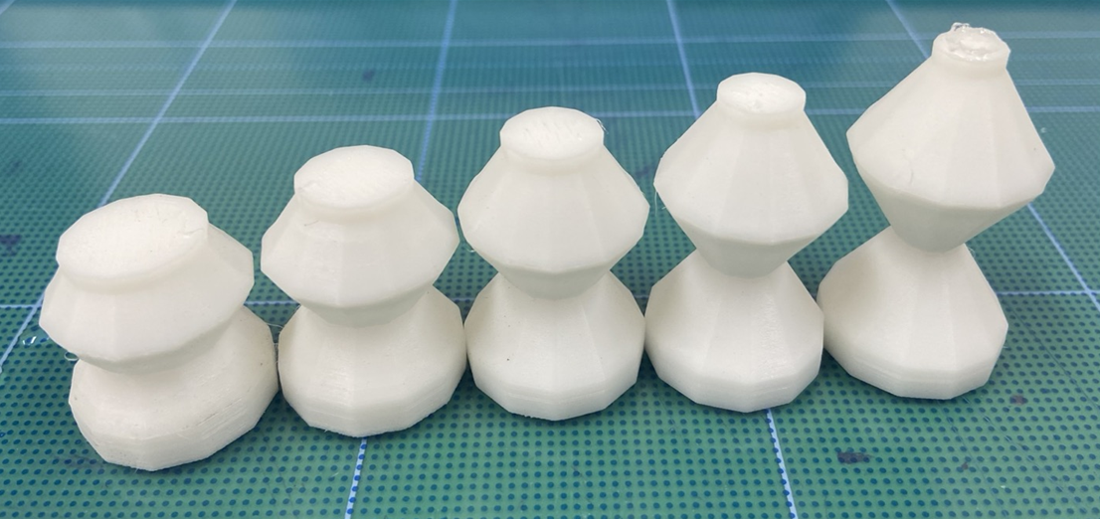
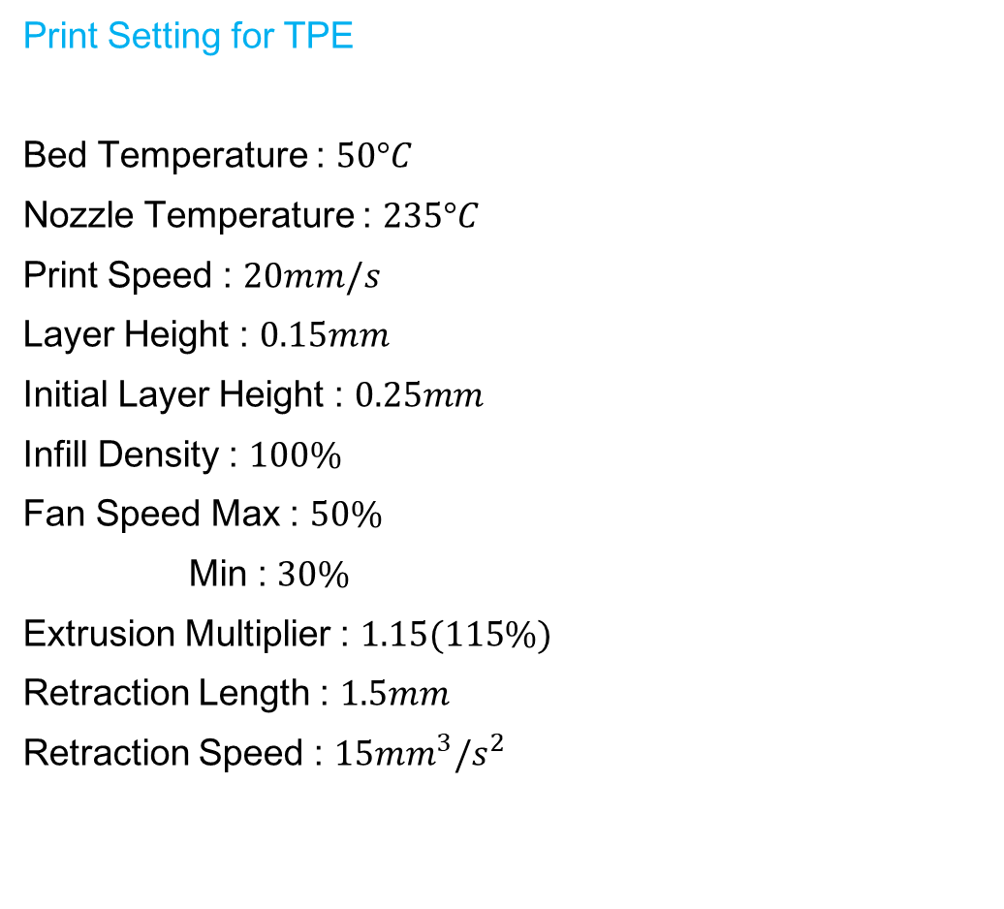
$$Print Setting for TPE$$
$$Bed Temperature :$$
$$50°C$$
$$Nozzle Temperature :$$
$$235°C$$
$$Print Speed :$$
$$20mm/s$$
$$Layer Height :$$
$$0.15mm$$
$$Initial Layer Height :$$
$$0.25mm$$
$$Infill Density :$$
$$100\%$$
$$Fan Speed Max :$$
$$50\%$$
$$Min :$$
$$30\%$$
$$Extrusion Multiplier :$$
$$1.15(115\%)$$
$$Retraction Length :$$
$$1.5mm$$
$$Retraction Speed :$$
$$15{mm}^{3}/s^{2}$$

Slide 3
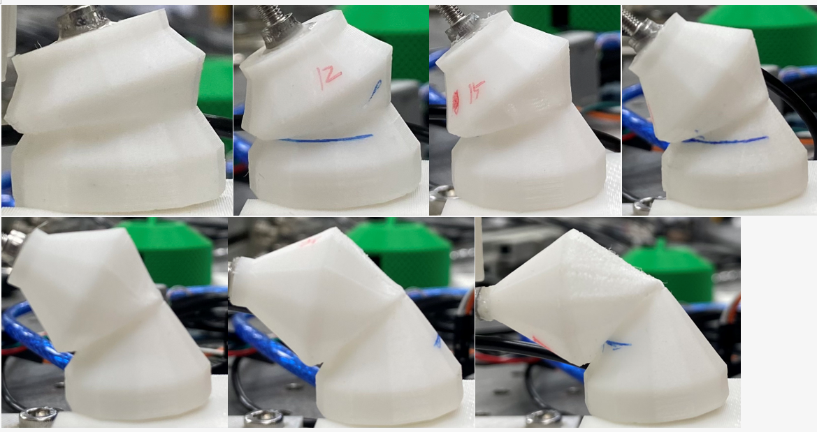
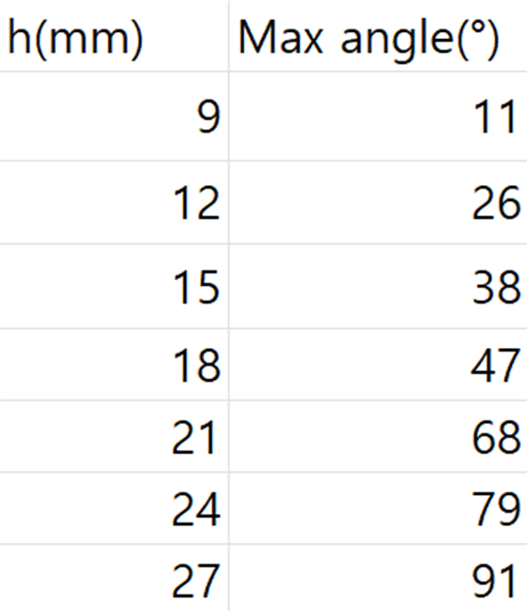
9mm
12mm
15mm
18mm
21mm
24mm
27mm

Slide 4
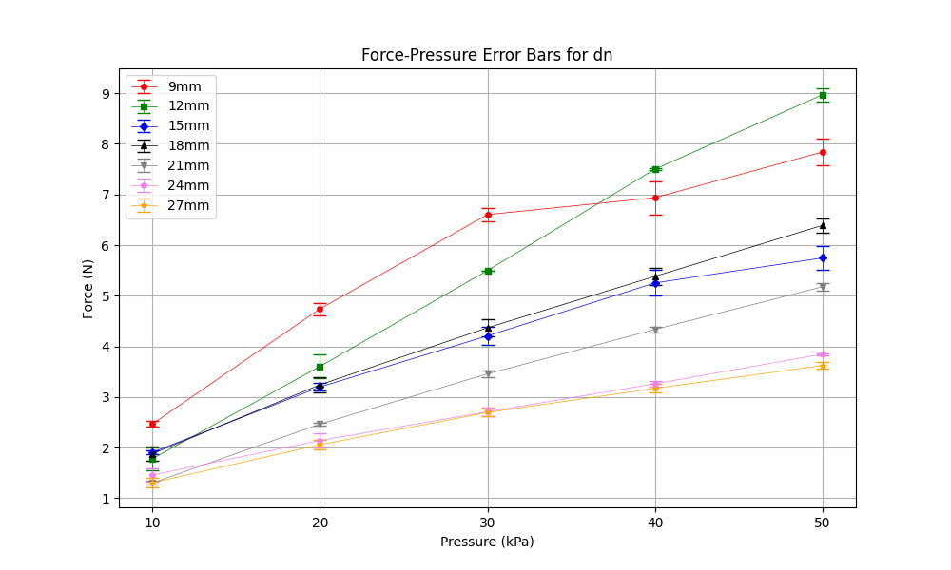
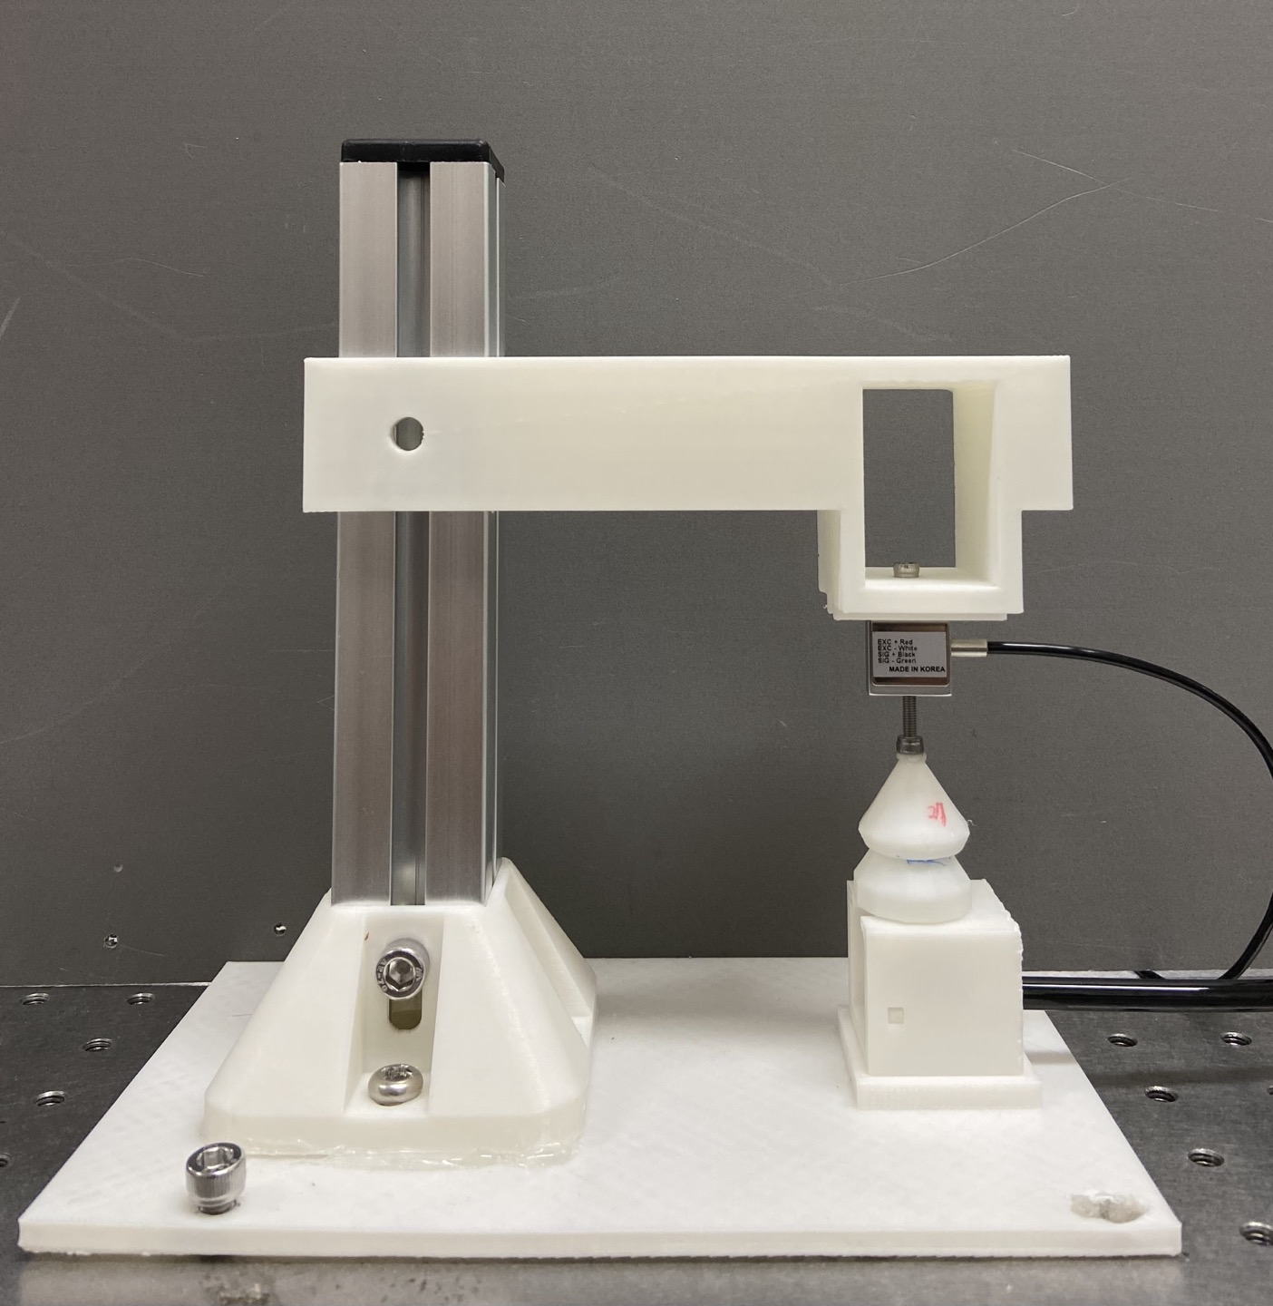
down position, negative pressure
dn

Slide 5
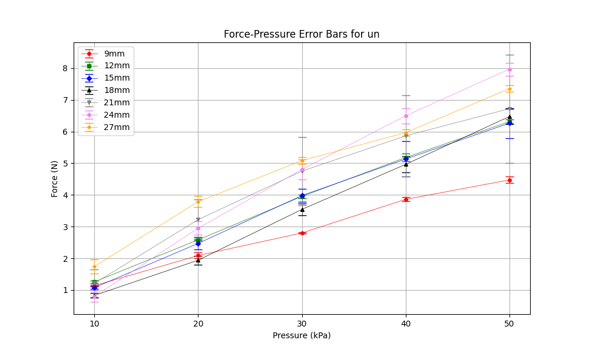
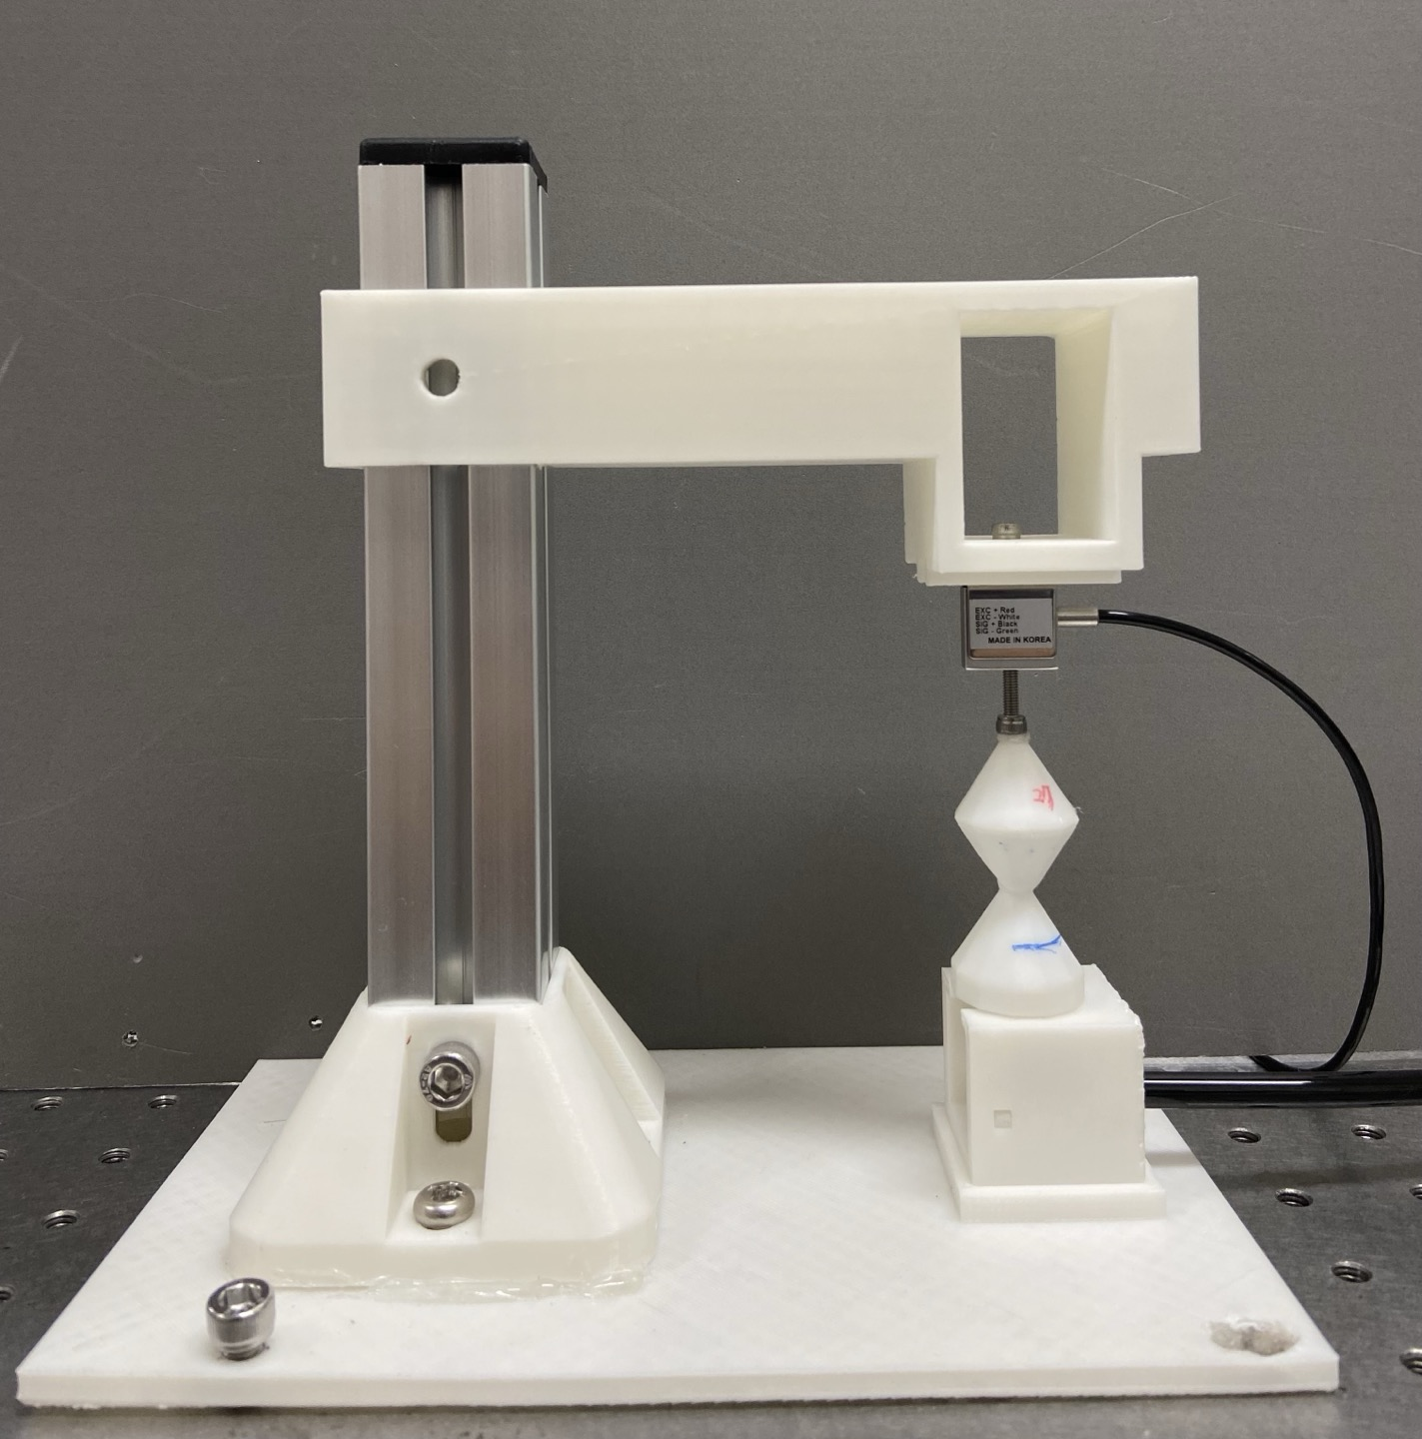
up position, negative pressure
un

Slide 6
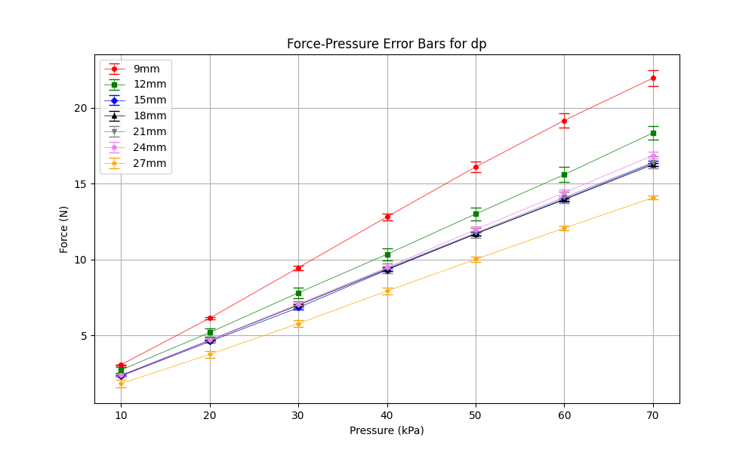
down position, positive pressure
dp

Slide 7
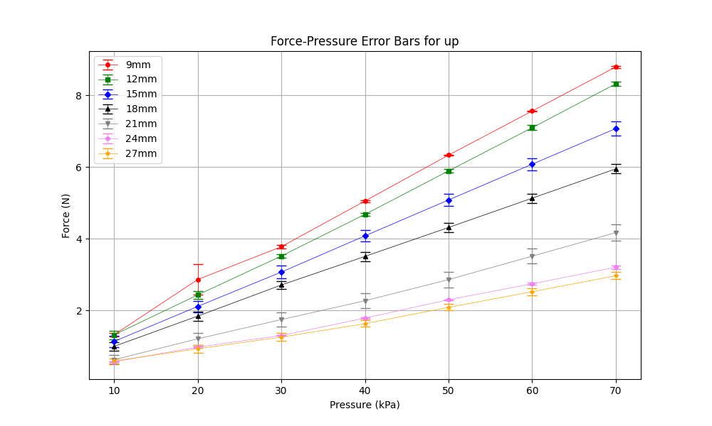
up position, positive pressure
up

