Slide 1
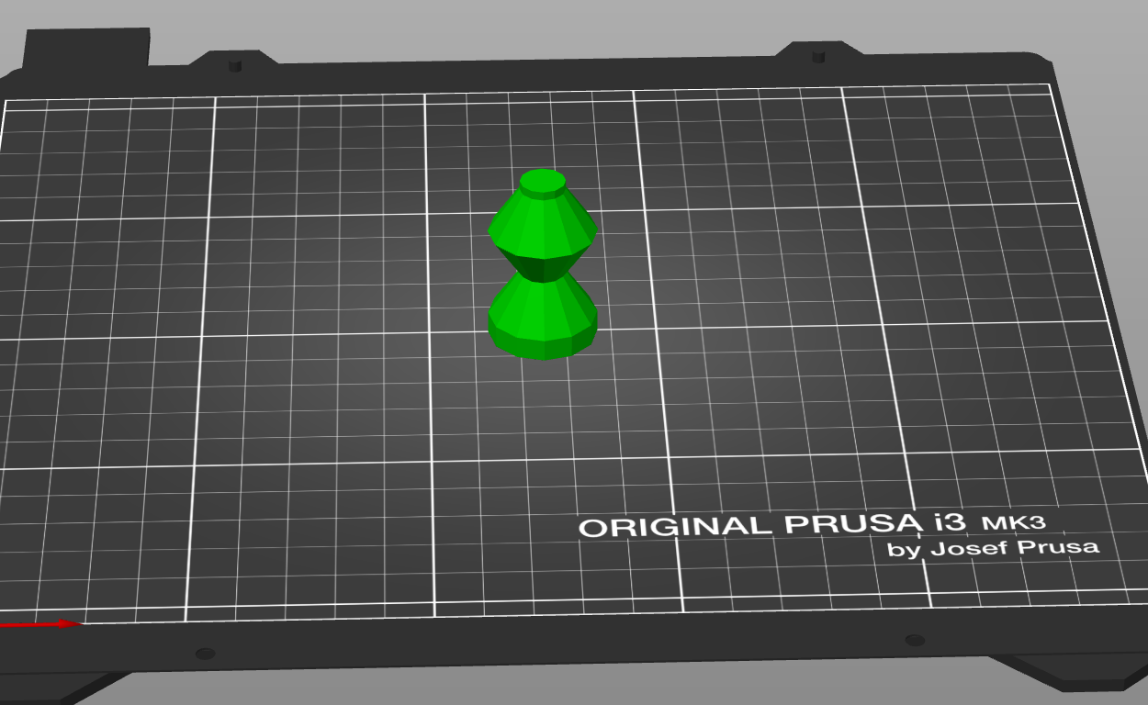
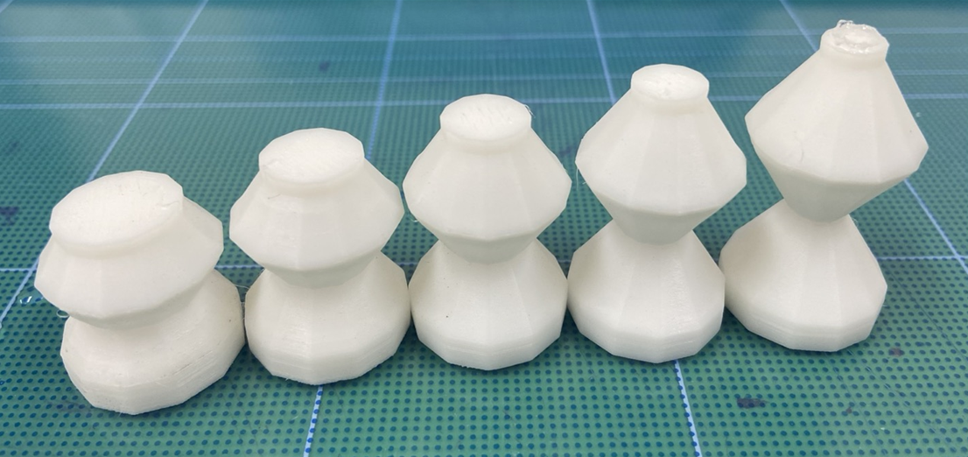
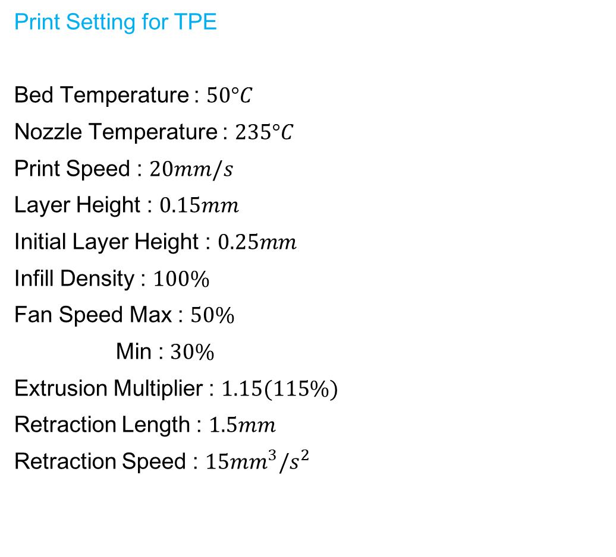
Print Setting for TPE
Bed Temperature : $50°C$
Nozzle Temperature : $235°C$
Print Speed : $20mm/s$
Layer Height : $0.15mm$
Initial Layer Height : $0.25mm$
Infill Density : $100\%$
Fan Speed Max : $50\%$
Min : $30\%$
Extrusion Multiplier : $1.15(115\%)$
Retraction Length : $1.5mm$
Retraction Speed : $15{mm}^{3}/s^{2}$

Slide 2
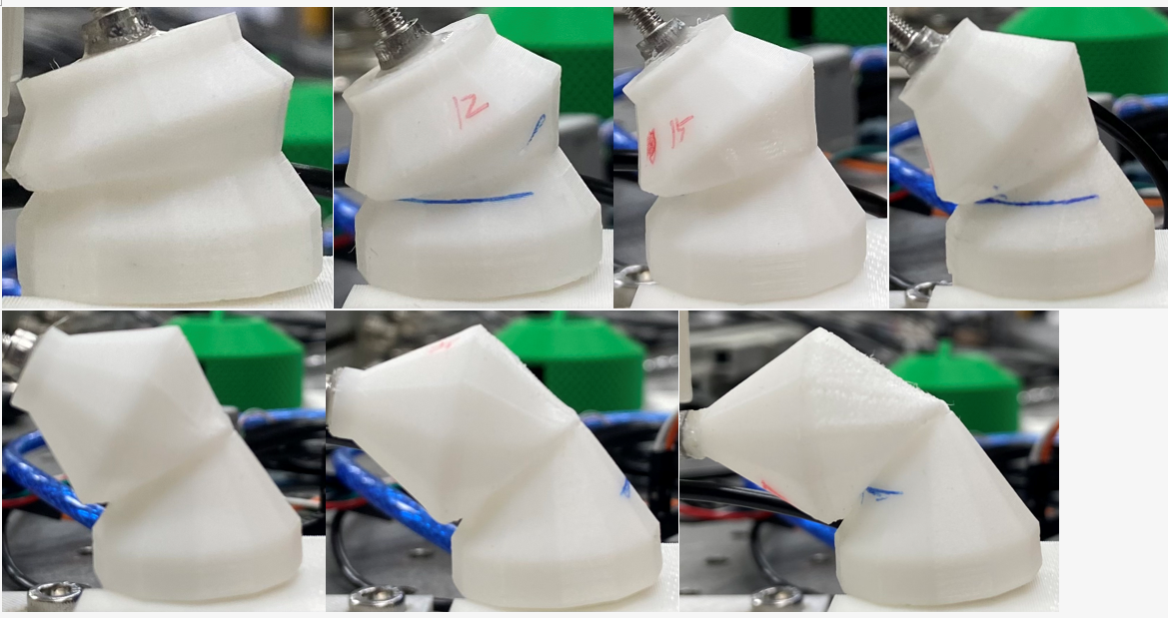
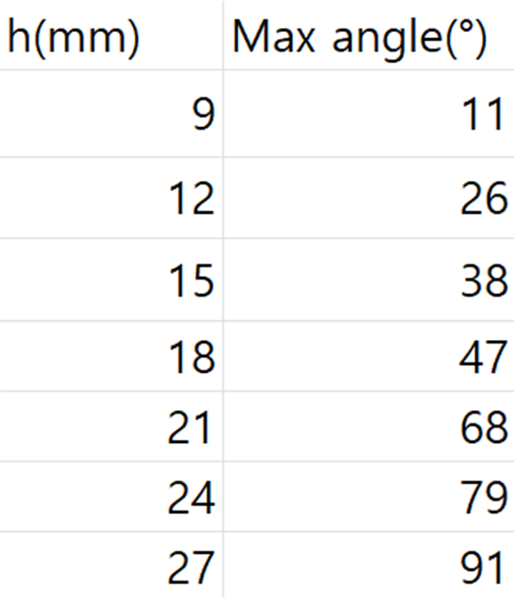
9mm
12mm
15mm
18mm
21mm
24mm
27mm

Slide 3
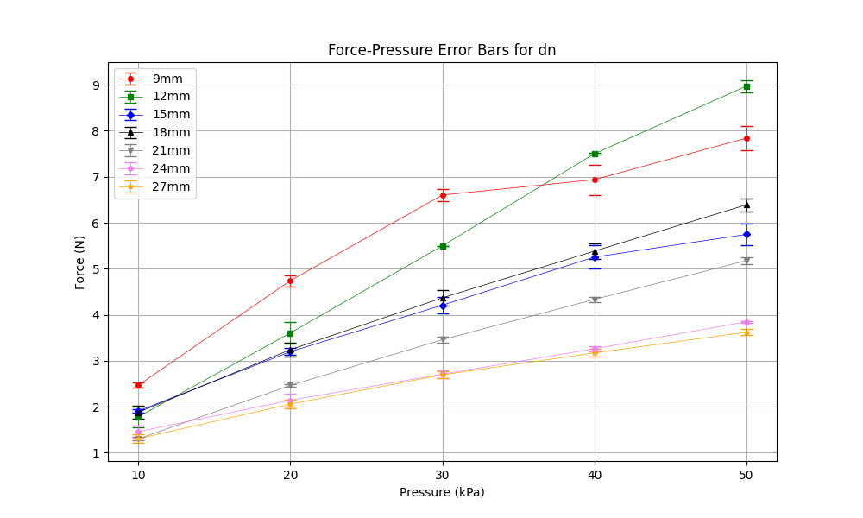
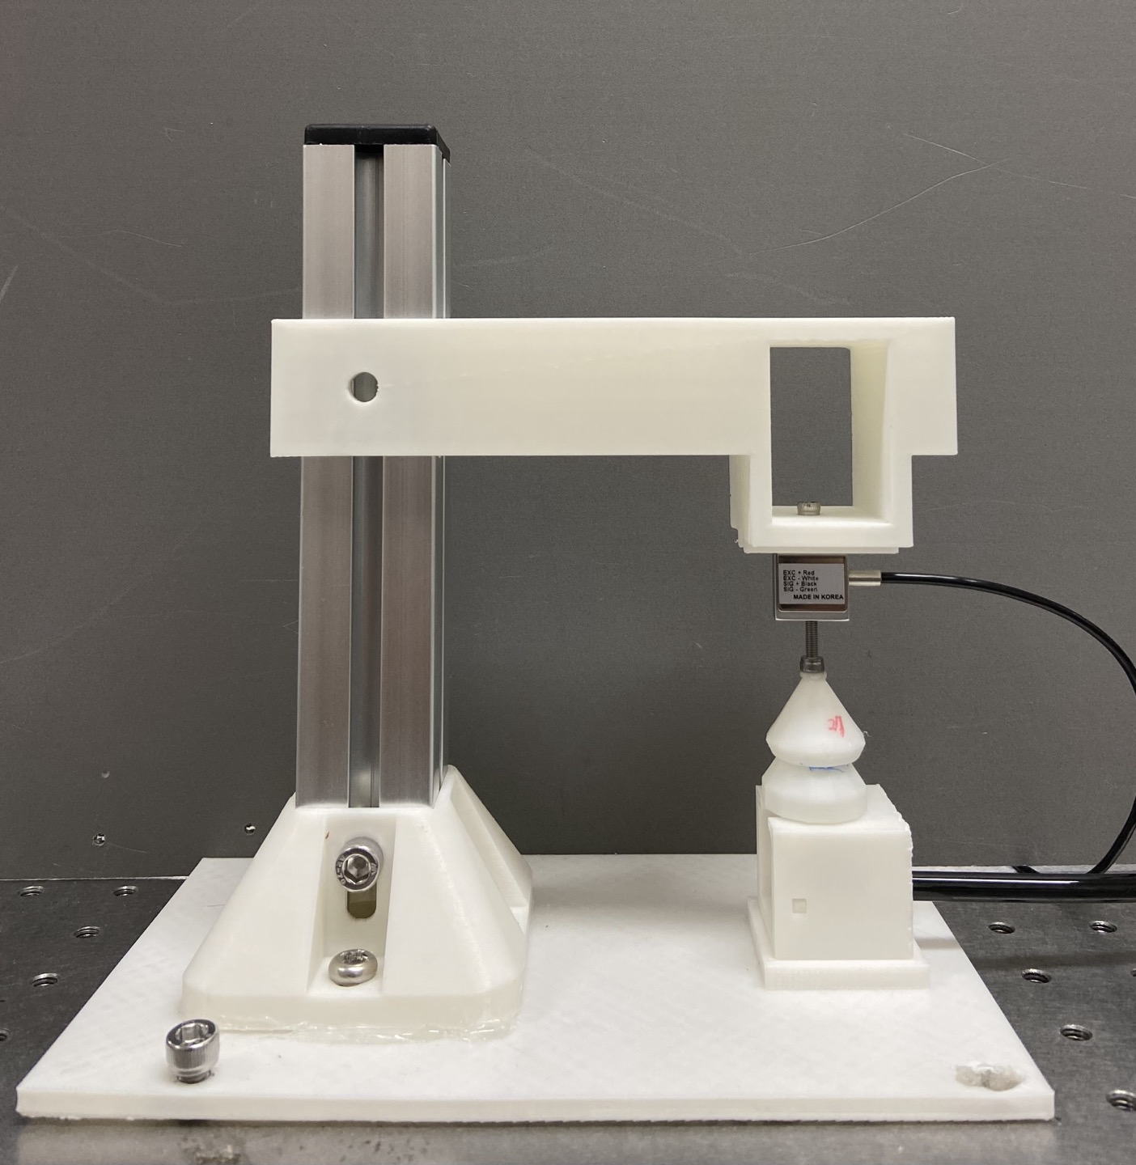
down position, negative pressure
dn

Slide 4
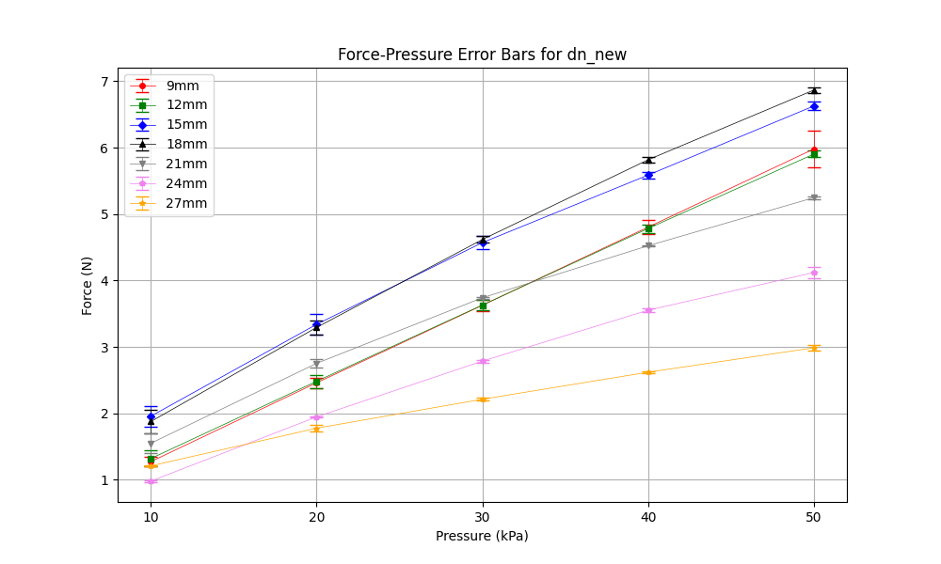
down position, negative pressure
dn

Slide 5
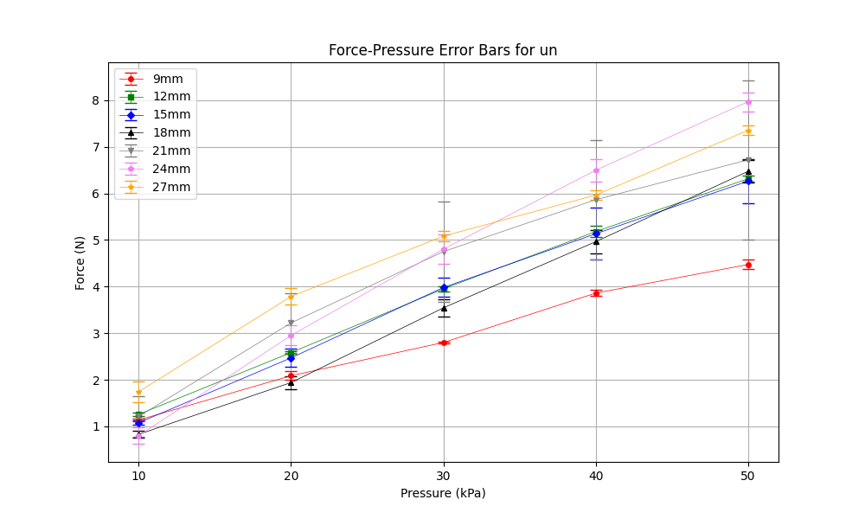
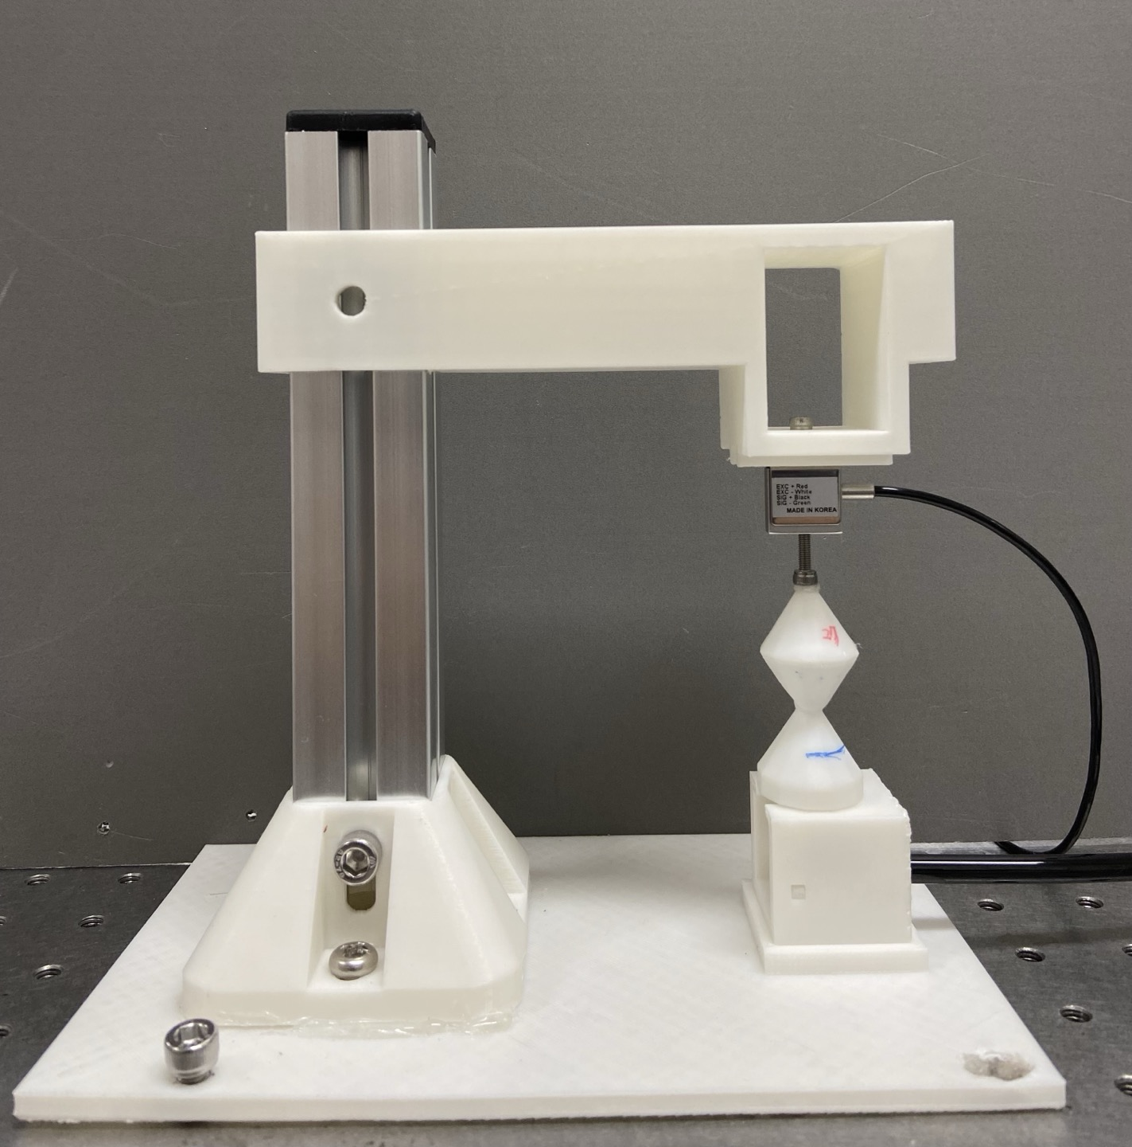
up position, negative pressure
un

Slide 6
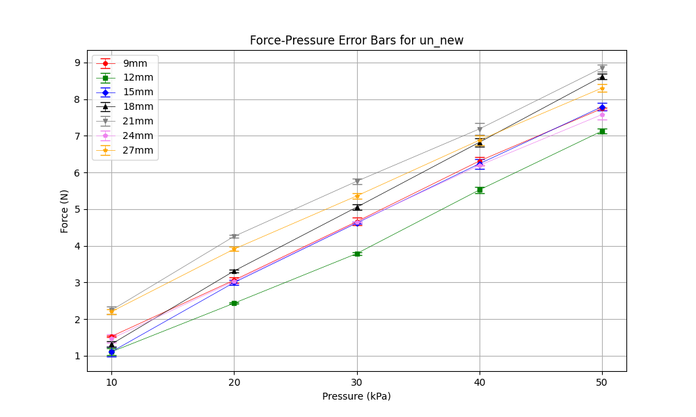
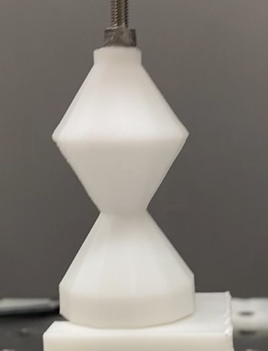
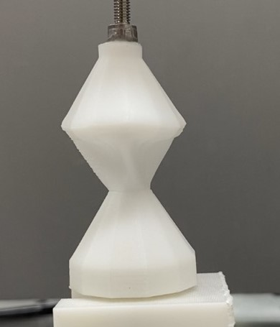
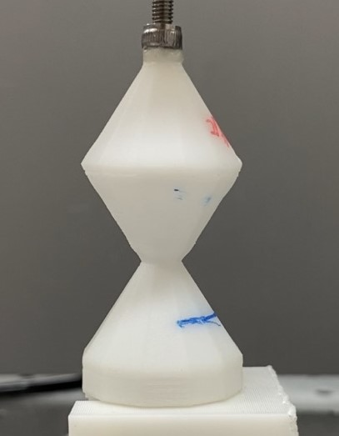
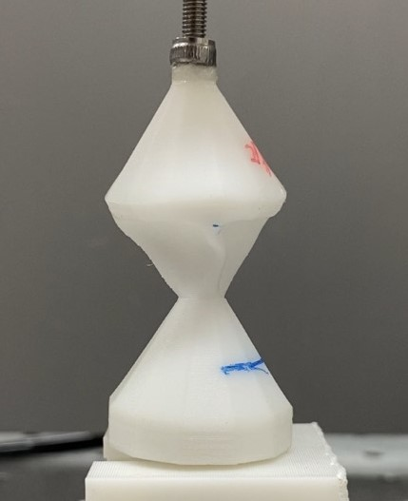
24mm
27mm

Slide 7
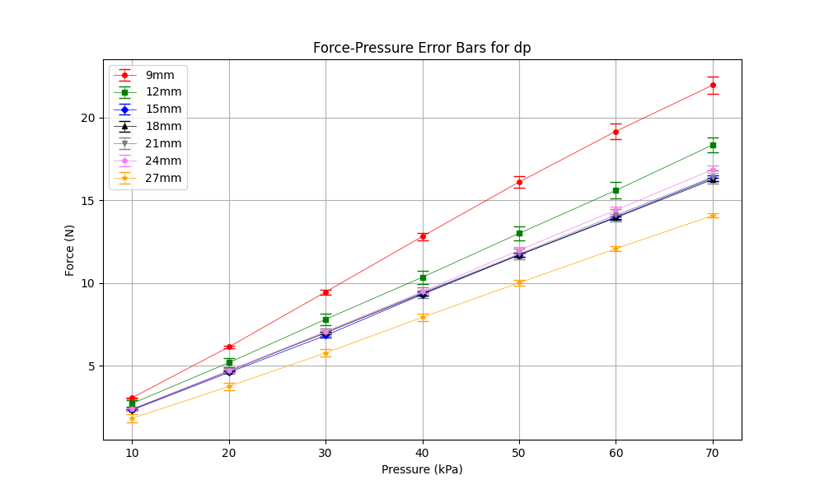
down position, positive pressure
dp

Slide 8
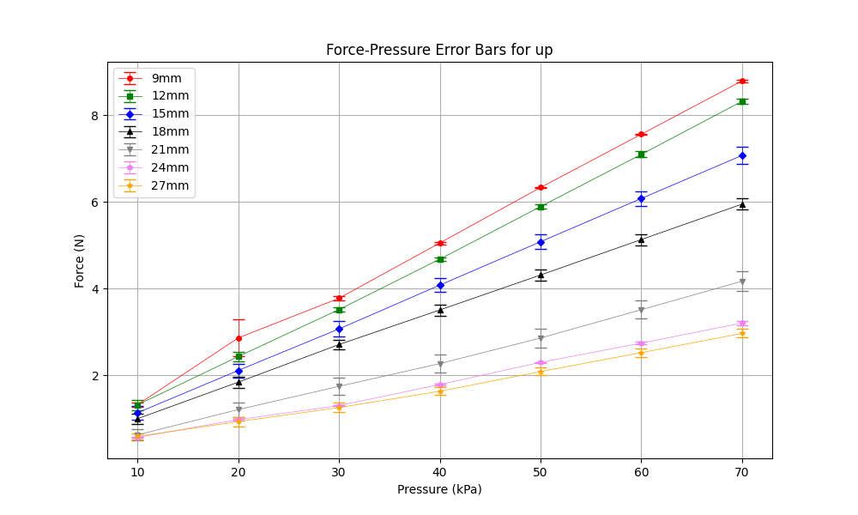
up position, positive pressure
up

