Slide 1
Graduation Project
EG-CompBio
BCB Diploma SS2026
DAV-R
By: Omar Khaled

Slide 2
Disease we will discuses: Lung Adenocarcinoma (LUAD)
Lung adenocarcinoma is the most common histologic subtype of lung cancer in the United States and worldwide, accounting for approximately 40% of all lung cancers.
This cancer is classified within the broader category of non-small cell lung cancer (NSCLC), which comprises roughly 85% of all lung malignancies.
Unlike squamous cell carcinoma, which is strongly associated with a central airway origin and heavy smoking, adenocarcinoma characteristically arises in the peripheral lung parenchyma. It exhibits a distinct molecular profile that now guides precision treatment selection.
Lung adenocarcinoma remains the leading cause of cancer death in the United States, largely because most cases are diagnosed at an advanced stage. Early-stage disease is frequently asymptomatic and is often detected incidentally on imaging, most commonly on computed tomography (CT) scans obtained for other indications.

Slide 3
What is The Cancer Genome Atlas (TCGA) ?
Launched in 2006, the project aimed to collect and analyze clinical and molecular data for over 33 different tumor types, targeting approximately 500 cases per tumor type. To date, it represents the most comprehensive repository of human cancer genomic data.
The TCGA research network has compiled and made publicly available the clinical and molecular phenotypes of more than 10,000 tumor patients.
The analyzed cases span a highly diverse pathological spectrum, including both solid and hematological tumors ranging from benign to metastatic, and from mildly to severely aggressive.
For each patient case, DNA, RNA, and proteins are extracted to conduct genomic, transcriptomic, epigenomic, and proteomic profiling using technologies ranging from custom microarrays to large-scale sequencing.
TCGA systematically organizes its database into three distinct tiers: raw (level 1), processed (level 2), and interpreted (level 3) data.
The network has published over 20 landmark marker papers detailing cancer alterations. These have redefined prior tumor classifications and fueled the development of clinical prognostic and diagnostic biomarkers.

Slide 4
Paper: TCGAbiolinks: an R/Bioconductor package for integrative analysis of TCGA data
TCGAbiolinks is distinguished from other TCGA data retrieval and analysis tools by several unique capabilities:
Integrative Multi-Omics Analysis: While older tools are restricted to downloading data or analyzing single platforms, TCGAbiolinks fully integrates diverse molecular datasets. It can combine DNA methylation with gene expression data to pinpoint epigenetically silenced genes (visualized via starburst plots) and supports functional copy number identification.
Bioconductor Interoperability via SummarizedExperiment: TCGAbiolinks prepares downloaded Level 3 TCGA data as SummarizedExperiment objects. This standardized matrix-like class ensures immediate, seamless compatibility with a broad ecosystem of R/Bioconductor analytical packages, including GRanges, IRanges, limma, and edgeR.
Unified End-to-End Pipeline: The package integrates a complete workflow under three functional levels, eliminating the need to chain multiple standalone software tools:
      Data: Querying (TCGAquery), downloading (TCGAdownload), and formatting (TCGAprepare) across all TCGA platforms.
      Analysis: Standard and advanced biological analyses such as preprocessing, transcript normalization, and differential expression.
      Visualization: Direct generation of survival curves, volcano plots, PCA plots, heatmaps, and starburst plots.

Slide 5
Now let’s see how this package will help us!
We will use this package to handle LUAD data.
Main Steps:
Install and load required packages.
Query the Genomic Data Commons (GDC).
Download and prepare the data.
Pre-processing & filtering.
Perform Differential expression analysis (DEA) and visualization using a volcano plot.
Prepare gene lists (up- and down-regulated).
Perform Enrichment analysis (EA) and visualization using a bar plot.

Slide 6
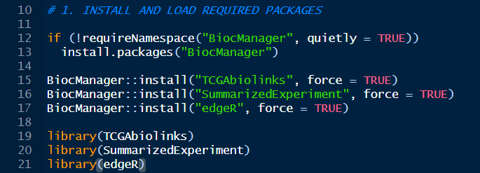
Step No. 1: Install and load required packages
R checks if the BiocManager package is installed. If not, it installs it from CRAN (the standard R repository). BiocManager is the tool used to install bioinformatics packages from Bioconductor, which hosts TCGAbiolinks and edgeR.
Installing three core Bioconductor packages. force = TRUE ensures they install or reinstall even if R thinks they are already up to date.
  TCGAbiolinks: The main package to query, download, and analyze cancer data from the Genomic Data Commons (GDC).
  SummarizedExperiment: A specific data structure package. It handles complex genomic data where the rows are genomic features (like genes), and columns are samples (like patients).
  edgeR: The statistical engine we will use later to figure out which genes are significantly different between tumor and normal samples.
Then we load the installed packages into the current R session so we can use their functions.

Slide 7
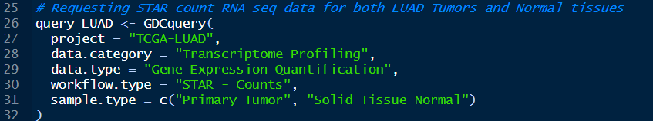
Step No. 2: Query the Genomic Data Commons (GDC)
This is a search request to the GDC server. It does not download the data yet; it just creates a "manifest" of what to download.
    project = "TCGA-LUAD": Lung Adenocarcinoma.
    data.category and data.type: we want gene expression data.
    workflow.type = "STAR - Counts": specifically want RNA-seq reads that were aligned to the human genome using the STAR aligner, output as raw read counts.
    sample.type: requesting data for both the actual tumor and the adjacent healthy tissue (normal).

Slide 8
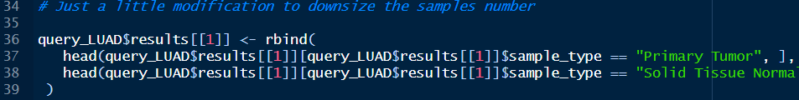
Just a little modification of the query
The full TCGA-LUAD dataset is massive (hundreds of samples, gigabytes of data). This code takes the query and trims it down to just 10 Tumor samples and 10 Normal samples. It saves massive amounts of time and memory while we are testing the pipeline.

Slide 9

Step No. 3: Download and prepare the data
GDCdownload reads your modified query and downloads the raw STAR count files from the GDC servers to your local hard drive.
GDCprepare reads the downloaded files and merges them into a single SummarizedExperiment object named data_LUAD. This object contains the count data, patient clinical data, and gene annotations all in one place.
The assay() function extracts the numeric matrix of gene counts from the data_LUAD object. and "unstranded" because RNA-seq libraries are often unstranded, meaning the count represents all reads mapped to a gene regardless of which DNA strand they came from. The result, counts_matrix, has genes as rows, samples as columns, and integers (read counts) in the cells.

Slide 10
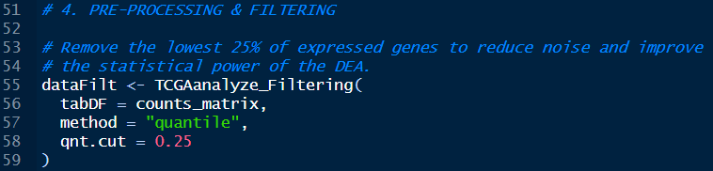
Step No. 4: Pre-processing & filtering
This filters out genes with very low expression. The "quantile" method with qnt.cut = 0.25 calculates the mean expression of each gene across all samples. It then removes any gene whose mean expression falls in the bottom 25% of all genes. Removing genes that are barely transcribed reduces statistical noise and makes the subsequent differential expression analysis more accurate.

Slide 11
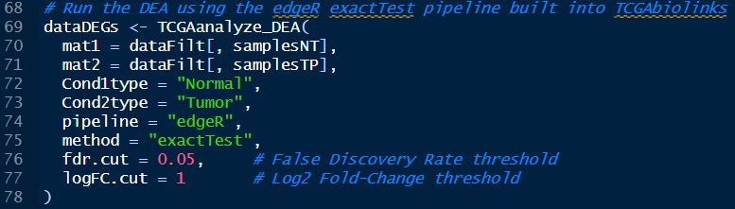
Step No. 5: Differential Expression Analysis (DEA)
These lines scan the column names (which contain TCGA barcodes) of your filtered matrix. It separates them into a list of Normal Tissue (NT) samples and a list of Primary Tumor (TP) samples.
pipeline = "edgeR" and method = "exactTest": You are telling TCGAbiolinks to use the edgeR package to run a statistical test (the exact test, based on the negative binomial distribution) to compare the counts.
The function will output a dataframe (dataDEGs) containing all genes, their Log2 Fold Change (how much expression changed between normal and tumor), and their FDR (the adjusted p-value indicating statistical significance).

Slide 12
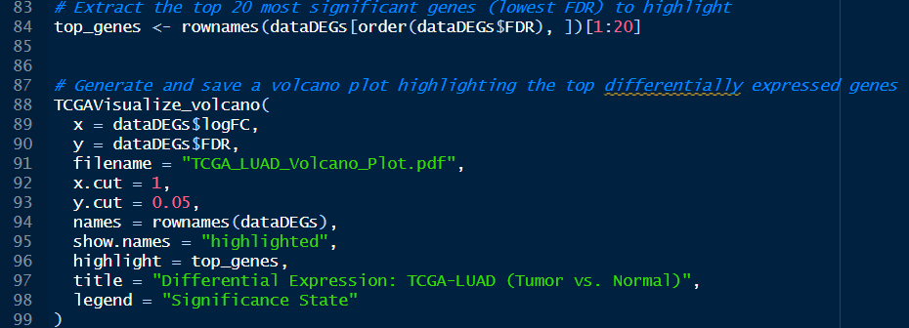
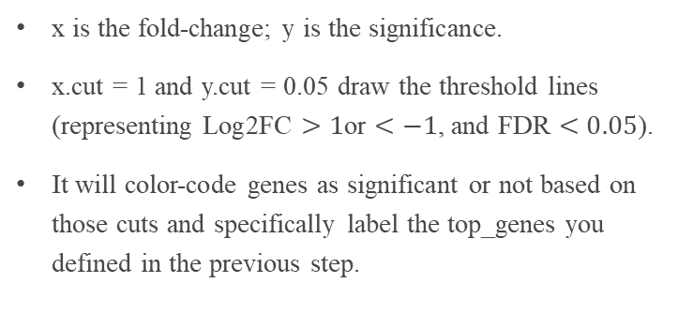
The visualization step
(Volcano Plot)
x is the fold-change; y is the significance.
x.cut = 1 and y.cut = 0.05 draw the threshold lines (representing $\text{Log2FC}>1$or $<−1$, and $\text{FDR}<0.05$).
It will color-code genes as significant or not based on those cuts and specifically label the top_genes you defined in the previous step.

Slide 13
Step No. 6: Prepare gene lists (up and down regulated)
Filtering the results table. up_genes will only contain genes that are highly expressed in the tumor ($\text{logFC}>1$) and statistically significant ($\text{FDR}<0.05$).
down_genes isolates the genes that are suppressed in the tumor.

Slide 14
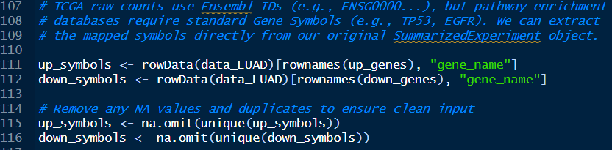
Preparing data for Enrichment Analysis (EA)
This is a crucial data conversion step. The raw counts use Ensembl IDs (e.g., ENSG00000141510), but pathway databases (like KEGG) prefer standard HUGO gene symbols (e.g., TP53). We are going back to your original data_LUAD object, accessing the rowData (which contains gene annotations), matching your significant Ensembl IDs, and extracting the corresponding "gene_name".
Also, we cleans the gene lists before pathway analysis.
    unique() removes duplicates.
    na.omit() removes any genes that didn't have a mapped symbol, ensuring the pathway tool doesn't crash on bad data.

Slide 15
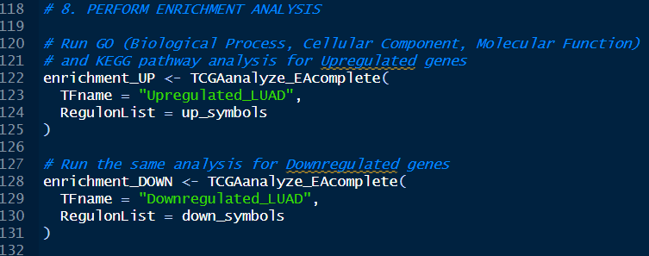
Step No. 7: Enrichment Analysis (EA)
Running the pathway enrichment analysis on clean gene symbol lists. TCGAanalyze_EAcomplete automatically checks the genes against the Gene Ontology (GO) databases (Biological Process, Cellular Component, Molecular Function) and the KEGG pathway database to see if the DEGs cluster into specific biological functions (like "cell cycle regulation" or "apoptosis").

Slide 16
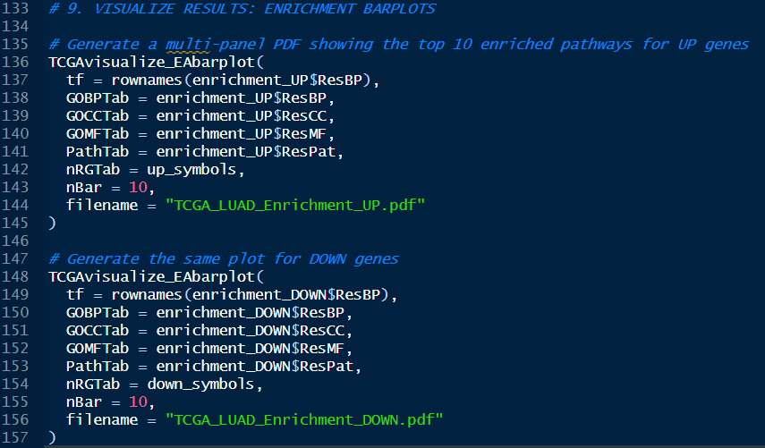
The visualization step
(Bar Plot)
This function takes the complex mathematical output of the enrichment analysis (enrichment_UP). It generates a clean, multi-panel PDF bar chart showing the top 10 (nBar = 10) most significant pathways for each category (BP, CC, MF, KEGG). The second block of code does the same thing, generating a separate PDF for the enrichment_DOWN results.

Slide 17
Finally, we did it!
Now we have performed the exact analysis in the paper, but on a different dataset!

Slide 18
acknowledgement
Special thanks to Dr. Suhaila Saleh,
Cell Culture Research Assistant at Nawah Scientific, whose support and insightful feedback greatly enhanced the content and structure of this presentation.

Slide 19
Thank You!

