Slide 1
RNA-seq Differential Expression Analysis
Under Supervision of Dr/Mariam Oweda

Slide 2
Code for both approaches
DESeq2:
Note: in manual script I run Wilcoxon test but when I tried to save it as HTML file it didn’t save “the warning message said that the data is normally distributed”, but when I deleted this chunk it run successfully.
Manual:

Slide 3
Comparison
DESeq2
Manual
2394 DEGs were observed using DESeq2 package.
1139 DEGs were observed using manual analysis.
Intersection between two different approaches:
879 genes are in common

Slide 4
The difference in DEGs number?
While using DESeq2 package the number of DEGs were higher twice roughly even if the logFC > 2 it means that they are over expressed 4 times!
It also mean that there are many different genes involved in bladder cancer than the 1139 that were observed by manual analysis.
Which leads us to a fact that a package such DESeq2 make our life easer and also its output is very accurate.
It is important to fully understand the theoretical background behind this package to handle in unexpected error.

Slide 5
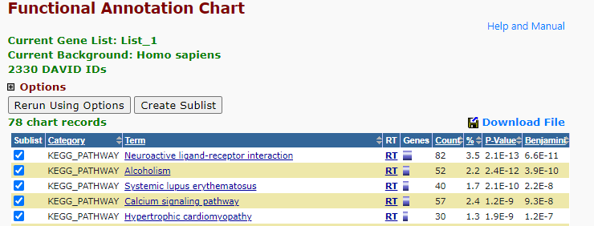
Top 5 KEGG Pathways
DESeq2:

Slide 6
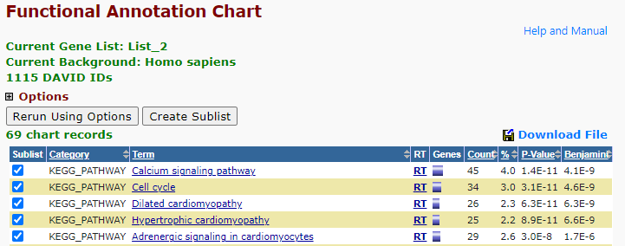
Top 5 KEGG Pathways
Manual:

Slide 7
Comment on Enriched Pathways
By looking to the top 5 pathways you can tell that the DESeq2 package results are more accurate than manual analysis because they are more relevant to the disease we study.

