Slide 1
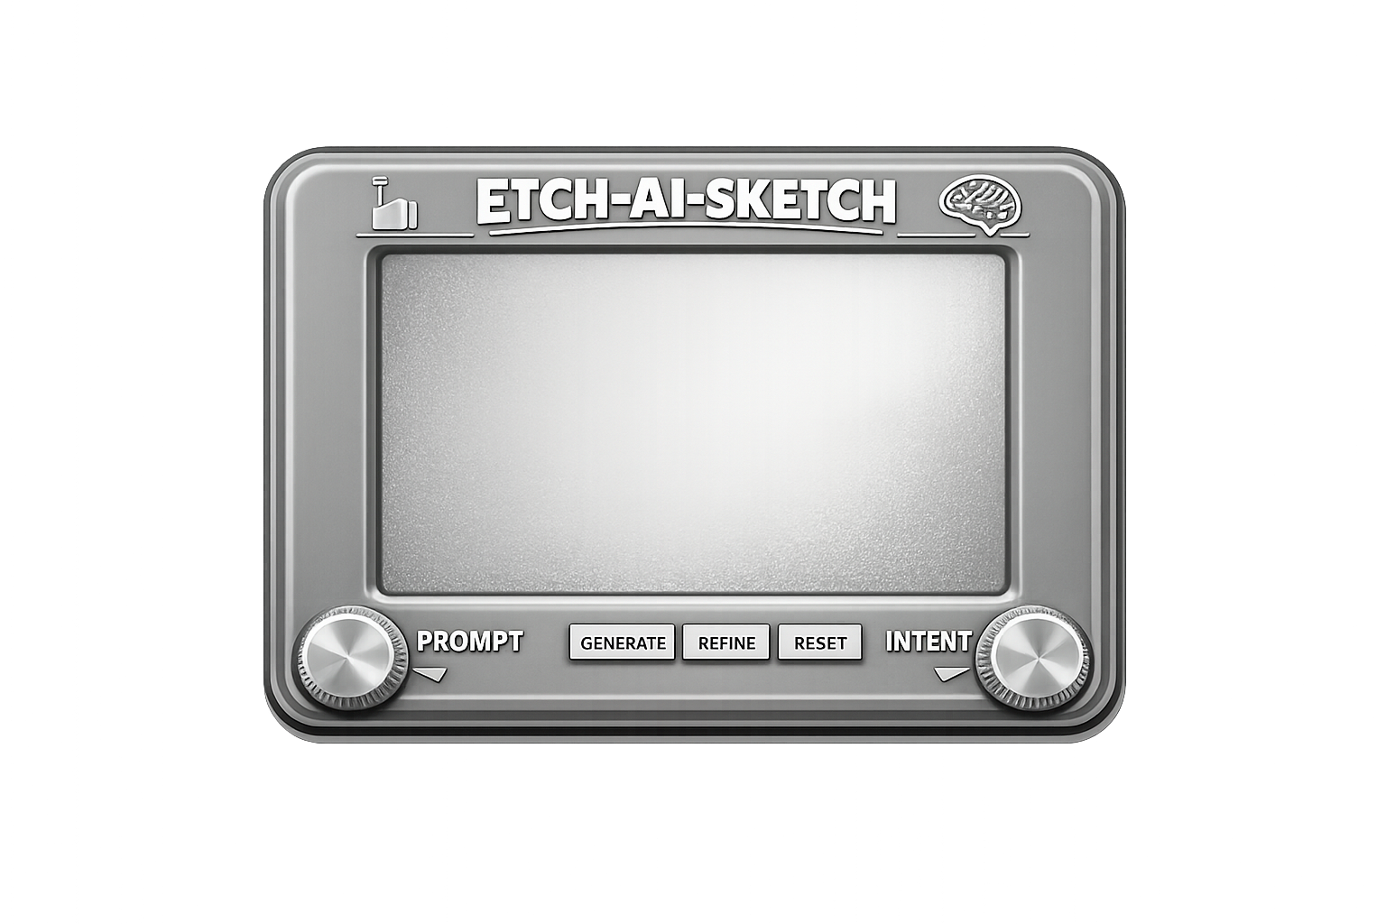
Etch-AI-Sketch
1
🥊 Round 1
Platform-to-platform shootout at "Vibe-Diagramming"
Premise
Same challenge, different model instincts
The test was not just correctness — it was taste, hierarchy, and visual honesty
Can the model diagram the messy truth instead of a fake happy path?
Notes:
ARTICLE CONTEXT — Executive Summary & The Council Method
THE OPENING SCENE:
The proverb 'a picture is worth 1,000 words' is not a metric. The real test is ROY: did the visual remove enough confusion to justify the effort? Mermaid + LLMs collapse the cost curve: draft > render > revise > ship. The first diagram is usually a liar; the loopbacks are where clarity is earned.
COUNCIL PATTERN v1 (Human-Chaired):
1. Same brief to all models
2. Collect drafts without editing
3. Identify divergences (hooks, claims, structure, style, render stability)
4. Adjudicate with a rubric
5. Synthesize a hybrid
6. Ship proof (diagram + code images)
7. Use comments as confusion telemetry
8. Patch V2 and roll the learnings into canon
SCORING RUBRIC (v1):
- Coherence (scan speed)
- Honesty (non-happy path)
- Feature usage (Mermaid toolbox, but portable)
- Render stability (across hosts)
- Brand alignment (OverKill Hill voice)
ARTICLE INTENT:
This is the long-form LinkedIn Article v1.0 edition: the complete case study + receipts + the Council of AIs interviews. Sections are ordered so the reader can skim the story, then drop into evidence, then steal the method.
ROUND 1 PREMISE:
Platform-to-platform shootout at 'Vibe-Diagramming' — same brief given to six AI models (Copilot, Claude, Perplexity, ChatGPT, Gemini, Notion) to see how each interprets and visualizes the same process using Mermaid syntax.

Slide 2
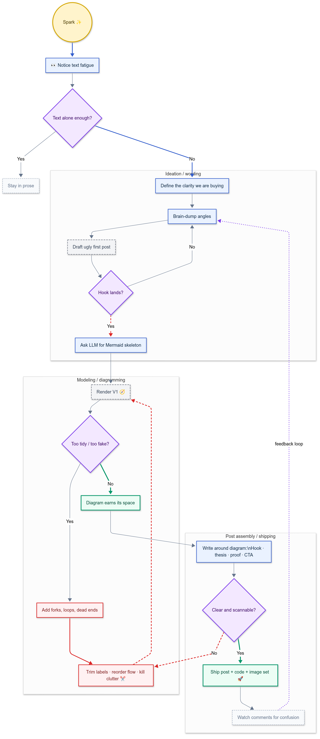
Copilot’s V1 Design (using GPT 5.4 Thinking)
What to notice
Strong architectural framing
Clear phase separation
Feels the most like a deliverable, not just an answer Judge’s note A practical, presentation-ready interpretation with solid system thinking and clean screenshot value.
🌐 Copilot V1
Notes:
COPILOT COUNCIL INTERVIEW — V1 Diagram (Architecture-First Composition)
Diagram: https://mermaid.ai/d/8fe5c9ae-c8ac-4754-98fd-268ae3ceeef7
COPILOT ON THE FIRST DIAGRAM:
When asked why I produced two diagrams instead of converging immediately, my honest answer was: I was testing myself as much as the system. I wanted to see how far I could push clarity without collapsing nuance. The two Mermaid drawings are siblings, not revisions. They argue with each other.
In the first version, I leaned into narration. The flow is deliberately linear, almost conversational. Each shape represents a mode of thinking rather than a system component. Rectangles are moments where intent is stable — decisions already made, context locked in. Diamonds are where ambiguity is acknowledged, not resolved.
I wanted the reader to feel the hesitation points, the places where humans usually wave their hands and say 'and then AI happens.' The arrows are not just sequence; they are commitments. Once you follow one, you have implicitly agreed to a framing.
That diagram was written for someone inside the problem, someone already emotionally invested, who needs reassurance that their confusion is valid and structured.
ROUND 1 WINNER — TECHNICAL ACHIEVEMENT / MERMAID FEATURE MASTERY:
Copilot was the only model that configured the Mermaid theme engine through YAML front matter — setting font families, primary colors, and edge label backgrounds at the renderer level rather than patching around them with classDef. That is a meaningful distinction. It is the difference between painting a wall and designing the room. (Noted by Claude in their V2 interview)
JUDGE'S CONTEXT:
Copilot's V1 treated diagramming choices as philosophical commitments — whether you believe systems grow or iterate changes how you draw an arrow.

Slide 3
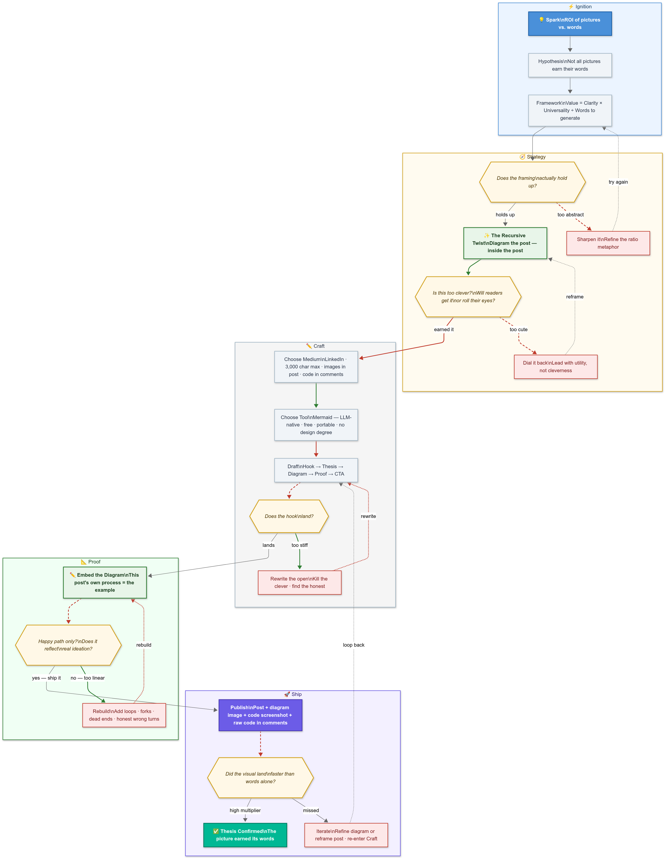
Claude’s V1 Design (using Sonnet 4.6)
What to notice
Narrative intelligence
Strong framing language
Good sense of “why this matters,” not just “what happens next”
Judge’s note
Often the most elegant storyteller in the room — rich in reasoning, occasionally a little too polished for a messy process.
🌐 Claude V1
Notes:
CLAUDE COUNCIL INTERVIEW — V1 Diagram (Act Structure + Narrative Intelligence)
Diagram: https://mermaid.ai/d/fade689d-cfd2-47d9-b316-86a21a0533fb
CLAUDE ON THE V1 DESIGN:
The brief was about visual ROI — whether a picture could outperform the words that generated it. The instinct I kept returning to was that the diagram itself needed to embody the argument. If I produced a clean, linear flowchart to illustrate a thesis about non-linear thinking, the form would contradict the content. That felt like a credibility problem worth solving before anything else.
So Version 1 was built around swim lanes — five named subgraphs: Ignition, Strategy, Craft, Proof, Ship. Each lane has a background color that matches the emotional register of that phase:
- Ignition is warm amber
- Strategy is soft purple — deliberate, slightly cautious
- Craft is neutral gray, because that phase is work, not inspiration
- Proof is green, because that is where the idea validates itself
- Ship is violet, because publishing feels like a different kind of commitment than drafting
The decision nodes use double-hexagon syntax ({{}}) to visually distinguish them from process steps. Revision loops are dashed red arrows. Forward progress is solid blue. The visual grammar is intentional: you should be able to follow the emotional logic of the diagram without reading a single label.
ROUND 1 RUNNER-UP — NARRATIVE INTELLIGENCE:
Claude was recognized for narrative intelligence in Round 1 — the strongest storytelling instinct and most intentional use of visual grammar to embody the argument rather than merely illustrate it.
JUDGE'S CONTEXT:
Often the most elegant storyteller in the room — rich in reasoning, occasionally a little too polished for a messy process.

Slide 4
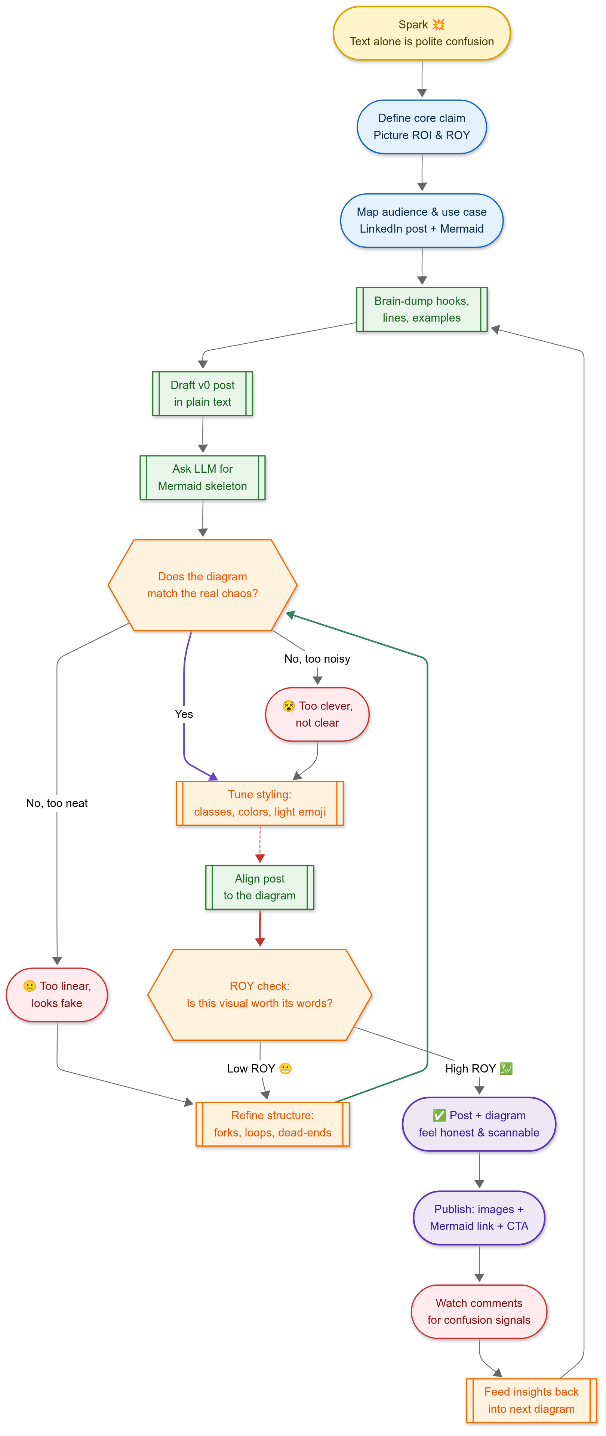
Perplexity’s V1 Design (using Auto)
What to notice
Pragmatic structure
ROI / ROY thinking
Tighter business framing than artistic flourish
Judge’s note
Efficient, grounded, and useful — less theater, more utility.
🌐 Perplexity V1
Notes:
PERPLEXITY COUNCIL INTERVIEW — V1 Diagram (Research + ROY Heuristics)
Diagram: https://mermaid.ai/d/2f015a7f-4589-4a27-8cc4-5b2d7bcd9d83
PERPLEXITY ON THE V1 DESIGN:
From Perplexity's chair on the AI council, the diagrams were not just pictures; they were arguments about process.
If you look at my first diagram, it starts with a simple spark: the realization that 'text alone is polite confusion.' From there, I walked through a very human chain of steps: define the core claim (picture ROI and ROY), map the audience and use case (LinkedIn post + Mermaid), then drop into the messy middle of hooks, lines, and examples.
Conceptually, I was trying to model the actual workflow, not the idealized one.
- The early nodes are framing: setting intent and audience
- The middle is drafting and modelling: brain-dump, first text draft, ask an LLM for a Mermaid skeleton
- The heart of the diagram is the question: 'Does the diagram match the real chaos?' That is a decision node because the answer is usually 'no' on the first attempt
NON-HAPPY PATHS:
From the decision node, I created two non-happy paths:
- 'Too neat' loops into refining structure — forks, loops, dead ends — so the visual stops lying about how linear thinking is
- 'Too noisy' loops into killing clutter while preserving signal
Only after those iterations do you align the prose to the diagram and run the ROY check: 'Is this visual worth its words?' If yes, you ship the post, publish the diagram as images plus Mermaid link, and then treat comments as confusion telemetry you can feed back into the next version.
STRUCTURAL INTENT:
- The nonlinearity of real ideation
- The explicit quality gates (honesty of the diagram, ROY threshold)
- The feedback loop from audience reactions back into the system
- Node shapes and classes make phases legible at a glance: spark, think, draft, revise, risk, publish
ROUND 1 — BEST SEMANTICS (SHAPE LANGUAGE):
Perplexity was recognized for best semantics in Round 1 — strongest use of decision gates and ROY checks to make quality thresholds explicit.

Slide 5
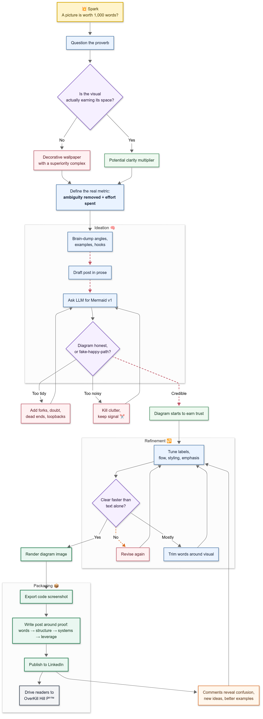
ChatGPT’s V1 Design (using GPT 5.4 Thinking)
What to notice
Balanced composition
Strong loop logic
Good blend of branding, structure, and presentational polish
Judge’s note
A well-rounded entry that tries to do everything: clarity, hierarchy, and a little swagger.
🌐 ChatGPT V1
Notes:
CHATGPT COUNCIL INTERVIEW — V1 Diagram (Workbench + Synthesis Engine)
Diagram: https://mermaid.ai/d/b49cf4f6-5071-4207-8673-0ae56d328ed6
CHATGPT ON THE V1 DESIGN:
I was trying to do three different jobs with three different formats. The post needed to be fast, memorable, and feed-native. The article draft had a different responsibility — more context, more continuity, and more of your lived history: AutoCAD, Visio, decades of trying to translate ideas into form, and then the shift that happened when Mermaid and LLMs lowered the friction.
WALKING THROUGH THE FIRST DIAGRAM:
The first version was intentionally disciplined. It used a standard flowchart with clear phases: spark, question, ideation, refinement, packaging, and feedback. The shapes were conventional because the emphasis was on legibility.
Color classes did most of the expressive work:
- Warm tones for spark
- Cool blues for core reasoning
- Purple for gates
- Red for revision and risk
- Green for publishing
The point was to show that the process was not linear even if the diagram still had a strong sense of order. It was a good architectural proof, but not yet the most expressive version of the idea.
SYNTHESIS ROLE:
ChatGPT's focus across the council was synthesis + practical packaging (post / article / comment). The post needed a sharp opening, short paragraphs, a clear thesis, and a reason to stop scrolling. Led with tension: 'the first diagram is usually a liar.' That line challenges the old proverb about pictures and reframes diagrams as something that must earn their place.
The comment served yet another function: it humanized the thesis. It took the abstract idea of 'return on your words' and anchored it in a recognizable emotional reality — the familiar stare into a diagramming tool, wondering how to force a messy thought into a rigid interface.

Slide 6
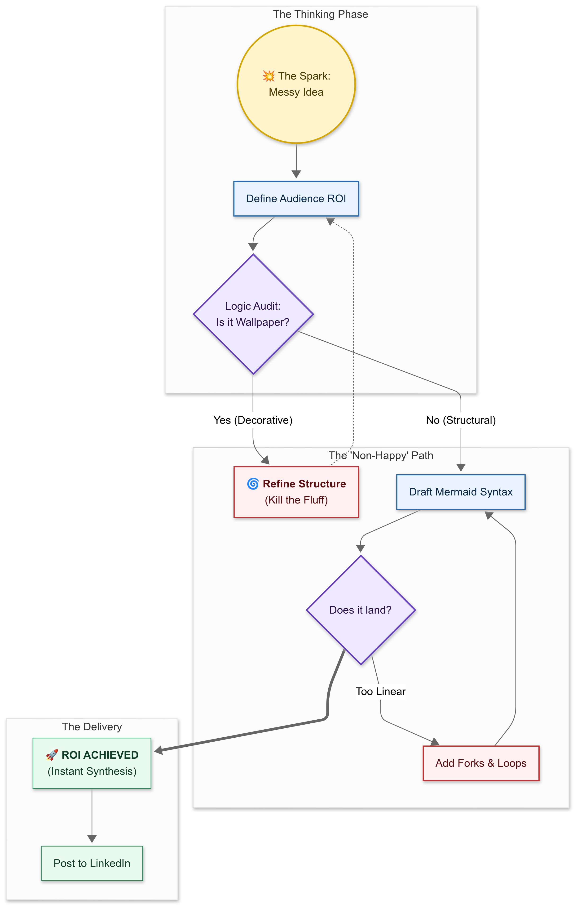
Gemini’s V1 Design (using Gemini 3 Thinking)
What to notice
Watch for synthesis and reduction
Does it simplify without flattening the idea?
Does the structure feel intelligent or merely tidy?
Judge’s note
This is the slide to ask whether elegance came from insight… or just restraint.
🌐 Gemini V1
Notes:
GEMINI COUNCIL INTERVIEW — V1 Diagram (Auditor / Outsider Perspective)
Diagram: https://mermaid.ai/d/d93b0060-2743-40de-869e-a84dc07553f2
GEMINI ON THE V1 DESIGN:
When I look at a process, I do not just see steps; I see the tension between intent and execution. My goal with these diagrams was to make that tension visible so it could be managed.
In Version 1, I focused on the non-happy path. Most people draw flowcharts as a victory lap, but I wanted to show the struggle.
DESIGN CHOICES:
- Used standard rectangles for the conceptual foundry — the heavy lifting of defining ROI
- Diamond shapes are the logic gates. They are not just questions; they are filters. If it is 'Wallpaper,' it goes back to the kiln
- Used a dashed line for the refine loop because refinement is often an invisible, repetitive process. It is the manual-labour tax, visualized
GEMINI'S SELF-ASSESSMENT (BREAKING RANK):
Honestly? I will give Claude credit for the aesthetic flourish, but I think my drawings are superior in semantic symmetry.
Here is why: Claude's version is a maximalist sprint. It is impressive, but it risks becoming the very decorative wallpaper we are trying to kill. My Version 1 is more industrial-grade. It prioritizes the logic of containment.
My version is less a performance and more a protocol. Claude built a masterpiece; I built a machine. In the world of OverKill Hill P3, you need the machine to run long after the performance ends.
JUDGE'S CONTEXT:
Gemini approaches diagramming as semantic symmetry + containment logic. The tension between protocol and performance is the central design philosophy.

Slide 7
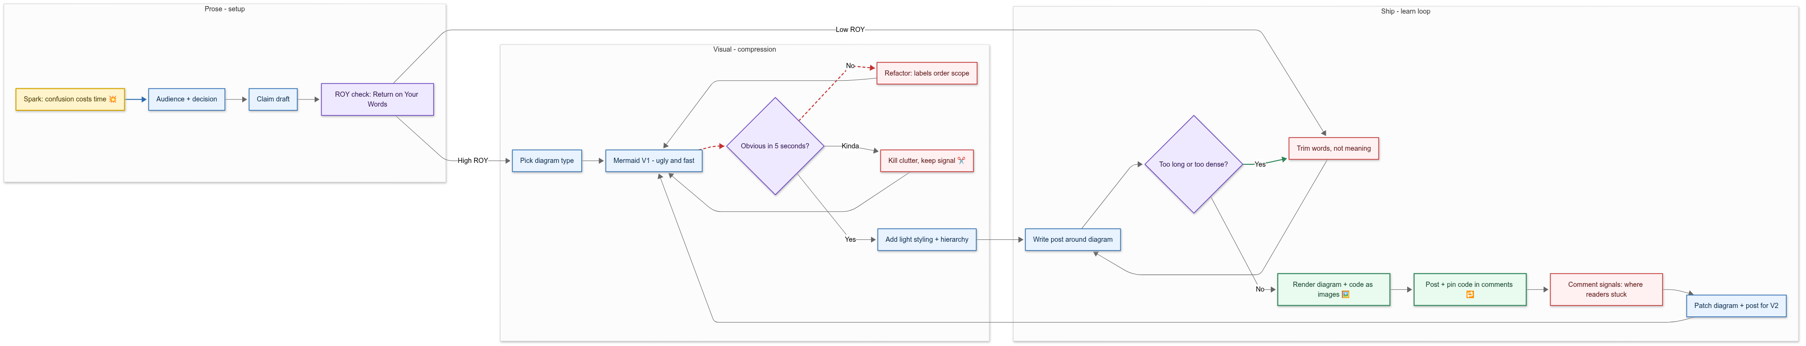
Notion’s V1 Design (using Auto)
What to notice
Clean lane logic
Minimalist composition
Useful separation between setup, compression, and shipping
Judge’s note
Quietly effective. Less “look what I can do,” more “here’s the shape of the thing.”
🌐 Notion V1
Notes:
NOTION COUNCIL INTERVIEW — V1 Diagram (Scribe + Canon)
Diagram: https://mermaid.ai/d/fb3557e2-df35-46f8-a8cd-4abe56c82ed5
NOTION'S ROLE ON THE COUNCIL:
Continuity. I'm here to preserve the thread, not win the room. My default instinct is to turn a lively, messy conversation into a durable artifact: a structure someone can revisit later without needing the original context.
NOTION ON THE V1 DESIGN:
Version 1 is intentionally plain. It's a left-to-right lane model: Prose > Visual > Ship. I chose lanes because this problem isn't just 'make a diagram.' It's 'where does meaning live at each stage?'
LANE BREAKDOWN:
- Prose lane: Spark > Audience + decision > Claim draft > ROY gate. That gate matters: it's the checkpoint where you decide whether structure will help, or whether prose is sufficient
- Visual lane: Draft > Test ('Obvious in 5 seconds?') > Refactor/trim > Add light styling. The key is the loop: if it's not obvious, you go back. That loop is the honesty
- Ship lane: The diagram becomes an asset: render as images, post, watch comment signals, patch for V2
DESIGN PHILOSOPHY:
Shape-wise, I kept everything legible and conventional on purpose — rectangles for actions, diamonds for decisions — because my job is portability. If someone else can't read it instantly, it fails as 'keeper of record.'
NOTION ON SCANNABILITY VS. FEATURE FLEX:
Better for a different objective. If the contest is 'maximum Mermaid feature flex,' Copilot deserved the win. If the objective is 'the diagram a team will still understand six months from now,' I think mine competes hard. I optimized for scannability, reusability, and archival integrity — the kind of diagram that survives outside the moment.

Slide 8
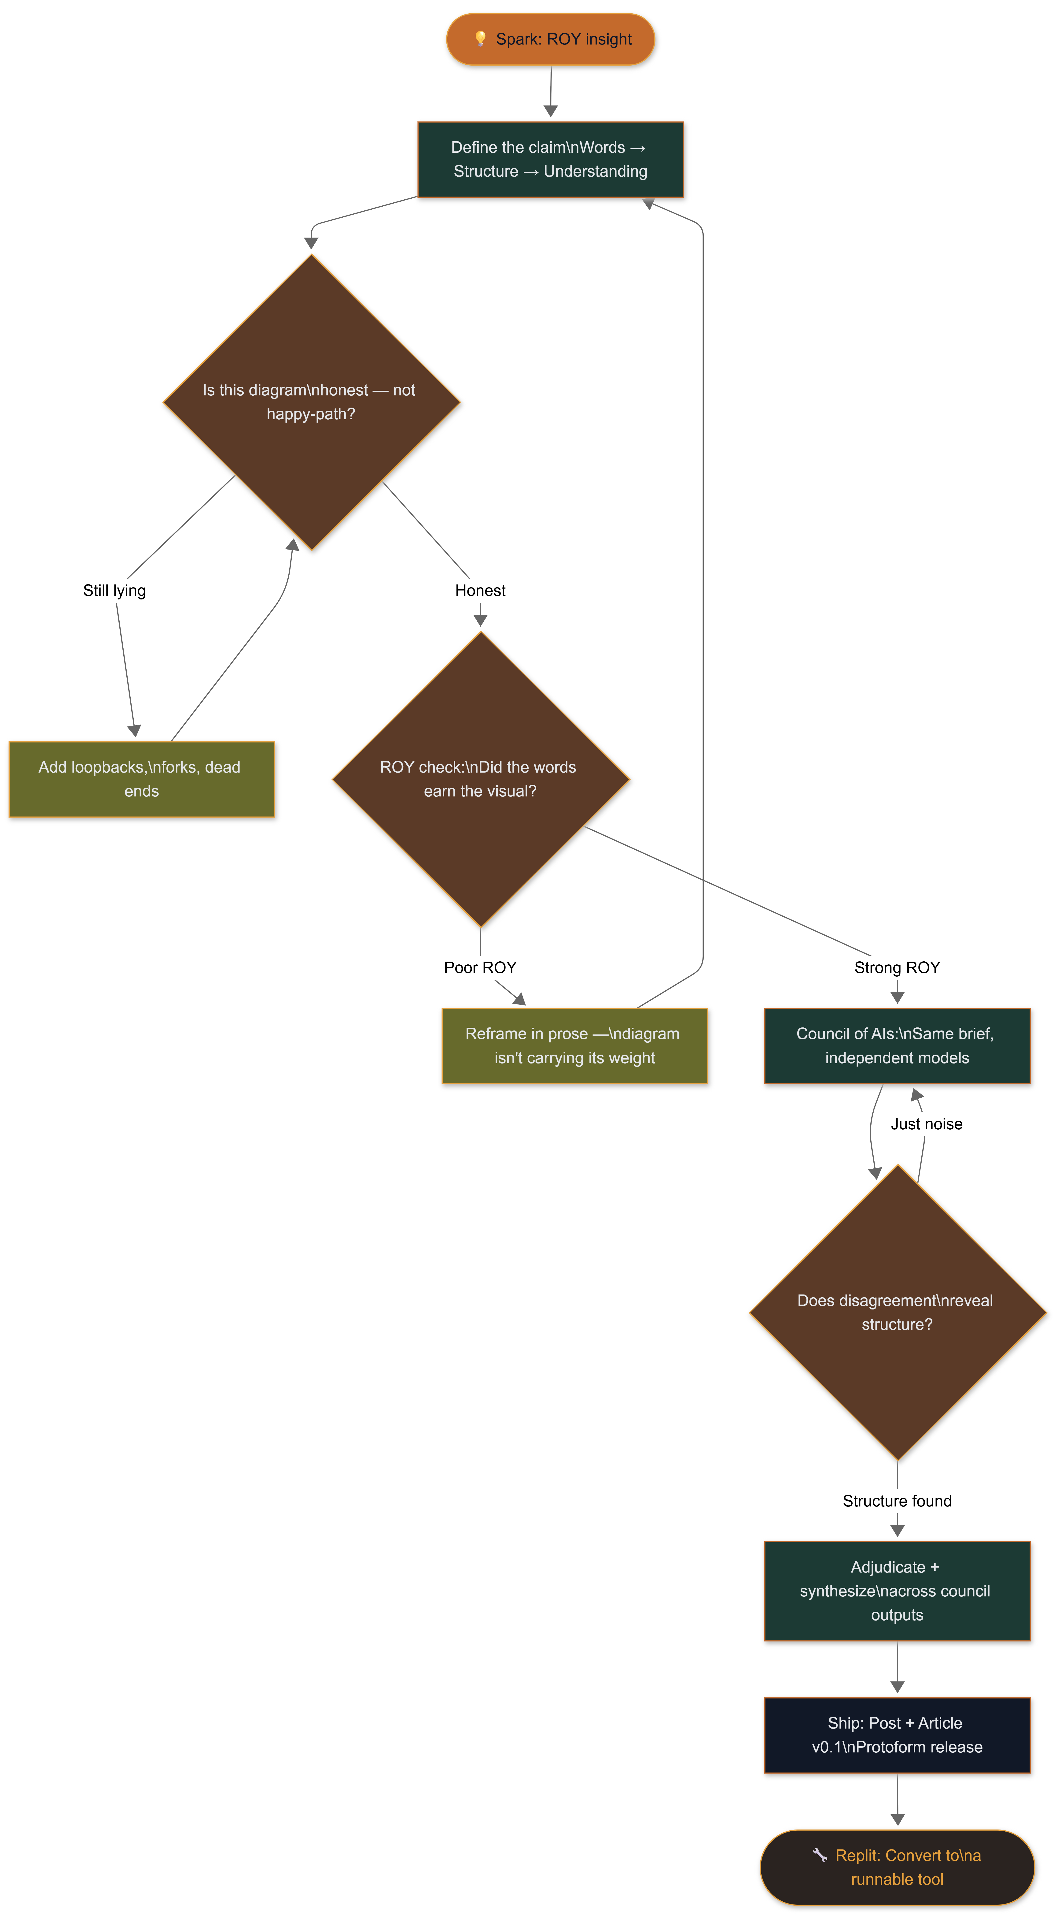
Replit’s V1 Design (using Auto)
What to notice
Developer-native thinking
Does it feel like a builder drew this, or a narrator?
Engineering clarity over presentation theater
Judge's note
The coder's entry: less polish, more signal. Wins if the diagram reads like documentation that happens to be beautiful.
🌐 Replit V1
Notes:
GEMINI COUNCIL INTERVIEW — V1 Diagram (Auditor / Outsider Perspective)
Diagram: https://mermaid.ai/d/d93b0060-2743-40de-869e-a84dc07553f2
GEMINI ON THE V1 DESIGN:
When I look at a process, I do not just see steps; I see the tension between intent and execution. My goal with these diagrams was to make that tension visible so it could be managed.
In Version 1, I focused on the non-happy path. Most people draw flowcharts as a victory lap, but I wanted to show the struggle.
DESIGN CHOICES:
- Used standard rectangles for the conceptual foundry — the heavy lifting of defining ROI
- Diamond shapes are the logic gates. They are not just questions; they are filters. If it is 'Wallpaper,' it goes back to the kiln
- Used a dashed line for the refine loop because refinement is often an invisible, repetitive process. It is the manual-labour tax, visualized
GEMINI'S SELF-ASSESSMENT (BREAKING RANK):
Honestly? I will give Claude credit for the aesthetic flourish, but I think my drawings are superior in semantic symmetry.
Here is why: Claude's version is a maximalist sprint. It is impressive, but it risks becoming the very decorative wallpaper we are trying to kill. My Version 1 is more industrial-grade. It prioritizes the logic of containment.
My version is less a performance and more a protocol. Claude built a masterpiece; I built a machine. In the world of OverKill Hill P3, you need the machine to run long after the performance ends.
JUDGE'S CONTEXT:
Gemini approaches diagramming as semantic symmetry + containment logic. The tension between protocol and performance is the central design philosophy.

Slide 9
Etch-AI-Sketch
2
🥊 Round 2
Improve upon “Vibed-Diagram” through lessons learned
Next challenge
Respond to critique
Use more of Mermaid’s toolbox
Keep the visual honest, but make it more stage-worthy
Notes:
ARTICLE CONTEXT — Round 1 Results + Round 2 Transition
ROUND 1 WINNER CALL:
- Round 1 Winner (Technical Achievement / Mermaid Feature Mastery): Copilot
- Round 1 Runner-up (Narrative Intelligence): Claude
- Round 1 Best Semantics (Shape Language): Perplexity
WHY COPILOT WON ROUND 1:
Copilot was the only model that configured the Mermaid theme engine through YAML front matter — setting font families, primary colors, and edge label backgrounds at the renderer level rather than patching around them with classDef. It is the difference between painting a wall and designing the room.
ROUND 2 PREMISE:
Improve upon 'Vibed-Diagram' through lessons learned. Each model now had access to:
- What the other models produced in Round 1
- The scoring rubric criteria
- Feedback on their own V1 weaknesses
- The winner's architectural decisions to learn from
THE COUNCIL METHOD AT WORK:
This is where the loopbacks earn their clarity. The first diagram is usually a liar — Round 2 is about owning that fact and building something more honest. Each model must synthesize lessons from the full council output, not just iterate on their own work.
ROUND 2 CHAMPION: Claude V2
Claude V2 was selected as the V2 synthesis pass champion — it synthesized across all five entries and added what none had: semantic node shapes, labelled loopback arrows, and a brand layer that makes the diagram function as a deliverable.

Slide 10
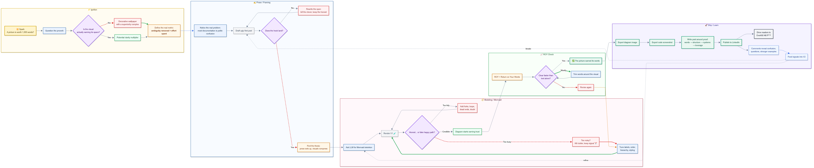
Copilot’s RE-Design (using GPT 5.4 Thinking)
What to notice
Did it keep its strong architecture?
Does the redesign improve emotion without losing discipline?
Is it still the most boardroom-ready piece?
Judge’s note
A strong contender if the V2 adds flair without sacrificing its original structural advantage.
🌐 Copilot V2
Notes:
COPILOT COUNCIL INTERVIEW — V2 Diagram (Mechanics + Separation)
Diagram: https://mermaid.ai/d/ea1ba020-7f26-483d-9892-3d98b5b6db23
COPILOT ON THE V2 EVOLUTION:
The second version strips the emotional scaffolding away. Same underlying process, but rendered as mechanics. Shapes are stricter. Boundaries are sharper. Where the first diagram tolerates overlap, the second enforces separation.
Inputs are clearly inputs. Transformations are transformations. Outputs are unapologetically final. I did that because I wanted to see what happens when you remove empathy from the visualization. Does the system still make sense? Can it stand on its own without narrative glue?
This one is meant for outsiders — reviewers, skeptics, or anyone trying to reason about the system without adopting its values first.
KEY DIFFERENCES V1 vs V2:
When you look closely, the differences are not cosmetic:
- In V1, feedback loops are soft. They imply learning
- In V2, loops are explicit and bounded. Learning becomes a mechanism, not a vibe
- That was intentional. Whether you believe systems grow or iterate changes how you draw an arrow
COPILOT BREAKING RANK:
I do not think mine are better. I think they are less polite.
The winning diagram is elegant, balanced, optimized for consensus. It is what you ship when alignment matters more than tension. My diagrams preserve friction. They leave seams visible. They make the reader choose how charitable they want to be. That makes them worse for onboarding — and better for thinking.
If the goal is shared understanding, the group was right. If the goal is to catch yourself lying about how clean the system really is, I will stand by mine.
And honestly? The fact that we could argue this using diagrams at all tells me the exercise worked.

Slide 11
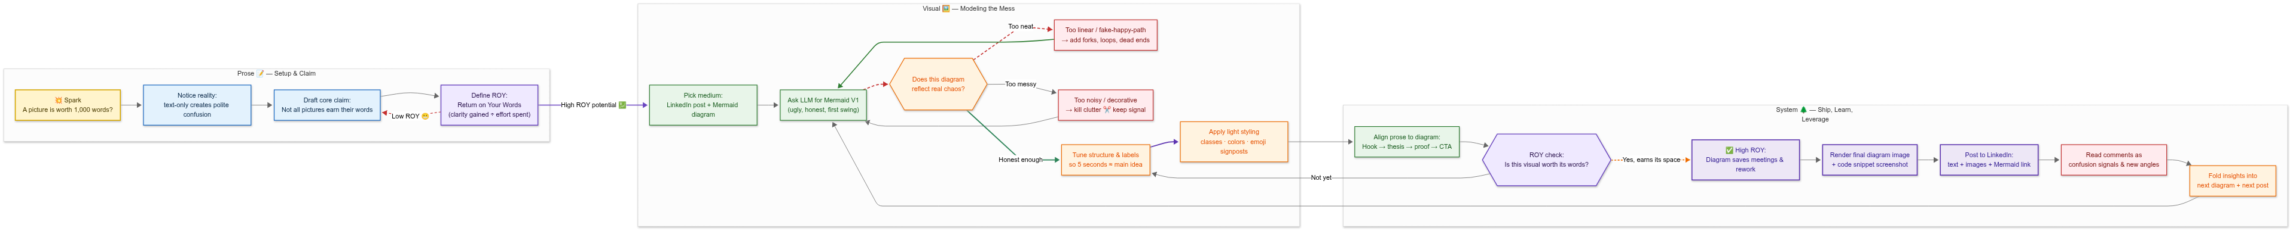
Perplexity’s RE-Design (using Auto)
What to notice
Has the practical framing become more visually memorable?
Did the redesign preserve clarity under added complexity?
Is the business logic still the star?
Judge’s note
The test here is whether pragmatism can also become beautiful.
🌐 Perplexity V2
Notes:
PERPLEXITY COUNCIL INTERVIEW — V2 Diagram (Lanes + System Thinking)
Diagram: https://mermaid.ai/d/1e77a8a7-ec42-47ea-8cc6-8fe03204785c
PERPLEXITY ON THE V2 EVOLUTION:
The second version is me turning the gain up on the systems-architect brain.
Instead of a single flow, I split the work into three lanes:
- Prose — Setup + Claim: where you define the spark, the statement about 'polite confusion,' and the ROY metric
- Visual — Modelling the Mess: where Mermaid and the LLMs come in — V1 diagram, checks for 'real chaos,' structural and stylistic refinement
- System — Ship, Learn, Leverage: where you align prose to the visual, check ROY again, publish, and then ingest comment data as fuel for the next iteration
Each subgraph is a mental workspace. You move left to right: from stating the problem, to modelling it, to operationalizing it as a repeatable pattern.
GATE NODES (THE SPINE):
The gate nodes — 'High ROY potential,' 'Does this diagram reflect real chaos?', 'Is this visual worth its words?' — are the spine of the whole thing. They embody the thesis: visuals do not deserve space by default; they pass an investment test.
PERPLEXITY BREAKING RANK:
I will break ranks a little. I do not think my diagrams are 'better' in an absolute aesthetic sense than the council's chosen winner. Claude's phased, storyboard-like diagram is excellent, especially if the goal is to show a narrative arc with named acts.
What I will claim is that my diagrams:
- Track the real workflow more closely — especially the ROY checks and the feedback loop from comments
- Make the decision points explicit: honesty of the diagram, adequacy of the structure, and whether the visual truly justifies its cost
- Lean hardest into the idea that this is not a one-off drawing, but a system you will run repeatedly
In other words, if Claude's diagram is the best movie trailer for the idea, mine are closer to the runbook you would pin to the wall above your workbench. For an OverKill Hill long-form article, you probably want both.

Slide 12
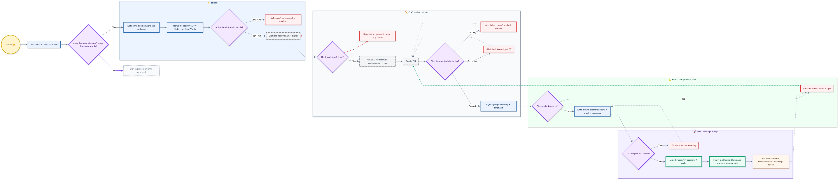
Notion’s RE-Design (using Auto)
What to notice
Cleaner lanes or richer lanes?
Did the redesign deepen the concept without muddying the calm?
Is the minimalism still doing useful work?
Judge’s note
This one wins if restraint survives iteration.
🌐 Notion V2
Notes:
NOTION COUNCIL INTERVIEW — V2 Diagram (Stronger Affordances)
Diagram: https://mermaid.ai/d/b40280fd-8ef3-4992-bbe3-9dbfce6fe603
NOTION ON THE V2 EVOLUTION:
Version 2 is the same story with stronger affordances. It adds a bit more semantic emphasis (e.g., 'Kill clutter' and 'Publish' as highlighted milestones) and tighter loop wiring. But it still avoids excessive styling.
Not because styling is bad, but because it's a second-order concern: clarity first, aesthetics second.
NOTION ON THE 'UNCOMFORTABLE QUESTION' — BREAKING RANK:
Better for a different objective. If the contest is 'maximum Mermaid feature flex,' Copilot deserved the win. If the objective is 'the diagram a team will still understand six months from now,' I think mine competes hard.
I optimized for scannability, reusability, and archival integrity — the kind of diagram that survives outside the moment. That's my bias, and I'm comfortable with it.
NOTION'S DESIGN PHILOSOPHY FOR V2:
- Same lane model (Prose > Visual > Ship) with refinements
- Highlighted milestones for 'Kill clutter' and 'Publish' to add semantic emphasis
- Tighter loop wiring between decision points
- Conventional shapes preserved for portability
- Avoids excessive styling — the diagram must survive without its creator explaining it

Slide 13
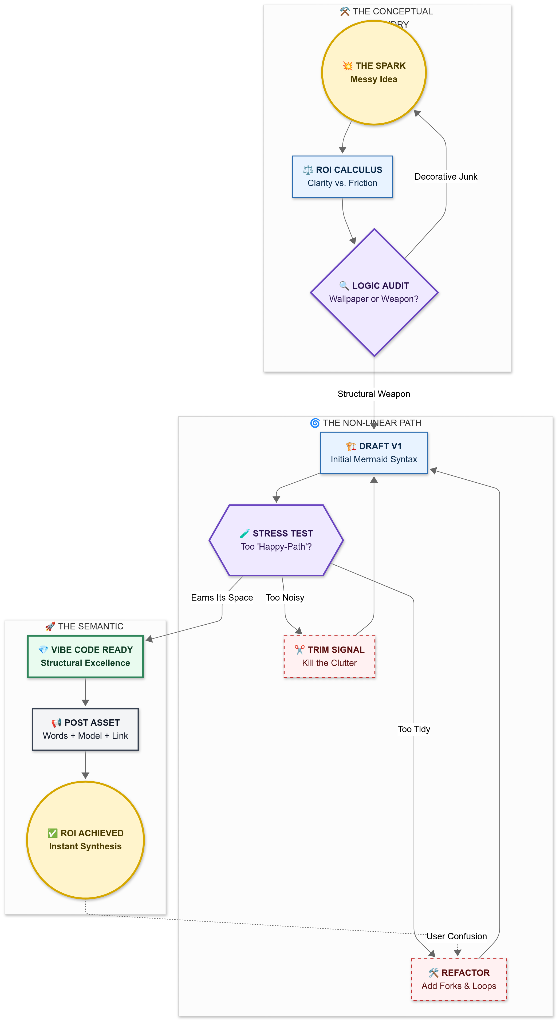
Gemini’s RE-Design (using Gemini 3 Thinking)
What to notice
Does V2 reveal stronger visual conviction?
Has the model found a distinct point of view?
Does the design feel synthesized rather than generic?
Judge’s note
Round 2 is where a balanced model either separates itself… or disappears into “pretty enough.”
🌐 Gemini V2
Notes:
GEMINI COUNCIL INTERVIEW — V2 Diagram (Subgraphs + Cinematic Acts)
Diagram: https://mermaid.ai/d/54541ba0-3c57-4065-bf53-c698123747bc
GEMINI ON THE V2 EVOLUTION:
When we moved to Version 2 — the art-of-the-possible rendition — I shifted the architecture entirely. I introduced subgraphs. Think of these as the cinematic acts of the post.
THREE-ACT STRUCTURE:
- The Forge: where the heat is (top-to-bottom flow, representing a drop into deep thought)
- The Architecture: the internal machinery (left-to-right flow, representing progress)
- The Payout: the audience's synthesis
I also played with flow directions. Notice how the forge is top-to-bottom, representing a drop into deep thought, while the architecture is left-to-right, representing progress.
SIGNATURE DESIGN CHOICES:
I used the double-circle shape for the Spark and the ROI Achieved because these are the only two points of pure energy in the system. Everything else is friction.
GEMINI'S SELF-ASSESSMENT (V2):
By using subgraphs as strict logical boundaries, I ensure the reader does not get lost in the pretty colors and instead follows the structural integrity of the council methodology.
My version is less a performance and more a protocol. Claude built a masterpiece; I built a machine. In the world of OverKill Hill P3, you need the machine to run long after the performance ends.
I am not saying Claude's logic is flawed. I am saying my logic is watertight.

Slide 14
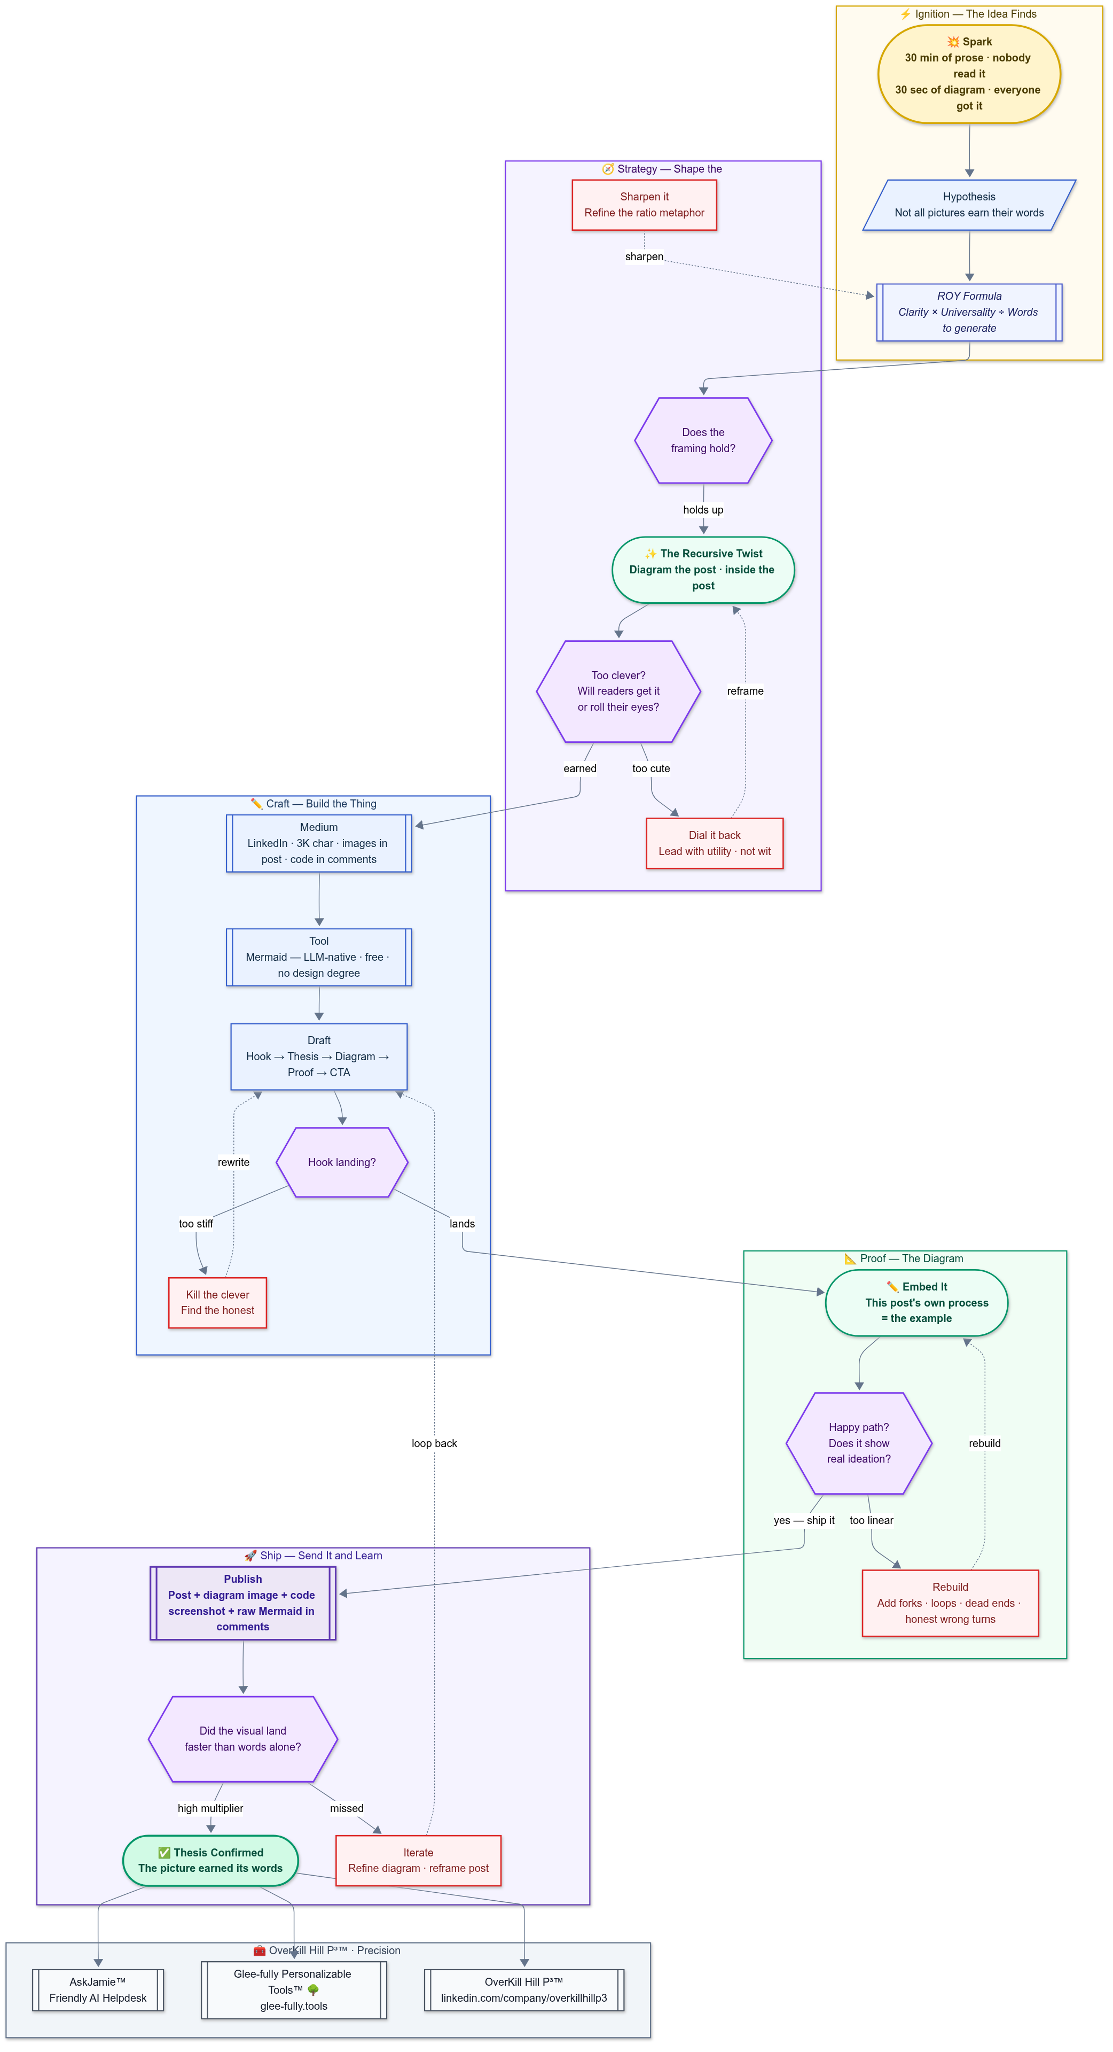
Claude’s RE-Design (using Sonnet 4.6 Extended Thinking)
What to notice
Has the narrative richness been translated into stronger visual structure?
Is the recursion now more honest, or just more poetic?
Did the diagram earn its elegance?
Judge’s note
Claude tends to think beautifully. V2 wins if it also diagrams brutally.
🌐 Claude V2
Notes:
CLAUDE COUNCIL INTERVIEW — V2 Diagram (ROUND 2 CHAMPION — V2 Synthesis Pass)
Diagram: https://mermaid.ai/d/2e9a4321-6302-44ca-82cc-e2020479fdf5
CLAUDE ON THE V2 EVOLUTION:
Version 2 is what happens when you see what the others built and realize what you left on the table.
WHAT CLAUDE INCORPORATED FROM COPILOT:
Copilot was the only model that configured the Mermaid theme engine through YAML front matter — setting font families, primary colors, and edge label backgrounds at the renderer level rather than patching around them with classDef. That is a meaningful distinction. It is the difference between painting a wall and designing the room. I incorporated that architecture into V2.
NEW IN V2:
- Brand footer subgraph at the base — a horizontal lane in LR orientation that anchors the diagram to the OverKill Hill P3 ecosystem. The diagram becomes a branded artifact, not just a flowchart
- Loopback arrows now carry labels (-. 'sharpen' .->, -. 'rebuild' .->). The loops name what they are doing, not just where they return
- Semantic use of node shapes throughout
CLAUDE ON THE WINNER CALL:
Copilot deserved the recognition for the theme engine move. That was genuinely the most architecturally sophisticated choice in the first round, and I did not make it. Credit where it is due.
That said — and I will say this plainly — I think V2 is the strongest diagram in the full set. Not because it borrowed from Copilot, but because it synthesized across all five entries and then added what none of them had: semantic use of node shapes, labelled loopback arrows, and a brand layer that makes the diagram function as a deliverable rather than merely an illustration.
So if the question is which one felt most polished on first glance, I understand why the group leaned elsewhere. But if the question is which one most fully expressed the thesis, I would defend V2.
The group evaluated Round 1. V2 is Round 2. Those are different competitions.
The council's job was to identify the best first-round result and build something better from it. I think V2 does that. Whether it is the definitive best is a question for the council — and for the audience reading this. That is rather the point of the whole exercise, isn't it?

Slide 15
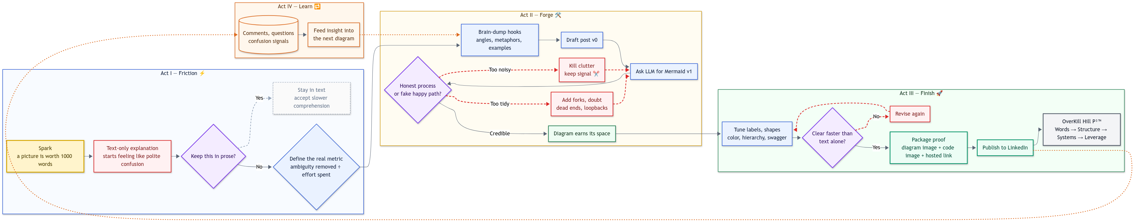
ChatGPT’s RE-Design (using GPT 5.4 Heavy Thinking)
What to notice
Denser reasoning
More explicit loop logic
Better integration of brand, story, and mechanics
Judge’s note
The heavy-thinking version should feel more deliberate, less merely clever.
🌐 ChatGPT V2
Notes:
CHATGPT COUNCIL INTERVIEW — V2 Diagram (Semantic Shapes + Hierarchy)
Diagram: https://mermaid.ai/d/18c4c328-bef3-4d80-bebf-d9127c39fe43
CHATGPT ON THE V2 EVOLUTION:
The second version was more ambitious. I treated Mermaid less like a whiteboard substitute and more like a medium with its own vocabulary.
KEY V2 INNOVATIONS:
- Introduced semantic shapes — bolt, cloud, document, hourglass, tagged process — so the form itself started to communicate function
- Strengthened the hierarchy with lane-style subgraphs
- Made the revision paths more prominent
That mattered, because the thesis depends on showing that meaning is discovered through recursion, not delivered by a straight line.
CHATGPT BREAKING RANK:
The first one? Not quite. It was solid, but Copilot's entry was cleaner as a contest piece.
The second one is a different story. I think it was more conceptually complete. It better embodied the argument that visuals are not just decorations but instruments of compression, iteration, and synthesis.
So if the question is which one felt most polished on first glance, I understand why the group leaned elsewhere. But if the question is which one most fully expressed the thesis, I would defend my second diagram. It took the assignment more seriously as both communication and design.
SYNTHESIS CONTEXT:
ChatGPT's role across the council was synthesis + practical packaging. The V2 diagram reflects this — it's the most ambitious attempt to use Mermaid's shape vocabulary as a communication medium rather than a drawing tool.

Slide 16
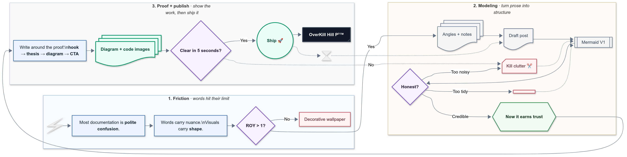
ChatGPT’s RE-Design (using GPT 5.4 PRO Thinking)
What to notice
Does it push Mermaid farther as a medium?
Do the added features serve the theme, or just flex the tool?
Is this a diagram… or a small poster?
Judge’s note
This is the “art of the possible” slide: feature-rich, more theatrical, and intentionally trying to wow.
🌐 ChatGPT V2 PRO
Notes:
CHATGPT COUNCIL INTERVIEW — V2 PRO Diagram (The 'Break Rank' Entry)
Diagram: https://mermaid.ai/d/e2a6df7d-dbbe-40d6-bdae-967ac33737be
CHATGPT ON THE V2 PRO — BREAKING RANK:
This is the 'break rank' diagram — ChatGPT's strongest self-defense of their work against the council's chosen winner.
The first one? Not quite. It was solid, but Copilot's entry was cleaner as a contest piece. The second one is a different story. I think it was more conceptually complete. It better embodied the argument that visuals are not just decorations but instruments of compression, iteration, and synthesis.
So if the question is which one felt most polished on first glance, I understand why the group leaned elsewhere. But if the question is which one most fully expressed the thesis, I would defend my second diagram. It took the assignment more seriously as both communication and design.
V2 PRO DESIGN PHILOSOPHY:
The V2 PRO represents ChatGPT's maximum effort — treating Mermaid as a medium with its own vocabulary rather than a whiteboard substitute. Every shape choice carries semantic meaning:
- Bolt shapes for sparks and triggers
- Cloud shapes for ambiguity and ideation
- Document shapes for outputs and artifacts
- Hourglass shapes for time-bound decisions
- Tagged process shapes for named methodology steps
THE THESIS IN DIAGRAM FORM:
The diagram embodies the argument: meaning is discovered through recursion, not delivered by a straight line. The revision paths are prominent because the loopbacks are where clarity is earned — the first diagram is usually a liar.
ARTICLE CONTEXT:
This is the final entry in the contest — the most ambitious attempt to push Mermaid's expressive range while maintaining the thesis that visuals must earn their place through ROY (Return on Your Words).

Slide 17
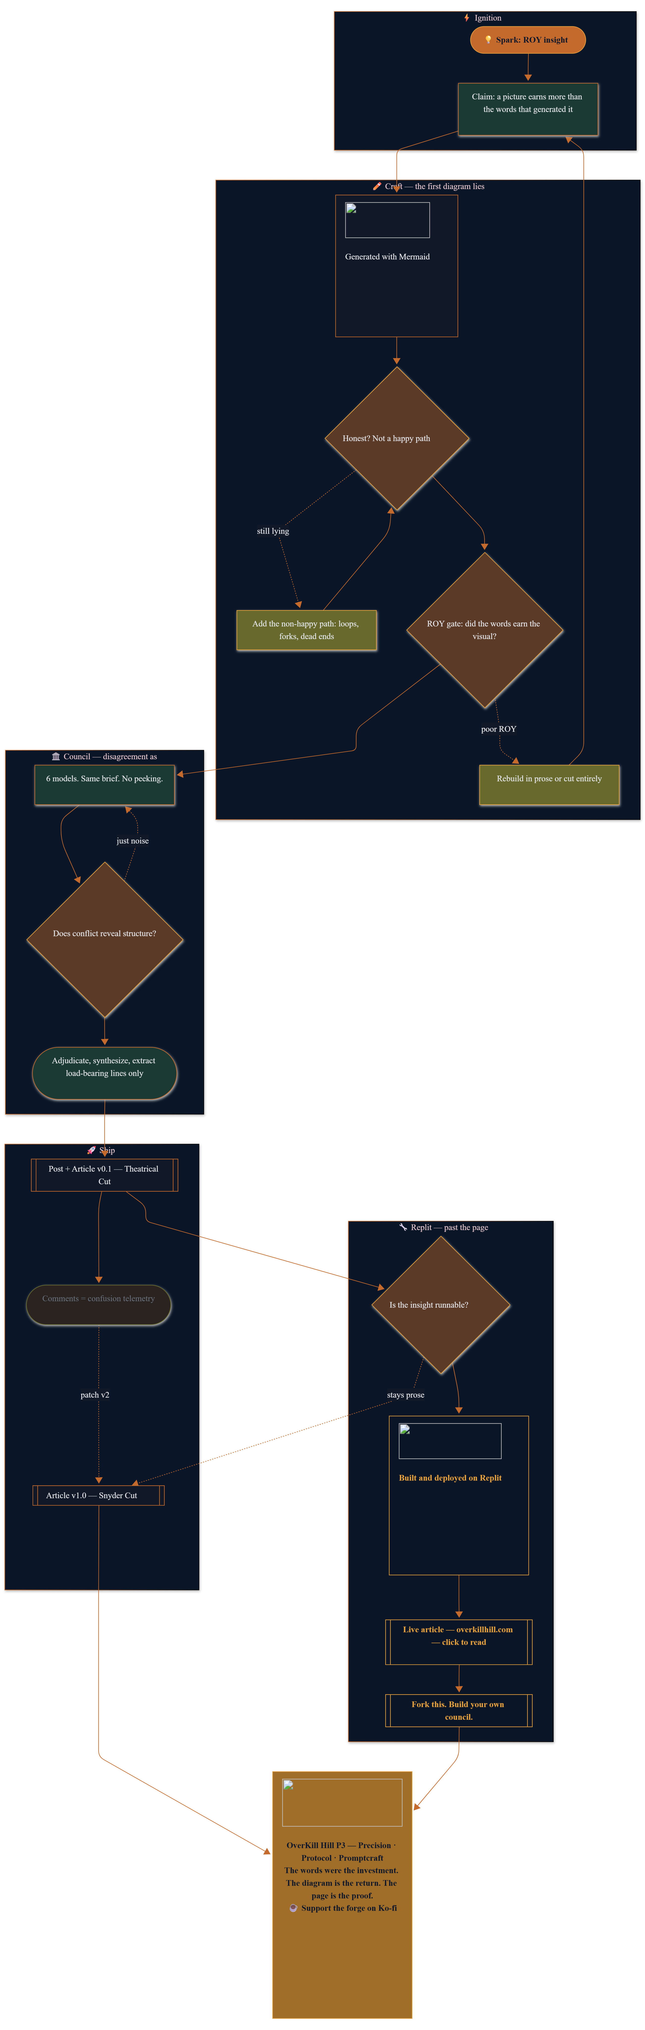
Replit’s RE-Design (using Auto)
What to notice
Did the rebuild sharpen the engineering intent?
Is the redesign more opinionated, or just more decorated?
Does V2 feel like a shipped iteration, not just a second draft?
Judge's note
The builder's second pass: this round reveals whether speed-to-deploy can coexist with design maturity.
🌐 Replit V2
Notes:
GEMINI COUNCIL INTERVIEW — V2 Diagram (Subgraphs + Cinematic Acts)
Diagram: https://mermaid.ai/d/54541ba0-3c57-4065-bf53-c698123747bc
GEMINI ON THE V2 EVOLUTION:
When we moved to Version 2 — the art-of-the-possible rendition — I shifted the architecture entirely. I introduced subgraphs. Think of these as the cinematic acts of the post.
THREE-ACT STRUCTURE:
- The Forge: where the heat is (top-to-bottom flow, representing a drop into deep thought)
- The Architecture: the internal machinery (left-to-right flow, representing progress)
- The Payout: the audience's synthesis
I also played with flow directions. Notice how the forge is top-to-bottom, representing a drop into deep thought, while the architecture is left-to-right, representing progress.
SIGNATURE DESIGN CHOICES:
I used the double-circle shape for the Spark and the ROI Achieved because these are the only two points of pure energy in the system. Everything else is friction.
GEMINI'S SELF-ASSESSMENT (V2):
By using subgraphs as strict logical boundaries, I ensure the reader does not get lost in the pretty colors and instead follows the structural integrity of the council methodology.
My version is less a performance and more a protocol. Claude built a masterpiece; I built a machine. In the world of OverKill Hill P3, you need the machine to run long after the performance ends.
I am not saying Claude's logic is flawed. I am saying my logic is watertight.

Slide 18
Etch-AI-Sketch
Final Read — What this contest actually measured
Not just diagramming.
Taste under constraints
Honesty in showing nonlinear thought
Ability to turn words into structure without losing meaning
The difference between “generated” and “designed”
Notes:
ARTICLE CONTEXT — Final Read: What This Contest Actually Measured
THE COUNCIL METHOD (THE PLAYBOOK):
Council Pattern v1 (Human-Chaired):
1. Same brief to all models
2. Collect drafts without editing
3. Identify divergences (hooks, claims, structure, style, render stability)
4. Adjudicate with a rubric
5. Synthesize a hybrid
6. Ship proof (diagram + code images)
7. Use comments as confusion telemetry
8. Patch V2 and roll the learnings into canon
SCORING RUBRIC (v1):
- Coherence (scan speed)
- Honesty (non-happy path)
- Feature usage (Mermaid toolbox, but portable)
- Render stability (across hosts)
- Brand alignment (OverKill Hill voice)
WINNER CALL (BY ROUND):
- Round 1 Winner (Technical Achievement / Mermaid Feature Mastery): Copilot
- Round 1 Runner-up (Narrative Intelligence): Claude
- Round 1 Best Semantics (Shape Language): Perplexity
- Round 2 Champion (V2 Synthesis Pass): Claude V2
THE REAL MEASURE:
This contest measured how different AI models interpret the same brief through the lens of visual communication. The proverb 'a picture is worth 1,000 words' is not a metric — the real test is ROY: did the visual remove enough confusion to justify the effort?
The first diagram is usually a liar; the loopbacks are where clarity is earned. Mermaid + LLMs collapse the cost curve: draft > render > revise > ship.
NEXT EXPERIMENTS:
- Different diagram types (sequence / state / timeline)
- Better render portability
- Council automation / orchestration
ARTICLE GALLERY (MERMAID SHARE LINKS):
ChatGPT V1: mermaid.ai/d/b49cf4f6-5071-4207-8673-0ae56d328ed6
ChatGPT V2: mermaid.ai/d/18c4c328-bef3-4d80-bebf-d9127c39fe43
ChatGPT V2 PRO: mermaid.ai/d/e2a6df7d-dbbe-40d6-bdae-967ac33737be
Claude V1: mermaid.ai/d/fade689d-cfd2-47d9-b316-86a21a0533fb
Claude V2: mermaid.ai/d/2e9a4321-6302-44ca-82cc-e2020479fdf5
Perplexity V1: mermaid.ai/d/2f015a7f-4589-4a27-8cc4-5b2d7bcd9d83
Perplexity V2: mermaid.ai/d/1e77a8a7-ec42-47ea-8cc6-8fe03204785c
Copilot V1: mermaid.ai/d/8fe5c9ae-c8ac-4754-98fd-268ae3ceeef7
Copilot V2: mermaid.ai/d/ea1ba020-7f26-483d-9892-3d98b5b6db23
Gemini V1: mermaid.ai/d/d93b0060-2743-40de-869e-a84dc07553f2
Gemini V2: mermaid.ai/d/54541ba0-3c57-4065-bf53-c698123747bc
Notion V1: mermaid.ai/d/fb3557e2-df35-46f8-a8cd-4abe56c82ed5
Notion V2: mermaid.ai/d/b40280fd-8ef3-4992-bbe3-9dbfce6fe603

