Slide 1
Air Quality Monitoring Dashboard
Progress Presentation
November 2024

Slide 2
Work Completed So Far
Real-time data fetching using OpenWeather API.
Displaying key metrics such as:
Temperature and humidity.
Pollutants like PM2.5, PM10, and NOx levels.
Created interactive charts:
Line chart for trends over time.
Bar chart for pollutant levels.
Doughnut chart for pollutant distribution.
Sidebar navigation for toggling between sections (Home, Dashboard, About).

Slide 3
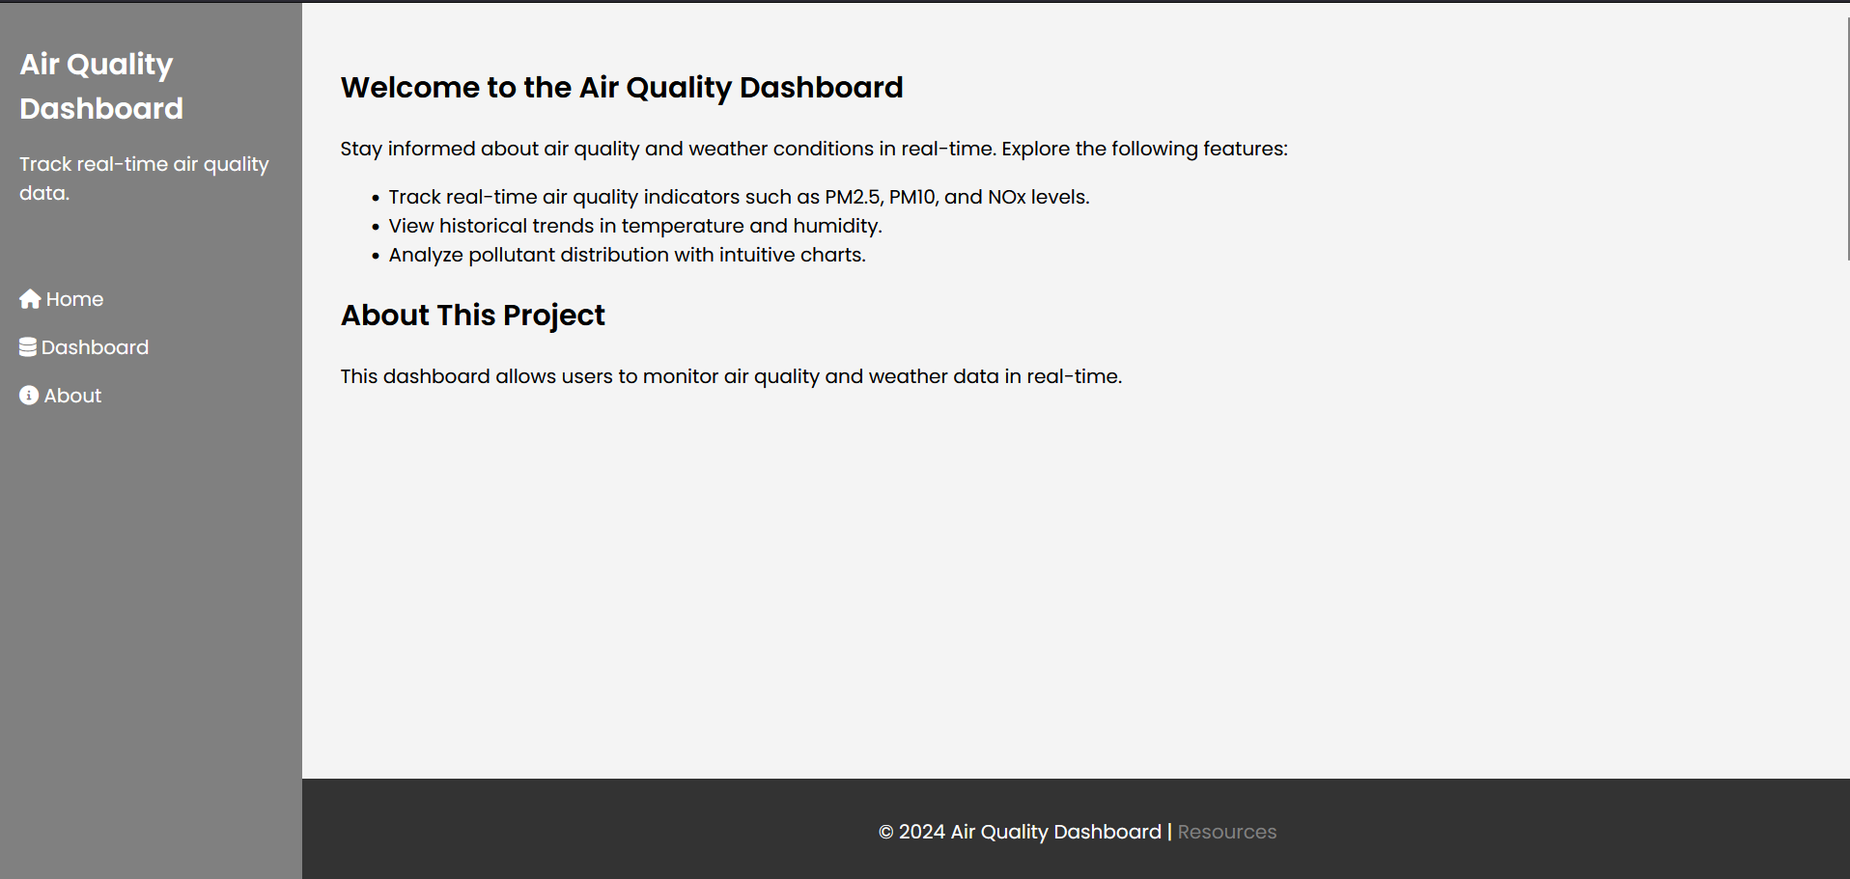

Slide 4
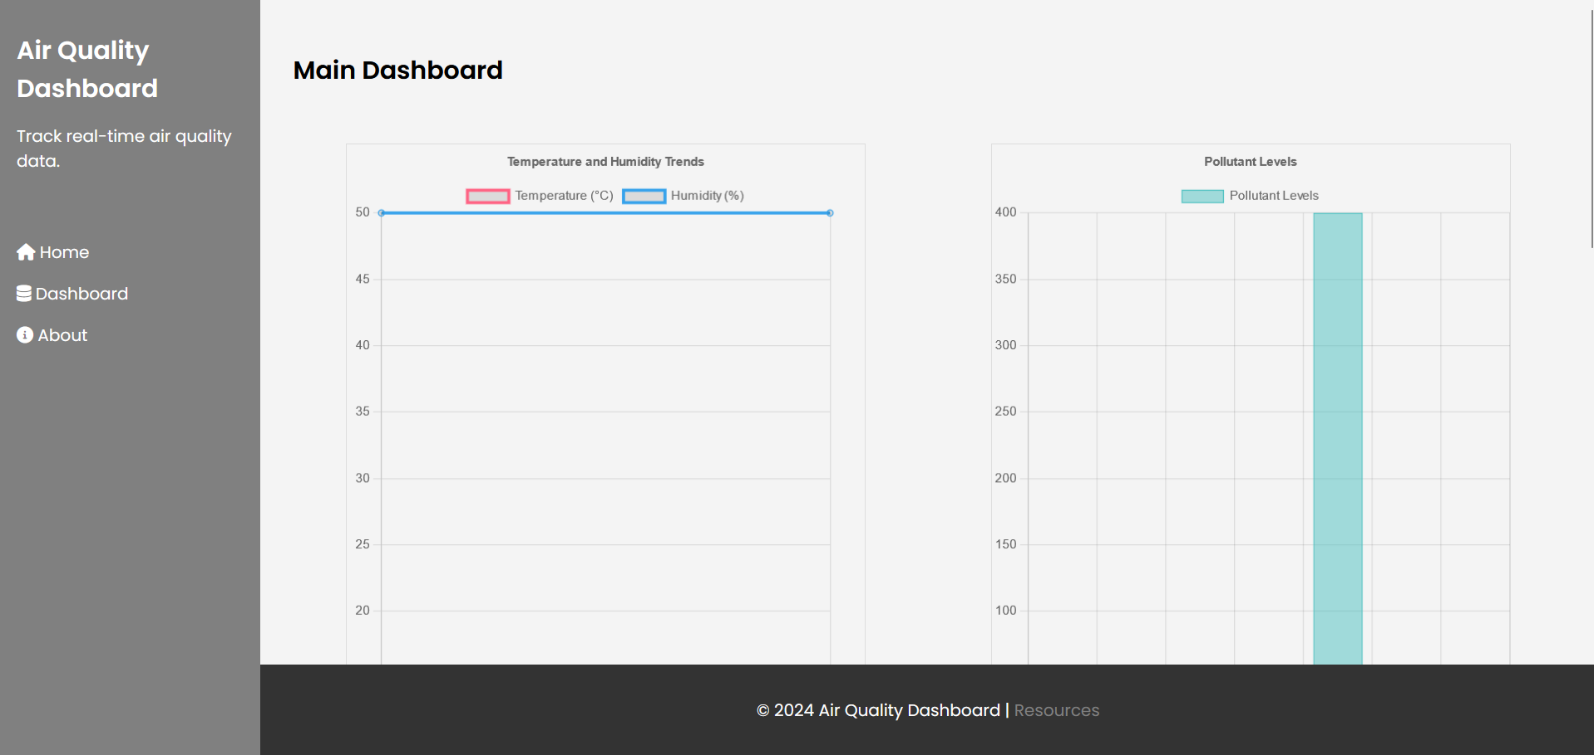

Slide 5
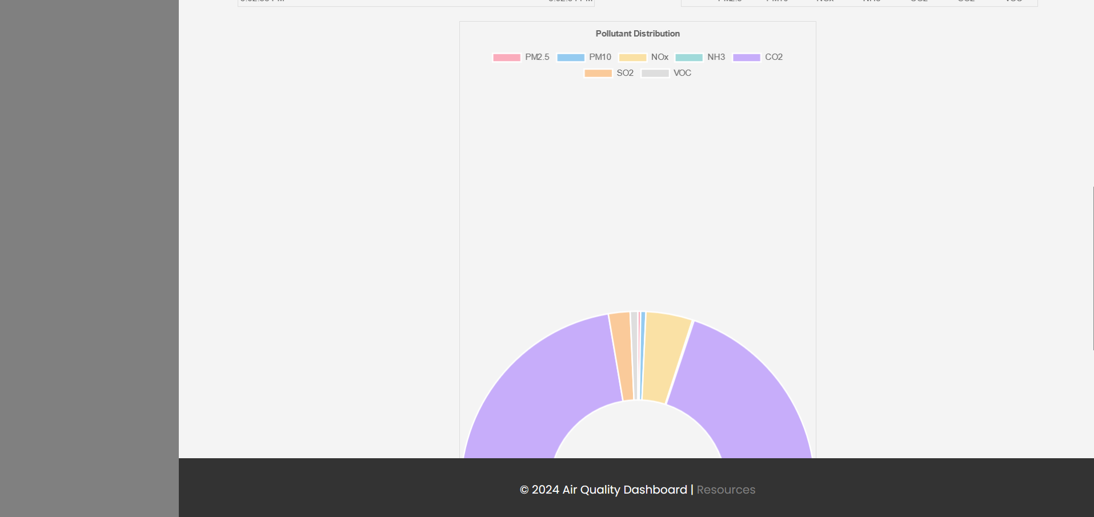

Slide 6
Upcoming Work
Use a clean, atmospheric image (e.g., skyline, nature) or a subtle looping video to make the page more engaging in the home page.
Enhance chart interactivity:
Add tooltips and data filtering options.
Include historical trends:
Allow users to view past air quality data.
Improve UI/UX Design:
Add animations to enhance user experience.

