Slide 1
Payment Call Model
1:Exploratory Data Analysis
2:Data Cleaning and Transformation
3:Model Building
4:Evaluation

Slide 2
1:Exploratory Data Analysis
I got an overview through the EDA on the dataset
There are string, inter and float data types
Not too many missing values, they are nice distributed
By checking boxplot for each feature, there are outliers in those features
By using heatmap, there no clear collinearity among these features
Also, there is one constant column that will not bring any information
By checking bar plots, a lot of these features has effect on the target “Call_flag”
Also, there are some interaction relationship between some features

Slide 3
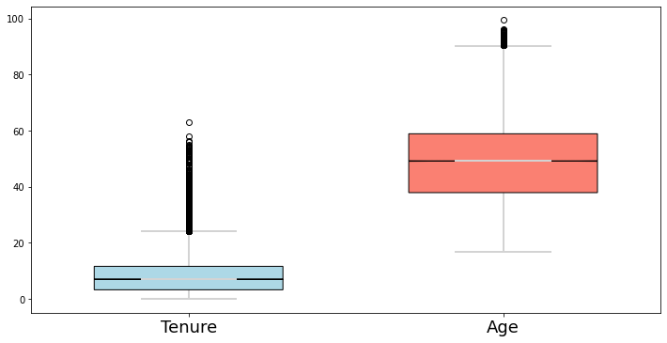
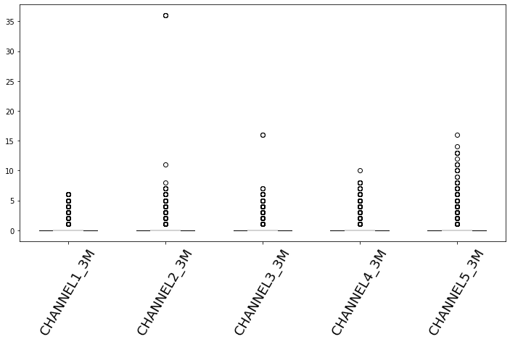
Boxplots for Outliers
In general, outliers are not that many
Some features like Tenure and Age, they have relative wide range of values, the outliers is not a big issue for them
The features shown below have majority density near 0, therefore we can consider these features are dummies

Slide 4
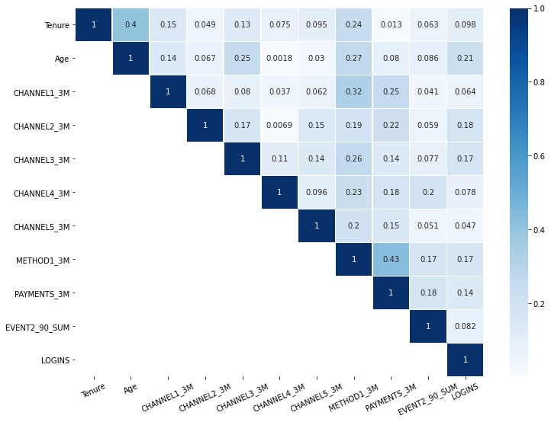
Collinearity
The heatmap shows there no collinearities among the features with data types of integer

Slide 5
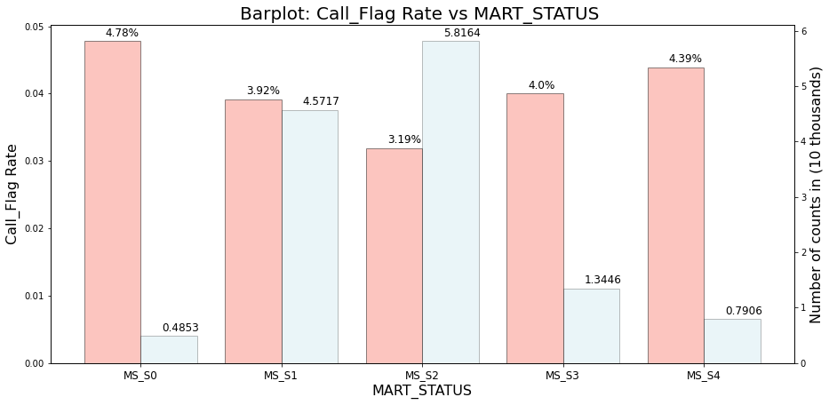
Bar-plots
The bar plot shows that the target rate are different across MART_STATUS, so the features with string values are also informative

Slide 6
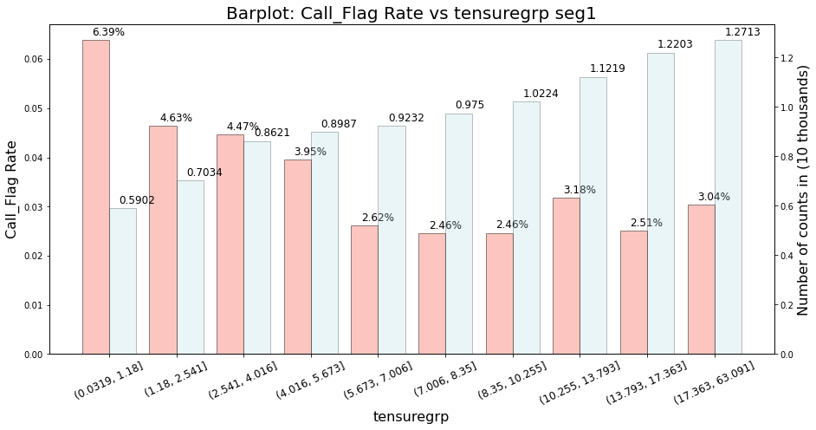
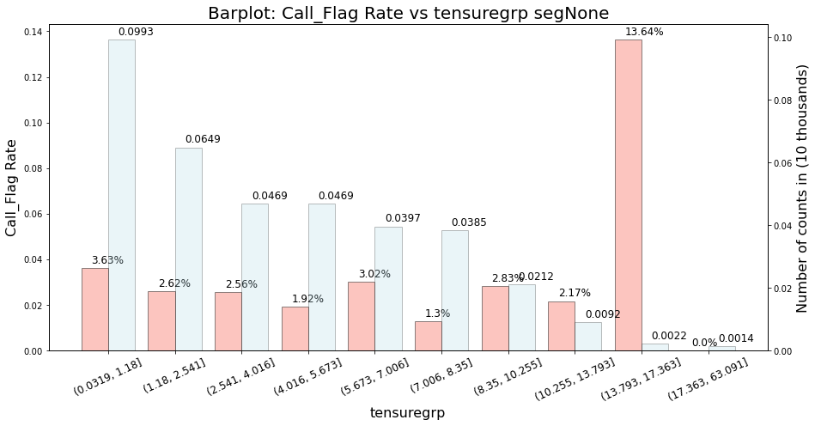
Bar-plots
The target rates of different Tenure groups are different across CustomerSegment variable, this indicates that the potential interaction relationship exists

Slide 7
2:Data Cleaning and Transformation
Before building models, dropped the constant columns
Also, I created the dummy variables of string features
Since data has positive values as inputs, therefore I used -9 to replace missing values, it indicates the special case happens
I created a “Weekday” feature based on “Date_for”, and used “Weekday” to create 7 dummy variables

Slide 8
3:Model Building
Based on the EDA, I decide to use tree-based models as my predictors since it can pick up interactions, avoid outlier effect and missing values problems.
The algorithms I used are Catboost and XGBoost, Catboost can deal with string features directly and no need for transformation also the data are very nice formatted, they are all integers and can be converted into integers by using simple python function; Since I created some dummies I also fit a Xgboost model compare to Catboot, I can use float as input in XGBoost

Slide 9
3:Model Building
I split data into train and test, train dataset are 70% random selected from original with the same target rate
To save time, I used random search method to selected the best set of hyperparameters based on minimizing the logloss of a subsample of training data for both Catboost and XGBoost
Once I have the best estimator, I train the models on training dataset and test on the test dataset

Slide 10
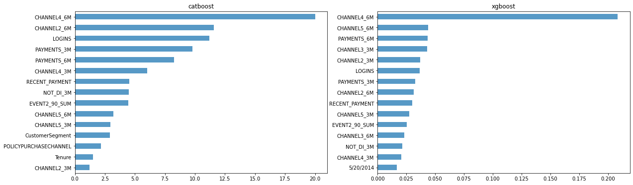
4:Evaluation
I evaluated the models on different metrics
Precision, recall, roc, ks, logloss and accuracy
I checked the feature ranks of two models, their top features are similar which make sense
I also check shap values for their top features

Slide 11
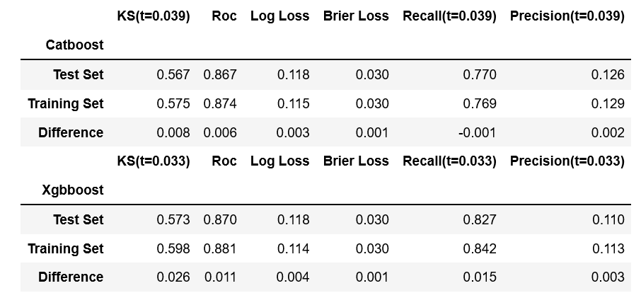
4:Evaluation
Two models have similar performance, xgboost is faster , for simplicity catboost is better since it can deal with string features automatically

