Slide 1
Predictive Analysis of House Prices Using Regression Techniques

Slide 2
Background of the Research
In Real estate business various factors can affect house prices. Knowing what are these factors are and how they effect on house prices is very important to everyone who involved in Real estate market.

Slide 3
Research Questions And Objectives

Slide 4
01
02
Question
What are the main key factors that influence house prices?
Objective
Determine the main components that have major impact on house prices
Question
What is the relationship between various features and house prices?
Objective
Study relationships between multiple features and house price

Slide 5
03
04
Question
Is it possible to build a predictive model to estimate house prices based on variety of features?
Objective
Create prediction technique to determine the house prices
Question
Are there any noticeable patterns in house prices throughout multiple time periods?
Objective
Study the patterns in house prices over time and place.

Slide 6
Dataset and Variables

Slide 7
Dataset and Variables
This research used a dataset from Kaggle Competition “House Prices: Advance Regression Techniques” to study the main factors that affect house prices.
The dataset is consist with 1460 observation and 81 variables. It include both numerical and categorical data regarding residential properties.
For this research we selected eight key variables from this dataset that most likely to effect house prices.

Slide 8
Variables
Original Construction date – YearBuilt
Masonry Veneer type – MasVnrType
          Brick Face - BrkFace
          Cinder Block – Cblock
          Stone – Stone
          None – None
Masonry veneer area in square feet - MasVnrArea
Total square feet of basement area - TotalBsmtSF
Above grade (ground) living area square feet - GrLivArea
Year Sold - YrSold
Year garage was built - GarageYrBlt
Sold price - SalePrice

Slide 9
Data Exploration & Preprocessing

Slide 10
Data Exploration & Preprocessing
Data exploration and preprocessing are critical steps in the data analysis.
Exploration helps identify anomalies, missing values and potential data quality issues.
Preprocessing involves cleaning the data, handling missing values, normalizing, encoding categorical variables and transforming the data into a suitable format for analysis or modeling.

Slide 11
Hypotheses and Relationships

Slide 12
Key Hypotheses and Expected Relationships
Assessing the validity of these hypotheses to understand key drivers of house prices
Relationship between ground living area and house prices.
Impact of year built on house prices.
Relationship between basement area and sale price.
Distribution of sale prices.
Comparative impact of basement area and living area on sale price.
Return on sale price for homes with. large living areas

Slide 13
Hypotheses
Hypothesis 01: Ground Living Area and House Prices
H0: No significant relationship.
H1: Significant positive relationship.
Hypothesis 02: Year Built and House Prices
H0: Year built does not affect prices.
H1: Newer houses have higher prices.

Slide 14
Hypotheses
Hypothesis 03: Basement Area and Sale Price
H0: No relationship.
H1: Significant relationship.
Hypothesis 04: Distribution of Sale Prices
H0: Normally distributed around the median.
H1: Not normally distributed, indicating outliers.

Slide 15
Hypotheses
Hypothesis 05: Comparative Impact of Areas
H0: Basement and living area impact sale price equally.
H1: Basement area has less impact.
Hypothesis 06: Return on Sale Price for Large Living Areas
H0: Constant Return.
H1: Reducing Return for larger areas.

Slide 16
Linear Regression Model

Slide 17
Implementing Linear Regression Model
We have implemented the multiple linear regression model to predict house prices based on the identified key features
The equation: -
Sale Price= β0 ​+ β1​(Ground Living Area) + β2​(Year Built) + β3​(Total Basement Area) + β4​(Masonry Veneer Area) + β5​(Garage Year Built)

Slide 18
Implementing Linear Regression Model
Model Parameters
β0: Intercept
β1: Coefficient for Ground Living Area
β2: Coefficient for Year Built
β3: Coefficient for Total Basement Area
β4: Coefficient for Masonry Veneer Area
β5: Coefficient for Garage Year Built

Slide 19
Model Performance Evaluation
The outcome of the regression model was evaluated using two major indicators.
Mean Squared Error (MSE): 0.1397524
This indicator shows the average of the squares of the mistakes, or the average squared difference between the noted actual results and the predicted result by the model.
Root Mean Squared Error (RMSE): 0.3738348
This is the root of the MSE and shows the standard deviation of prediction errors. It is less difficult to understand because it is in similar units as the response parameter or the Sale Price
R-Squared: 0.7047986
useful metric for understanding the effectiveness of a predictive model in explaining the variance in the response variable, providing insight into the model's explanatory power.

Slide 20
Visualization

Slide 21
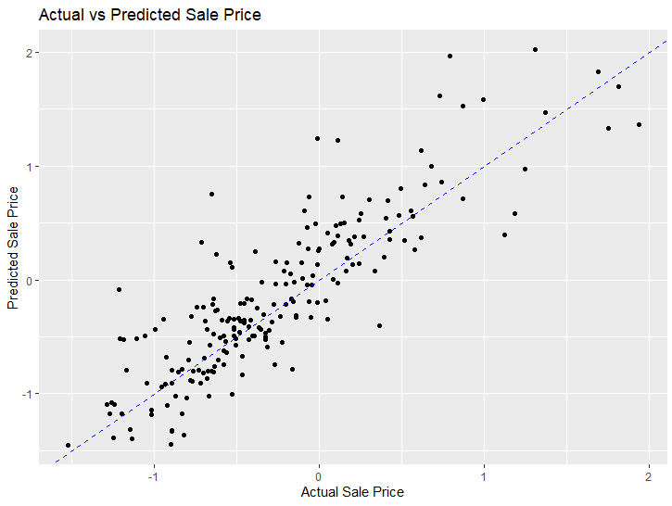
Scatter Plot of Actual and Predicted Sale Prices
Most predictions are close to actual values, indicating model accuracy. Dots near the blue dashed line are accurate.
distant dots show areas needing improvement.

Slide 22
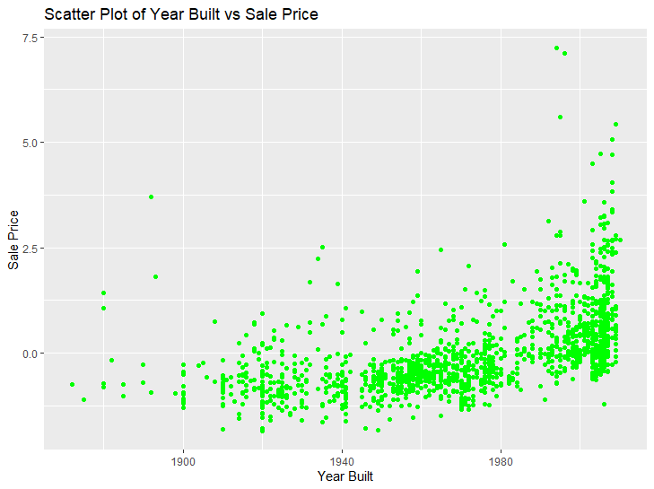
Scatter Plot of Year Built and Sale Prices
There is a very noticeable tend that newly built houses have higher market value.
This indicates that newly built houses sold more than old houses.
Newer houses generally have higher prices, but older houses can also sell for high prices with renovations and favorable locations.
Finally there are some outliers in this plot, which shows that houses with unique features which could be affect on selling price of the house.

Slide 23
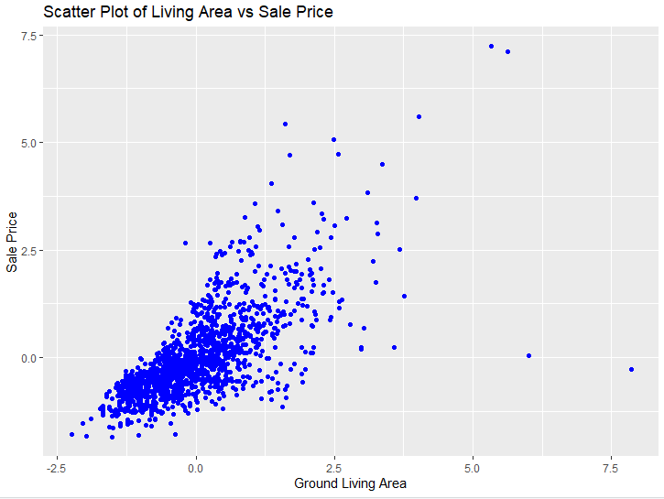
Scatter Plot of Living Area and Sale Prices
There is a positive correlation between the living area and the sale price. If the living area increases the sale price also increases.
Which conclude that larger houses sold for more value.
appears to be a linear relationship, which is each unit of living area equals to consistence amount of sale price, but it may not work when higher values.
The plot shows some outliers, with extremely large houses like mansions not fitting the general price trend.

Slide 24
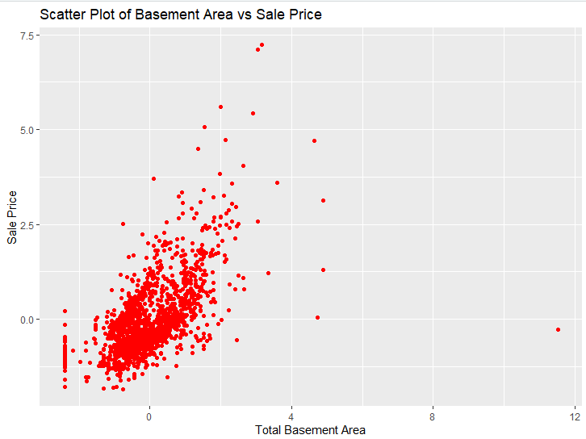
Scatter Plot of Basement Area and Sale Prices
There is a positive correlation between basement area and the sale price.
The larger basement area means the higher sale price.
There is some changes in the trend but overall trend is clear.
This relationship suggest that total basement area is significantly affect the selling price of a house.

Slide 25
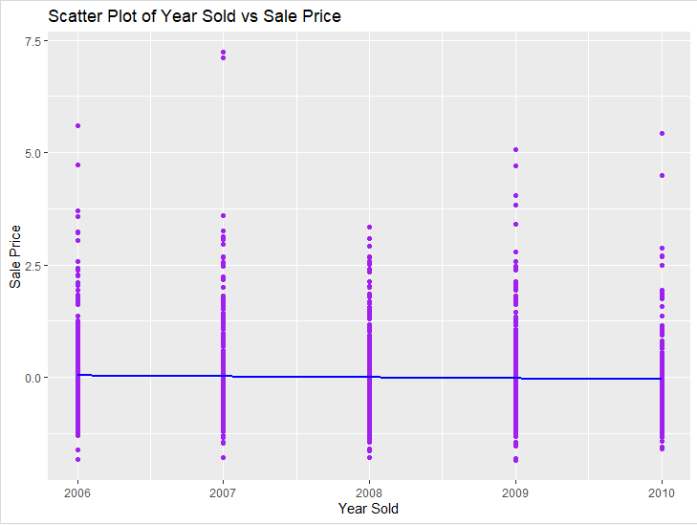
Scatter Plot of Year Sold and Sale Prices
The blue line (represent mean/median sale price) shows relative consistency over years, with some differences.
Each year has outliers, indicating occasional sales higher or lower than most of the data.
Even sales price distribution suggests market stability over the years, with minor changes warranting regression analysis.

Slide 26
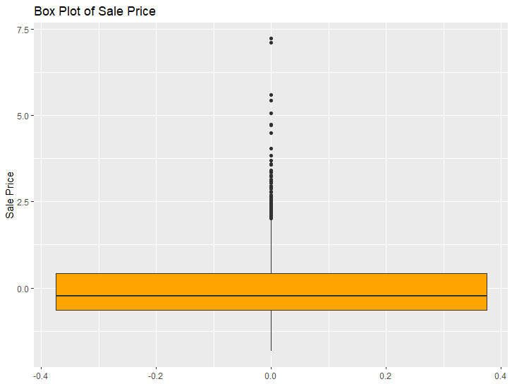
Box plot of Sale Price
Interquartile Range (IQR): Represents the middle 50% of sale prices in the dataset.
Median Sale Price: Positioned within the box, indicating the central tendency of prices.
Outliers: Dots outside the whiskers denote high-value outliers, indicating positive skew in house prices

Slide 27
Discussion &
Recommendations

Slide 28
Discussion and Insights
Feature Importance:
Major predictors: ground living area, year built, total basement area, masonry veneer area, and garage year built.
Positive correlation between basement/ground living area and sale price highlights their importance in the real estate market.
Model Robustness:
Low Mean Squared Error (MSE) and Root Mean Squared Error (RMSE) show strong predictor features and robust model performance.
Scatter plot of actual vs. predicted prices shows a tight grouping around the diagonal, confirming the model's effectiveness in capturing data patterns.

Slide 29
Discussion - Limitations
Research limited to dataset features; other factors like neighborhood quality and economic conditions not included.
Assumes linear relationships, potentially overlooking complex interactions.

Slide 30
Recommendations
Recommendations for Buyers:
Focus on properties with larger living and basement areas as these significantly impact higher sale prices.
Recommendations for Sellers:
Emphasize newer construction dates and well-maintained masonry veneer areas to enhance property value.

Slide 31
Conclusions

Slide 32
Conclusions
Successful Identification: Key factors impacting house prices were identified.
Accurate Predictive Model: Developed with significant accuracy, validated by close prediction to actual sale prices.
Valuable Insights: Findings offer valuable guidance for buyers and sellers in making informed real estate decisions.

Slide 33
Thank You!
Presented By Group 5
COHNDSE 23.3F – 018 Diluksha Malan
COHNDSE 23.3F – 019 Oshadha Samarasinghe
COHNDSE 23.3F – 020 Sohan Weerasinghe
COHNDSE 23.3F – 021 Avinda Udeshitha

