Slide 1
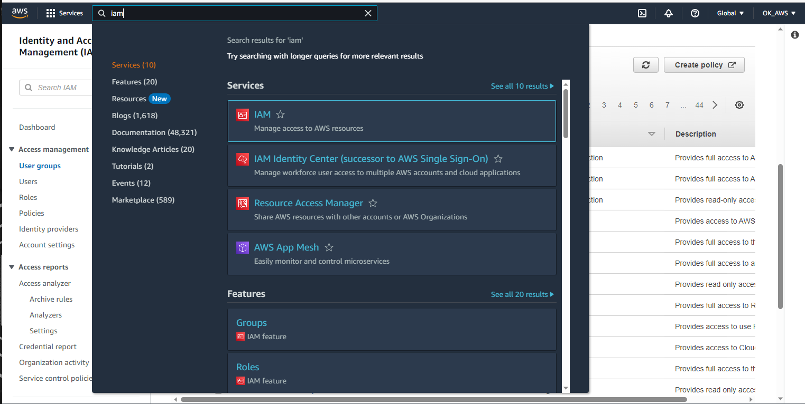

Slide 2
Search “IAM”

Slide 3
Search “IAM”

Slide 4
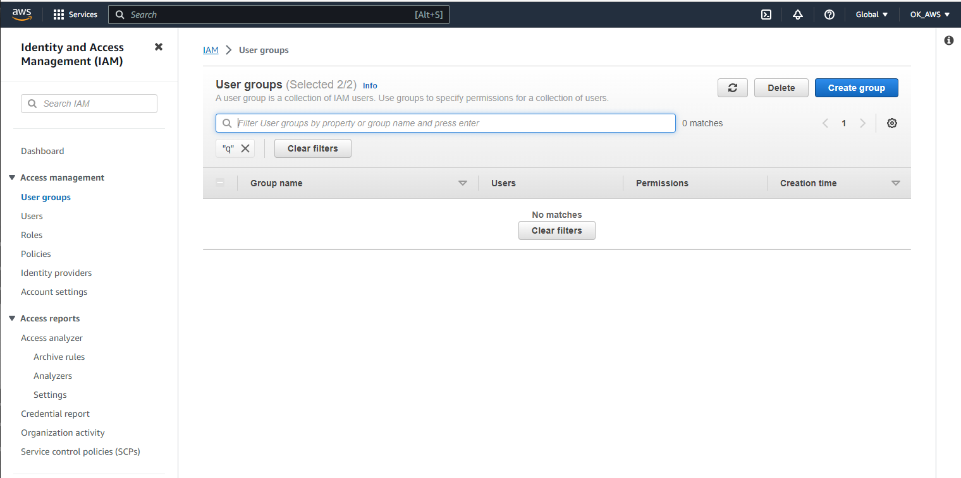

Slide 6
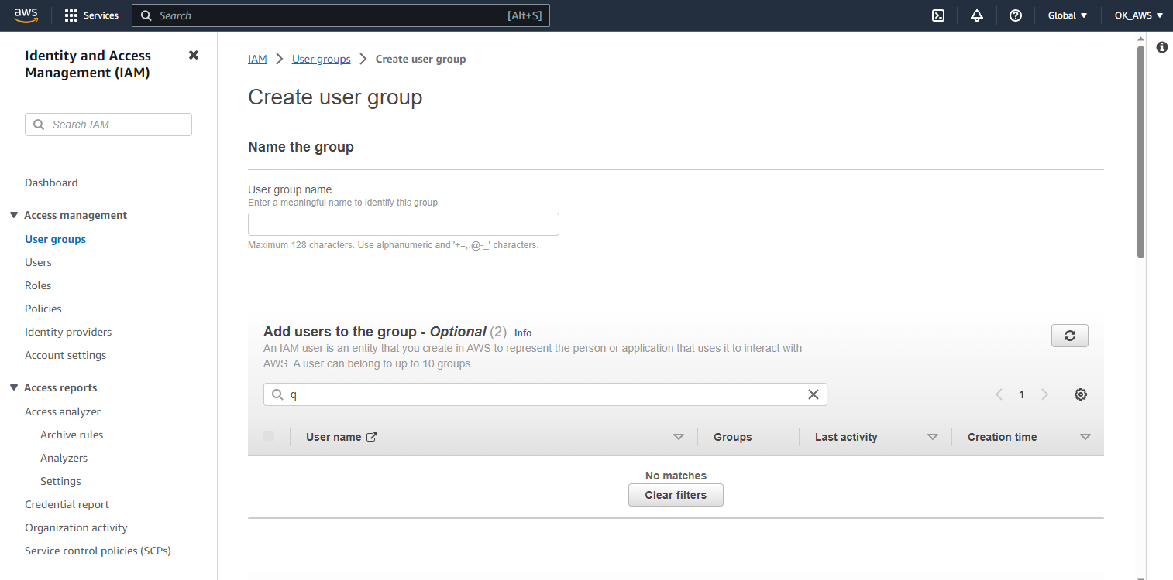

Slide 7
Input Name

Slide 8
Input Name

Slide 9
Input Name

