Slide 1
APPLICATION OF INTEGRALS
Om Kshatriya
Vanshaj Nathani

Slide 2
INTEGRATION AS A LIMIT OF SUM

Slide 3
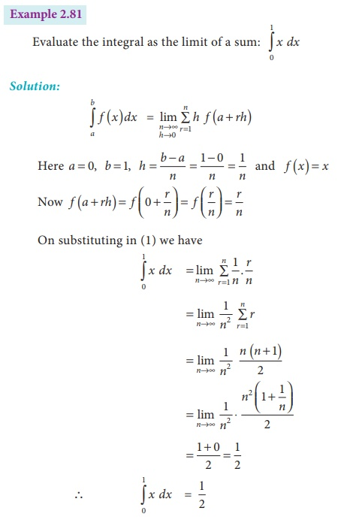
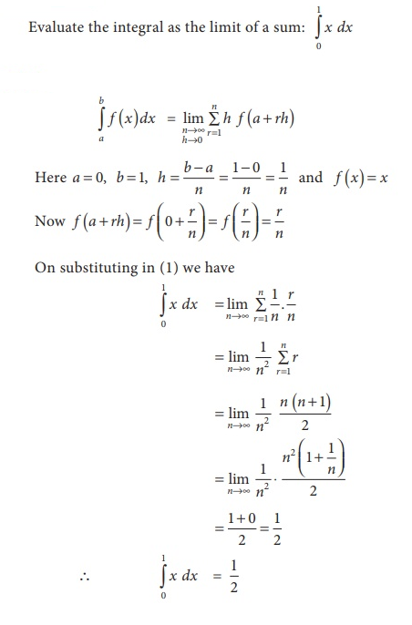

Slide 4
PARAMETRIC CURVES

Slide 5
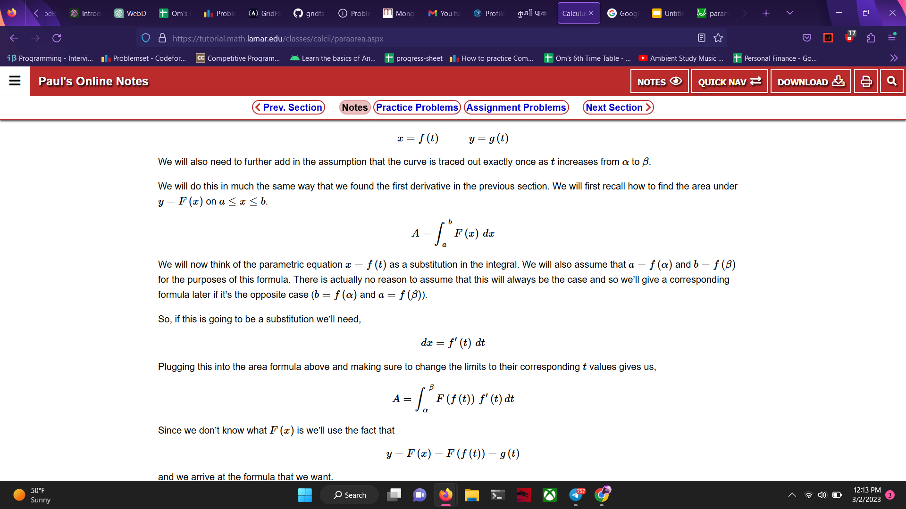
Let the parametric Equations be.
To Calculate,

Slide 6
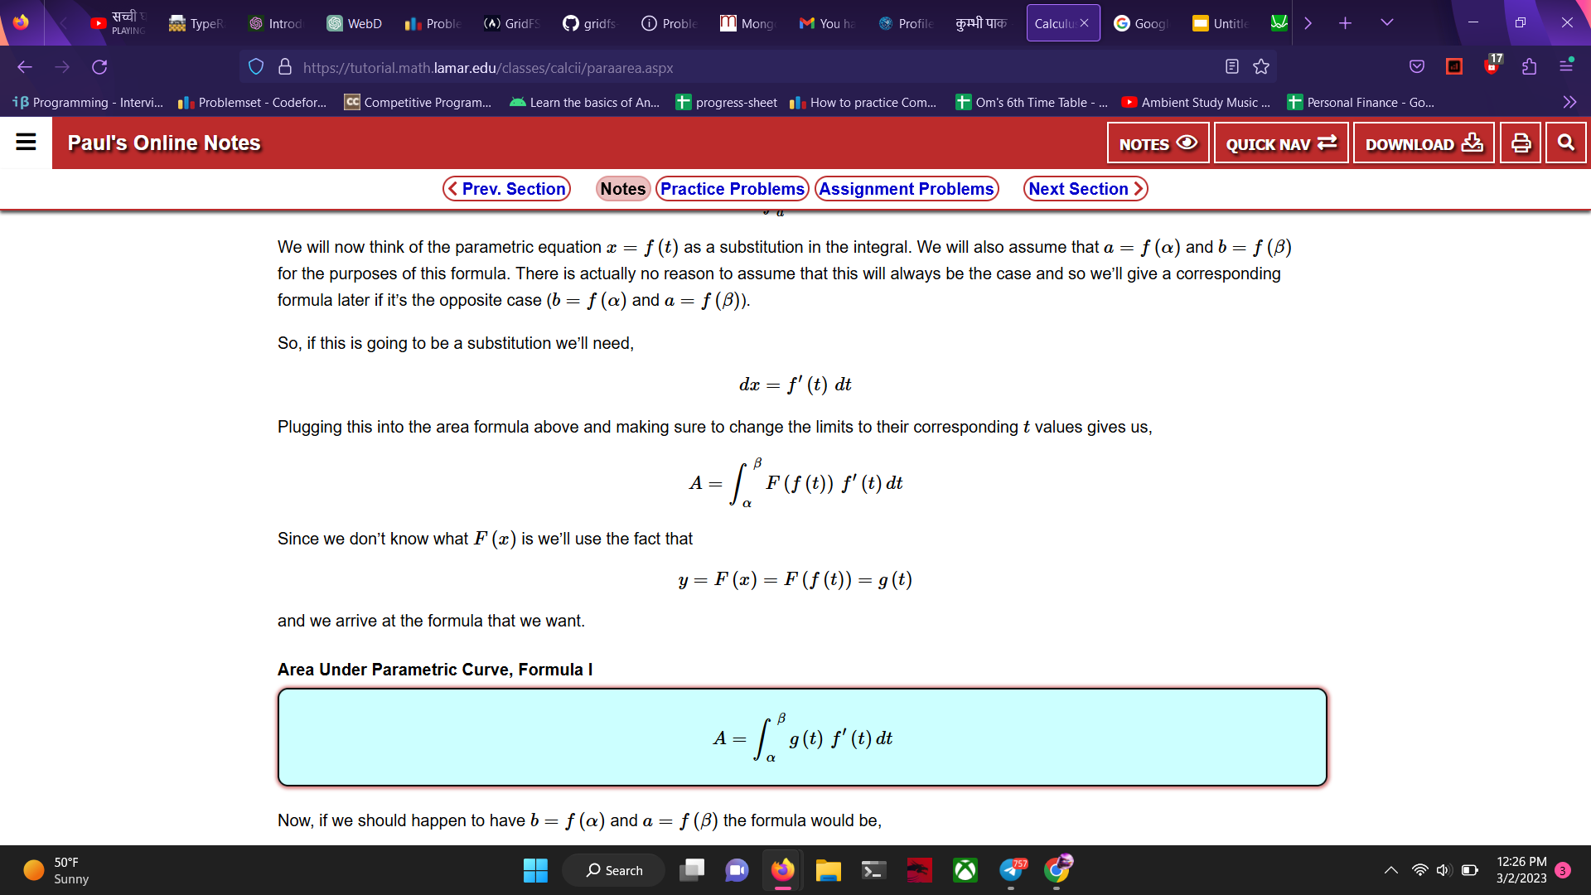
The Derivation
Photo by Pixabay

Slide 7
The Formula
Photo by Pixabay

Slide 8
Assumptions
- Curve is traced out exactly once as t increases from α to β.
- dx=f′(t)dt.
Photo by Pixabay

Slide 9
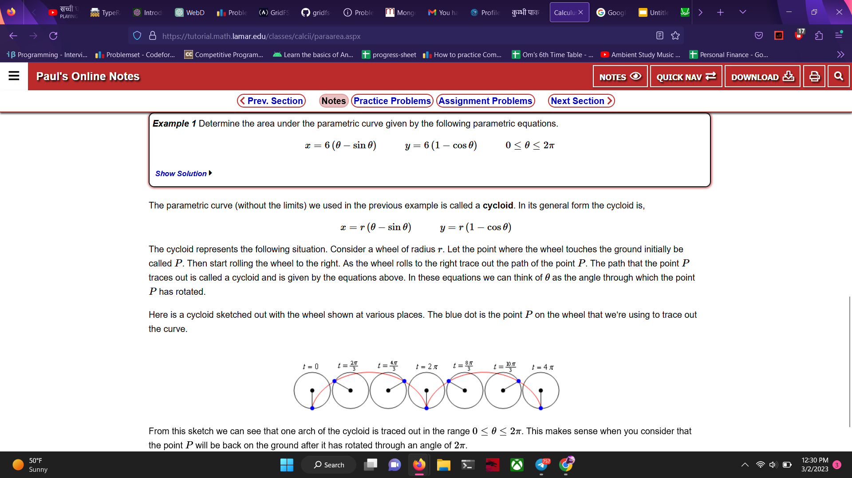
A Problem
Photo by Pixabay

Slide 10
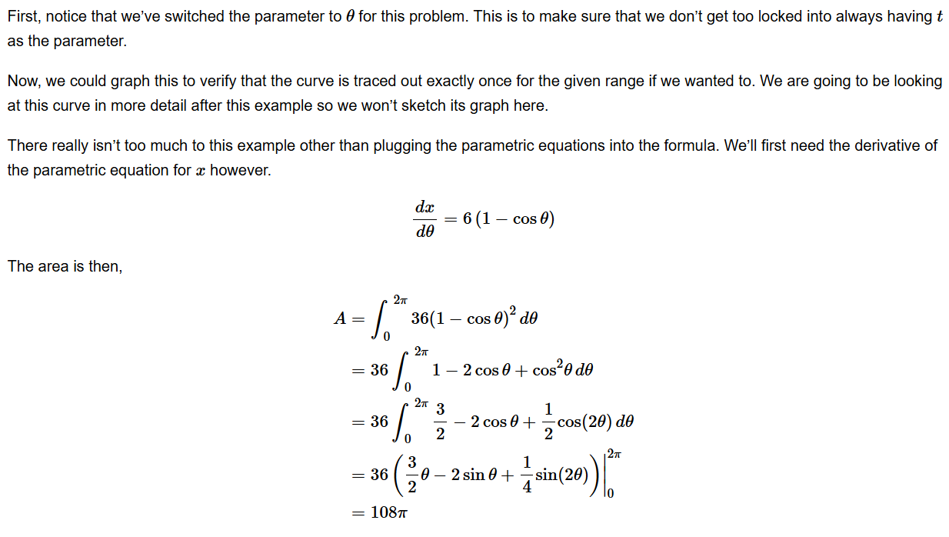
Solution
Photo by Pixabay

Slide 11
Cycloid Example
- x=r(θ−sinθ)y=r(1−cosθ)
Photo by Pixabay

Slide 12
KINGS, QUEENS & OTHER RULES

Slide 13
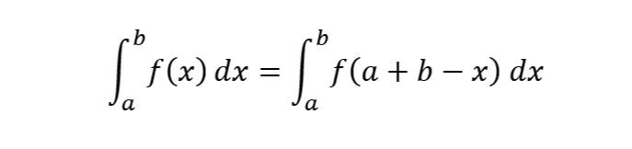
King’s Rule of Definite Integration gives

Slide 14
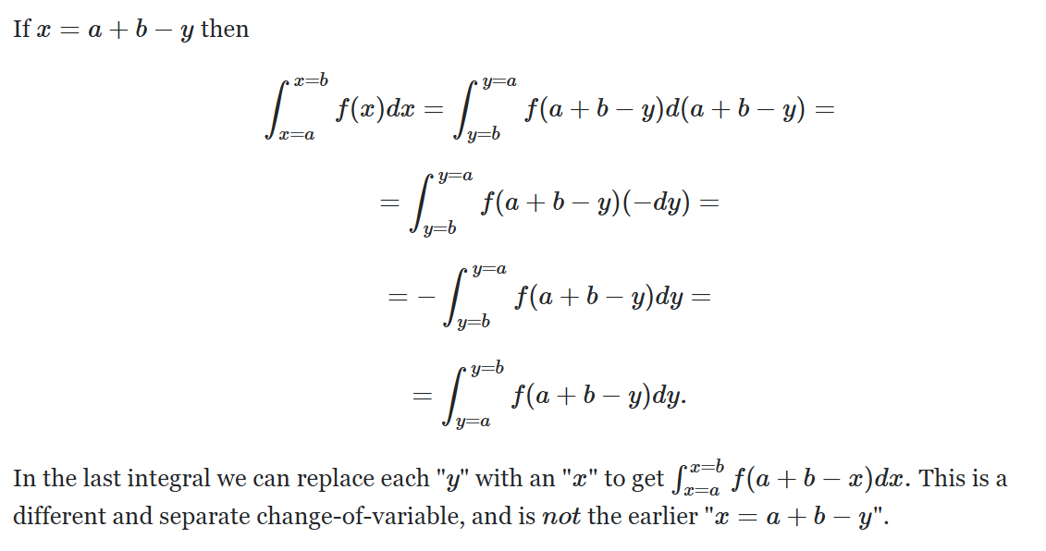

Slide 15
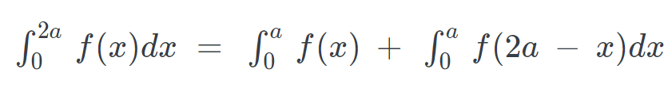
Queen’s Property of Definite Integration gives:

Slide 16
Queen’s Property of Definite Integration gives:

Slide 17
The Derivation
Photo by Pixabay

Slide 18
Thank you. Please feel free to ask any questions. 😄

