Slide 1
An example of User Study
Version 7

Slide 2
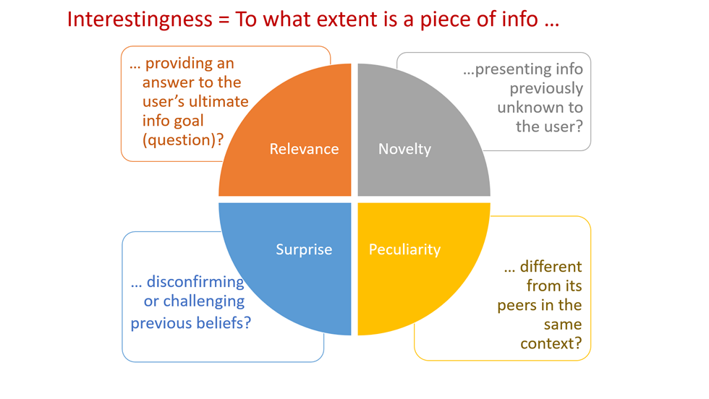
How do we define “interesting”?
We consider that a cube is interesting when it is of high Relevance, Novelty, Surprise or Peculiarity

Slide 3
The dataset that we use
Adult dataset from the UC Irvine Machine learning repository with a fact table of 30.162 tuples
Attribute
Distinct Value
Age
72
Gender
2
Quasi-identifiers
Race
2
Marital Status
7
Education
16
Native country
41
Work Class
7
Sensitive attribute
Occupation
14
Hours per week
94
Salary
2

Slide 4
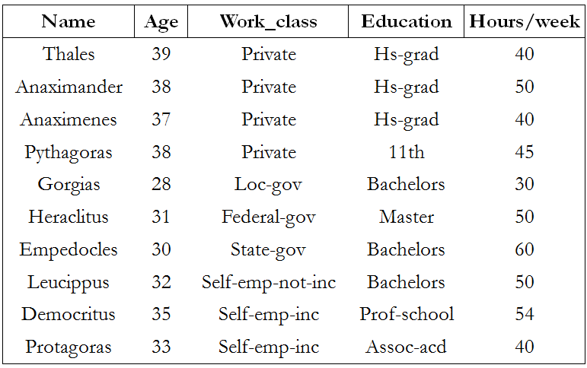
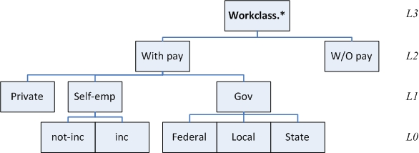
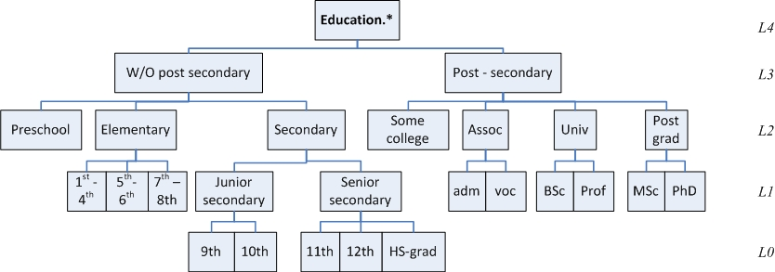

Slide 5
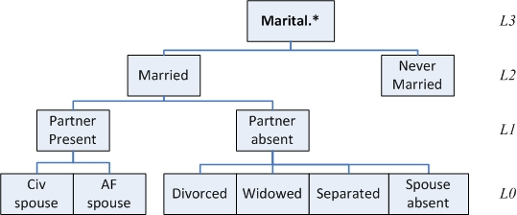
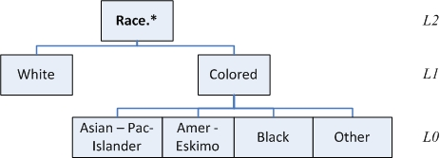
Dimensions with their level hierarchies

Slide 6
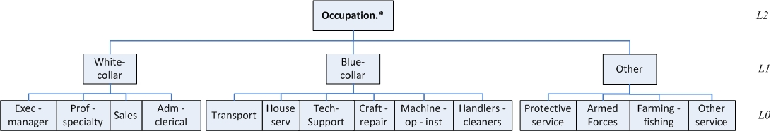
Dimensions with their level hierarchies

Slide 7
Session 1: The story
Discover the categories of working people with the significantly higher and lower average working hours per week.
Dimensions: education, occupation, work class, age
First, we present some initial/warmup cubes for the understanding of the context of the session.

Slide 8
Warmup Query 1 Schema: [education.lvl2, occupation.lvl1], [Avg(hours_per_week)] σ = work_class.lvl2=‘With-Pay’, age.lvl3 = ‘17-36’ | Warmup Query 2 Schema: [work_class.lvl1, occupation.lvl1], [Avg(hours_per_week)] σ = work_class.lvl2=‘With-Pay’, education.lvl3=‘Post-Secondary’
Warmup Query 3 Schema: [work_class.lvl1, age.lvl2], [Avg(hours_per_week)] σ = work_class.lvl2=‘With-Pay’, education.lvl2=‘Post-grad’ | Warmup Query 4 Schema: [education.lvl2, age.lvl3], [Avg(hours_per_week)] σ = work_class.lvl2=‘With-Pay’, occupation.lvl1=‘white-collar’
Warmup Query 1 | Occupation.lvl1
Education.lvl2 | Blue-collar | Other | white-collar
Preschool | 38.00 | 37.79 | 25.00
Elementary | 39.73 | 42.65 | 39.90
Secondary | 41.23 | 35.76 | 37.94
Some-college | 40.07 | 34.14 | 36.27
Assoc | 41.61 | 42.21 | 40.71
University | 40.86 | 41.00 | 42.74
Post-grad | 35.15 | 46.45 | 44.19
Warmup Query 2 | Occupation.lvl1
Work_class.lvl1 | Blue-collar | Other | white-collar
Gov | 39.11 | 42.23 | 41.19
Private | 41.33 | 35.52 | 41.81
Self-emp | 43.75 | 50.03 | 46.32
Warmup Query 4 | Age.lvl3
Education.lvl2 | 17-36 | 37-56 | 57-76 | 77-96
Preschool | 25.00 | 40.00 | 30.00
Elementary | 39.90 | 44.60 | 34.07 | 22.50
Secondary | 37.94 | 42.37 | 36.56 | 24.11
Some-college | 36.27 | 43.35 | 37.63 | 27.73
Assoc | 40.71 | 42.44 | 39.43 | 18.00
University | 42.74 | 45.62 | 40.44 | 33.88
Post-grad | 44.19 | 46.11 | 42.73 | 37.91
Warmup Query 3 | Age.lvl2
Work_class.lvl1 | 17-26 | 27-36 | 37-46 | 47-56 | 57-66 | 67-76 | 77-86 | 87-96
Gov | 37.81 | 42.62 | 43.59 | 46.07 | 41.63 | 35.87 | 23.00 | 60.00
Private | 40.14 | 45.60 | 45.35 | 46.22 | 45.40 | 39.52 | 36.83 | 43.33
Self-emp | 50.00 | 43.53 | 51.22 | 49.71 | 42.11 | 31.72 | 40.00

Slide 9
And then….
In each slide, we give four cubes for the user to order them based on how interesting they are for him/her.
For us, each cube is more novel/peculiar/surprising or relevant than the rest.
In this way, we evaluate which dimension of Interestingness is the most used or favored by the user preferences and his ranking order

Slide 10
The user’s task
Please Rank the queries of each slide from 1 to 4, where 1 is the most interesting and 4 the least interesting

Slide 11
Query 11 Schema: [work_class.lvl1, occupation.lvl1], [Avg(hours_per_week)] σ = work_class.lvl2=‘With-Pay’, education.lvl2=‘University’ | Query 12 Schema: [education.lvl2, occupation.lvl1], [Avg(hours_per_week)] σ = work_class.lvl2=‘With-Pay’, age.lvl3=’37-56’
Query 13 Schema: [education.lvl1, occupation.lvl0], [Avg(hours_per_week)] σ = education.lvl2=‘Post-grad’, work_class.lvl2=‘With-Pay’, occupation.lvl1=‘Other’ | Query 14 Schema: [education.lvl3, occupation.lvl1], [Avg(hours_per_week)] σ = work_class.lvl2=‘Without-Pay’, education.lvl3=‘Post-Secondary’, age.lvl3=‘17-36’
Query 12 | Occupation.lvl1
Education.lvl2 | Blue-collar | Other | white-collar
Preschool | 40.56 | 36.50 | 40.00
Elementary | 40.91 | 40.35 | 44.60
Secondary | 42.57 | 40.90 | 42.37
Some-college | 43.43 | 44.17 | 43.35
Assoc | 42.39 | 42.98 | 42.44
University | 42.40 | 45.40 | 45.62
Post-grad | 42.13 | 51.00 | 46.11
Query 11 | Occupation.lvl1
Work_class.lvl1 | Blue-collar | Other | white-collar
Gov | 39.24 | 45.30 | 42.01
Private | 40.99 | 38.56 | 43.71
Self-emp | 45.91 | 49.15 | 46.46
 | 11 | 12 | 13 | 14
Novelty | 0.0 | 0.13 | 0.0 | 1.0
Relevance | 1.0 | 0.87 | 1.0 | 0.0
Peculiarity | 0.59 | 0.64 | 0.97 | 0.81
Surprise | -1.0 | 0.29 | -1.0 | -1.0
Query 13 | Occupation.lvl0
Education.lvl1 | Armed-Forces | Farming-fishing | Other-service | Protective-serv
Masters | 40.00 | 66.60 | 37.11 | 41.80
Doctorate |  | 40.00
Query 14 | Occupation.lvl1
Education.lvl3 | Blue-collar | Other | white-collar
Post-Secondary |  | 65.00

Slide 12
Query 21 Schema: [work_class.lvl1, occupation.lvl1], [Avg(hours_per_week)] σ = work_class.lvl2=‘With-Pay’, education.lvl3=‘Post-Secondary’, age.lvl3=‘37-56’ | Query 22 Schema: [work_class.lvl0, age.lvl1], [Avg(hours_per_week)] σ = work_class.lvl1=‘Self-emp’, education.lvl2=‘Post-grad’, age.lvl2=’47-56’
Query 23 Schema: [occupation.lvl1, age.lvl1], [Avg(hours_per_week)] σ = work_class.lvl2=‘Without-Pay’, age.lvl3=’17-36’ | Query 24 Schema: [education.lvl2, occupation.lvl1], [Avg(hours_per_week)] σ = work_class.lvl1=‘Gov’, education.lvl3='Post-Secondary'
Query 21 | Occupation.lvl1
Work_class.lvl1 | Blue-collar | Other | white-collar
Gov | 41.08 | 43.37 | 42.84
Private | 42.93 | 40.77 | 44.49
Self-emp | 44.85 | 53.90 | 48.68
Query 22 | Age.lvl1
Work_class.lvl0 | 47-51 | 52-56
Self-emp-inc | 51.20 | 55.00
Self-emp-not-inc | 48.07 | 46.64
 | 21 | 22 | 23 | 24
Novelty | 0.0 | 0.0 | 0.8 | 0.0
Relevance | 1.0 | 0.1 | 0.2 | 1.0
Peculiarity | 0.35 | 0.94 | 0.75 | 0.72
Surprise | -1.0 | -1.0 | -1.0 | 0.39
Query 24 | Occupation.lvl1
Education.lvl2 | Blue-collar | Other | white-collar
Some-college | 38.85 | 40.93 | 36.99
Assoc | 40.31 | 42.48 | 40.02
University | 39.24 | 45.30 | 42.01
Post-grad | 34.00 | 43.92 | 43.73
Query 23 | Age.lvl1
Occupation.lvl1 | 17-21 | 22-26 | 27-31
Blue-collar | 40.00 | 40.00
Other | 15.00 |  | 65.00

Slide 13
Query 31 Schema: [education.lvl1, age.lvl1], [Avg(hours_per_week)] σ = education.lvl2=‘Post-grad’, age.lvl2=’47-56’, occupation.lvl1=‘white-collar’ | Query 32 Schema: [education.lvl2, age.lvl3], [Avg(hours_per_week)] σ = work_class.lvl2=’Without-Pay’
Query 33 Schema: [education.lvl2, age.lvl2], [Avg(hours_per_week)] σ = work_class.lvl2=‘With-Pay’, age.lvl3=’37-56’, occupation=‘Blue-collar’ | Query 34 Schema: [education.lvl2, occupation.lvl1], [Avg(hours_per_week)] σ = education.lvl3=‘Without-Post-Secondary‘, age.lvl3=’37-56’
Query 32 | Age.lvl3
Education.lvl2 | 17-36 | 37-56 | 57-76
Elementary |  |  | 50.00
Secondary | 27.50 | 27.50 | 29.00
Some-college | 65.00 |  | 20.50
Assoc |  |  | 50.00
Query 31 | Age.lvl1
Education.lvl1 | 47-51 | 52-56
Masters | 45.95 | 46.15
Doctorate | 49.97 | 49.15
 | 31 | 32 | 33 | 34
Novelty | 0.0 | 0.64 | 0.0 | 0.0
Relevance | 1.0 | 0.36 | 1.0 | 1.0
Peculiarity | 0.77 | 0.69 | 0.68 | 0.46
Surprise | -1.0 | -1.0 | -1.0 | 0.3
Query 33 | Age.lvl2
Education.lvl2 | 37-46 | 47-56
Preschool | 42.00 | 38.75
Elementary | 40.23 | 41.34
Secondary | 42.54 | 42.63
Some-college | 43.79 | 42.67
Assoc | 42.59 | 41.89
University | 42.21 | 42.85
Post-grad | 41.15 | 43.47
Query 34 | Occupation.lvl1
Education.lvl2 | Blue-collar | Other | white-collar
Preschool | 40.56 | 36.50 | 40.00
Elementary | 40.91 | 40.35 | 44.60
Secondary | 42.57 | 40.90 | 42.36

Slide 14
Session 2: The story
Discover the categories of working people with the significantly higher and lower average working hours per week.
Dimensions: occupation, education, race, native country
First, we present some initial/warmup cubes for the understanding of the context of the session.

Slide 15
Warmup Query 1 Schema: [education.lvl2, native_country.lvl2], [Avg(hours_per_week)] σ = occupation.lvl1=‘white-collar’, education.lvl3=‘Post-Secondary’ | Warmup Query 2 Schema: [education.lvl2, race.lvl1], [Avg(hours_per_week)] σ = education.lvl3=‘Post-Secondary’, native_country.lvl1=‘USA’
Warmup Query 3 Schema: [occupation.lvl0, race.lvl0], [Avg(hours_per_week)] σ = race.lvl1=‘Colored’, education.lvl3=‘Post-Secondary’ | Warmup Query 4 Schema: [native_country.lvl2, race.lvl1], [Avg(hours_per_week)] σ = education.lvl3=‘Post-Secondary’, occupation.lvl1=‘white-collar’
Warmup Query 1 | Native_country.lvl2
Education.lvl2 | Asia | Europe | Middle-America | North-America | South-America
Some-college | 38.86 | 38.83 | 36.67 | 39.09 | 38.82
Assoc | 41.76 | 41.57 | 45.80 | 41.34 | 40.76
University | 43.36 | 43.50 | 42.00 | 43.89 | 40.11
Post-grad | 41.51 | 46.11 | 49.38 | 45.37 | 42.35
Warmup Query 2 | Race.lvl1
Education.lvl2 | Colored | White
Some-college | 38.52 | 39.57
Assoc | 40.10 | 41.88
University | 41.66 | 43.67
Post-grad | 42.02 | 45.37
Warmup Query 3 | Race.lvl0
Occupation.lvl0 | Amer-Indian-Eskimo | Asian-Pac-Islander | Black | Other
Adm-clerical | 37.65 | 37.37 | 37.84 | 34.50
Armed-Forces |  |  | 60.00
Craft-repair | 44.41 | 40.36 | 41.51 | 41.40
Exec-managerial | 39.71 | 45.39 | 43.31 | 36.13
Farming-fishing | 57.50 | 40.00 | 40.67 | 50.00
Handlers-cleaners | 49.75 | 40.50 | 37.85 | 30.00
Machine-op-inspct | 38.75 | 42.93 | 40.62 | 36.67
Other-service | 40.00 | 39.18 | 36.35 | 37.22
Priv-house-serv |  |  | 20.00
Prof-specialty | 42.92 | 40.19 | 39.38 | 44.43
Protective-serv | 40.00 | 35.50 | 43.03 | 41.00
Sales | 44.86 | 42.49 | 37.75 | 41.09
Tech-support | 35.00 | 38.23 | 39.15 | 43.33
Transport-moving | 43.33 | 40.00 | 42.20 | 56.67
Warmup Query 4 | Race.lvl1
Native_country.lvl2 | Colored | White
Asia | 41.64 | 43.94
Europe | 40.89 | 42.95
Middle-America | 42.20 | 40.15
North-America | 39.73 | 42.60
South-America | 38.14 | 41.10

Slide 16
And then….
In each slide, we give four cubes for the user to order them based on how interesting they are for him/her.
For us, each cube is more novel/peculiar/surprising or relevant than the rest.
In this way, we evaluate which dimension of Interestingness is the most used or favored by the user preferences and his ranking order

Slide 17
The user’s task
Please Rank the queries of each slide from 1 to 4, where 1 is the most interesting and 4 the least interesting

Slide 18
Query 11 Schema: [education.lvl1, native_country.lvl2], [Avg(hours_per_week)] σ = occupation.lvl1=‘blue-collar’, education.lvl3=‘Post-Secondary’ | Query 12 Schema: [education.lvl2, native_country.lvl1], [Avg(hours_per_week)] σ = education.lvl3=‘Without-Post-Secondary’, occupation.lvl1=‘white-collar’, native_country.lvl2=‘North-America’
Query 13 Schema: [education.lvl1, native_country.lvl2], [Avg(hours_per_week)] σ = education.lvl2=‘University’, occupation.lvl1=‘white-collar’ | Query 14 Schema: [education.lvl1, native_country.lvl2], [Avg(hours_per_week)] σ = education.lvl2=‘Post-grad’, race.lvl1=‘Colored’
Query 11 | Native_country.lvl2
Education.lvl1 | Asia | Europe | Middle-America | North-America | South-America
Some-college | 40.48 | 44.15 | 39.12 | 41.29 | 38.76
Assoc | 43.14 | 41.50 | 39.29 | 41.95 | 34.22
University | 42.79 | 40.44 | 43.71 | 41.34 | 40.00
Post-grad | 34.22 | 40.00 | 41.25 | 39.34 | 40.00
Query 21 | Native_country.lvl1
Education.lvl2 | Canada | USA
Preschool |  | 32.50
Elementary |  | 40.46
Secondary | 41.00 | 39.38
 | 11 | 12 | 13 | 14
Novelty | 0.05 | 0.3 | 0.0 | 0.0
Relevance | 0.95 | 0.7 | 1.0 | 0.1
Peculiarity | 0.77 | 0.8 | 0.5 | 0.89
Surprise | 0.43 | -1.0 | -1.0 | 0.25
Query 13 | Native_country.lvl2
Education.lvl1 | Asia | Europe | Middle-America | North-America | South-America
Bachelors | 42.44 | 43.14 | 41.05 | 43.34 | 39.13
Prof-school | 47.84 | 46.56 | 52.50 | 48.36 | 48.00
Query 14 | Native_country.lvl2
Education.lvl1 | Asia | Middle-America | North-America | South-America
Masters | 39.30 | 40.00 | 41.51 | 40.00
Doctorate | 44.19 |  | 46.80 | 35.00

Slide 19
Query 21 Schema: [occupation.lvl1, race.lvl0], [Avg(hours_per_week)] σ = race.lvl1=‘White’, education.lvl3=‘Post-Secondary’, native_country.lvl2=‘North-America’ | Query 22 Schema: [occupation.lvl1, race.lvl0], [Avg(hours_per_week)] σ = education.lvl3=‘Without-Post-Secondary’, race.lvl1=‘Colored’, native_country.lvl2=‘North-America’
Query 23 Schema: [occupation.lvl0, race.lvl1], [Avg(hours_per_week)] σ = education.lvl2=‘Post-grad’, occupation.lvl1=‘blue-collar’ | Query 24 Schema: [occupation.lvl0, race.lvl0], [Avg(hours_per_week)] σ = native_country.lvl2=‘North-America’, occupation.lvl1 = ‘white-collar’
Query 21 | Race.lvl0
Occupation.lvl1 | White
Blue-collar | 41.50
Other | 39.28
white-collar | 42.60
Query 22 | Race.lvl0
Occupation.lvl1 | Amer-Indian-Eskimo | Asian-Pac-Islander | Black | Other
Blue-collar | 40.66 | 42.59 | 39.37 | 38.68
Other | 36.97 | 38.00 | 35.61 | 36.29
white-collar | 39.40 | 38.29 | 38.38 | 38.94
 | 21 | 22 | 23 | 24
Novelty | 0.0 | 0.59 | 0.0 | 0.0
Relevance | 1.0 | 0.41 | 1.0 | 1.0
Peculiarity | 0.23 | 0.87 | 0.95 | 0.31
Surprise | -1.0 | -1.0 | -1.0 | 0.37
Query 23 | Race.lvl1
Occupation.lvl0 | Colored | White
Craft-repair | 38.33 | 44.70
Handlers-cleaners |  | 33.60
Machine-op-inspct | 42.00 | 37.25
Tech-support | 35.38 | 37.00
Transport-moving | 40.00 | 39.13
Query 24 | Race.lvl0
Occupation.lvl0 | Amer-Indian-Eskimo | Asian-Pac-Islander | Black | Other | White
Adm-clerical | 37.86 | 35.72 | 38.32 | 38.11 | 37.52
Exec-managerial | 41.77 | 43.92 | 43.99 | 40.00 | 45.02
Prof-specialty | 41.88 | 40.05 | 39.03 | 43.39 | 42.74
Sales | 40.76 | 40.86 | 36.25 | 39.30 | 41.09

Slide 20
Query 31 Schema: [native_country.lvl2, race.lvl0], [Avg(hours_per_week)] σ = occupation.lvl1=‘Blue-collar’, education.lvl3=‘Without-Post-Secondary’, race.lvl1=‘Colored’ | Query 32 Schema: [native_country.lvl2, race.lvl0], [Avg(hours_per_week)] σ = education.lvl3=‘Post-Secondary’, occupation.lv1=‘white-collar’, race.lvl1=‘Colored’
Query 33 Schema: [native_country.lvl0, race.lvl1], [Avg(hours_per_week)] σ = education.lvl2=‘Post-grad’, native_country.lvl2=‘North-America’ | Query 34 Schema: [native_country.lvl2, race.lvl1], [Avg(hours_per_week)] σ = education.lvl3=‘Post-Secondary’, occupation.lvl1=‘Blue-collar’
Query 31 | Race.lvl0
Native_country.lvl2 | Amer-Indian-Eskimo | Asian-Pac-Islander | Black | Other
Asia | 35.00 | 40.74
Europe | 43.00 | 40.00 | 45.00
Middle-America | 40.00 |  |  | 39.83
North-America | 40.66 | 42.59 | 39.37 | 38.68
South-America | 56.00 | 60.00 | 40.13 | 40.72
Query 32 | Race.lvl0
Native_country.lvl2 | Amer-Indian-Eskimo | Asian-Pac-Islander | Black | Other
Asia | 40.00 | 41.61 | 45.00 | 42.14
Europe |  | 45.00 | 38.83
Middle-America |  | 25.00 | 36.00 | 57.00
North-America | 41.38 | 40.06 | 39.47 | 41.00
South-America |  | 14.00 | 40.00 | 33.50
 | 31 | 32 | 33 | 34
Novelty | 0.18 | 0.0 | 0.0 | 0.0
Relevance | 0.82 | 1.0 | 1.0 | 1.0
Peculiarity | 0.6 | 0.37 | 0.77 | 0.23
Surprise | -1.0 | -1.0 | -1.0 | 0.34
Query 34 | Race.lvl1
Native_country.lvl2 | Colored | White
Asia | 40.53 | 44.00
Europe | 40.00 | 42.35
Middle-America | 39.43 | 40.00
North-America | 40.61 | 41.50
South-America | 38.00 | 38.29
Query 33 | Race.lvl1
Native_country.lvl0 | Colored | White
Canada |  | 42.86
United-States | 42.02 | 45.37

