Slide 1
A user study on analyzing data with dimensions
June 2023

Slide 2
Introduction
Assume that in your country a census has been conducted. So, the ministry has collected a large data set, where for every person, we have knowledge of several attributes like their age, gender, country of origin, marital status, education, occupation, their work-class (whether they work for the state/private company/self-employed), as well as, salary and average number of hours they work every week.
You can see a glimpse of 3 rows of the dataset to get an idea of what is inside…
Age | Race | Gender | Country of origin | Education | WorkClass | Marital Status | Occupation | Weekly work hours | Salary
39 | White | Male | United-States | Bachelors | State-gov | Never-married | Adm-clerical | 40 | <=50K
50 | Asian-Pac-Islander | Male | India | Bachelors | Self-emp-not-inc | Married-civ-spouse | Exec-managerial | 13 | <=50K
38 | Amer-Indian-Eskimo | Female | Cuba | HS-grad | Private | Divorced | Handlers-cleaners | 40 | <=50K
… | … | … | … | … | … | … | … | … | …

Slide 3
Introduction
Now assume you are an analyst of the ministry of social welfare, and, you are given access to the dataset. The ministry has enriched the dataset with aggregation levels for every dimension of the data.
In the next slide, you can see the different dimensions of the data organized at different levels of detail. For example:
Occupation is broken into three subcategories: {white-collar, blue-collar, other}.
White-collar, in turn, is broken down into further subcategories, one level down the hierarchy: {exec-mgr, prof-specialty, sales, adm-clerical}
Attn: whenever you do not see a detailed value, this simply means that the more aggregate value is not broken down to several components. For example:
For Marital_status the value NeverMarried is repeated without further decomposition in levels L2, L1, L0

Slide 4
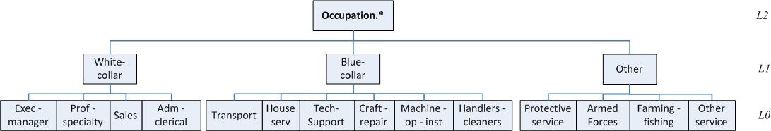
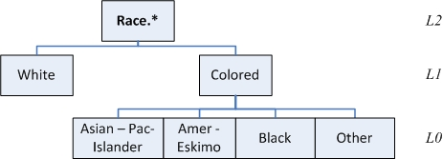
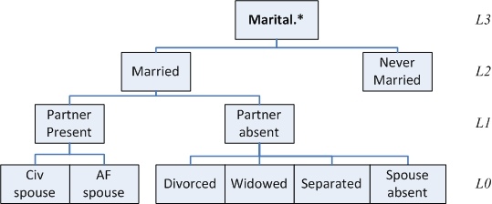
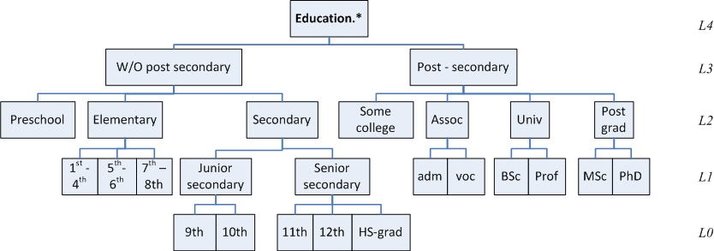
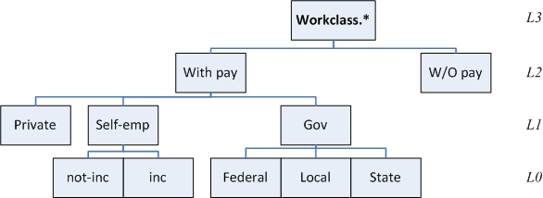
Dimensions of the data values at different levels of detail

Slide 5
Introduction
Now, assume your are an analyst of the ministry and you are involved in an task group to find which are the categories of working people with the significantly higher and lower average working hours per week, depending on their education, occupation, work class, age.
So, you are given some reports, prepared from the IT dept of the ministry with data that contribute towards this goal of understanding who works more and who works less.
In all that follows, you are the analyst who wants to find out which people work more and which ones work less
Be careful: this is just the context of the things that follow, and not what you will be asked to do – this will be given to you right next

Slide 6
Your task
First, you will be given a warm-up slide with 4 query results that give a broad description of how work hours are related to the various data dimensions.
Please spend 5’ – 10’ minutes to (a) study the data, and (b) write down in a free-form text, who do you think work the most and the least hours
Then, you will be given 3 data slides, each with 4 query results. For each of these 3 slides
Please rank the query results of the data slide with respect to how interesting they seem to you, in a scale from 1 to 4.
Give rank 1 to the most interesting and rank 4 to the less interesting.
Avoid ties and blanks: each query gets a number from 1 to 4
Write in the free-text form a short justification for your ranking: what made you believe that a certain query results deserves the rank it gave

Slide 7
Let’s start with the warm up
First, you will be given a warm-up slide with 4 query results that give a broad description of how work hours are related to the various data dimensions.
Please spend 5’ – 10’ minutes to (a) study the data, and (b) write down in a free-form text, who do you think work the most and the least hours

Slide 8
WARMUP
Warmup Query Result 1 Here, we see the average work hours of people in the age range 17-36, in the Work Class ‘With-Pay’, organized by education level and occupation | Warmup Query Result 2 Here, we see the average work hours of people with a ‘Post-Secondary’ Education, in the Work Class ‘With-Pay’, organized by occupation and work class subdivision
Warmup Query Result 3 Here, we see the average work hours of people with a ‘Post-grad’ Education, who also belong to the work-class ‘With-Pay’, organized by age range and detailed work-class | Warmup Query Result 4 Here, we see the average work hours of people in the Work Class ‘With-Pay’, with ‘White-collar’ Occupation organized by education and age range
Please give a short memo of who you think works more or less
Warmup Query 1 | Occupation.lvl1
Education.lvl2 | Blue-collar | Other | white-collar
Preschool | 38.00 | 37.79 | 25.00
Elementary | 39.73 | 42.65 | 39.90
Secondary | 41.23 | 35.76 | 37.94
Some-college | 40.07 | 34.14 | 36.27
Assoc | 41.61 | 42.21 | 40.71
University | 40.86 | 41.00 | 42.74
Post-grad | 35.15 | 46.45 | 44.19
Warmup Query 2 | Occupation.lvl1
Work_class.lvl1 | Blue-collar | Other | white-collar
Gov | 39.11 | 42.23 | 41.19
Private | 41.33 | 35.52 | 41.81
Self-emp | 43.75 | 50.03 | 46.32
Warmup Query 4 | Age.lvl3
Education.lvl2 | 17-36 | 37-56 | 57-76 | 77-96
Preschool | 25.00 | 40.00 | 30.00
Elementary | 39.90 | 44.60 | 34.07 | 22.50
Secondary | 37.94 | 42.37 | 36.56 | 24.11
Some-college | 36.27 | 43.35 | 37.63 | 27.73
Assoc | 40.71 | 42.44 | 39.43 | 18.00
University | 42.74 | 45.62 | 40.44 | 33.88
Post-grad | 44.19 | 46.11 | 42.73 | 37.91
Warmup Query 3 | Age.lvl2
Work_class.lvl1 | 17-26 | 27-36 | 37-46 | 47-56 | 57-66 | 67-76 | 77-86 | 87-96
Gov | 37.81 | 42.62 | 43.59 | 46.07 | 41.63 | 35.87 | 23.00 | 60.00
Private | 40.14 | 45.60 | 45.35 | 46.22 | 45.40 | 39.52 | 36.83 | 43.33
Self-emp | 50.00 | 43.53 | 51.22 | 49.71 | 42.11 | 31.72 | 40.00

Slide 9
Now to the ranking slides…
For each of the following 3 data slides
Please rank the 4 query results within the same data slide with respect to how interesting they seem to you, in a scale from 1 to 4.
Give rank 1 to the most interesting and rank 4 to the less interesting.
Avoid ties and blanks: each query gets a number from 1 to 4
Write in the free-text form a short justification for your ranking: what made you believe that a certain query results deserves the rank it gave

Slide 10
Query Result 11 Here, we see the average work hours of people with ‘University’ Education who also belong to Work Class ‘With-Pay’, organized by occupation and detailed work class | Query Result 12 Here, we see the average work hours of people with Age in ’37-56’ who also belong to Work Class ‘With-Pay’, organized by occupation and education
Query Result 13 Here, we see the average work hours of people with ‘Post-Grad’ Education who also belong to Work Class ‘With-Pay’ and their occupation is ‘Other’ (neither Blue or White collar), organized by occupation and education subdivision | Query Result 14 Here, we see the average work hours of people with Age in ’17-36’, who also belong to Work Class ‘Without-Pay’, and have a ‘Post-Secondary’ Education, organized by occupation and education
Plz. rank in the range 1 to 4, with 1 for the most interesting
Plz. rank in the range 1 to 4, with 1 for the most interesting
Query 12 | Occupation.lvl1
Education.lvl2 | Blue-collar | Other | white-collar
Preschool | 40.56 | 36.50 | 40.00
Elementary | 40.91 | 40.35 | 44.60
Secondary | 42.57 | 40.90 | 42.37
Some-college | 43.43 | 44.17 | 43.35
Assoc | 42.39 | 42.98 | 42.44
University | 42.40 | 45.40 | 45.62
Post-grad | 42.13 | 51.00 | 46.11
Query 11 | Occupation.lvl1
Work_class.lvl1 | Blue-collar | Other | white-collar
Gov | 39.24 | 45.30 | 42.01
Private | 40.99 | 38.56 | 43.71
Self-emp | 45.91 | 49.15 | 46.46
DATA SLIDE #1
Please give a short justification of your ranking
Query 14 | Occupation.lvl1
Education.lvl3 | Blue-collar | Other | white-collar
Post-Secondary |  | 65.00
Query 13 | Occupation.lvl0
Education.lvl1 | Armed-Forces | Farming-fishing | Other-service | Protective-serv
Masters | 40.00 | 66.60 | 37.11 | 41.80
Doctorate |  | 40.00
Plz. rank in the range 1 to 4, with 1 for the most interesting
Plz. rank in the range 1 to 4, with 1 for the most interesting

Slide 11
Query Result 21 Here, we see the average work hours of people in the age range ‘17-36’, with a ‘Post-Secondary’ Education who also belong to Work Class ‘With-Pay’, organized by occupation and detailed work class | Query Result 22 Here, we see the average work hours of people in the age range ‘47-56’, with a ‘Post-grad’ Education who also belong to Work Class ‘Self-emp’, organized by age range and detailed work class
Query Result 23 Here, we see the average work hours of people in the Age range ‘17-36’ who also Belong to Work Class ‘Without-Pay’, organized by occupation and age range subdivision | Query Result 24 Here, we see the average work hours of people with a ‘Post-Secondary’ Education who also belong to Work Class ‘Gov’, organized by occupation and education subdivision
Plz. rank in the range 1 to 4, with 1 for the most interesting
Plz. rank in the range 1 to 4, with 1 for the most interesting
Query 21 | Occupation.lvl1
Work_class.lvl1 | Blue-collar | Other | white-collar
Gov | 41.08 | 43.37 | 42.84
Private | 42.93 | 40.77 | 44.49
Self-emp | 44.85 | 53.90 | 48.68
DATA SLIDE #2
Please give a short justification of your ranking
Query 22 | Age.lvl1
Work_class.lvl0 | 47-51 | 52-56
Self-emp-inc | 51.20 | 55.00
Self-emp-not-inc | 48.07 | 46.64
Query 24 | Occupation.lvl1
Education.lvl2 | Blue-collar | Other | white-collar
Some-college | 38.85 | 40.93 | 36.99
Assoc | 40.31 | 42.48 | 40.02
University | 39.24 | 45.30 | 42.01
Post-grad | 34.00 | 43.92 | 43.73
Query 23 | Age.lvl1
Occupation.lvl1 | 17-21 | 22-26 | 27-31
Blue-collar | 40.00 | 40.00
Other | 15.00 |  | 65.00
Plz. rank in the range 1 to 4, with 1 for the most interesting
Plz. rank in the range 1 to 4, with 1 for the most interesting

Slide 12
Query Result 31 Here, we see the average work hours of people in the Age range ‘47-56’, with a ‘Post-grad’ Education and Occupation of ‘White-collar’, organized by age and education subdivision | Query Result 32 Here, we see the average work hours of people who belong to Work Class ‘Without-Pay’, organized by age range and education subdivision
Query Result 33 Here, we see the average work hours of people in the Age range ’37-56’ who also belong to Work Class ‘With-Pay’ and Occupation of ‘Blue-collar’, organized by education and age range subdivision | Query Result 34 Here, we see the average work hours of people ‘Without-Post-Secondary’ Education in the Age range ‘37-56’, organized by occupation and education subdivision
Plz. rank in the range 1 to 4, with 1 for the most interesting
Plz. rank in the range 1 to 4, with 1 for the most interesting
Query 32 | Age.lvl3
Education.lvl2 | 17-36 | 37-56 | 57-76
Elementary |  |  | 50.00
Secondary | 27.50 | 27.50 | 29.00
Some-college | 65.00 |  | 20.50
Assoc |  |  | 50.00
Query 31 | Age.lvl1
Education.lvl1 | 47-51 | 52-56
Masters | 45.95 | 46.15
Doctorate | 49.97 | 49.15
DATA SLIDE #3
Please give a short justification of your ranking
Query 33 | Age.lvl2
Education.lvl2 | 37-46 | 47-56
Preschool | 42.00 | 38.75
Elementary | 40.23 | 41.34
Secondary | 42.54 | 42.63
Some-college | 43.79 | 42.67
Assoc | 42.59 | 41.89
University | 42.21 | 42.85
Post-grad | 41.15 | 43.47
Query 34 | Occupation.lvl1
Education.lvl2 | Blue-collar | Other | white-collar
Preschool | 40.56 | 36.50 | 40.00
Elementary | 40.91 | 40.35 | 44.60
Secondary | 42.57 | 40.90 | 42.36
Plz. rank in the range 1 to 4, with 1 for the most interesting
Plz. rank in the range 1 to 4, with 1 for the most interesting

