Slide 1
A user study on analyzing data with dimensions
June 2023

Slide 2
Introduction
Assume that in your country a census has been conducted. So, the ministry has collected a large data set, where for every person, we have knowledge of several attributes like their age, gender, country of origin, marital status, education, occupation, their work-class (whether they work for the state/private company/self-employed), as well as, salary and average number of hours they work every week.
You can see a glimpse of 3 rows of the dataset to get an idea of what is inside…
Age | Race | Gender | Country of origin | Education | WorkClass | Marital Status | Occupation | Weekly work hours | Salary
39 | White | Male | United-States | Bachelors | State-gov | Never-married | Adm-clerical | 40 | <=50K
50 | Asian-Pac-Islander | Male | India | Bachelors | Self-emp-not-inc | Married-civ-spouse | Exec-managerial | 13 | <=50K
38 | Amer-Indian-Eskimo | Female | Cuba | HS-grad | Private | Divorced | Handlers-cleaners | 40 | <=50K
… | … | … | … | … | … | … | … | … | …

Slide 3
Introduction
Now assume you are an analyst of the ministry of social welfare, and, you are given access to the dataset. The ministry has enriched the dataset with aggregation levels for every dimension of the data.
In the next slide, you can see the different dimensions of the data organized at different levels of detail. For example:
Occupation is broken into three subcategories: {white-collar, blue-collar, other}.
White-collar, in turn, is broken down into further subcategories, one level down the hierarchy: {exec-mgr, prof-specialty, sales, adm-clerical}
Attn: whenever you do not see a detailed value, this simply means that the more aggregate value is not broken down to several components. For example:
For Marital_status the value NeverMarried is repeated without further decomposition in levels L2, L1, L0

Slide 4
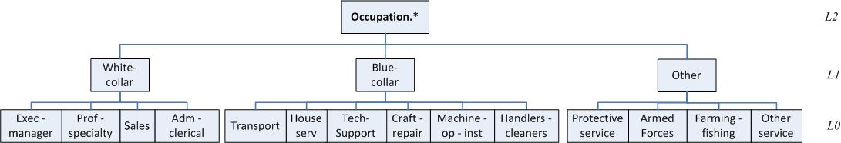
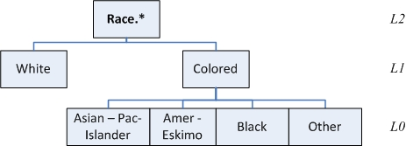
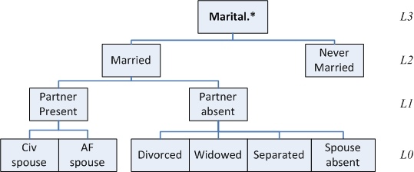
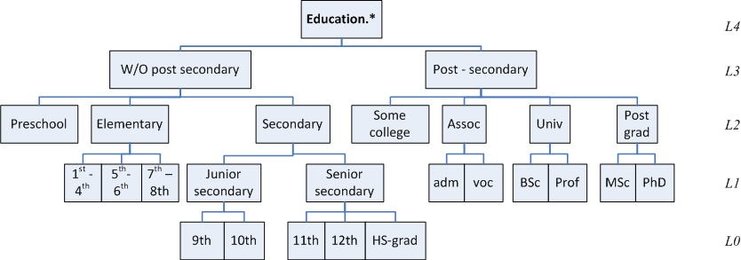
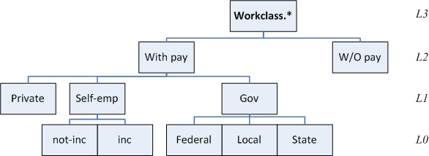
Dimensions of the data values at different levels of detail

Slide 5
Introduction
Now, assume your are an analyst of the ministry and you are involved in an task group to find which are the categories of working people with the significantly higher and lower average working hours per week, depending on their education, occupation, race, native country.
So, you are given some reports, prepared from the IT dept of the ministry with data that contribute towards this goal of understanding who works more and who works less.
In all that follows, you are the analyst who wants to find out which people work more and which ones work less
Be careful: this is just the context of the things that follow, and not what you will be asked to do – this will be given to you right next

Slide 6
Your task
First, you will be given a warm-up slide with 4 query results that give a broad description of how work hours are related to the various data dimensions.
Please spend 5’ – 10’ minutes to (a) study the data, and (b) write down in a free-form text, who do you think work the most and the least hours
Then, you will be given 3 data slides, each with 4 query results. For each of these 3 slides
Please rank the query results of the data slide with respect to how interesting they seem to you, in a scale from 1 to 4.
Give rank 1 to the most interesting and rank 4 to the less interesting.
Avoid ties and blanks: each query gets a number from 1 to 4
Write in the free-text form a short justification for your ranking: what made you believe that a certain query results deserves the rank it gave

Slide 7
Let’s start with the warm up
First, you will be given a warm-up slide with 4 query results that give a broad description of how work hours are related to the various data dimensions.
Please spend 5’ – 10’ minutes to (a) study the data, and (b) write down in a free-form text, who do you think work the most and the least hours

Slide 8
WARMUP
Warmup Query Result 1 Here, we see the average work hours of people with a ‘Post-Secondary’ Education and Occupation of ‘White-collar’, organized by native country and education subdivision | Warmup Query Result 2 Here, we see the average work hours of people with a ‘Post-Secondary’ Education, that also have ‘USA’ as Native Country, organized by race and education subdivision
Warmup Query Result 3 Here, we see the average work hours of ‘Colored’ people with a ‘Post-Secondary’ Education, organized by detailed occupation and race | Warmup Query Result 4 Here, we see the average work hours of people with a ’Post-Secondary’ Education, with ‘White-Collar’ Occupation organized by native country and race
Warmup Query 1 | Native_country.lvl2
Education.lvl2 | Asia | Europe | Middle-America | North-America | South-America
Some-college | 38.86 | 38.83 | 36.67 | 39.09 | 38.82
Assoc | 41.76 | 41.57 | 45.80 | 41.34 | 40.76
University | 43.36 | 43.50 | 42.00 | 43.89 | 40.11
Post-grad | 41.51 | 46.11 | 49.38 | 45.37 | 42.35
Warmup Query 2 | Race.lvl1
Education.lvl2 | Colored | White
Some-college | 38.52 | 39.57
Assoc | 40.10 | 41.88
University | 41.66 | 43.67
Post-grad | 42.02 | 45.37
Please give a short memo of who you think works more or less
Warmup Query 3 | Race.lvl0
Occupation.lvl0 | Amer-Indian-Eskimo | Asian-Pac-Islander | Black | Other
Adm-clerical | 37.65 | 37.37 | 37.84 | 34.50
Armed-Forces |  |  | 60.00
Craft-repair | 44.41 | 40.36 | 41.51 | 41.40
Exec-managerial | 39.71 | 45.39 | 43.31 | 36.13
Farming-fishing | 57.50 | 40.00 | 40.67 | 50.00
Handlers-cleaners | 49.75 | 40.50 | 37.85 | 30.00
Machine-op-inspct | 38.75 | 42.93 | 40.62 | 36.67
Other-service | 40.00 | 39.18 | 36.35 | 37.22
Priv-house-serv |  |  | 20.00
Prof-specialty | 42.92 | 40.19 | 39.38 | 44.43
Protective-serv | 40.00 | 35.50 | 43.03 | 41.00
Sales | 44.86 | 42.49 | 37.75 | 41.09
Tech-support | 35.00 | 38.23 | 39.15 | 43.33
Transport-moving | 43.33 | 40.00 | 42.20 | 56.67
Warmup Query 4 | Race.lvl1
Native_country.lvl2 | Colored | White
Asia | 41.64 | 43.94
Europe | 40.89 | 42.95
Middle-America | 42.20 | 40.15
North-America | 39.73 | 42.60
South-America | 38.14 | 41.10

Slide 9
Now to the ranking slides…
For each of the following 3 data slides
Please rank the 4 query results within the same data slide with respect to how interesting they seem to you, in a scale from 1 to 4.
Give rank 1 to the most interesting and rank 4 to the less interesting.
Avoid ties and blanks: each query gets a number from 1 to 4
Write in the free-text form a short justification for your ranking: what made you believe that a certain query results deserves the rank it gave

Slide 10
Query Result 11 Here, we see the average work hours of people with a ‘Post-Secondary’ Education and Occupation of ‘Blue-collar’, organized by native country and education subdivision | Query Result 12 Here, we see the average work hours of people ‘Without-Post-Secondary’ Education, with Occupation of ‘White-collar’ and a country of ‘North America’ as Native Country, organized by native country and education subdivisions
Query Result 13 Here, we see the average work hours of people with a ‘University’ Education and Occupation of ‘White-collar’, organized by native country and education subdivision | Query Result 14 Here, we see the average work hours of ‘Colored’ people with a ‘Post-grad’ Education, organized by native country and education subdivision
Plz. rank in the range 1 to 4, with 1 for the most interesting
Plz. rank in the range 1 to 4, with 1 for the most interesting
Query 11 | Native_country.lvl2
Education.lvl1 | Asia | Europe | Middle-America | North-America | South-America
Some-college | 40.48 | 44.15 | 39.12 | 41.29 | 38.76
Assoc | 43.14 | 41.50 | 39.29 | 41.95 | 34.22
University | 42.79 | 40.44 | 43.71 | 41.34 | 40.00
Post-grad | 34.22 | 40.00 | 41.25 | 39.34 | 40.00
DATA SLIDE #1
Please give a short justification of your ranking
Query 12 | Native_country.lvl1
Education.lvl2 | Canada | USA
Preschool |  | 32.50
Elementary |  | 40.46
Secondary | 41.00 | 39.38
Query 13 | Native_country.lvl2
Education.lvl1 | Asia | Europe | Middle-America | North-America | South-America
Bachelors | 42.44 | 43.14 | 41.05 | 43.34 | 39.13
Prof-school | 47.84 | 46.56 | 52.50 | 48.36 | 48.00
Query 14 | Native_country.lvl2
Education.lvl1 | Asia | Middle-America | North-America | South-America
Masters | 39.30 | 40.00 | 41.51 | 40.00
Doctorate | 44.19 |  | 46.80 | 35.00
Plz. rank in the range 1 to 4, with 1 for the most interesting
Plz. rank in the range 1 to 4, with 1 for the most interesting

Slide 11
Query Result 21 Here, we see the average work hours of ‘White’ people with a ‘Post-Secondary’ Education, that have a country of ‘North America’ as Native Country, organized by occupation and race | Query Result 22 Here, we see the average work hours of ‘Colored’ people, ‘Without-Post-Secondary’ Education, that have a country of ‘North America’ as Native Country, organized by Occupation and races in detail
Query Result 23 Here, we see the average work hours of people with a ‘Post-grad’ Education and Occupation of ‘Blue-collar’, organized by race and detailed occupations | Query Result 24 Here, we see the average work hours of people with Occupation of ‘White-Collar’ who also have a country of ‘North-America’ as Native Country, organized by detailed occupation and race
Plz. rank in the range 1 to 4, with 1 for the most interesting
Plz. rank in the range 1 to 4, with 1 for the most interesting
Query 21 | Race.lvl0
Occupation.lvl1 | White
Blue-collar | 41.50
Other | 39.28
white-collar | 42.60
DATA SLIDE #2
Please give a short justification of your ranking
Query 22 | Race.lvl0
Occupation.lvl1 | Amer-Indian-Eskimo | Asian-Pac-Islander | Black | Other
Blue-collar | 40.66 | 42.59 | 39.37 | 38.68
Other | 36.97 | 38.00 | 35.61 | 36.29
white-collar | 39.40 | 38.29 | 38.38 | 38.94
Query 24 | Race.lvl0
Occupation.lvl0 | Amer-Indian-Eskimo | Asian-Pac-Islander | Black | Other | White
Adm-clerical | 37.86 | 35.72 | 38.32 | 38.11 | 37.52
Exec-managerial | 41.77 | 43.92 | 43.99 | 40.00 | 45.02
Prof-specialty | 41.88 | 40.05 | 39.03 | 43.39 | 42.74
Sales | 40.76 | 40.86 | 36.25 | 39.30 | 41.09
Query 23 | Race.lvl1
Occupation.lvl0 | Colored | White
Craft-repair | 38.33 | 44.70
Handlers-cleaners |  | 33.60
Machine-op-inspct | 42.00 | 37.25
Tech-support | 35.38 | 37.00
Transport-moving | 40.00 | 39.13
Plz. rank in the range 1 to 4, with 1 for the most interesting
Plz. rank in the range 1 to 4, with 1 for the most interesting

Slide 12
Query Result 31 Here, we see the average work hours of ‘Colored’ people, ‘Without-Post-Secondary’ Education, with a ‘Blue-Collar’ Occupation, organized by native country and races in detail | Query Result 32 Here, we see the average work hours of ‘Colored’ people, with a ‘Post-Secondary’ Education, with a ‘White-Collar’ Occupation, organized by native country and races in detail
Query Result 33 Here, we see the average work hours of people with a ‘Post-grad’ Education that have a country of ‘North America’ as Native Country, organized by race and native country in detail | Query Result 34 Here, we see the average work hours of people with a ‘Post-Secondary’ Education with an Occupation of ‘Blue-Collar’, organized by native country and race
Plz. rank in the range 1 to 4, with 1 for the most interesting
Plz. rank in the range 1 to 4, with 1 for the most interesting
DATA SLIDE #3
Please give a short justification of your ranking
Query 32 | Race.lvl0
Native_country.lvl2 | Amer-Indian-Eskimo | Asian-Pac-Islander | Black | Other
Asia | 40.00 | 41.61 | 45.00 | 42.14
Europe |  | 45.00 | 38.83
Middle-America |  | 25.00 | 36.00 | 57.00
North-America | 41.38 | 40.06 | 39.47 | 41.00
South-America |  | 14.00 | 40.00 | 33.50
Query 31 | Race.lvl0
Native_country.lvl2 | Amer-Indian-Eskimo | Asian-Pac-Islander | Black | Other
Asia | 35.00 | 40.74
Europe | 43.00 | 40.00 | 45.00
Middle-America | 40.00 |  |  | 39.83
North-America | 40.66 | 42.59 | 39.37 | 38.68
South-America | 56.00 | 60.00 | 40.13 | 40.72
Query 34 | Race.lvl1
Native_country.lvl2 | Colored | White
Asia | 40.53 | 44.00
Europe | 40.00 | 42.35
Middle-America | 39.43 | 40.00
North-America | 40.61 | 41.50
South-America | 38.00 | 38.29
Query 33 | Race.lvl1
Native_country.lvl0 | Colored | White
Canada |  | 42.86
United-States | 42.02 | 45.37
Plz. rank in the range 1 to 4, with 1 for the most interesting
Plz. rank in the range 1 to 4, with 1 for the most interesting

