Slide 1

toka ime
From Static Parcels to Living Land Intelligence.

Slide 2
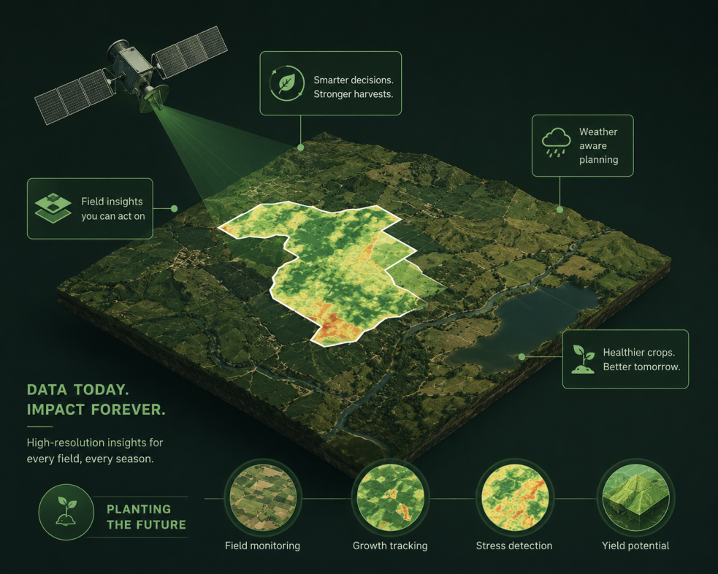
Data Foundation & Roadmap
The prototype demonstrates the workflow today; production connects it to trusted earth-observation data.
Copernicus Browser - Sentinel imagery search, visualization, and download for parcel checks.
Copernicus Land Monitoring Service - land cover, land use, vegetation state, water cycle, and surface variables.
BigEarthNet / TU Berlin - 590,326 Sentinel-2 patches across Europe, including Kosovo, for land-cover classification research.
Crop-classification ML references - model direction for future crop prediction from satellite imagery.
Prototype note: current analytics are demo intelligence; these sources define the production data path.

Slide 3
The Challenge
Cadastral systems focus on legal ownership, but ignore the actual biological and agricultural reality of the land.

Slide 4



PROBLEM STATEMENT
Current Systems Are Broken
Fragmented Registries
Subsidy Fraud
Land data is scattered across incompatible systems. No single source of truth exists.
Farmers report inflated land areas. The state pays over 28% in fraudulent claims every year.
Paper-Based Reports
No Real-Time Monitoring
Officials rely on manual documentation. Errors and delays harm policy decisions.
Crop damage and illegal land changes go undetected for months.

Slide 5

The Fallow Land Crisis
According to ASK (2024):
6,429.78 Hectares
Agricultural land in Kosovo remains completely FALLOW.

Slide 6





The Solution: Living Land Registry
Chatbot & Assistance
Audit Trail & Transparency
Our AI assistant guides farmers on crop rotation and helps institutions generate parcel-level reports faster.
Every planting cycle can be recorded as a verified history event, reducing false reports and making subsidy decisions easier to audit.
Prototype architecture: GIS parcels, AI risk scoring, and an audit-ready crop history.

Slide 7
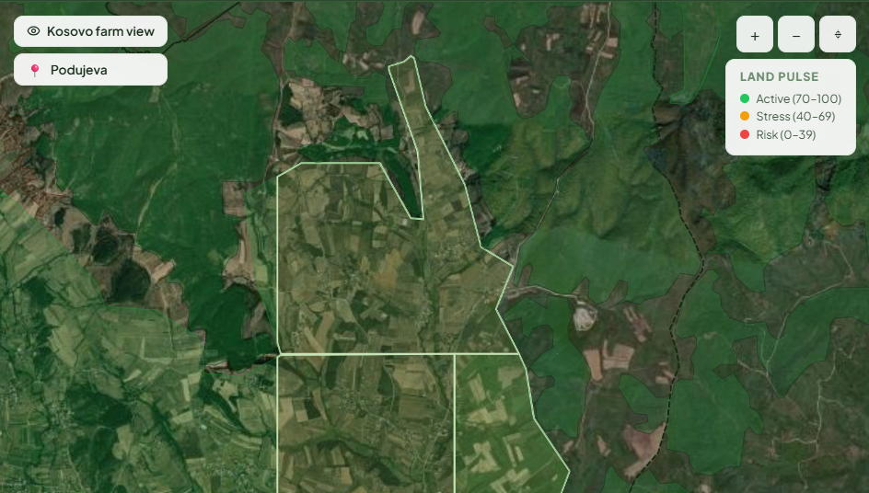

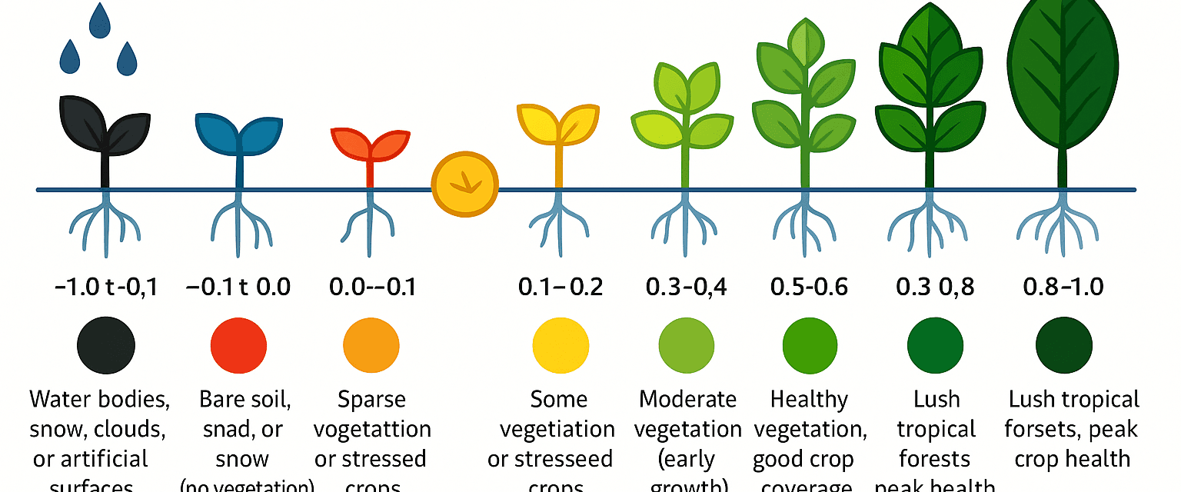
Functional Prototype
Prototype Intelligence
Satellite Monitoring Roadmap
AI Assistant Workflow
Monoculture Risk Alerts
Integrated Semaphore System
View of the functional platform interface.

Slide 8

Market Opportunity
Under the MAFRD 2025-2028 Digital Agriculture Program, there is an urgent need for integration with IPARD and the EU.
400K+ Ha
Early Traction
Potential Market in Kosovo
Tested with farmers in the Prizren region: 90% confirmed this solution would save weeks of paperwork.
Potential expansion across 38 municipalities.

Slide 9

Business Model (Revenue Streams)
B2G SaaS
B2B Analytics
Annual licenses for municipalities and the Ministry for parcel management.
Banks and Insurance: Data for land risk assessment.
Projected ARR (2027): €120,000+

Slide 10
SWOT Analysis
Toka Ime AI — Strategic Position
S Strengths
W Weaknesses
Unified GIS, parcel intelligence, and audit-history architecture
Satellite-based monitoring roadmap
AI chatbot for farmers & institutions
Functional prototype with React app and HTML demo views
Strong team across RIT, UBT & FSHMN
Early-stage startup — limited track record
B2G sales cycles are long and slow
Dependent on government adoption & policy alignment
Small team managing complex tech stack
O Opportunities
T Threats
MAFRD 2025-2028 Digital Agriculture Programme
EU IPARD integration requirements for Kosovo
400K+ Ha addressable market across 38 municipalities
Neighbouring Balkan countries face same problems
Government budget constraints & procurement delays
Larger EU GIS vendors entering the Balkan market
Data privacy regulations around land & farmer data
Low digital literacy among rural farmers

Slide 11


THE TRANSFORMATION OF AGRICULTURAL GOVERNANCE
Before vs After
BEFORE
AFTER
Fragmented registries across systems
Real-time parcel intelligence
Manual paper reports with errors
→
AI risk & anomaly detection
Unverified subsidy claims
Audit-ready crop history
No real-time field monitoring
Transparent subsidy system

Slide 12





Our Unique Team
Riga Sadiku
Olt Imeri
Jona Berbatovci
Jona Latifi
Eljona Salihu
Student at RIT Kosovo
Student at FSHMN
Student at RIT Kosovo
Student at UBT
Student at RIT Kosovo

Slide 13

Why Kosovo, Why Now?
Kosovo needs a practical bridge between cadastral records, farmers, and satellite intelligence. TokaIme turns land parcels into live, inspectable decision data for fairer subsidies and better agricultural planning.

