Slide 2


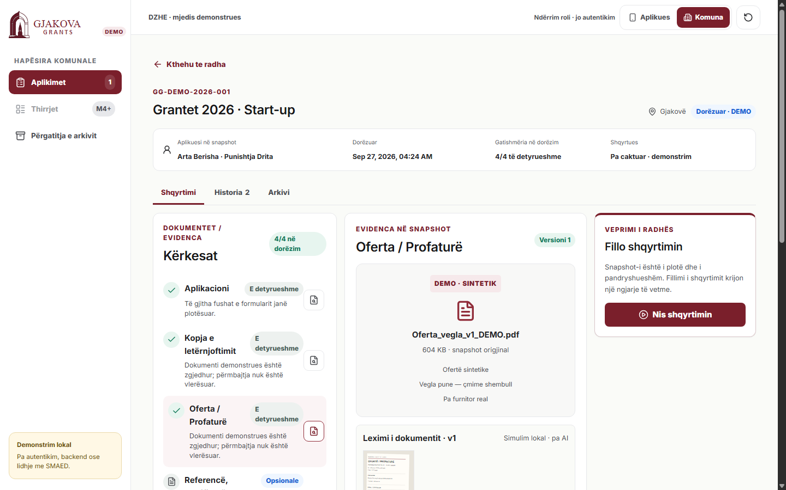
Gjakova Grants
Public funding, made understandable.
From application preparation to traceable municipal review.
Team Pooks · Gjakova · Track C

Slide 3
One grant. Too many disconnected steps.
TODAY
GJAKOVA GRANTS
Separate call + application documents
Guided preparation
Manual document checking
Reusable applicant information
Clear requirement checks
Missing evidence creates back-and-forth
Versioned corrections
Corrections need a clear record
Archive-ready handoff
Source: Gjakova Grantet 2026 public call + application pages (historical; deadline closed) · AI4Society Track C brief
LIVE DEMO →

Slide 4
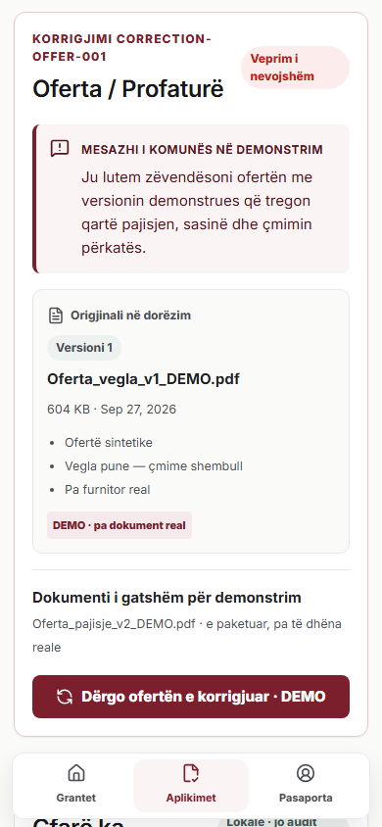
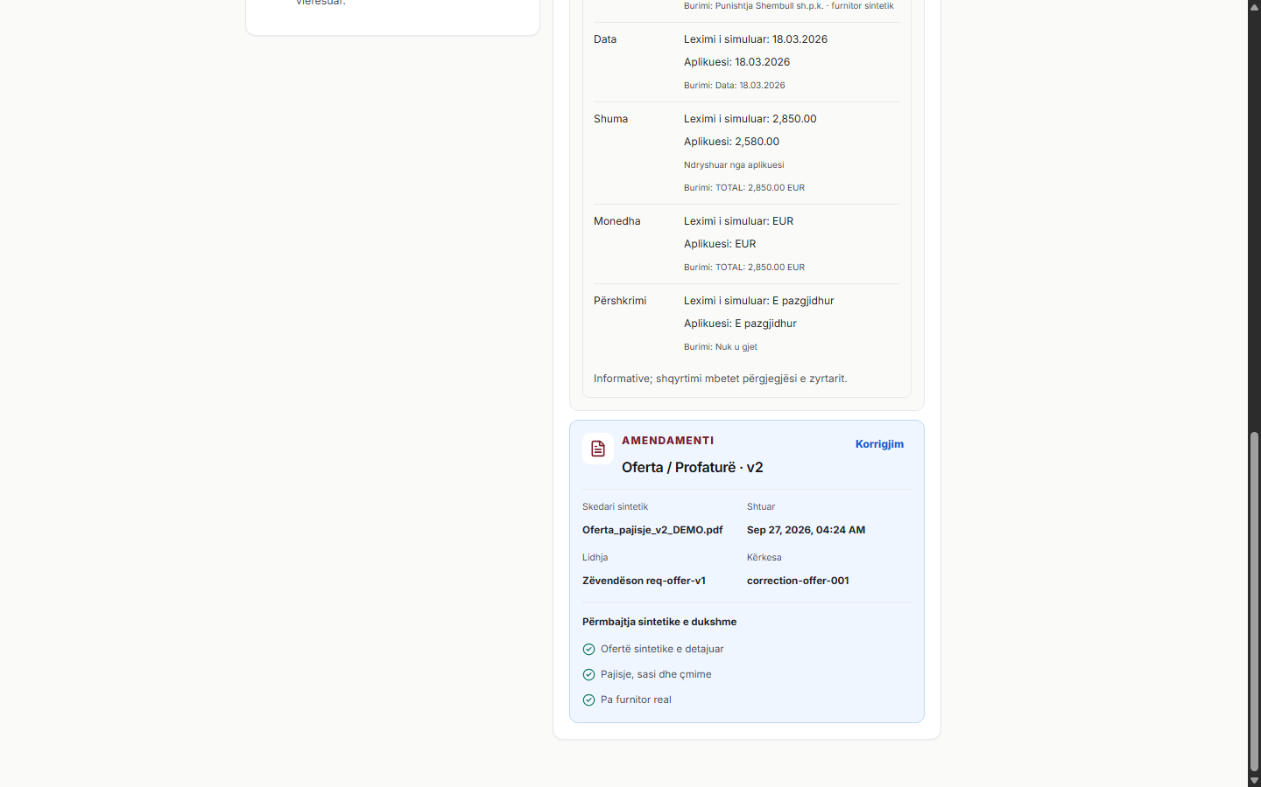
One workflow. Better for both sides.
APPLICANTS
MUNICIPAL STAFF
Understand what is required
Reuse information
See what is missing
Correct without restarting
Track what happens next
Review evidence together
Request targeted corrections
Compare document versions
Keep a readable history
Prepare the archive handoff
SIMULATED DOCUMENT READING
Reads structured information
Shows evidence
Shows uncertainty
Human review remains in control

Slide 5
A pilot Gjakova can actually test.
€6,000
€1,000
€50 / month
€2,400 / year
BUILD TOWARD PILOT READINESS
SETUP + TRAINING
OPERATION
SUPPORT
One-off
One-off
Planning assumption
Planning assumption
≈ €10,000
ILLUSTRATIVE FIRST YEAR
Planning assumptions — not quotes
FOUR WEEKS · VALIDATION
WEEK 1
WEEK 2
WEEK 3
WEEK 4
Map one real workflow
Adapt the pilot
Supervised testing
Measure and decide
START WITH
1 grant call · 1 grants officer · 1 archive / IT contact
Planning model excludes procurement, complex SMAED integration, broader compliance, larger production storage, taxes and travel. No savings measured.

