Slide 1

Visualization and Analysis – Between Components of a Mobile and its Net Weight Tutorial Presentation for Feedback Date:
Group Id: A149 Name of Student Presenting: Athul Krishna Renjith

Slide 2
What is the correlation between the components of a phone and its weight
Part 1: VISUALISATION

Slide 3
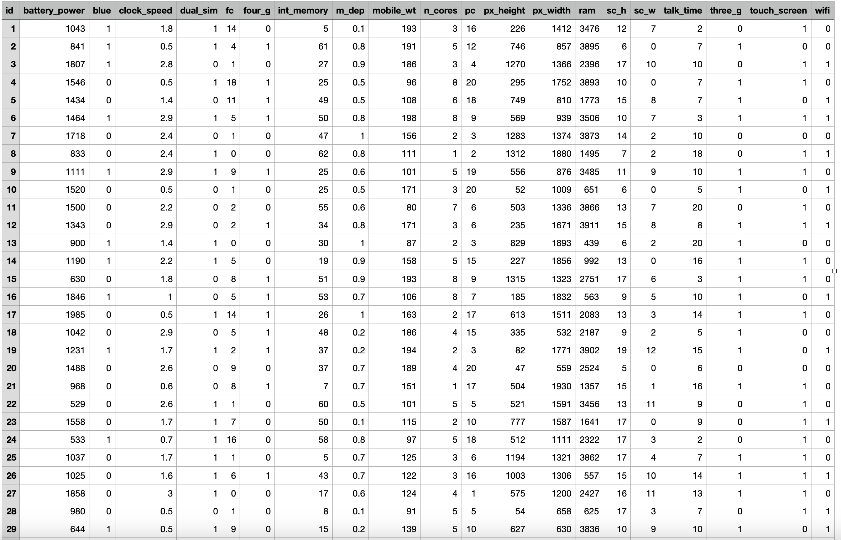
We are using the dataset (DS188-Mobile Price Classification) to answer our Research Question (“ What is the correlation between the components of a phone and its weight ”)

Slide 4
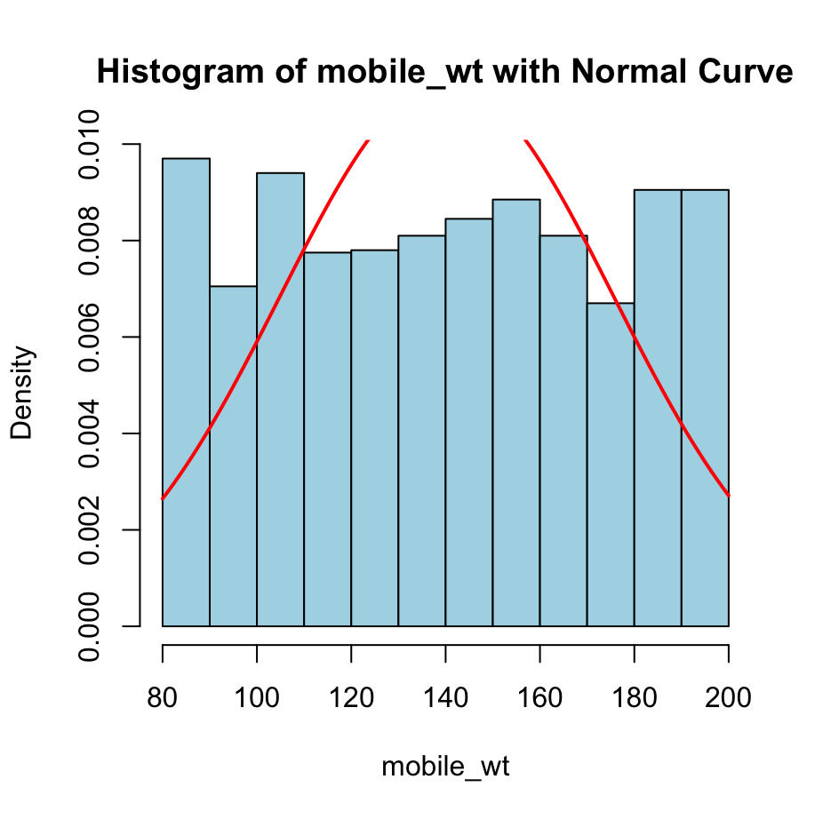
VISUALISATION OF MOBILE WEIGHT WITH NORMAL CURVE

Slide 5
ANALYSIS OF MOBILE WEIGHT WITH NORMAL CURVE
The histogram shows the distribution of mobile weights. It is slightly skewed to the right, meaning there are a few heavier phones.
The normal curve superimposed on top shows the ideal normal distribution. The actual data is close to the normal distribution, with a slight peak around 150-160.
The data deviates from the normal curve on both extremes, where the histogram bars are slightly lower than the normal curve.

Slide 6
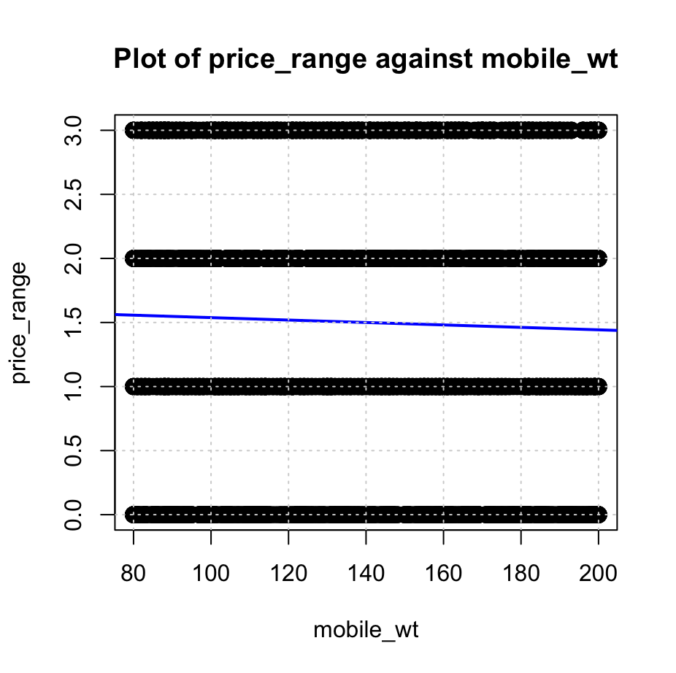
VISUALISATION BETWEEN PRICE RANGE AND MOBILE WEIGHT

Slide 7
ANALYSIS BETWEEN PRICE RANGE AND MOBILE WEIGHT
The scatter plot shows a weak negative relationship between price_range and mobile_wt.
This means that as mobile_wt increases, price_range tends to decrease slightly.
However, the relationship is not very strong, and there is a lot of variation in the data.
This indicates that mobile_wt is not a good predictor of price_range.

Slide 8
#load data
training<-read.csv("Data_csv/train.csv", header = TRUE)
# histogram for all columns
for (col_name in names(training)) {
if (col_name != "mobile_wt") {
hist(training[[col_name]],
main = paste("Histogram of", col_name),
xlab = col_name,
col = "lightblue",
border = "black")
}
}
# Dependent variable
dependent_var <- training[["mobile_wt"]]
# Histogram with normal curve
hist(dependent_var,
main = "Histogram of mobile_wt with Normal Curve",
xlab = "mobile_wt",
col = "lightblue",
border = "black",
prob = TRUE)
mean_val <- mean(dependent_var, na.rm = TRUE)
sd_val <- sd(dependent_var, na.rm = TRUE)
curve(dnorm(x, mean = mean_val, sd = sd_val),
col = "red", lwd = 2, add = TRUE)
#plots
for (col_name in names(training)) {
if (col_name != "mobile_wt") {
plot(training[["mobile_wt"]], training[[col_name]],
xlab = "mobile_wt",
ylab = col_name,
main = paste("Plot of", col_name, "against mobile_wt"), type = "p", pch = 19,
cex = 1.5, col = "black")
#linear trend line
model <- lm(training[[col_name]] ~ training[["mobile_wt"]])
abline(model, col = "blue", lwd = 2)
grid()
}
}

