Slide 1






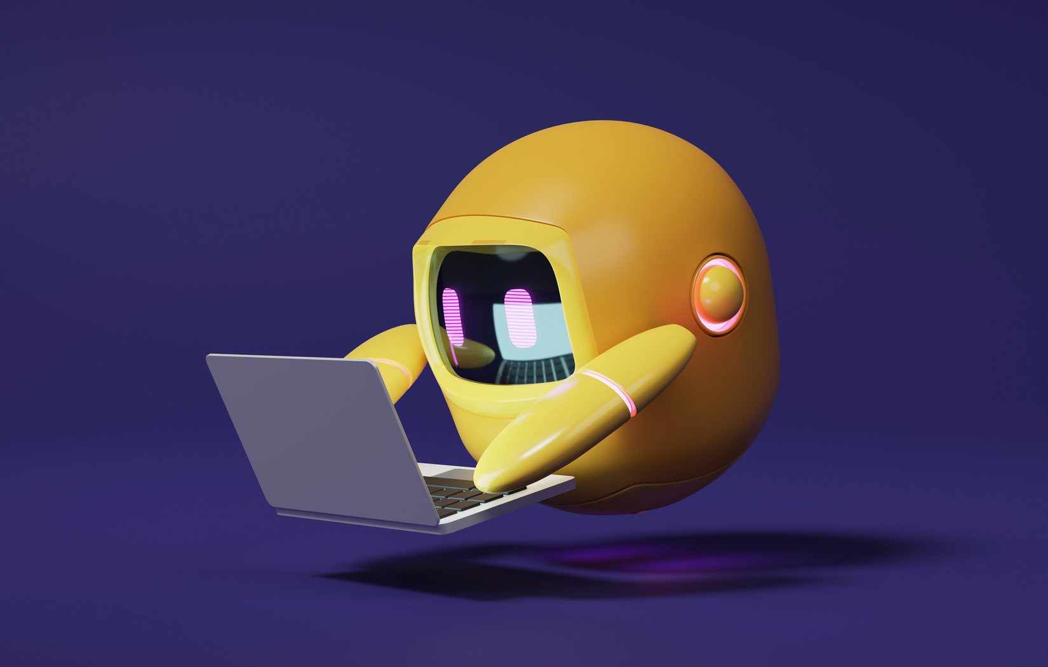

A 2-days National Level Hackathon on
AI in education
ARTIFICIAL INTELLIGENCE IN SPECIAL EDUCATION
Team Name: Neuro code
Name of Leader:Om Kapile
Date of submission:
College Address:Sanjivani University, Kopargaon, Near Shirdi, Ahilyanagar
www.samadhan.sistec.ac.in/

Slide 2


AREA OVERVIEW
Education needs personalized learning for diverse students.
Traditional one-size-fits-all teaching often fails to engage.
AI can adapt quizzes, detect emotions, and guide students better.
Focus Area: Improving student engagement & reducing fear of learning.
IMPORTANCE OF AREA
Boosts student confidence by adapting difficulty levels.
Encourages self-paced learning with instant feedback.
Reduces dropout by keeping learners motivated.

Slide 3
Potential Challenges and Opportunities
Challenges:
Accurately detecting student emotions in varied lighting and environments.
Protecting sensitive data like facial expressions and voice recordings.
Designing adaptive logic that balances difficulty fairly for all students.
Opportunities:
Create personalized learning paths for every student.
Provide real-time performance + emotional feedback to teachers.
Build a scalable platform usable in schools, colleges and even online courses.

Slide 4
Preliminary Solution Concept
An AI-powered application that integrates emotion
detection with adaptive quizzes.
Detects student’s mood using facial expressions or voice
tone while attempting quizzes.
If student is stressed → easier next question; if confident →
moderate/harder question.
Generates performance reports, certificates, and
leaderboards to motivate students.
Teachers get a dashboard view of student progress and
Engagement.

Slide 5
Key Features and Functionalities
Emotion Detection: Face/voice analysis to identify worried, confused, or confident states.
Adaptive Quizzes: Difficulty adjusts dynamically based on emotions
and performance.
Student & Teacher Dashboards: Track performance trends, strengths, and weaknesses.
Gamification: Leaderboards, badges, and certificates to make learning fun.
AI Tutor Chatbot: Helps explain answers, give hints, and clarify doubts.
Multi-language Support: Enables inclusivity for students from different regions.

Slide 6
Target Users and Expected Use Cases
Target Users:
Students: From school level (5–10) up to B.Tech/college learners.
Teachers: To track performance, emotional engagement, and
difficulties.
Use Cases:
Student takes quiz → AI adjusts next question based on mood.
Teacher sees emotional + academic performance reports.
Students can challenge peers in quizzes for better motivation.
Certificates & badges can be added to student portfolios/resumes.

Slide 7
Data Requirements and Privacy Considerations
Data collected: Facial expressions, quiz responses, scores, and voice tone.
All sensitive data will be encrypted and anonymized to ensure privacy.
Students’ raw images or voices will not be stored, only analyzed results.
Teachers receive aggregated insights only, not personal recordings.

Slide 8
AI Technologies and Methods
Computer Vision: OpenCV, DeepFace, FER for facial emotion recognition.
Natural Language Processing: Chatbot and voice tone analysis using Python NLP libraries.
Machine Learning Models: Adaptive difficulty prediction
(TensorFlow).
Backend & Database: Python (Flask/FastAPI), Firebase/MongoDB for scalability.
Frontend: Flutter app for students & teachers (cross-platform mobile).

Slide 9
Implementation Approach
Phase 1: UI/UX design → Login, Student Dashboard,Teacher Dashboard.
Phase 2: Integrate emotion detection usingcamera/voice input.
Phase 3: Implement adaptive quiz engine thatmodifies difficulty in real-time.
Phase 4: Add gamification features (leaderboards,certificates, badges).
Phase 5: Testing with sample students →Deployment for schools/colleges.

Slide 10
Evaluation Metrics
Improvement in student quiz completion rates: Measures how many more
students are finishing quizzes after using the adaptive system.
Reduction in stress/fear levels: Tracks whether students feel less anxious during learning, based on their self-reported feedback.
Accuracy of emotion detection model in real conditions: Evaluates how reliably the AI can recognize emotions during live quizzes.
Teacher satisfaction based on usefulness of reports: Reflects how helpful
teachers find the dashboards and insights for guiding students.
Overall impact on learning outcomes & student engagement: Assesses
whether students are learning better and staying more involved.

