Slide 1

E-BOOKMART
(Online Book Management)
Om Chavan 20104056
Parthavi Khatu 20104108
Sampada Mahadik 20104092
Project Guide
Ms. Sneha Dalvi

Slide 2
Contents
Introduction
Objectives
Scope
Literature Survey
Proposed System
Project Outcomes
Block Diagram
Use Case/DFD
Technology Stack
Suggestions in Review-1
Result and Discussion
Conclusion
References

Slide 3
1. Introduction
Problem Identified :
    The major problem faced by customers was they generally use to go to book store or library to buy a book.
    Earlier customers use to found it difficult to explore the books according to their need at book store.
Solution Proposed :
    By using E-Bookmart customer will get their favourite book at doorstep with just few clicks and will save time and transportation cost as well.
    By using E-Bookmart customer can be able to explore the books category wise or by entering the authors name at one place within few clicks.

Slide 4
2. Objectives
To develop user friendly interface for the customer.
To provide category wise segmentation of books for the customers.
To manage the details of books, payment, delivery and bills.
To manage the detailed information/summary of book.
To save time and travelling cost of customer while searching for books.

Slide 5
3. Scope
Can be useful for Bookstores to increase their sales.
Can be helpful for the customer to get their favourite book at doorstep.
Can be used to provide wide collection of book ranges.
Can be used to provide an essence of books/e-books via a simple and yet powerful medium.
Can be used to build an application to reduce the work for managing the Books, Customers and Payment etc.

Slide 6
4. Literature Survey
YEAR | AUTHOR | TITLE | OUTCOMES | DRAWBACKS
2017 | Ms. Sonam Upadhyay | Online book store. | It simulated the working of an actual online book store. Economical, quick & time convenient. View books of all categories. | They failed to provide a user with soft copy of the book.
2017 | Mr. Pragati Bagmare | Online bookshop management system. | It manages all the information about Books, Stock, Bills, Books. | There was no receipt generated after the payment process.
2020 | Mr. Shubham Zunjar | Library management system. | A search column to search availability of books. Student login page where student can find books issued by them. | There was no confirmation message provided for user after the delivery of the book.

Slide 7
5. Proposed System
User Friendly and Easy To Use :
    Customer panel features allow users to find and order their favourite books within few clicks.
Category based segmentation :
    Customer can search their book according to its category (e.g. sports, science fiction, history, etc).
    The books will be displayed in perfect manner so that user can pick and order the book easily.
Cart :
    Customer can add his/her favourite book to cart.
Review Section :
    Customer can share their Experience/Opinion by rating the app.

Slide 8
6. Outcome of Project
User can get summary of book through this system.
User can search and buy the book according to their categories or authors.
Customer can buy the book online within few clicks of buttons by saving time and travelling cost as well.
Customer can keep track of his/her order delivery status.

Slide 9
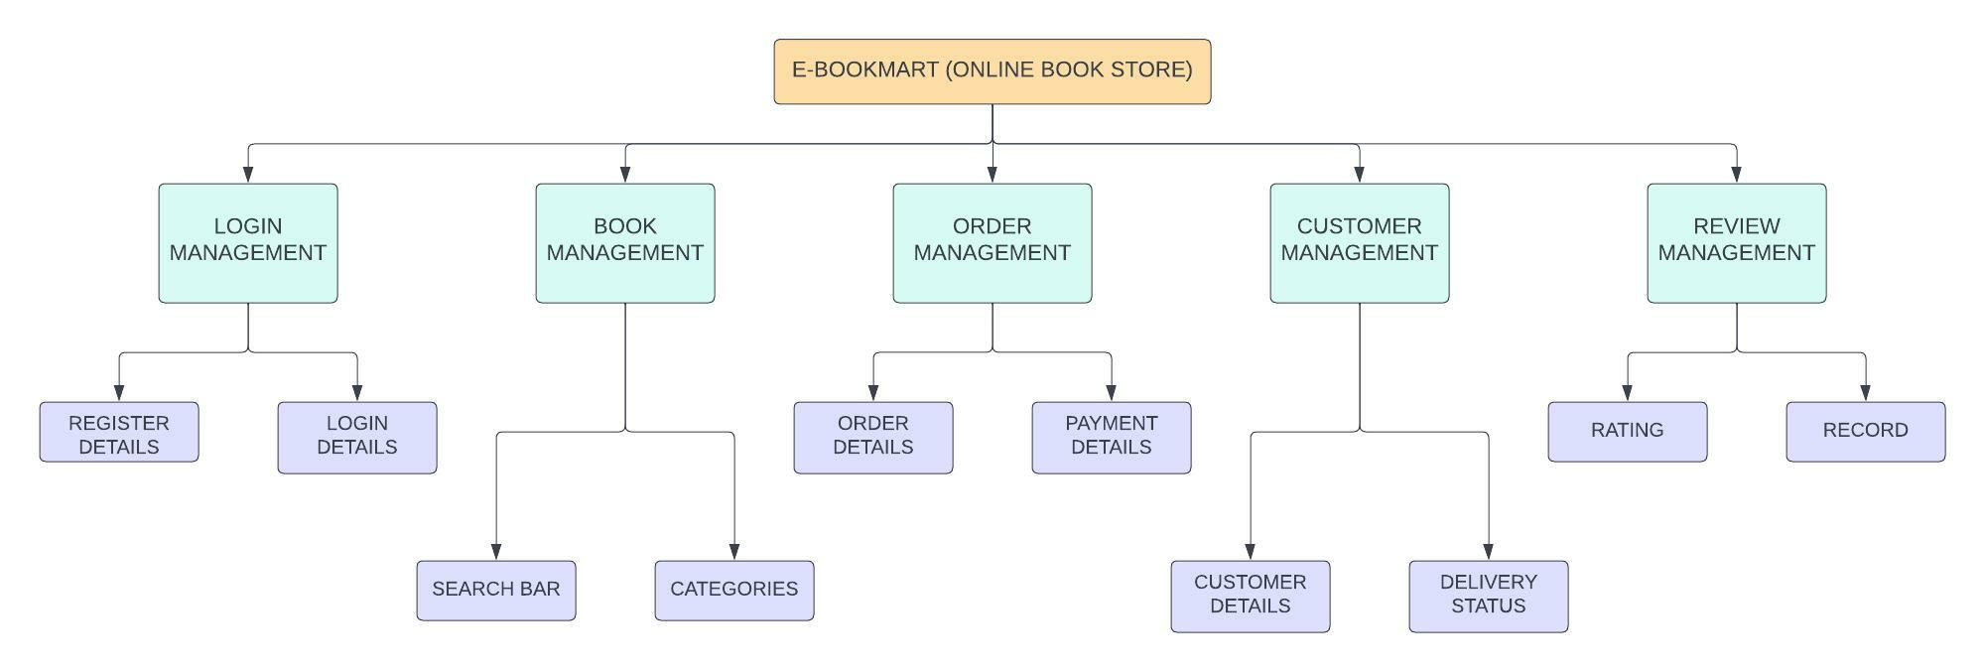
7. Block Diagram / Flowchart

Slide 10
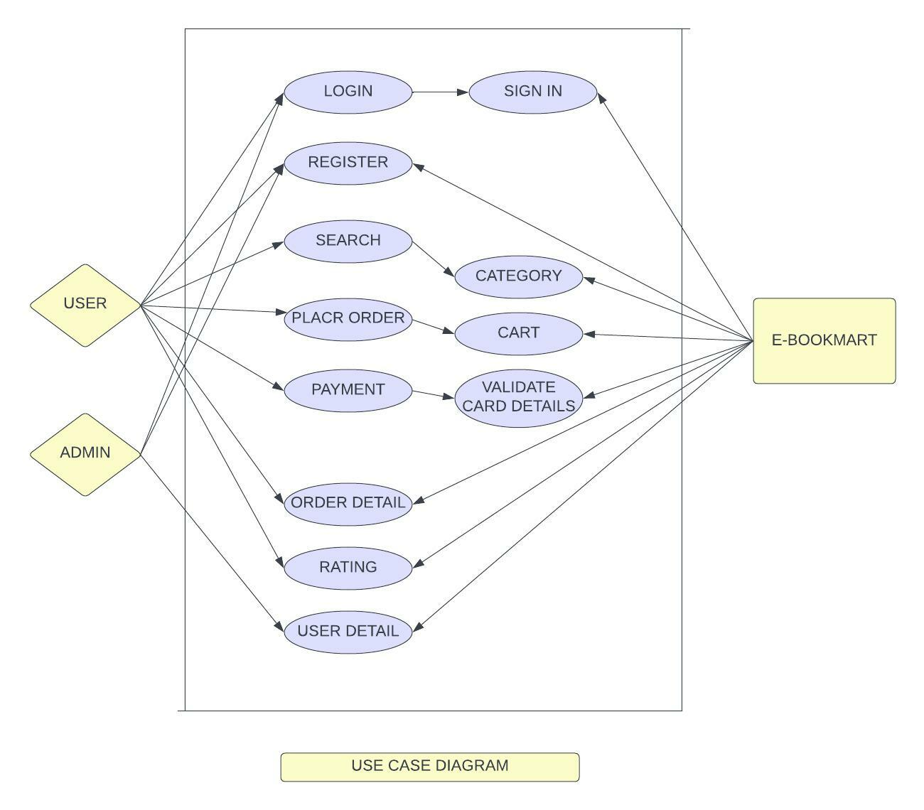
8. Use Case/Data Flow Diagram

Slide 11
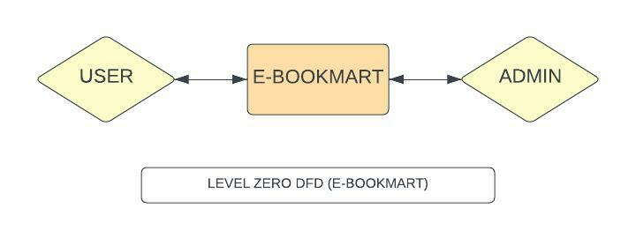

Slide 12
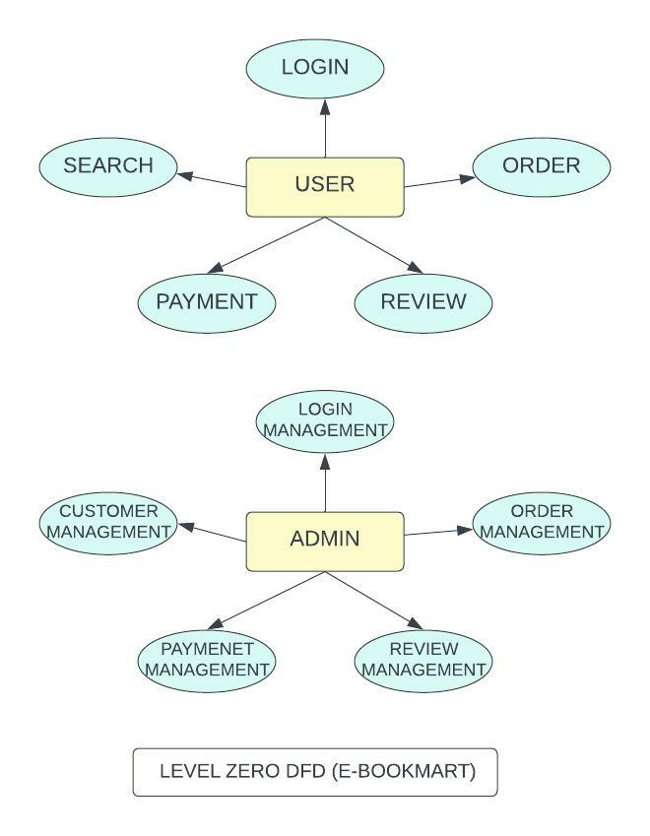

Slide 13
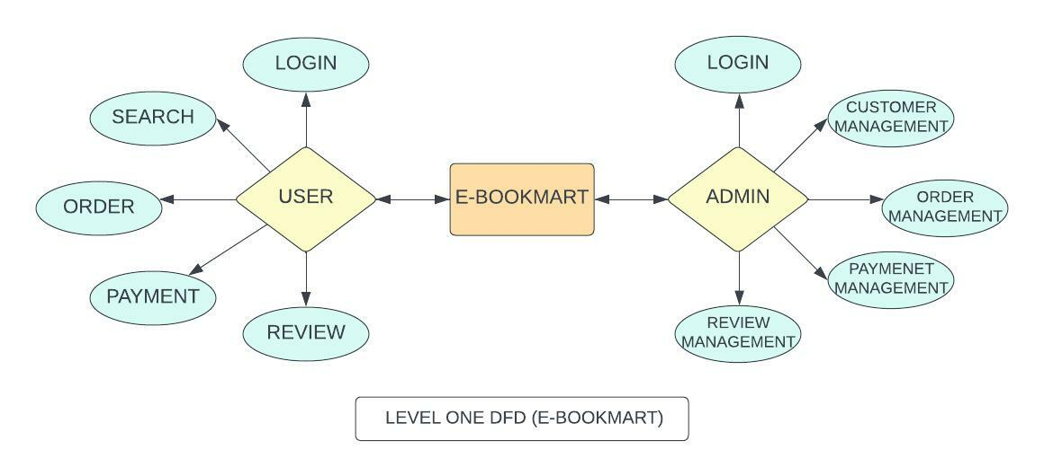

Slide 14
9. Technology Stack
Front-end - HTML ,CSS ,Java Script.
Database – phpMyAdmin.
Integrated Development Environment (IDE) - VS Code.
Platform - Windows 10/11

Slide 15
10.Suggestions in Review-1
Modification in literature survey.
Modification in DFD diagram.
To add recommendation feature.
Work on Status of delivery.
Work on payment gateway.
Database connectivity.

Slide 16
11. Result and Discussion
We offer huge collection of books in diverse category of Fiction, Non-fiction, Biographies, History, Religions, Self -Help, Children. We also sell in vast collection of Investments and Management, Computers, Engineering, Medical, College and School text references books proposed by different institutes as syllabus across the country. Besides to this, we also offer a large collection of E-Books at very fair pricing.
We attempt to extend the customer satisfaction by catering easy user-friendly search engine, quick and user-friendly payment options and quicker delivery systems. Upside to all of this, we are disposed to provide exciting offers and pleasant discounts on our books.

Slide 17
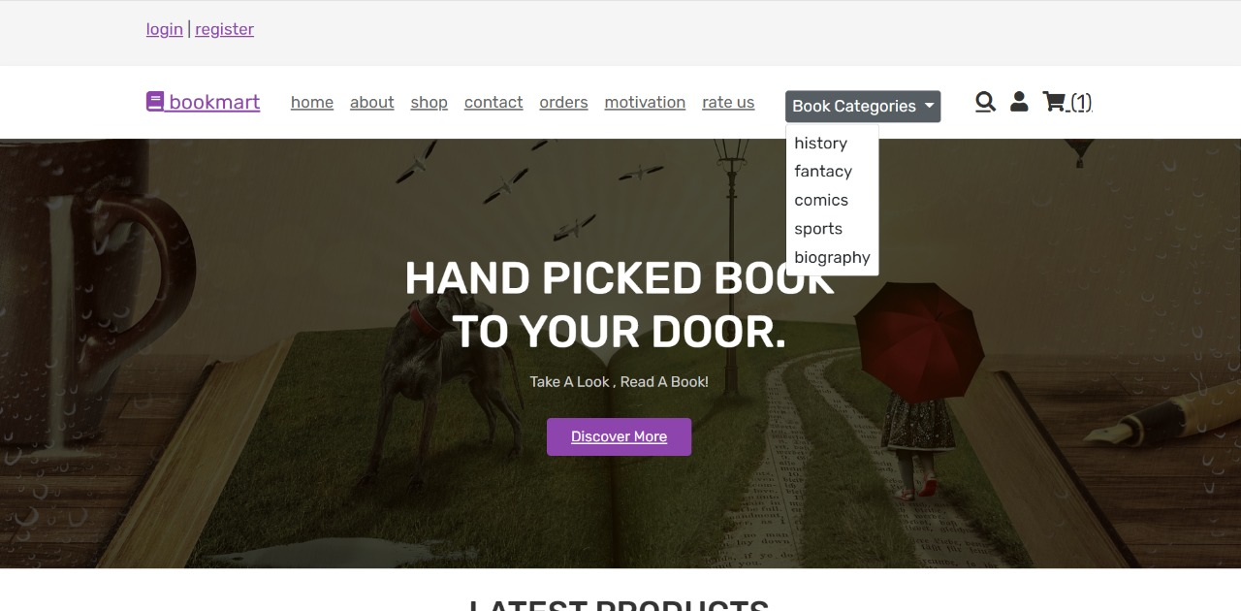
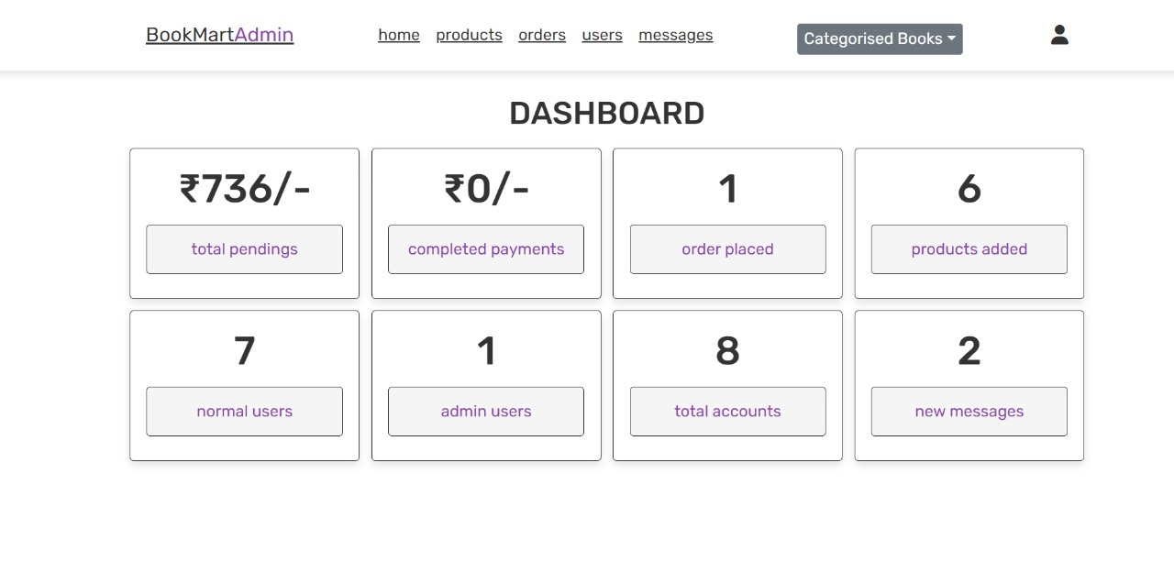
1.Home page and Admin dashboard.

Slide 18
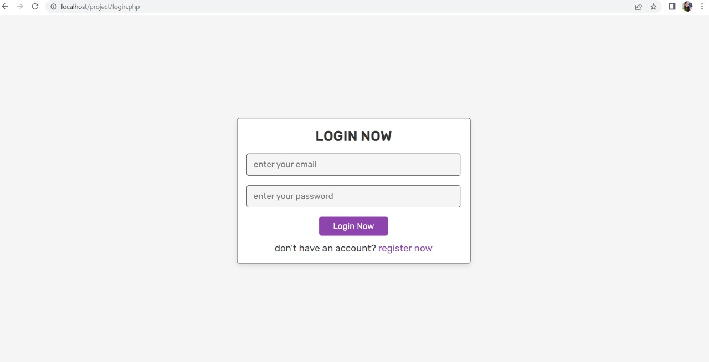
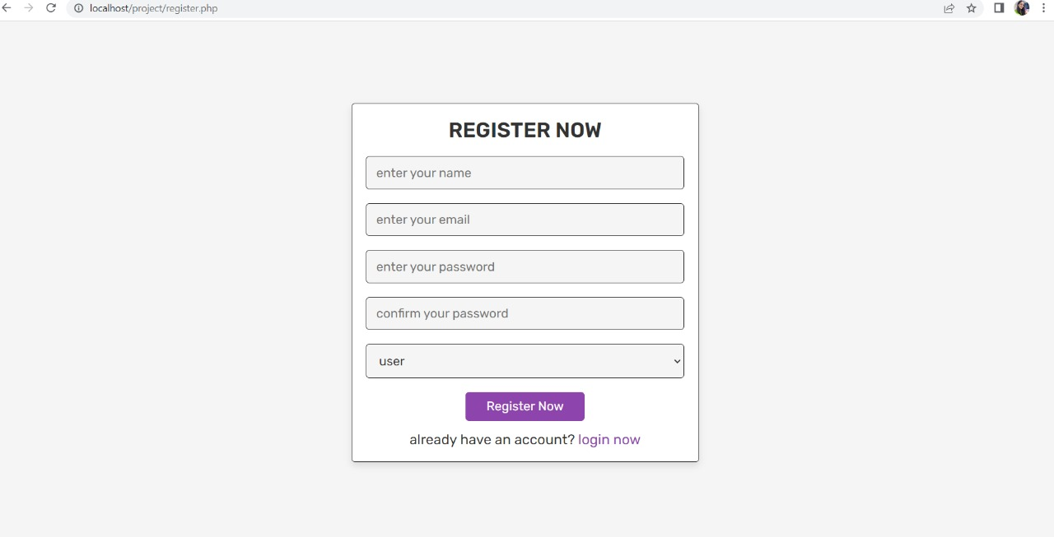
2. Login and Registration.

Slide 19
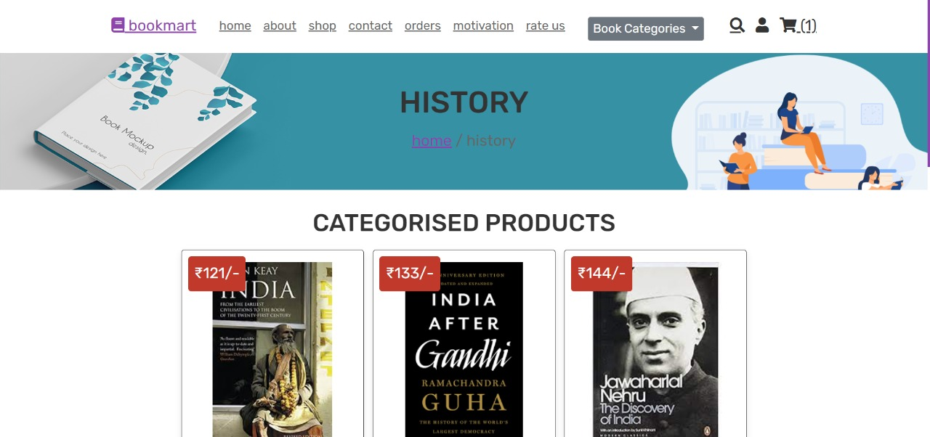
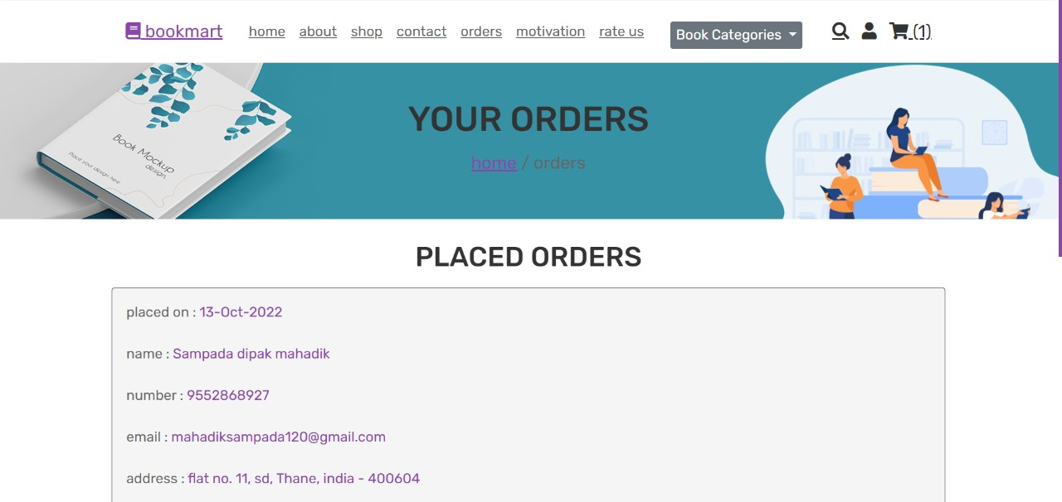
3.Category and order page .

Slide 20
12. Conclusion and Future Scope
Online Book Store application will provide a user friendly and easy interface to operate. User can buy the book of his/her choice with pocket friendly budget. User can buy types of books according to their favorite categories. And lastly user can also be able to make secured Payments. The project (E-Bookmart) has a very vast scope in future. We can give more advance software for Online Book Store including more facilities. In the future, we will try to cover all the states and cities till now we have covered it at a very small scale. We will also introduce new features such as Author videos and reviews so that users can get more satisfaction about his deal.

Slide 21
References
[1] Ms. Sonam Upadhyay (2017), “Online book store.” https://www.academia.edu/36199398/Online_Book_Store
[2] Ms. Pragati Bagmare (2017), “Online bookshop management system”. https://www.researchgate.net/publication/316459661_Research_Paper_on_Online_Bookshop_Management_System
[3] Mr. Shubham Zunjar (2020), “Library management system”. https://ijcrt.org/papers/IJCRT2105603.pdf
[4] Prasad N K, Varun Kishore (2020).“Online Book Store”(IRJET). https://www.studocu.com/in/document/university-of-delhi/btech/irjet-v7i51409-projectreport/2961012

Slide 22
Thank You...!!

