Slide 1

Distributed Chat with Leader Election
Mini-project presentation
Computer Networks Laboratory (CSE20110)
Department of Computer Engineering and Technology
1262241930
1262243385
1262243181
1262241292
Mitansh Dekate
Om Mali
Kartik Saxena
Harpal Kalankar
Group 11 Panel K (iOS) Batch 2 & 3
Faculty: Dr. Uma Pujeri Mam, Dr. Swati Mam
Academic Year: 2026–2027
Presentation date: 10/26/2026
Computer Networks Laboratory CSE20110

Slide 2

Problem Statement
A conventional chat server is a single point of failure: when it crashes, every connected user loses the service. A distributed chat service runs several server nodes, so it needs leader election to choose a coordinator, failure detection to notice a crash, and message replication so that no message is lost and every user sees one order.
Objectives
Detect leader failure using heartbeats.
Elect a new leader using three algorithms.
Preserve one consistent, ordered chat history through replication and majority commitment.
Recover restarted nodes and support client reconnection.
Compare election algorithms using message count and recovery time.
Computer Networks Laboratory CSE20110

Slide 3
System Architecture
Tools
Browser dashboard
127.0.0.1:8080
Python 3.14
socket, threading, json, http.server
Browser-based dashboard
Matplotlib (benchmark graphs)
Chat client A
client.py
TCP: CHAT ↔ DELIVER
Node 1
TCP 9001 | HTTP 9101
HTTP status / control
Node 5 (leader)
TCP 9005 | HTTP 9105
Node 2
TCP 9002 | HTTP 9102
Protocol and Addressing
Full TCP mesh
heartbeats + elections
Protocol: TCP between nodes and clients
Messages: newline-delimited JSON
TCP: 127.0.0.1:9001–9005 (peers and clients)
HTTP status/control: 127.0.0.1:9101–9105
Dashboard: 127.0.0.1:8080
Heartbeat 0.5 s, failure timeout 1.5 s
All nodes ran on one computer (loopback)
Chat client B
client.py
Node 4
TCP 9004 | HTTP 9104
Node 3
TCP 9003 | HTTP 9103
TCP
Teal lines: leader replicates log entries to followers. Grey lines: heartbeats and election messages between nodes.
Write path of one chat message
1
Client sends CHAT to its node
2
Follower FORWARDs it to the leader
3
Leader assigns a sequence no. and REPLICATEs
4
Majority ACK, then leader COMMITs
5
Nodes DELIVER committed messages to clients
Computer Networks Laboratory CSE20110

Slide 4

Technical Working
Implementation
Start the node cluster and the dashboard.
Nodes exchange heartbeats every 0.5 s.
A follower detects leader silence after the 1.5 s timeout.
Nodes run the selected election algorithm.
The new leader collects peers’ logs before serving writes.
Chat messages are sequenced and replicated to followers.
A message is committed after a majority acknowledges it.
Clients receive committed messages in the same order.
Restarted nodes synchronise their missing history.
Every node runs the same program (node.py)
States: follower, election, leader
Threads: accept, read, heartbeat, monitor
JSON-line messages with a Lamport clock
Election Algorithms
Voting: random 0.5–1.5 s timeout, one vote per term, majority wins
Bully: ELECTION to higher ids; highest live id wins
Ring (Chang–Roberts): token circulates the ring; its owner id returning wins
Selected at start-up: --algo vote | bully | ring
Computer Networks Laboratory CSE20110

Slide 5


Testing and Results
Test scenarios (single computer, loopback):
Performance Comparison
Startup and leader selection: all five nodes agree on one leader.
Two clients on different nodes exchange 10 messages: same order on both.
Leader crashed during traffic: new leader in 2.6 s, 20 of 20 messages delivered.
Restarted node with an empty log recovers all 22 messages.
Leader isolated, then network healed: majority elects a new leader and logs converge.
Same scenarios repeated with Bully and Ring; all three algorithms compared in a benchmark.
Algorithm | Mean recovery time
Voting | 2.09 s
Bully | 1.56 s
Ring | 1.52 s
Measured mean recovery time after a leader crash, across the tested cluster sizes (3, 5, 7 and 9 nodes); 3 trials per configuration.
Voting election messages: 5, 11, 17 and 23 for 3, 5, 7 and 9 nodes.
Computer Networks Laboratory CSE20110

Slide 6
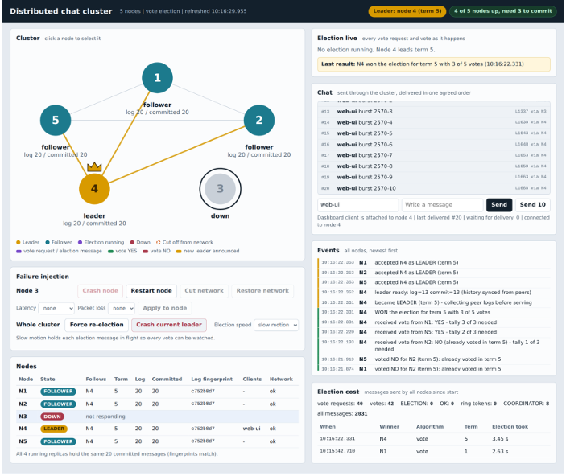

Demonstration / Execution
Run the Demo
python dashboard.py --spawn
Starts 5 nodes and the dashboard (port 8080).
python client.py --user alice
Terminal chat client.
python client.py --user bob --node 2
Second client on another node.
The dashboard displays:
Node status and current leader
Live elections, vote by vote
Chat activity and log fingerprints
Failure injection: crash, restart, cut network, delay, packet loss
Dashboard after recovery: Node 4 leads term 5 and all live nodes hold identical logs.
Computer Networks Laboratory CSE20110

Slide 7
Comparative Analysis of Election Algorithms
Criterion | Voting | Bully | Ring
Who wins | Any live node (random timers) | Highest live id | Highest live id
Election messages, 5 nodes | 11.0 | 20.0 | 10.0
Election messages, 9 nodes | 23.0 | 70.0 | 18.3
Mean recovery, all sizes | 2.09 s | 1.56 s | 1.52 s
Split votes possible | Yes, resolved by retry | No | No
Observations
Voting: randomised timeouts and majority voting; split votes are resolved by another election round.
Bully: the highest live identifier wins; its message count grows fastest (about 70 at nine nodes).
Ring: an election token circulates the logical ring; fewest messages at nine nodes (18.3).
Ring had the lowest mean recovery (1.52 s), closely followed by Bully (1.56 s); voting took longer (2.09 s) but its message count grew linearly (3n−4).
Means of 3 trials on one computer; the Bully–Ring difference is within trial variation.
Computer Networks Laboratory CSE20110

Slide 8
Advantages
Applications
Automatic leader recovery after a crash (about two seconds).
Consistent message ordering: no loss or duplicates across failover.
Replicated chat history; restarted nodes resynchronise.
Client reconnection and safe retry.
Visual monitoring and fault injection on the dashboard.
Educational value for understanding distributed systems.
Same ideas as replicated services and coordination services
Replicated databases
Message brokers
Teaching tool in a networks laboratory
A prototype for learning, not a production deployment.
Computer Networks Laboratory CSE20110

Slide 9
Limitations
Future Scope
Message history is held in memory and is lost if all nodes stop.
Node membership is fixed at start-up.
No encryption or authentication.
Simplified Raft-inspired protocol, not formally proved.
Tested on one computer; multi-computer behaviour was not evaluated.
Not tested: loss of a majority of nodes, failure of all nodes at once, and measured effects of delay and packet loss.
Persistent storage for the log
Dynamic node membership
TLS and authentication
Formal verification of the protocol
Benchmarks across several computers
Computer Networks Laboratory CSE20110

Slide 10

CONCLUSION
The project demonstrates a Python-based distributed chat service that uses heartbeat failure detection, leader election, TCP communication and majority-committed message replication.
Team Contributions:
Mitansh Dekate: Problem statement, objectives, and distributed-systems introduction.
Om Mali: Python implementation, client–server communication, and demonstration.
Kartik Saxena: System architecture, tools, protocols, and addressing.
Harpal Kalankar: Testing, results, limitations, and conclusion.
AI Use: Minimal AI assistance was used for documentation only.
Computer Networks Laboratory CSE20110

Slide 11
References:
[1] A. S. Tanenbaum and M. van Steen, Distributed Systems: Principles and Paradigms, 2nd ed. Upper Saddle River, NJ, USA: Pearson Prentice Hall, 2007.
[2] W. Eddy, Ed., “Transmission Control Protocol (TCP),” Internet Engineering Task Force, RFC 9293, Aug. 2022. [Online]. Available: https://www.rfc-editor.org/info/rfc9293.
[3] H. Garcia-Molina, “Elections in a distributed computing system,” IEEE Trans. Comput., vol. C-31, no. 1, pp. 48–59, Jan. 1982.
[4] E. Chang and R. Roberts, “An improved algorithm for decentralized extrema-finding in circular configurations of processes,” Commun. ACM, vol. 22, no. 5, pp. 281–283, May 1979.
[5] D. Ongaro and J. Ousterhout, “In search of an understandable consensus algorithm,” in Proc. USENIX Annu. Tech. Conf. (USENIX ATC), Philadelphia, PA, USA, Jun. 2014, pp. 305–319.
[6] L. Lamport, “Time, clocks, and the ordering of events in a distributed system,” Commun. ACM, vol. 21, no. 7, pp. 558–565, Jul. 1978.
[7] S. Gilbert and N. Lynch, “Brewer’s conjecture and the feasibility of consistent, available, partition-tolerant web services,” ACM SIGACT News, vol. 33, no. 2, pp. 51–59, Jun. 2002.
[8] Python Software Foundation, “socket — Low-level networking interface,” Python 3 Documentation. [Online]. Available: https://docs.python.org/3/library/socket.html
Computer Networks Laboratory CSE20110

Slide 12

Thank You
Computer Networks Laboratory CSE20110

