Slide 1
CASE STUDY 1 Charging Point Operator (CPO) in Addis Ababa
GROUP
NAME
NAME
NAME
This project receives funding from the European Union’s Horizon 2023 Framework Programme for Research and Innovation under Grant Agreement no. 101118123

Slide 2
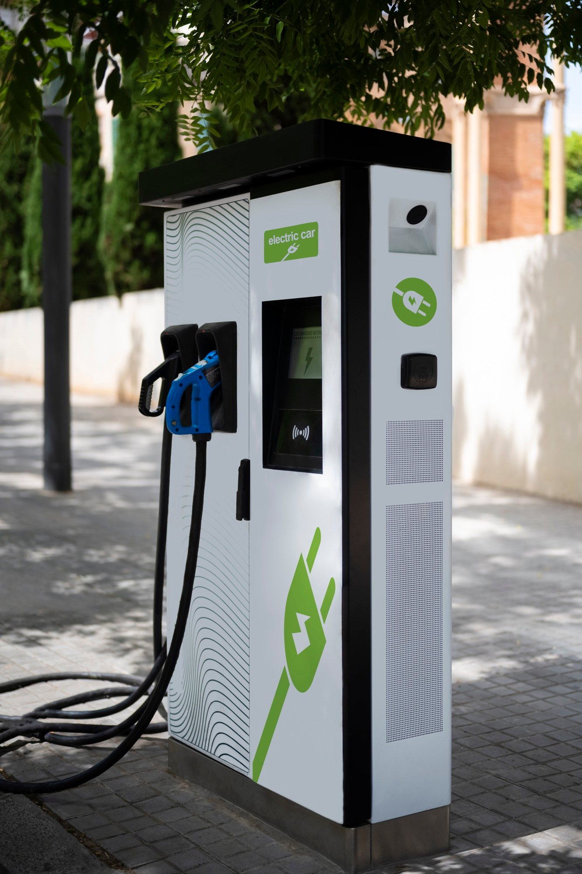
Rationale
You are a charging point operator (CPO) planning to deploy public EV charging stations (EVSE) in Addis Ababa. With the rapid growth of electric vehicles and the current lack of infrastructure, you see a strong market opportunity.
As a CPO, your primary objective is profitability. Therefore, you are looking for locations where your charging stations are likely to achieve high utilization rates. At this stage, your focus is not on precise EVSE siting, but on identifying high-potential zones.
Your objective is to obtain a first-order understanding of:
Where to install charging stations
Tradeoffs in planning based on balancing charging demand, uncertainty, and other criteria
Explore AC vs DC charging, get a first sense of the profitability of installing on-site PV

Slide 3
1. Baseline simulation
You assume the following baseline charging behavior based on a recent local projection. This is the expected share of charging needs if charging stations would be available at these locations.
You aim to target all these segments
Note that charging “at home” may still generate demand for public chargers located near residential areas, especially where private charging is not available.
Home | Work | POI
30% | 40% | 30%
📌 TASK: Run a simulation with the aforementioned scenario and:
A 2 km × 2 km grid (important to have a quite good spatial resolution for this use case)
10,000 EVs (conservative estimate to not overestimate economic potential for EVSE)
Default parameters otherwise.

Slide 4

1. Baseline simulation
🔎 QUESTIONS
Where is charging demand the highest? Make a screenshot of the charging demand map and paste it on the right
Do these spatial patterns make sense to you? (HINT: Display the density of workplaces and POIs layers)
Why is the density of workplaces and POI a good proxy for charging demand at these places in Addis Ababa? (HINT: Display the population density layers.)

Slide 5
2. Current EVSE network
Currently, only a limited number of public charging stations exist in Addis Ababa.
📌 TASK
Upload the provided GeoJSON file containing the locations of the existing EVSEs in Addis Ababa (EVSE_network_AddisAbaba.geojson)
Display them on the map.
Insert a screenshot of the map showing both the charging demand in space and the current charging infrastructure on the next slide

Slide 6
2. Current EVSE network
Charging needs vs current EVSE network

Slide 7
2. Current EVSE network
🔎 QUESTIONS
According to your simulation, are current charging stations strategically located? In the north-east, one station appears less optimally located: could explain the presence of a charging station there?
One potential candidate is zone 6_11. (high demand, low competition with other EVSE).
What is the expected daily charging demand in 6_11 under the current scenario?
Assume one EVSE delivers 22 kW with a 30% utilization rate.
How much energy does one EVSE deliver per day?
Based on the simulated demand, how many EVSE are needed? How does this compare to the current number of stations? Repeat the calculation with a 50 kW DC charger. What changes?

Slide 8
3. EVSE locations under uncertainty
In reality, the previous charging scenario might not hold. The exact split (home/work/POI) is difficult to anticipate due to uncertainty in user behaviors.
📌 TASK: Run three extreme scenarios: 100% charging at home, 100% charging at workplaces, 100% charging at home. Insert the 3 screenshots below.
100% Home
100% Work
100% POI

Slide 9
3. EVSE locations under uncertainty
To reduce investment risk, your idea is to try to identify robust locations: areas where demand is remains high regardless of the scenario. In these areas, a public charger may also benefit from a higher utilization as it may serve different use cases (home, work, POI).
💡You expect these places to be the best spots to kickstart the deployment of EVSE.
📌 TASK
In the online folder, you are provided with a file (spatial_demand_norm.xlsx) containing, for each zone: the normalized charging demand for home, work, and POI (i.e. share of total demand if 100% of charging occurs in that category). This file has been generated with EVPV-Simulator and some postprocessing.
Explore this file (spatial_demand_norm.xlsx)

Slide 10
3. EVSE locations under uncertainty
🔎 QUESTIONS
Look at the normalized home charging demand. Why is the maximum normalized demand at home lower than at work and POIs ?
Are there zones that have a high normalized demand across all categories?
Consider zones 6_11 and 6_10: Why might these be attractive?
Consider zone 4_11 (Highest home charging share): Why might this be riskier despite highest demand at home? (Hint: maximum value / multi-use demand)

Slide 11
4. A promising location: zone 6_11
You decide to further investigate zone 6_11, which appears promising due to
Capturing a high share of the total demand for both POI and workplaces
The potential to also capture some residential demand
Limited competition (only one charging station for the time being)
You want to identify promising locations
🔎 QUESTIONS
EVPV looks at the energy demand and competition (other nearby chargers). But, for precise sitting, other siting criteria become also important. What additional criteria should guide the exact placement of a charging station?

Slide 12
5. A good candidate: AC or DC charging?
A potential location is identified: an open-access parking area near the future Arada Luxury Shopping Center. Expected use cases:
Daytime: shopping, short stays
Night: residential overnight charging
💡 Expected typical usage :
Average dwell time for shopping: ~2 hours
Average energy demand: ~20 kWh per session

Slide 13
5. A good candidate: AC or DC charging?
🔎 QUESTIONS
What charging power is sufficient to meet the charging demand on average? Based on this first-order consideration, would DC fast charging be justified in this context?
When looking at the EVPV charging demand per car (see the additional data files) it can be seen that some EV users are likely to have sessions up to 50 kWh:
Is using the average really sufficient? What risks does this create?
What would you do to better guess the optimal number of charging stations and their power on this location?

Slide 14
6. Potential for on-site PV
Further investigation has shown that you are likely to cover about 30 charging sessions of 20 kWh on average (600 kWh/day). The optimal mix includes a mix of AC 22 kW charging and slower low-cost AC (up to 7.4 kW only), likely used overnight for residential charging.
As the parking is located in a non-shaded area, you are considering installing solar panels on top of part of the parking spaces.
An EVPV run suggests that the capacity needed to produce around 600 kWh/day is approximately ~100 kWp. This is technically feasible given the available parking surface.
🡪Would this investment makes sense from an economic standpoint?

Slide 15



6. Potential for on-site PV
To evaluate whether an investment in PV is profitable, we compare two quantities: The effective value of PV electricity must be greater than or equal to the Levelized Cost of Electricity (LCOE).
🡪 Interpretation: The LCOE represents the average cost per kWh over the lifetime of the system. In other words, it is the minimum price at which PV electricity must be valued—either through electricity sold to the grid, or by savings achieved via self-consumption (avoided electricity purchases) to recover investment and operating costs over the system lifetime.

Slide 16
6. Potential for on-site PV
To evaluate whether an investment in PV is profitable, we compare two quantities: The effective value of PV electricity must be greater than or equal to the Levelized Cost of Electricity (LCOE).
🡪 Interpretation: The LCOE represents the average cost per kWh over the lifetime of the system. In other words, it is the minimum price at which PV electricity must be valued—either through electricity sold to the grid, or by savings achieved via self-consumption (avoided electricity purchases) to recover investment and operating costs over the system lifetime.
Self-consumption
Retail tariff
Feed-in tariff

Slide 17
6. Potential for on-site PV
🔎 QUESTIONS
Calculate the value of PV electricity assuming
Self-consumption of 60% on average
Retail price: 0.15 USD/kWh
Feed-in tariff: 0.05 USD/kWh
Considering that the LCOE of such a >100 kWp system is likely to be around 0.08 USD/kWh, does it make sense?
Assuming 600 kWh per day, what would be the yearly average gain due to PV?
Reducing PV capacity will enhance self-consumption. But, why will it not necessary results in a better profitability? Hint: LCOE

