Slide 1
CASE STUDY 2 Distribution System Operator (DSO) in Addis Ababa
GROUP
NAME
NAME
NAME
This project receives funding from the European Union’s Horizon 2023 Framework Programme for Research and Innovation under Grant Agreement no. 101118123

Slide 2
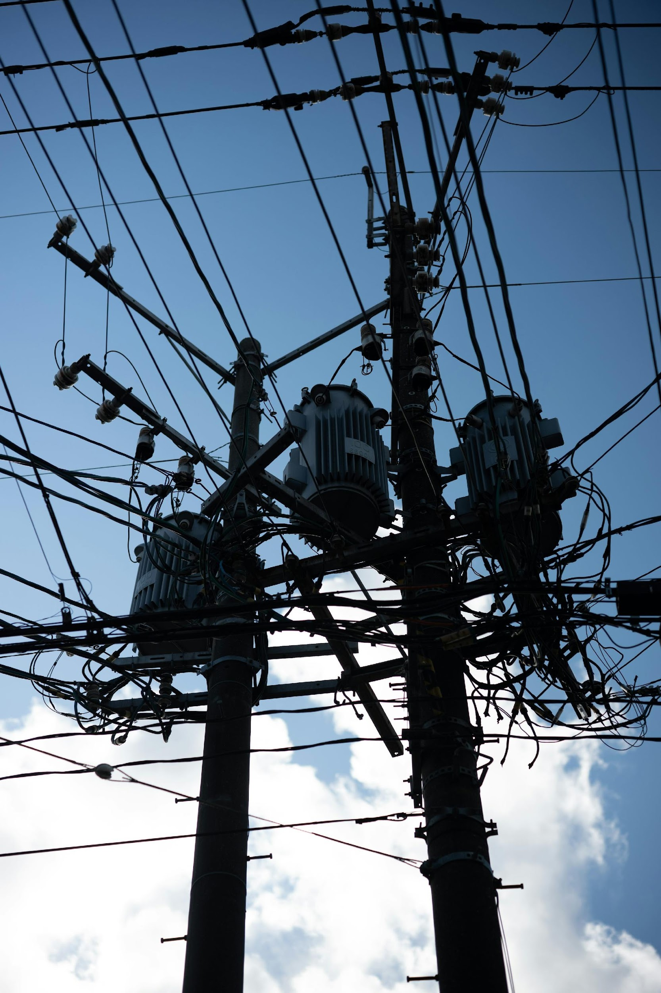
Rationale
You are the Distribution System Operator (i.e. the Ethiopian Electric Utility) responsible for ensuring the reliability of the electricity grid in Addis Ababa. With the rapid uptake of electric vehicles (EVs), you are concerned about the impact of charging loads on the power network.
As a DSO, your primary goal is to anticipate where and when potential new peak loads will occur in order to anticipate potential grid reinforcements and think about strategies to minimize them.
Your objective is to obtain a first-order understanding of:
Where and when the charging demand occurs
Differences in patterns between zones with a lot of home charging and others with charging at workplaces and POIs
Explore some mitigation strategies

Slide 3
1. Baseline simulation
You assume the following baseline charging scenario for early adopters of EVs. A few ones have access to private home charging and the majority needs to rely on charging at public POIs and workplaces.
This is the expected share of charging needs if charging stations would be available at these locations.
Home | Work | POI
20% | 40% | 40%
📌 TASK: Run a simulation with the aforementioned scenario and:
A 3 km × 3 km grid (let’s assume this is a the typical spatial scale for planning as it typical contains one MV/LV transformer)
10,000 EVs
Default parameters otherwise.

Slide 4

1. Baseline simulation
🔎 QUESTIONS
In which zone is the charging demand the highest? How much is it? Does this represent a lot additional demand compared to the current household demand (assume ~2 kWh/day/capita)? 🡪 Make a screenshot of the demand map and copy/paste it on this slide
What is the average total demand per car?
Do these spatial patterns make sense to you? (HINT: Display the density of workplaces and POIs layers)
Why is the density of workplaces and POI a good proxy for charging demand at these places in Addis Ababa? (HINT: Display the population density layers.)

Slide 5
2. Temporal demand and peak load
While the spatial distribution of the charging demand is important, grid stress is primarily driven by when charging occurs, not just where. The EVPV model allows you to easily visualize the load curve over the entire study area (i.e., the sum of all EV charging loads in Addis Ababa over time).
As a first approximation, let’s assume that:
The shape of the charging load curve is similar across zones
The aggregated profile can therefore be used to understand temporal dynamics and peak behavior
📌 TASK
Visualize the aggregated EV charging load curve and copy-paste it on this slide

Slide 6
2. Temporal demand and peak load
🔎 QUESTIONS
When does the total daily peak occur? Why do the contributions from home and POI charging contributes less to the total peak?
In particular, the share of charging at POIs is the same as at workplaces. Why is the peak contribution from POIs lower, despite higher a charging power there (7.4 kW at work vs 22 kW at POIs)?
Based on the assumption that the load curve will scale linearly with the demand in every zone, what is the expected peak load in the zone with the highest spatial demand?
Download and open the additional file “charging_spatial_demand.csv”. Look at the zone with the highest demand. How many vehicles are charging at work? If all these vehicles charge at the same time, what would have been the peak power? Why is it lower in the simulation?

Slide 7
3. Spatial variability in load curves
🔎 QUESTIONS
Why does the total load curve appear a bit “noisy”? Download the data and note the value of the peak power, then rerun the simulation and have now look: is it exactly the same? Why?
What does this variability imply for zones where only a small number of vehicles? If your objective is to estimate peak power in specific zones, what would you recommend in terms of simulation methodology?
💡 N.B.: The full python model would allow to extract a charging load curve per zone to dig more into spatial variations in the temporal demand

Slide 8
4. Impact of charging power on peak load
Let’s work with the aggregated load curve while keeping the previous limitations in mind for further analysis.
You are worried about the peak load at work (i.e. people charging at their workplace or nearby public charging stations). You think about limiting the allowed charging power to mitigate the potential peak.
📌 TASK
To dig more into this lets run a scenario where 100% of the charging demand occurs at workplaces. The idea is to isolate the impact of vehicles charging during work hours on the peak power.
Then, the idea is to run multiple simulations each time with a different charging power and fill out the table in the next slide. Each time, look at the number of vehicles charging per day to also compute the expected peak power if all vehicles would charge at the same time.

Slide 9
4. Impact of charging on peak load
Fill out the following table
 | 3 kW | 7.4 kW | 22 kW | 50 kW | 100 kW | 150 kW | 200 kW
Expected peak power (kW)
Simulated peak power (kW)
🔎 QUESTIONS
Why does the simulated demand not increase with charging station peak power as one might expect? From the perspective of minimizing grid stress, what incentives or recommendations would you propose regarding the optimal power rating of charging stations?
What additional strategies could be considered to reduce peak demand in workplace settings, given that vehicles are typically connected for extended periods throughout the day?

Slide 10
5. PV to reduce demand and peak load
📌 TASK
Simulate 10 MW of PV installed capacity under the 100% workplace charging scenario.
🔎 QUESTIONS
What are the energy coverage ratio and self-sufficiency levels? From an energy demand perspective, would installing PV be effective in reducing the charging demand?
Look at the temporal load curve, do you think the matching between PV production is good? Confirm this downloading the data and overlaying PV and EV demand on a day.
What does the self-consumption value < 1 point towards? Run a simulation with only 5 MW of PV. Any difference? (Tradeoff between self-sufficiency and self-consumption)
What do you expected for the others years as the share of home charging is expected to rise: Recommendations for policy makers?

