Slide 1
CASE STUDY 3 Energy Planner
GROUP
NAME
NAME
NAME
This project receives funding from the European Union’s Horizon 2023 Framework Programme for Research and Innovation under Grant Agreement no. 101118123

Slide 2
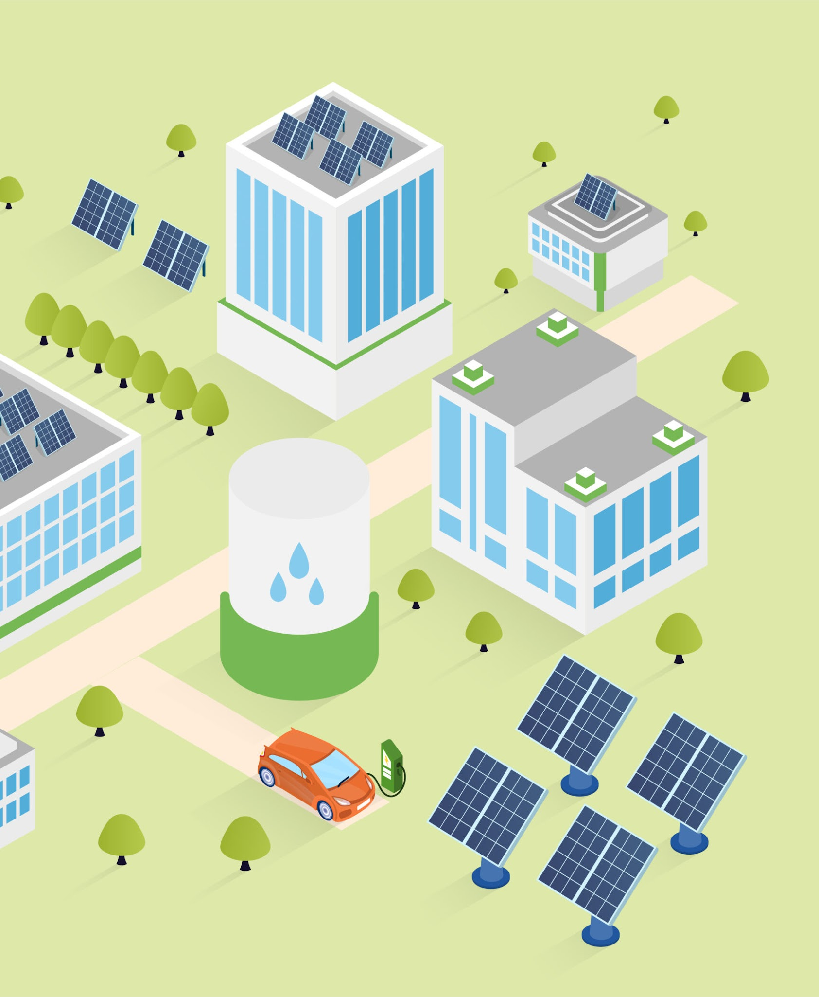
Rationale
You are an energy system planner working on the long-term development of the energy system in Addis Ababa. You are preparing inputs for a multi-energy system, and need to integrate electric vehicle (EV) demand over three planning horizons:
2030 (early adoption)
2035 (scale-up phase)
2040 (mass adoption)
Your goal is to generate EV charging demand patterns that can be directly used in system-level simulations. You also want to assess how PV can couple with EV demand and how this affects net demand and peak load.
Your objective is to obtain a first-order understanding of:
How EV adoption and usage shape demand in time and space
The potential of PV to offset EV demand and better align it with PV generation
Implications for planning and policies to minimize peak load and infrastructure needs

Slide 3
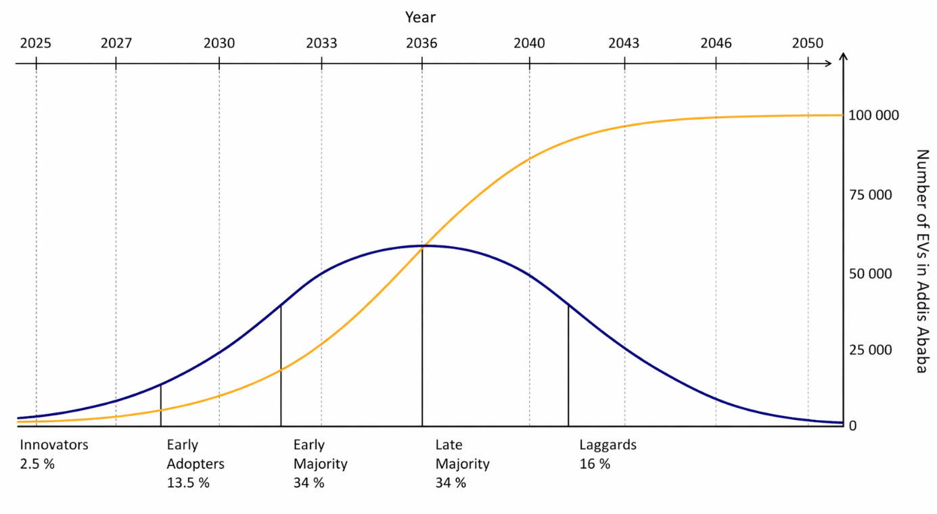
1. Multi-year scenarios (2030–2040)
The growth of electric vehicles (EVs) is expected to follow a typical logistic (S-shaped) adoption curve observed for new technologies. For simplicity, we assume a saturation level of 100,000 EVs in Addis Ababa (the real number is likely to be higher).
Driven by current policies and incentives, EV adoption is expected to grow rapidly until around 2035. After this point, the growth rate slows as the market approaches saturation. By approximately 2040, a large share of the vehicle fleet is expected to be electric.
Beyond the total number of EVs, the composition of users will also evolve over time. Different adopter groups are likely to exhibit distinct charging behaviors: before 2030 adoption is dominated by early adopters, 2030–2035 early majority users become increasingly prominent, 2035–2040 the late majority constitutes a growing share of users. As a result, not only does EV adoption increase over time, but charging behavior also changes as the user base broadens.

Slide 4
1. Multi-year scenarios (2030–2040)
You assume the following scenario for the difference years
 | 2030 | 2035 | 2040
Number of EVs | 10 000 | 50 000 | 80 000
Charging scenario | 10% Home 40% POI 50% Workplace | 30% Home 30% POI 40% Workplace | 60% Home 20% POI 20% Workplace
📌 TASK: Run a simulation with the 2030 scenario (10 000 EVs) and
a 3 × 3 km grid
default parameters otherwise.

Slide 5
1. Multi-year scenarios (2030–2040)
🔎 QUESTIONS
In which zone is the charging demand the highest? How much is it? Does this represent a lot additional demand compared to the current demand (assuming 2 kWh/day/household) ?
What is the total demand per car? What if every household would have a an electric car?
Do these spatial patterns make sense to you? Hint: Display the density of workplaces and POIs layers
Why is the density of workplaces and POI a good proxy for charging demand at these places in Addis Ababa? Hint: look also at the spatial population distribution

Slide 6

2. Spatial evolution
You are now interested in how EV charging demand evolves geographically over the years as this will be a very input for other models such as power system models.
📌 TASK: Make a screenshot of the spatial EV demand for each scenario (2030 / 2035 / 2040) and copy/paste them below. Keep track also of the total charging demand.
2030
2035
2040

Slide 7
2. Spatial evolution
🔎 QUESTIONS
How does the spatial distribution of charging demand evolve over time? Do demand hotspots become more concentrated or do they spread over time? Why?
Which zones consistently remain important hotspots throughout the years?
How does the total charging demand evolve over time? In particular, why does it appear to scale linearly with the number of electric vehicles? What underlying assumptions drive this linear relationship? Which key inputs could be adjusted to refine the model?

Slide 8
3. Temporal charging demand
You know focus on the evolution of the hourly demand on a typical day. This will be an important input as it drives the complementarity with renewables and other loads.
📌 TASK: Make a screenshot of the EV load curves for each year and copy/paste them below.
2030
2035
2040

Slide 9
3. Temporal charging demand
🔎 QUESTIONS
How does the shape of the total demand evolve over time? Which charging mode (home/work/POI) contributes the most to the total charging demand peak in each year?
In 2040, the share of home charging is higher than at work. Why is the peak contribution from workplaces still so high?
In 2030, why does the load curve appear somewhat “noisy”? Download the data and note the value of the peak power, then rerun the simulation: Is it the same? Why?

Slide 10
4. EV-PV Complementarity
📌 TASK: Simulate 10 MW of PV installed capacity under the 2030 scenario.
🔎 QUESTIONS
What are the energy coverage ratio and self-sufficiency levels? From an energy demand perspective, would installing PV be effective in reducing the net EV charging demand?
What does a self-consumption value < 1 indicate? What additional analysis would you perform to assess:
Peak power reduction potential (impact on peak grid import / net load peaks)
Appropriate PV sizing guidelines, i.e. how much PV capacity should be deployed to:
minimize grid demand,
while maximizing self-consumption and avoiding excess generation/export?

Slide 11
5. Sensitivity, charging power, recommendations
🔎 QUESTIONS
Assuming that the spatial resolution (3 × 3 km) is acceptable for a first-order planning model, which key results, temporal or spatial, are most sensitive to charging behaviour?
How does charging power influence system peaks and load shape? What happens to the demand profile if you change charging power assumptions?
At workplace charging, what is the impact of reducing charging power to 3 kW (slow charging)?
At POI charging, what is the effect of increasing charging power from 50 kW to 200 kW (fast charging)?
Is the expected long-term shift toward more home charging inherently beneficial or could it create new challenges? Which policy or economic instruments could encourage people to charge during the day?

