Slide 1
SARRTHI
Proactive compliance and payment monitoring for MSME suppliers to government transport bodies

Slide 2
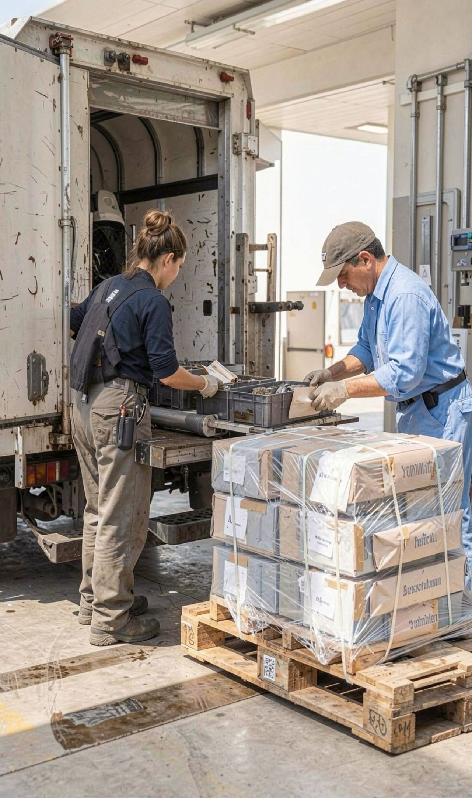



THE PROBLEM
MSME suppliers discover the loss too late
Working capital
Visibility gap
Damage signals
Delayed payments lock working capital and can trigger cascading financial stress.
Vendors lack live visibility into the statutory 45-day payment window.
Quota shortfalls and retroactive specification changes are difficult to detect before damage occurs.
02

Slide 3

THE GAP IN THE CURRENT REMEDY
The current remedy starts after the default
After the problem exists
Before the problem is visible
Upstream layer
The MSME ODR Portal supports dispute resolution after a payment problem exists.
It does not provide a vendor-facing payment clock, buyer risk view, quota monitoring, or specification-change alerts.
SARRTHI is designed as a complementary upstream layer, not a replacement for government dispute resolution.
03

Slide 4
FROM REACTIVE TO PROACTIVE
SARRTHI turns reactive disputes into proactive action
Evidence enters once. Deadlines, risk, and escalation stay connected.
01
02
03
Capture
Monitor
Act
Capture invoices, purchase orders, delivery proof, and business data.
Track payment deadlines, estimate interest, and surface buyer or compliance risk.
Alert the vendor early, organize evidence, and prepare an ODR-ready escalation package.
04

Slide 5



PRODUCT SURFACE
One command desk for the vendor lifecycle
Dashboard
Operations
Intelligence
KPIs, monthly trends, alerts, and buyer-risk indicators.
Tenders, purchase orders, deliveries, invoices, and payment status.
Compliance, documents, reports, business profile, and working-capital visibility.
A single command desk connects the vendor lifecycle from transaction to decision.
05

Slide 6
CORE WORKFLOW
The 45-day payment clock is the core workflow
01
02
03
04
Day 0
Day 30
Day 40
Overdue
Invoice created. Status is paid, upcoming, or overdue.
Upcoming payment remains visible with assumptions shown.
Early alert gives the vendor time to organize evidence.
Escalation package is prepared for an ODR-ready path.
Configurable monitoring supports the 45-day MSMED assumption and makes calculation assumptions visible.
Interest figures are estimates for planning, not guaranteed recoveries or legal advice.
06

Slide 7

DEMO READINESS
The prototype is designed for a real demo
Persistent demo mode
Core views
Operational handoff
Realistic sample data is persisted in the browser.
Dashboard metrics, invoices, purchase orders, tenders, compliance, documents, reports, and profile details.
CSV export and print-friendly reporting support academic demonstration and future operational use.
07

Slide 8



RELEASE ARCHITECTURE
A modular monolith keeps the first release buildable
React
Java Spring Boot
PostgreSQL
Presents dashboards and forms through REST APIs.
Owns payment clocks, interest estimates, risk scoring, and alerts.
Stores users, invoices, documents, alerts, and compliance records.
Modules stay separated so higher-scale services can be extracted later.
08

Slide 9
IMPLEMENTATION BASELINE
Technology stack aligns with the project mandate
Backend
Frontend
Java 17 LTS, Spring Boot, Spring Security, JWT, Spring Data JPA, Hibernate.
React.js with a responsive interface.
Data and delivery
Phased capabilities
PostgreSQL, cloud object storage, Docker, CI/CD.
OCR, WhatsApp Business, email, Tally, GST e-invoice, and TReDS.
Supporting integrations are phased capabilities, keeping the first release aligned to the project mandate.
09

Slide 10
DECISION SUPPORT
Compliance intelligence adds decision support
Quota performance
Specification alerts
Estimate MSME procurement-quota performance by buyer or zone.
Surface specification-change alerts relevant to a vendor’s product categories.
Buyer risk
Clear boundaries
Build buyer-risk profiles from aggregated, anonymized evidence.
Keep estimates clearly labelled and separate from official government data.
SARRTHI complements the MSME ODR Portal; it does not arbitrate, mediate, or replace it.

