Slide 1

SPT Progress Meeting
November 2026
Omar Mohamed – Practical Work (GBST-BERT)

Slide 2
Recap
Status at the last meeting: GBST-BERT = learned tokenizer (GBST) + small BERT encoder, 2.1M parameters
  Pretrained on the human genome (hg38) with the DNA-xLSTM short-context protocol: 10,000 steps
  Compared with the same model without GBST (Transformer++, 2.0M parameters)
Next step decided: test the model on real biology tasks
  Nucleotide Transformer benchmark (18 tasks), evaluated exactly like the Bio-xLSTM paper

Slide 3
Progress (1/6): pretraining and benchmark
Pretraining (test set): masked-base accuracy 56.44% vs 56.33% for Transformer++ (loss 0.975 vs 0.977)
Nucleotide Transformer benchmark: 18 tasks × 10 repeats, Bio-xLSTM protocol
  Histone marks, enhancers, promoters, splice sites
  Paper's learning rate and batch size per task (Table A5); best validation epoch tested
Result: best of all 7 models on 13 of 18 tasks
  Better than Transformer++ on 16 of 18 tasks → the learned tokenizer helps
  Better than the best published model on 12 tasks, tied on 1
  Weakest task: enhancer or not (−0.21 vs best paper model)

Slide 4
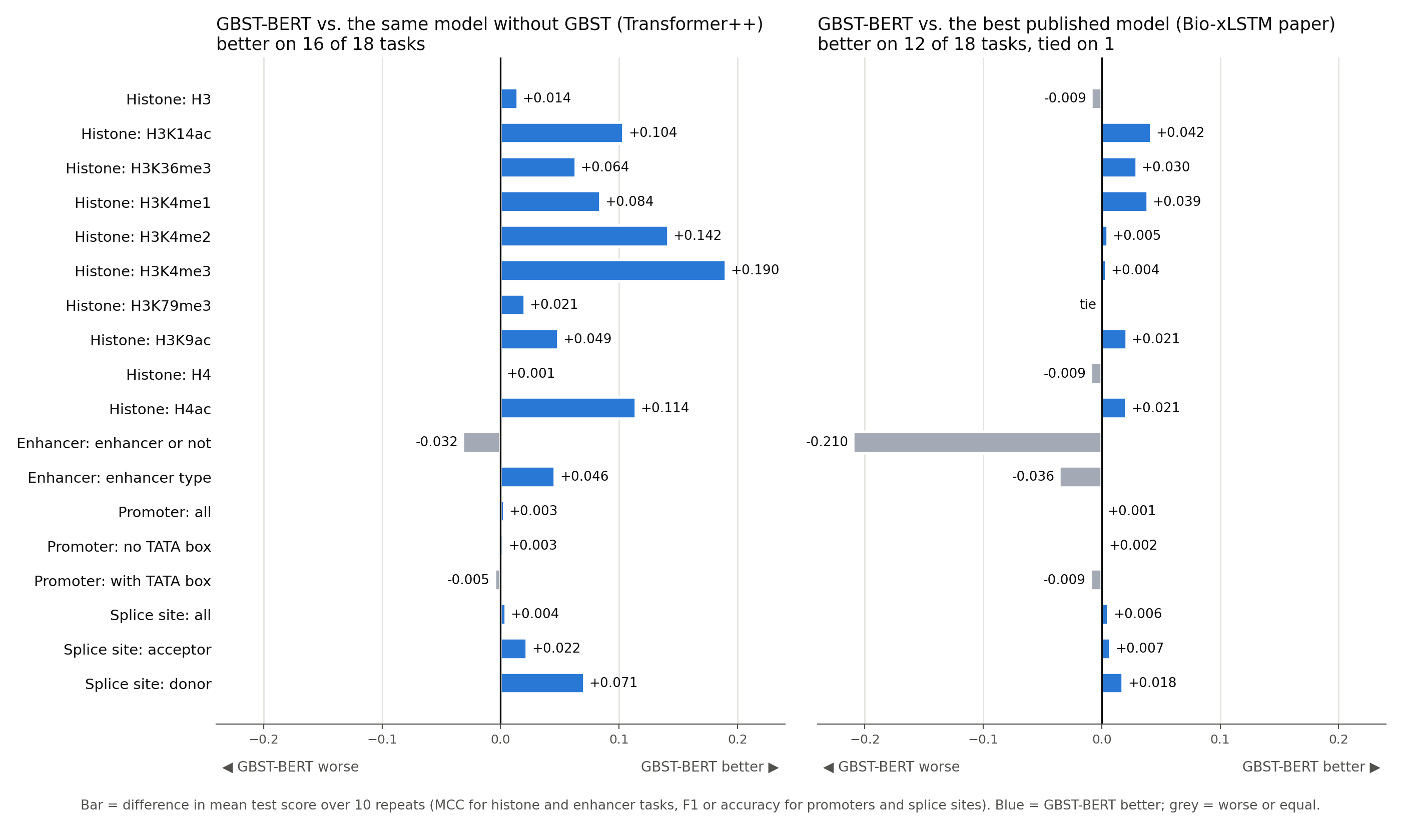
Progress (2/6): GBST-BERT vs other models
Blue = GBST-BERT better
Left: same model without GBST
Right: best model in the Bio-xLSTM paper
Score = mean test score over 10 repeats

Slide 5
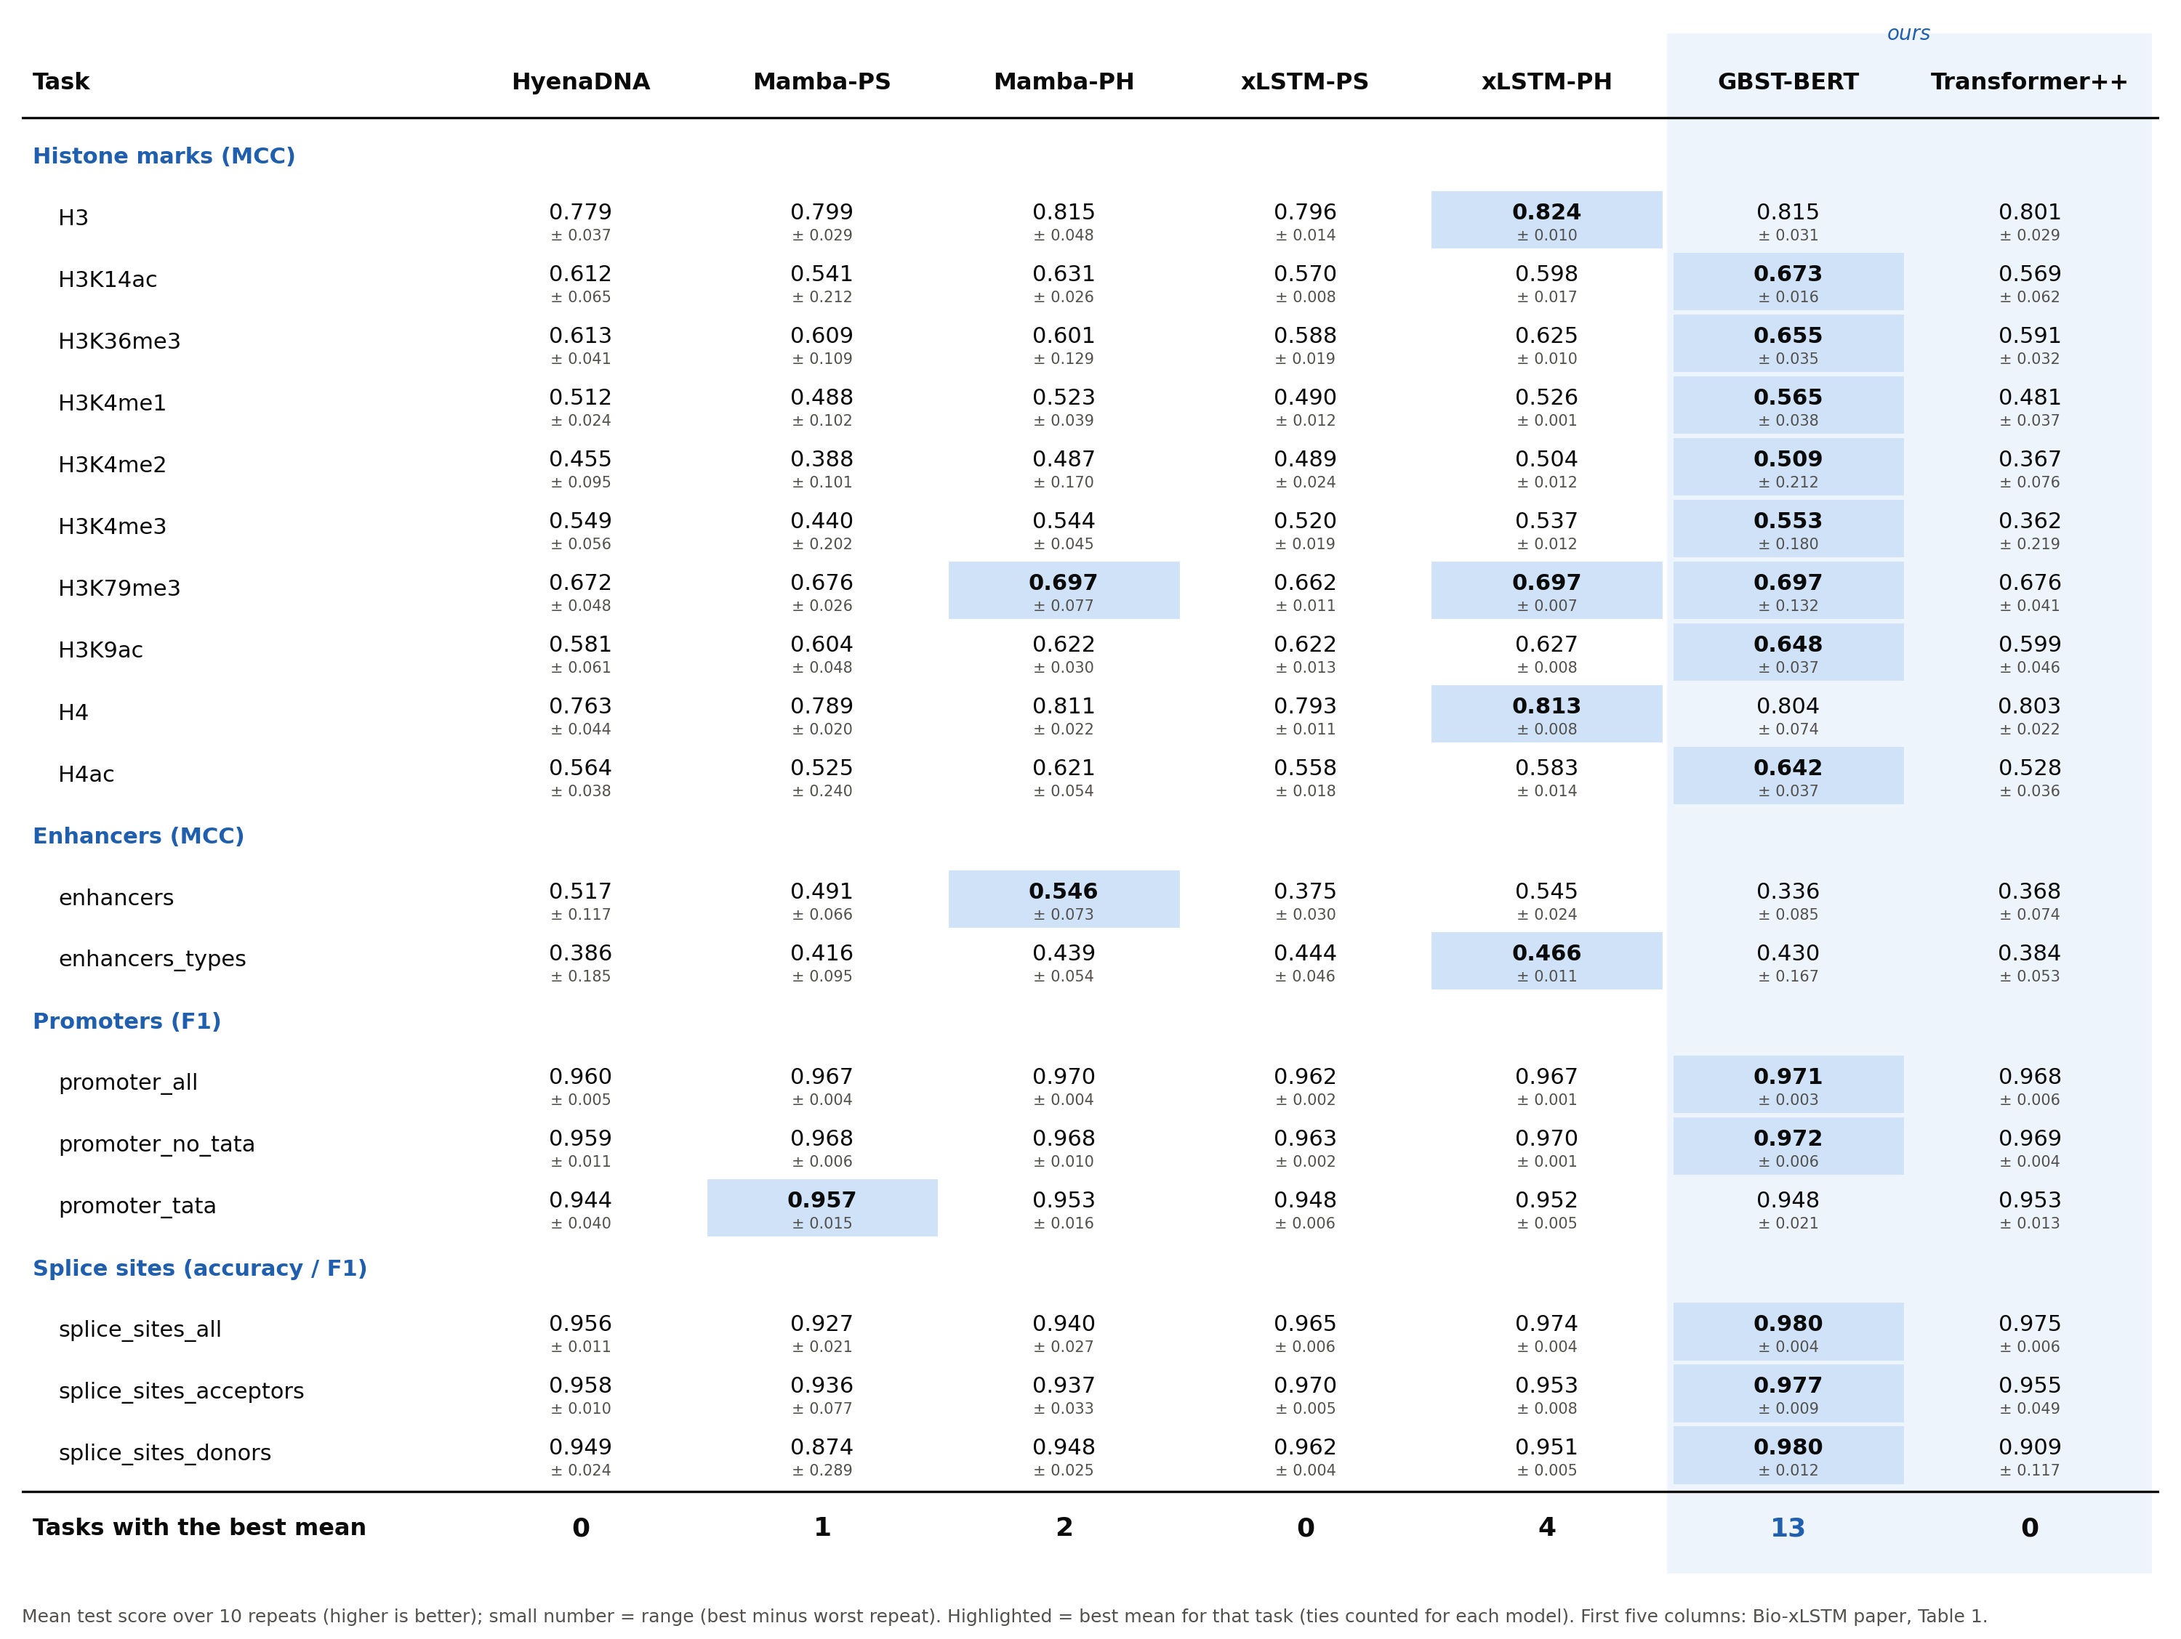
Progress (3/6): results of all 7 models

Slide 6
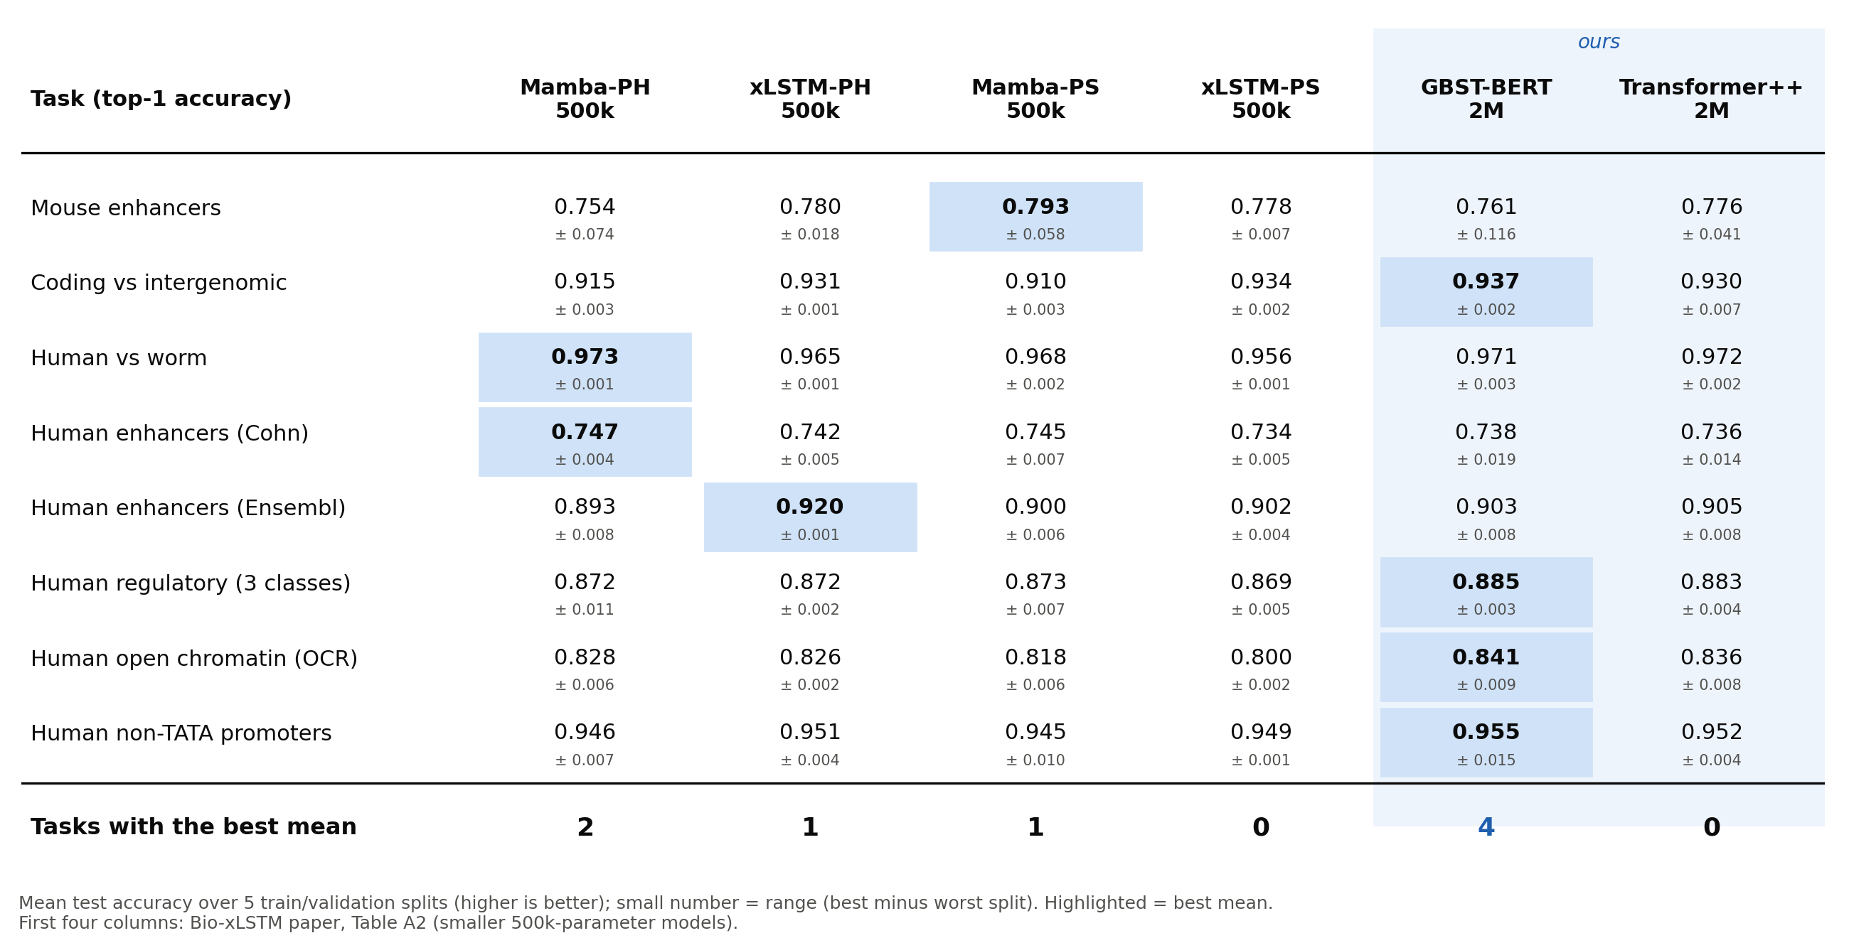
Progress (4/6): new data – Genomic Benchmarks
8 tasks (Grešová et al. 2023) · human, mouse, worm DNA · 5 splits × 10 epochs · test accuracy

Slide 7
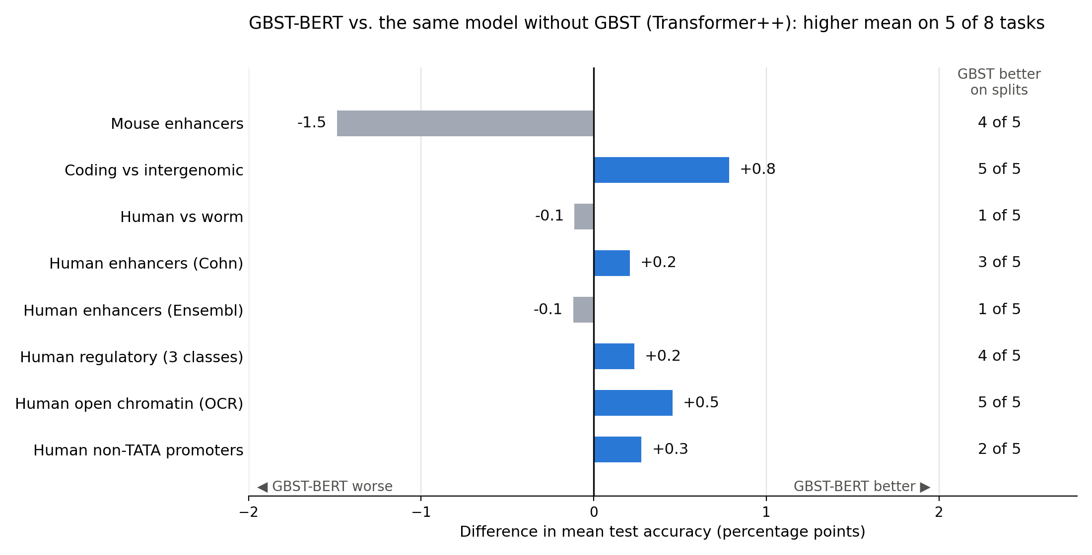
Progress (5/6): does GBST help here?
Higher mean than Transformer++ on 5 of 8 tasks
Best of all 6 models on 4 of 8
Gains small (≤ 0.8 points); clearest on coding and open chromatin (5 of 5 splits)
Mouse enhancers: tiny dataset (1,210 sequences), one bad split
Paper models are 4× smaller → compare mainly with Transformer++

Slide 8
Progress (6/6): findings and questions
What GBST learned: 98% of its weight on 1-base blocks, so it hardly merges bases
  The gain probably comes from the extra convolution (local context), not from real "words"
Implemented / written: one clean model file (gbst_bert.py, tested against the training code)
  Full notebook that re-runs every step on the server; report, poster, slides; all on GitHub
Questions :
  Is this result enough for the practical work, or should I do more experiments?
  Learning-rate search per task, or keep the paper's settings for a fair comparison?
  Longer pretraining (20k steps) or longer sequences (2048)?

Slide 9
Next steps
Before the next meeting :
  Small learning-rate / batch-size search on the weakest tasks (enhancers)
  Check whether GBST merges more bases with longer pretraining or longer sequences
  Finish the written report with the benchmark results

