Slide 1
GBST-BERT: does a learned tokenizer help a small DNA language model?
Practical work: pretraining on the human genome (hg38) and 18 prediction tasks
Presented by Omar Mohamed, K12103822
Notes:
One sentence: I built a small DNA language model that learns how to cut DNA into pieces by itself (GBST), trained it on the human genome, and tested whether this helps on 18 biology tasks.

Slide 2
Problem Overview
Problem: a DNA language model must first cut DNA into tokens – single bases or fixed k-mers. A fixed cut can split a motif in the wrong place.
Question: does a learned tokenizer (GBST, from ChaRNABERT) help a small model learn the human genome and predict biology?
Relevance: models that read DNA predict promoters, enhancers, splice sites and histone marks from sequence alone – a basis for interpreting genomes and variants.
State of the art: Bio-xLSTM (2024) compares small DNA models – HyenaDNA, Mamba, xLSTM – on the 18-task Nucleotide Transformer benchmark.
Three ways to cut the same DNA
Single bases
T A T A A A G G C
fine detail, no grouping
Fixed 3-mers
TAT | AAA | GGC
can split a motif (TATA box)
GBST (learned)
TATAAA | G | GC
block sizes 1–4 learned (illustration)
ChaRNABERT: Morales-Pastor et al. 2024, arXiv:2411.11808 · Bio-xLSTM: Schmidinger et al. 2024, arXiv:2411.04165
Notes:
Tokenization is the first step of every language model. For DNA people use single bases or fixed k-mers; fixed k-mers can cut a motif like the TATA box in the wrong place. GBST looks at blocks of 1 to 4 bases at every position and learns how much to trust each block size.

Slide 3
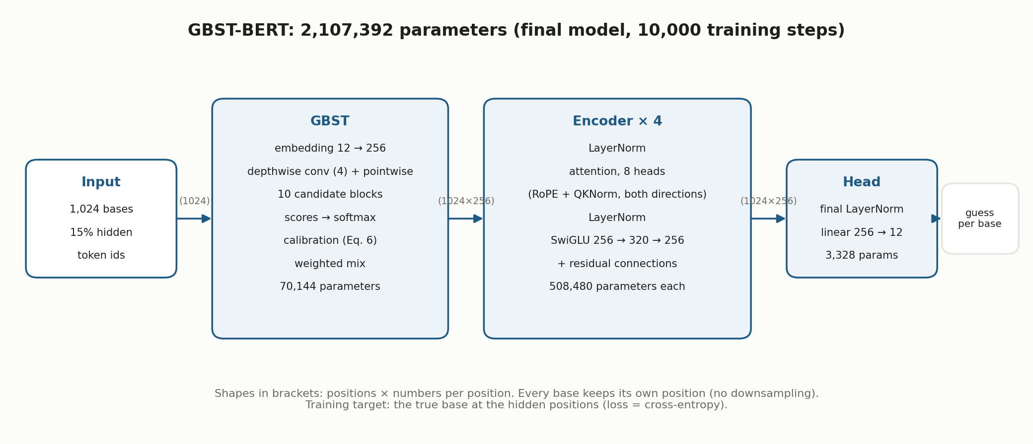
Method Interpretation
How it works: GBST mixes each base with its neighbours, scores candidate blocks of 1–4 bases and returns a weighted mix – one vector per base – which a bidirectional BERT encoder reads.
Notes:
Read the figure left to right. 1,024 bases go in, 15% are hidden. GBST: embedding, a 4-base convolution, 10 candidate blocks, learned scores, weighted mix (70,144 parameters). Then 4 encoder blocks with attention in both directions, RoPE and QKNorm, SwiGLU. The head guesses the hidden bases. 2,107,392 parameters in total.

Slide 4
Why this approach
1
2
3
Learned, not fixed
A clean comparison
A fair benchmark
GBST decides from the data how to group bases, while every base keeps its own position – a single-base change (SNP) still changes the input.
Control model Transformer++: the 2 M Transformer of Bio-xLSTM, same size, same training, plain lookup table instead of GBST.
Pretraining and fine-tuning follow the Bio-xLSTM protocol exactly, so our numbers sit next to the published HyenaDNA, Mamba and xLSTM results.
2,107,392
70,144
2,036,992
parameters in GBST-BERT
of them in GBST (3%)
parameters in Transformer++
Notes:
Three reasons for the design. The only real difference between the two models is the tokenizer (plus small details like the normalisation type), so differences in results point at GBST.

Slide 5
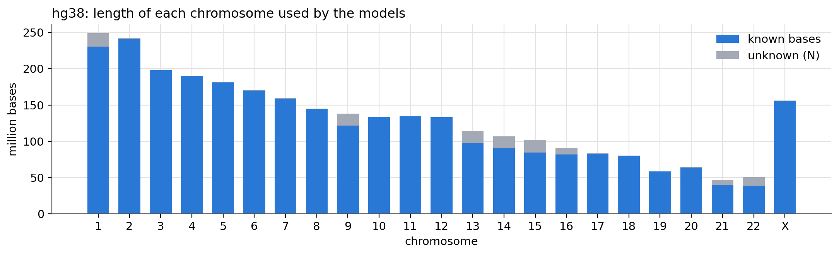
Data: the human genome hg38
3.03 billion
2.33 billion
0.29 / 0.27
bases, chromosomes 1–22 and X (4.0% unknown, N)
distinct training bases (34,021 regions)
billion validation / test bases – never seen in training
Notes:
The genome as prepared by the DNA-xLSTM repository. A BED file assigns regions to train, validation and test; each region is widened to 2^20 bases and cut into 1,024-base examples. Splits never overlap.

Slide 6
Pretraining: identical protocol for both models
Task | masked language modelling: hide 15% of bases, guess them
Batch | 1,024 sequences × 1,024 bases per step
Length | 10,000 steps = 10.5 billion bases per model
Optimiser | AdamW (0.9, 0.95), weight decay 0.1, cosine schedule
Learning rate | GBST-BERT 2e-3 (checked: 5e-4 … 5e-3); Transformer++ 1e-2
Hardware | 4 GPUs (JKU student servers), 32-bit precision
Same data, same masks, same schedule: only the tokenizer differs. Settings from Bio-xLSTM App. C.5 and Tables A3–A4; the learning rate of GBST-BERT was chosen by a 500-step check, Transformer++ uses the paper's value.
Notes:
The pretraining protocol is the short-context protocol of Bio-xLSTM. Each model saw exactly 10.5 billion bases. Only GBST-BERT's learning rate was tuned.

Slide 7
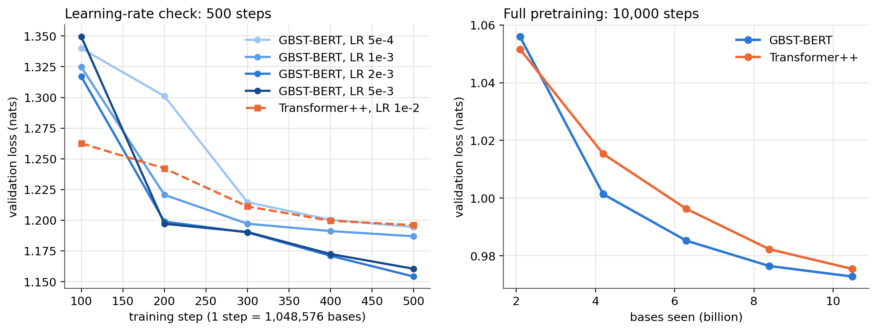
Pretraining result: almost level at the end
56.44%
GBST-BERT: hidden bases guessed right (2,048 test sequences)
56.33%
Transformer++
25%
random guessing
Left: 500-step learning-rate check – 2e-3 lowest loss. Right: full runs – GBST-BERT ahead from 4 to 8 billion bases, final validation loss 0.9728 vs 0.9755.
A 0.1-point gap from one pretraining run per model is too small to call. Test loss 0.9753 vs 0.9774.
Notes:
Loss = how surprised the model is by the true base; lower is better, 1.386 is random. Both models reach 56% accuracy, more than twice chance. On this measure alone we cannot say GBST helps.

Slide 8
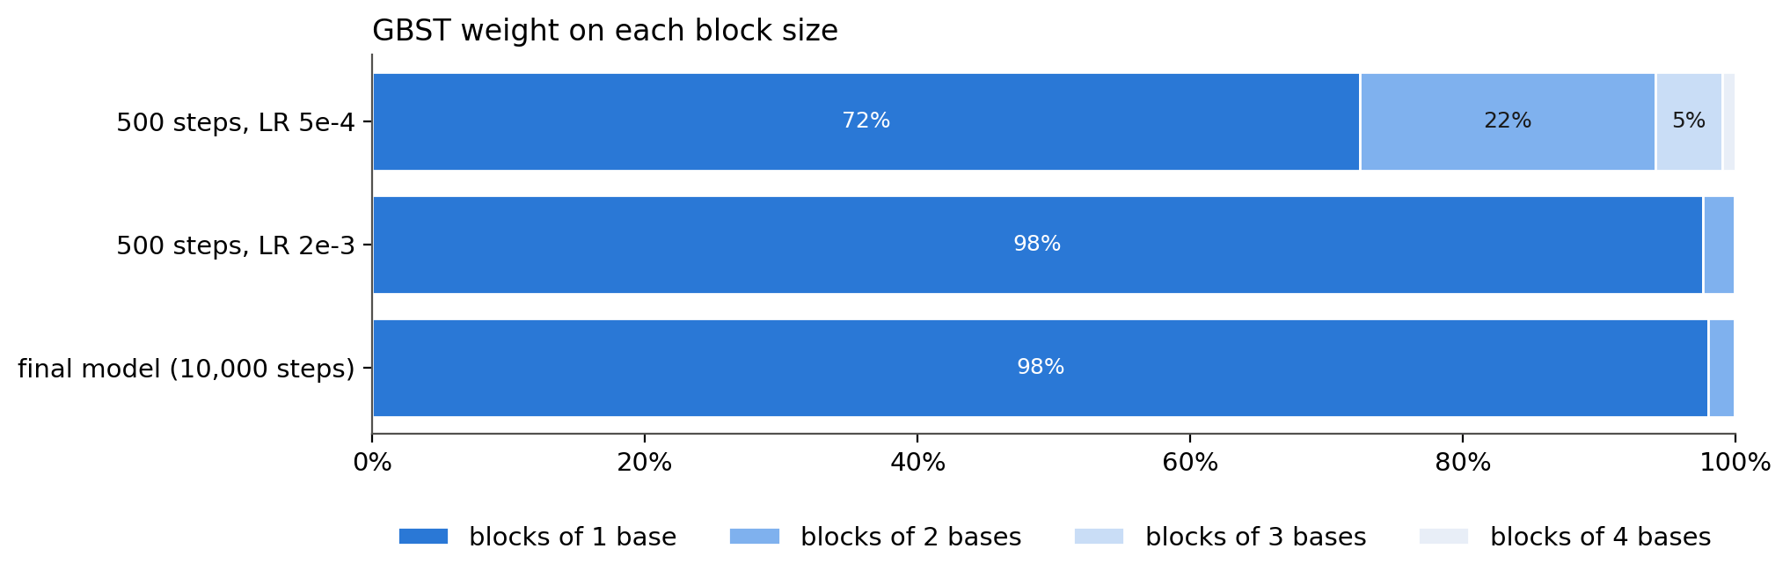
Inside the model: GBST chose single bases
98%
of GBST's weight is on single-base blocks in the final model
Early in training (LR 5e-4) it still used longer blocks: 72 / 22 / 5 / 1%.
Each base still sees its 3 neighbours through the convolution before the blocks.
Interpretation: on human DNA, GBST does not learn longer “words”. It behaves like a single-base model with a small local window in front – a likely reason why the pretraining losses end so close.
Average over 8 hg38 sequences from different chromosomes, 15% of bases hidden.
Notes:
GBST weights per block size. The original idea of learning multi-base words is not what happens on human DNA: the model prefers single bases.

Slide 9
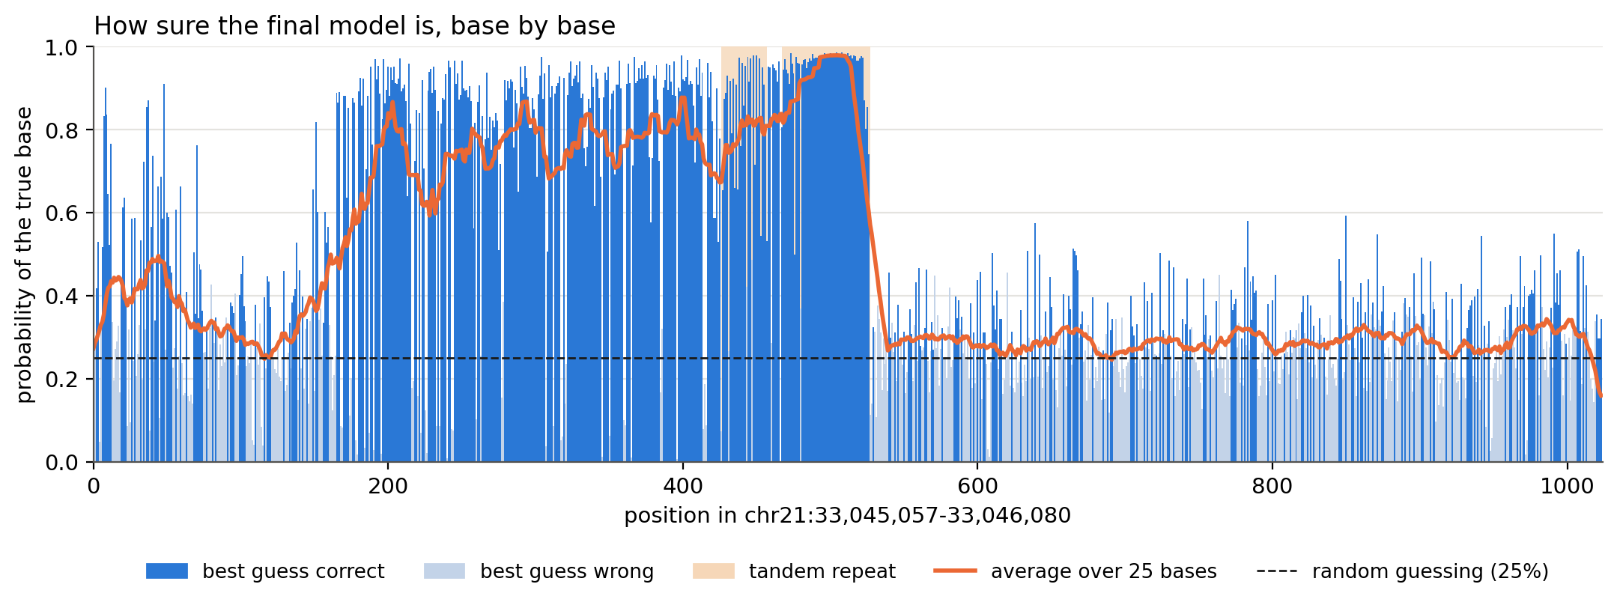
Inside the model: it learned real DNA structure
94.5%
of hidden bases right inside tandem repeats
50.8%
right in the rest of the window
25%
chr21:33,045,057–33,046,080, every base hidden once. Shaded: tandem repeats such as (GAAA)n.
random guessing
Notes:
Every base of a 1,024-base window of chromosome 21 was hidden once. Inside tandem repeats such as (GAAA)n the model predicts almost every base; in unique sequence it is much less sure.

Slide 10
Prediction tasks: the Nucleotide Transformer benchmark
10
2
3
3
Histone marks
Enhancers
Promoters
Splice sites
Is this DNA on a nucleosome with a given mark (H3K4me3, …)? Score: MCC
Is it an enhancer, and which type? Score: MCC
Is it a promoter (all, with / without TATA box)? Score: F1
Donor, acceptor or neither? Score: F1 / accuracy
Same protocol as Bio-xLSTM: pretrained model + mean pooling + linear layer, whole model fine-tuned for 20 epochs, both DNA strands averaged, best validation epoch tested, 10 repeats per task (360 runs). Per-task learning rate and batch from the paper (Table A5); on splice acceptors / donors these made GBST-BERT collapse, so 1e-3 and 5e-4 were also tried and chosen by validation score.
MCC: 0 = guessing, 1 = perfect. Data: InstaDeepAI/nucleotide_transformer_downstream_tasks.
Notes:
The standard downstream test of the Bio-xLSTM paper. Each repeat uses a new split of training and validation data, so the range over repeats shows how stable a result is. The test set never chooses anything.

Slide 11
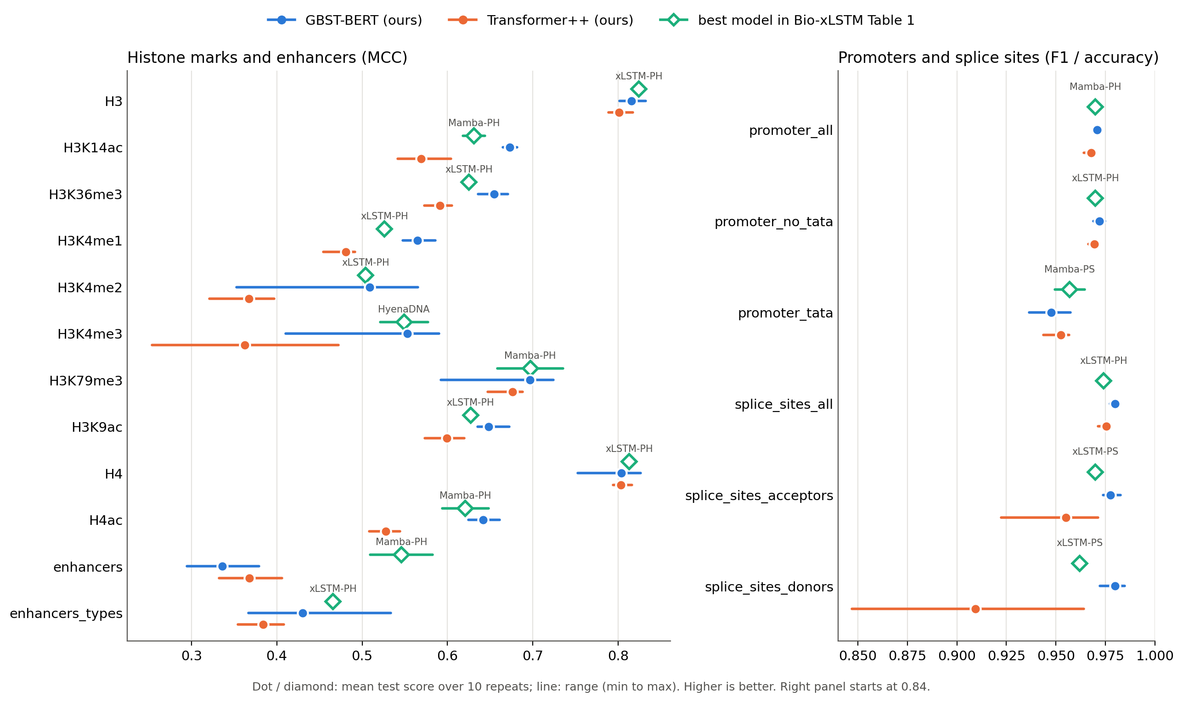
Results: GBST-BERT is furthest right on most tasks
How to read it
One row per task; further right is better.
Dot = mean of 10 repeats; line = worst to best repeat.
Blue GBST-BERT, orange Transformer++, green: best model of the paper.
Strongest: splice sites and histone marks.
Weakest: enhancers, for both of our models.
Notes:
Example row H3K14ac: GBST-BERT 0.673, best paper model Mamba-PH 0.631, Transformer++ 0.569, with a short range. Splice sites bottom right: GBST-BERT best with short lines. Enhancers bottom left: both our models behind.

Slide 12
All models: histone marks (MCC)
Task | HyenaDNA | Mamba-PS | Mamba-PH | xLSTM-PS | xLSTM-PH | GBST-BERT | Transformer++
H3 | 0.779 ±0.037 | 0.799 ±0.029 | 0.815 ±0.048 | 0.796 ±0.014 | 0.824 ±0.010 | 0.815 ±0.031 | 0.801 ±0.029
H3K14ac | 0.612 ±0.065 | 0.541 ±0.212 | 0.631 ±0.026 | 0.570 ±0.008 | 0.598 ±0.017 | 0.673 ±0.016 | 0.569 ±0.062
H3K36me3 | 0.613 ±0.041 | 0.609 ±0.109 | 0.601 ±0.129 | 0.588 ±0.019 | 0.625 ±0.010 | 0.655 ±0.035 | 0.591 ±0.032
H3K4me1 | 0.512 ±0.024 | 0.488 ±0.102 | 0.523 ±0.039 | 0.490 ±0.012 | 0.526 ±0.001 | 0.565 ±0.038 | 0.481 ±0.037
H3K4me2 | 0.455 ±0.095 | 0.388 ±0.101 | 0.487 ±0.170 | 0.489 ±0.024 | 0.504 ±0.012 | 0.509 ±0.212 | 0.367 ±0.076
H3K4me3 | 0.549 ±0.056 | 0.440 ±0.202 | 0.544 ±0.045 | 0.520 ±0.019 | 0.537 ±0.012 | 0.553 ±0.180 | 0.362 ±0.219
H3K79me3 | 0.672 ±0.048 | 0.676 ±0.026 | 0.697 ±0.077 | 0.662 ±0.011 | 0.697 ±0.007 | 0.697 ±0.132 | 0.676 ±0.041
H3K9ac | 0.581 ±0.061 | 0.604 ±0.048 | 0.622 ±0.030 | 0.622 ±0.013 | 0.627 ±0.008 | 0.648 ±0.037 | 0.599 ±0.046
H4 | 0.763 ±0.044 | 0.789 ±0.020 | 0.811 ±0.022 | 0.793 ±0.011 | 0.813 ±0.008 | 0.804 ±0.074 | 0.803 ±0.022
H4ac | 0.564 ±0.038 | 0.525 ±0.240 | 0.621 ±0.054 | 0.558 ±0.018 | 0.583 ±0.014 | 0.642 ±0.037 | 0.528 ±0.036
Mean over 10 repeats ± range (best − worst). Highlighted: best mean (ties marked for each). Columns 1–5: Bio-xLSTM Table 1.
Notes:
GBST-BERT is best on 8 of 10 histone tasks, one a three-way tie (H3K79me3). xLSTM-PH is best on H3 and H4. Compare the last two columns: GBST-BERT is higher than Transformer++ on all 10.

Slide 13
All models: enhancers, promoters and splice sites
Task | HyenaDNA | Mamba-PS | Mamba-PH | xLSTM-PS | xLSTM-PH | GBST-BERT | Transformer++
enhancers | 0.517 ±0.117 | 0.491 ±0.066 | 0.546 ±0.073 | 0.375 ±0.030 | 0.545 ±0.024 | 0.336 ±0.085 | 0.368 ±0.074
enhancers_types | 0.386 ±0.185 | 0.416 ±0.095 | 0.439 ±0.054 | 0.444 ±0.046 | 0.466 ±0.011 | 0.430 ±0.167 | 0.384 ±0.053
promoter_all | 0.960 ±0.005 | 0.967 ±0.004 | 0.970 ±0.004 | 0.962 ±0.002 | 0.967 ±0.001 | 0.971 ±0.003 | 0.968 ±0.006
promoter_no_tata | 0.959 ±0.011 | 0.968 ±0.006 | 0.968 ±0.010 | 0.963 ±0.002 | 0.970 ±0.001 | 0.972 ±0.006 | 0.969 ±0.004
promoter_tata | 0.944 ±0.040 | 0.957 ±0.015 | 0.953 ±0.016 | 0.948 ±0.006 | 0.952 ±0.005 | 0.948 ±0.021 | 0.953 ±0.013
splice_sites_all | 0.956 ±0.011 | 0.927 ±0.021 | 0.940 ±0.027 | 0.965 ±0.006 | 0.974 ±0.004 | 0.980 ±0.004 | 0.975 ±0.006
splice_sites_acceptors | 0.958 ±0.010 | 0.936 ±0.077 | 0.937 ±0.033 | 0.970 ±0.005 | 0.953 ±0.008 | 0.977 ±0.009 | 0.955 ±0.049
splice_sites_donors | 0.949 ±0.024 | 0.874 ±0.289 | 0.948 ±0.025 | 0.962 ±0.004 | 0.951 ±0.005 | 0.980 ±0.012 | 0.909 ±0.117
Best on (of 18) | 0 | 1 | 2 | 0 | 4 | 13 | 0
MCC for enhancers, F1 for promoters and splice acceptors / donors, accuracy for splice_sites_all. Last row: all 18 tasks, ties counted for each model.
Notes:
Enhancers: the paper's models are clearly better. Promoters: everybody near 0.95–0.97, GBST-BERT best on two of three. Splice sites: GBST-BERT best on all three. Overall GBST-BERT has the best mean on 13 of 18.

Slide 14
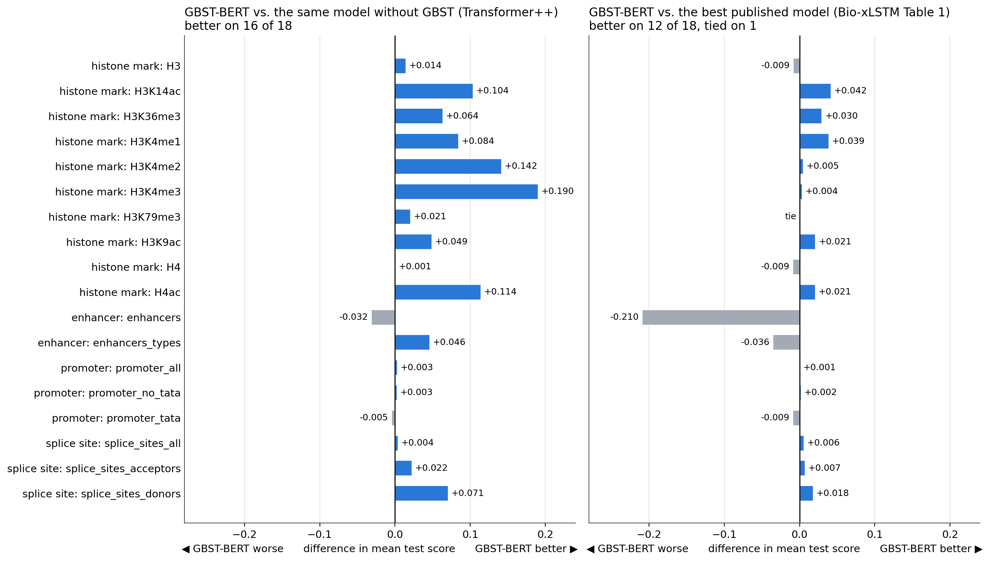
The GBST effect, task by task
16 / 18
tasks where GBST-BERT beats the same model without GBST
12 + 1 tie
tasks where it beats or ties the best published model
Biggest gains: H3K4me3 +0.19, H3K4me2 +0.14. Biggest loss: enhancers −0.21 vs the paper.
Notes:
Each bar is a difference in mean test score; right of zero means GBST-BERT is better. Left panel: the effect of GBST. Right panel: the comparison with the best published model per task.

Slide 15
Results Interpretation
Pretraining: both models learned human DNA (56% vs 25% chance); the 0.1-point gap is too small to call.
Prediction: the difference is clear – GBST-BERT beats Transformer++ on 16 of 18 tasks and has the best mean of all seven models on 13 of 18.
Why? GBST chose single bases (98%), so the gain likely comes from its local window and mixing layer – not yet proven, the models also differ in normalisation.
Limits: enhancers are weak for both models; some repeats trained poorly (wide ranges); fine-tuning settings were the paper's, not tuned for our models.
16 / 18
better than the same model without GBST
13 / 18
best mean of 7 models (xLSTM-PH: 4)
0.980
splice donor F1 (best paper model 0.962)
Notes:
Main message: pretraining loss could not separate the two models, but the prediction tasks can. Be honest about what is not shown yet: which part of GBST causes the gain.

Slide 16
GBST-BERT: advantages and disadvantages
Advantages
Disadvantages
Better than the same model without GBST on 16 of 18 tasks
Best mean of 7 models on 13 of 18, all 3 splice tasks
Keeps single-base resolution: a SNP still changes the input
Small cost: 70 k parameters, 3% of the model
No tokenizer to choose by hand; weights can be inspected
About 18% slower to fine-tune (962 s vs 816 s on H3)
Less stable: collapsed at high learning rates on splice tasks
On DNA it chose single bases – no longer “words” learned
Weak on enhancers, like our other model
Almost no gain in pretraining loss (0.1 points)
Notes:
The advantages are measured with 10 repeats per task. The fine-tuning time is from one timing run per model on task H3.

Slide 17
What was challenging
Genome reader bug
Benchmark loader bug
Parallel data readers shared one file and read wrong bases (up to 33%). Found after a crash, measured, fixed with a test.
Every task silently loaded the data of all 18 tasks. Fixed: one file per task.
Unstable fine-tuning
Long runs on shared GPUs
The paper's learning rates collapsed GBST-BERT on splice tasks. Re-chosen by validation score only.
10.5 billion bases per model, 384 fine-tuning runs; a full disk and a server error stopped the queue – fixed with checks and retries.
The first two were bugs in the original repository; every fix is documented on GitHub.
Notes:
The genome-reader bug: 0.35% wrong sequences with 2 workers, up to 33% with 12; wrong reads stayed in their own split, so no test DNA leaked. A Hugging Face server error made 9 jobs fail silently; they were re-run.

Slide 18
How to get better predictions
What to do – and how
Why (from our results)
1
Tune fine-tuning for our model Search learning rate and batch per task, choose by validation score:
Splice donors: 0.663 → 0.980 by the learning rate alone
LRS="1e-4 3e-4 1e-3" BATCH_SIZES="64 128" bash run_nucleotide_charna.sh
2
Average several fine-tuned models Ensemble: average the predictions of the 10 fine-tuned repeats of a task
Some single repeats failed (ranges up to ±0.21)
all 384 fine-tuned models are saved (GitHub release)
3
Pretrain longer More steps (and, if memory allows, a larger model):
Validation loss was still falling at 10,000 steps
MAX_STEPS=20000 bash run_pretrain_charna.sh
4
Give the model longer DNA Pretrain and fine-tune on longer pieces, for long-range signals:
Enhancers are the biggest gap: −0.21 vs the paper
SEQLEN=2048 bash run_pretrain_charna.sh
Only the effect of the learning rate (1) was measured; the gains of 2–4 are expected, not yet tested. Any new run: same repeats, choose by validation score, report every result.
Notes:
Four ways to get better predictions, ordered by how cheap they are. One: tune the fine-tuning settings for our model; the paper did this for its own models, and on splice donors the learning rate alone changed F1 from 0.663 to 0.980. Two: average the predictions of several fine-tuned models; the models already exist. Three: pretrain longer; the loss had not stopped falling. Four: give the model longer DNA, which should help enhancers. Only the first was measured in this project.

Slide 19
Conclusion and next steps
With 3% more parameters, a learned tokenizer made a small DNA model better at 16 of 18 biology tasks
– strongest on splice sites and histone marks, weak on enhancers.
1
2
3
Clean GBST test
Tune per model
Longer DNA context
Same model, GBST replaced by a lookup table – proves the gain comes from GBST
Learning-rate search for fine-tuning, as the paper did; fixes the wide ranges
Longer pretraining or longer pieces, to address enhancers
Code, models, notebook and results: github.com/OMAR622-ai/dna-xlstm-charna (branch charna-gbst)
Notes:
End on the one-sentence message. The most valuable next experiment is the clean test with everything identical except GBST.

