Slide 1
Q3 (Oct-Dec '23) Context Setting
26th August 2023

Slide 2
Q3 Planning Oct – Dec 2023
1
2
3
Context Setting (today)
Q3 Planning in teams (September)
Share back with wider Partnerships (26th Sep)
Notes:
What this is
A chance to make sure everyone has a view of the big picture to aid planning decisions for the next few months

Slide 3
Context Setting
Our wider ambition is stable
Update to our Objectives to be more holistic across Partnerships and focused on the outcomes
Wider context from the Product Group OKRs and Initiatives
Product leaders will work with teams to create Key Results as we make committed roadmaps
Important we now share our great work with Product Group and stakeholders

Slide 4


VALUE FOR ALL AUDIENCES
RENEW OUR COMMITMENT TO IMPARTIALITY
TRANSFORM THE
FOCUS ON UNIQUE, HIGH-IMPACT CONTENT
DIGITAL FIRST
LOCAL AND GLOBAL
EXTRACT MORE FROM ONLINE
BUILD COMMERCIAL
INCOME
GREAT PLACE TO WORK
Notes:
A reminder of the wider BBC Value For All Strategy of which Product Group plays a significant part

Slide 5
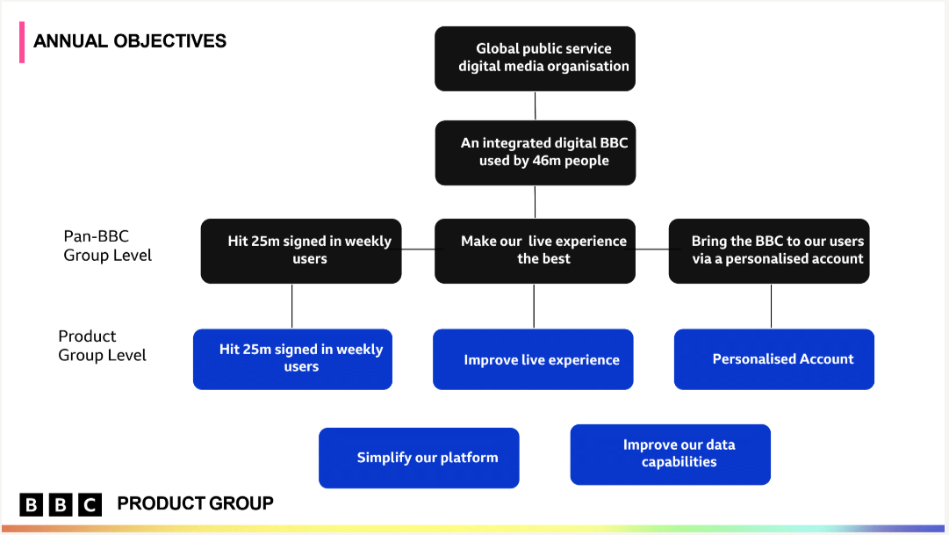
Product Group OKRS
Notes:
…Translated into the annual BBC and Product Group Objectives

Slide 6
Partnerships vision
We seamlessly integrate with our Partners’ platforms in order to create relevant and personalized journeys, that deliver users to the BBC ecosystem.

Slide 7
FY23 OBJECTIVES - WHAT THEY WERE
Single TV app discovery and experimentation
Core product / certification process streamlining
Data Standardisation across our top 5 partners*
Hit 25million signed in weekly users
OKR 9
Simplify our platform
OKR 13
Improve our Data capabilities OKR 14
Relevant trigger journeys from broadcast to iPlayer to increase conversion X%
Nitro / CPS / SVS decommissioned
Sustain activity down from 50% to 40%
Hit 25million signed in weekly users
OKR 9
Simplify our platform
OKR 13
Simplify our platform
OKR 13
* Goal to roll out across all, but start with our largest partners

Slide 8
FY23 OBJECTIVES for second half of year
Contribute to sustained growth of Weekly Average Accounts to 46m
Enable better decision making via an improved understanding of our data
Enable more capacity for growth and innovation in team via reduced sustain (DAVIS) needs
Hit 25million signed in weekly users
OKR 9
Improve our Data capabilities OKR 14
Simplify our platform
OKR 13
De-risk our products with a simplified platform
Our Partners want to work with us
Simplify our platform
OKR 13
* Goal to roll out across all, but start with our largest partners

Slide 9
Wider PG Context
FY23 OBJECTIVES for second half of year
* Goal to roll out across all, but start with our largest partners

Slide 10
Q3 Context Setting for Product Group
Programs to be aware of
Welsh Language
Nitro / CPS
NGP
Growth

Slide 11
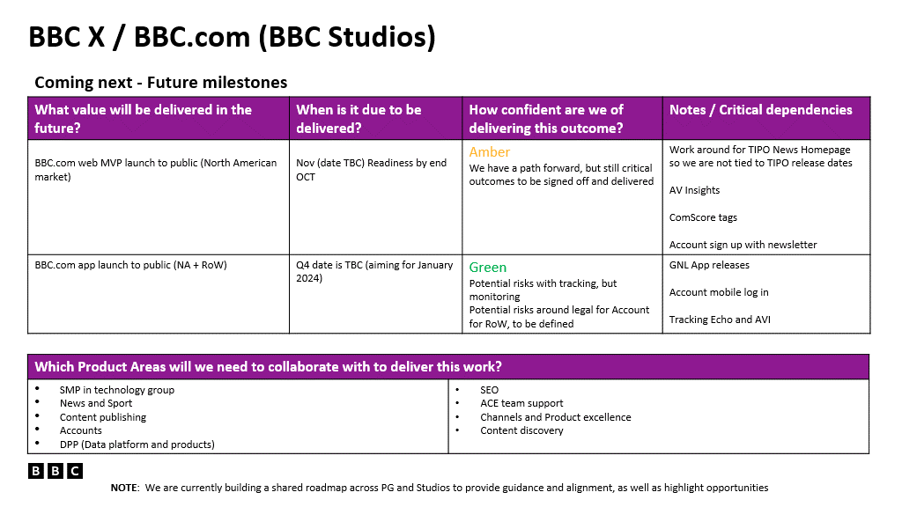
WIDER CONTEXT - OKRs
Context Setting across Product Group 240823 Q3 Context Setting.pptx

Slide 12
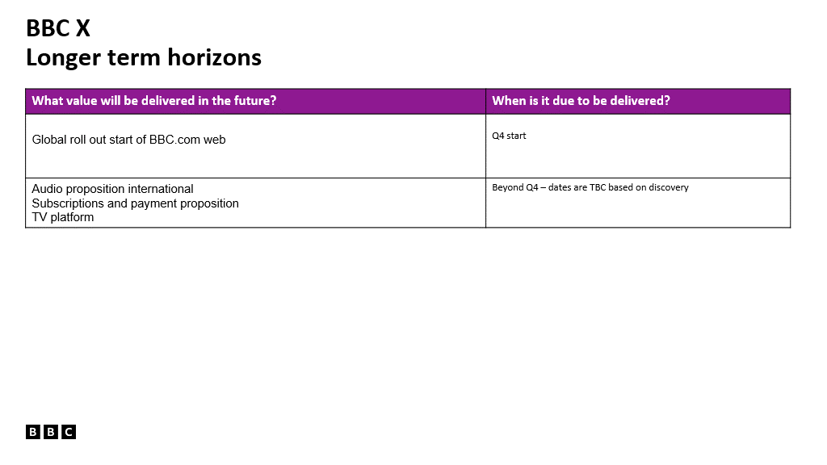
WIDER CONTEXT - OKRs
Context Setting across Product Group 240823 Q3 Context Setting.pptx

Slide 13
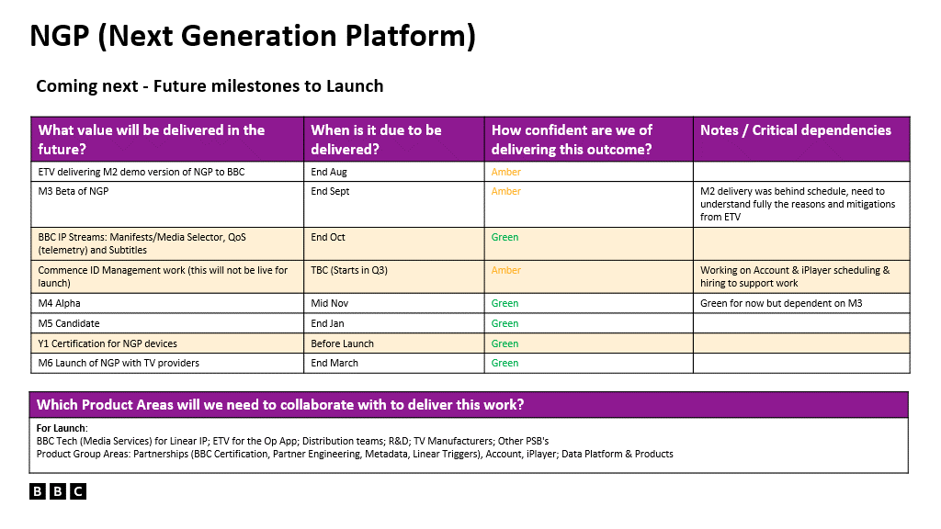
WIDER CONTEXT - OKRs
Context Setting across Product Group 240823 Q3 Context Setting.pptx

Slide 14
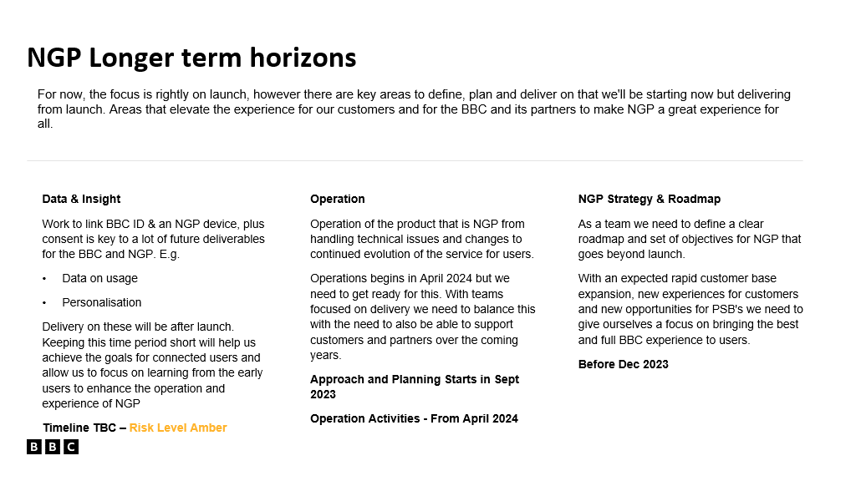
WIDER CONTEXT - OKRs
Context Setting across Product Group 240823 Q3 Context Setting.pptx

Slide 15
Recap
Our wider ambition is stable
Update to our Objectives to be more holistic across Partnerships and focused on the outcomes
Next steps, Product leaders will work with teams to create committed to roadmaps and ladder up Key Results to objectives
Important we now share our great work with Product Group and stakeholders
Notes:
Reminder…

Slide 16
Partnerships: Q3 Planning – Next Steps
1
2
3
Context Setting (today)
Q2 Planning in teams (September)
Share back with wider Partnerships (26 September)
Notes:
Lorna to cover this one

Slide 17
Questions?

Slide 18
Appendix

Slide 19
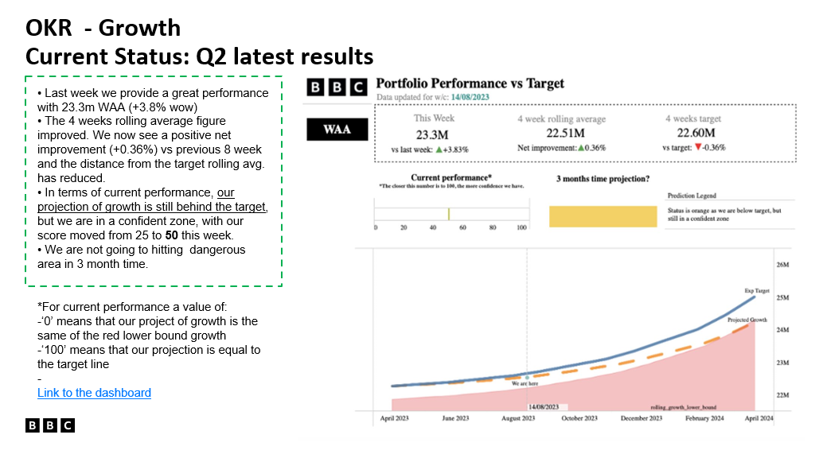
Q3 Context Setting for Product Group
Programs to be aware of
Welsh Language
* Goal to roll out across all, but start with our largest partners

Slide 20
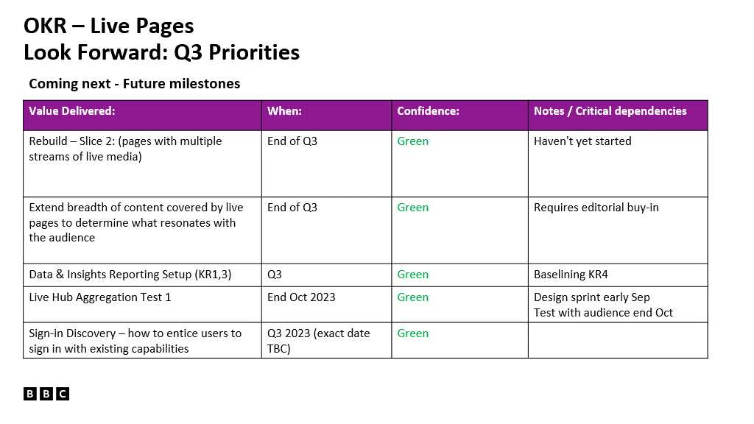
Q3 Context Setting for Product Group
Programs to be aware of
Welsh Language
* Goal to roll out across all, but start with our largest partners

Slide 21
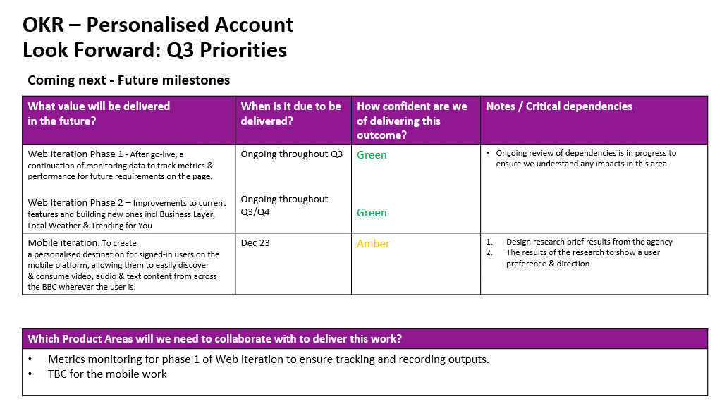
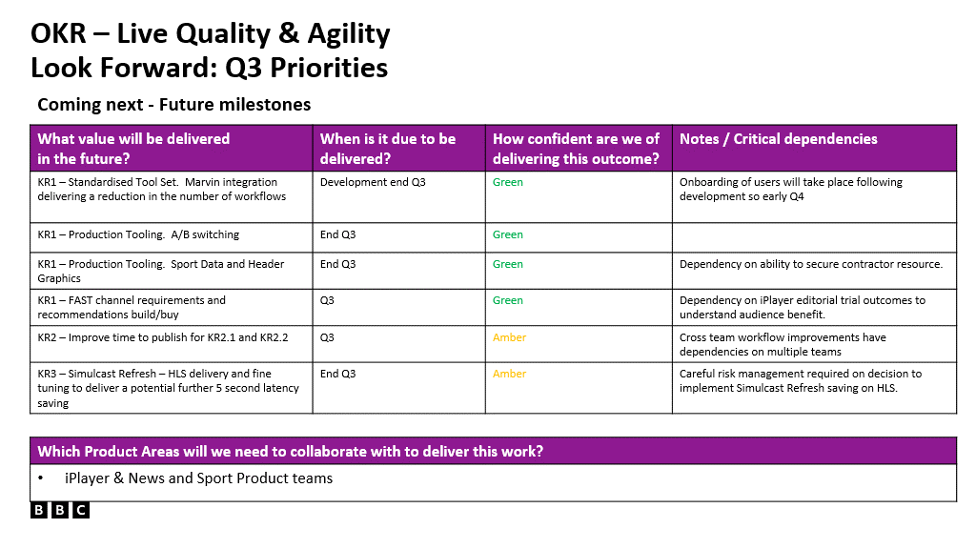
Q3 Context Setting for Product Group
Programs to be aware of
Welsh Language
* Goal to roll out across all, but start with our largest partners

Slide 22
Q3 Context Setting for Product Group
Programs to be aware of
Welsh Language
* Goal to roll out across all, but start with our largest partners

Slide 23
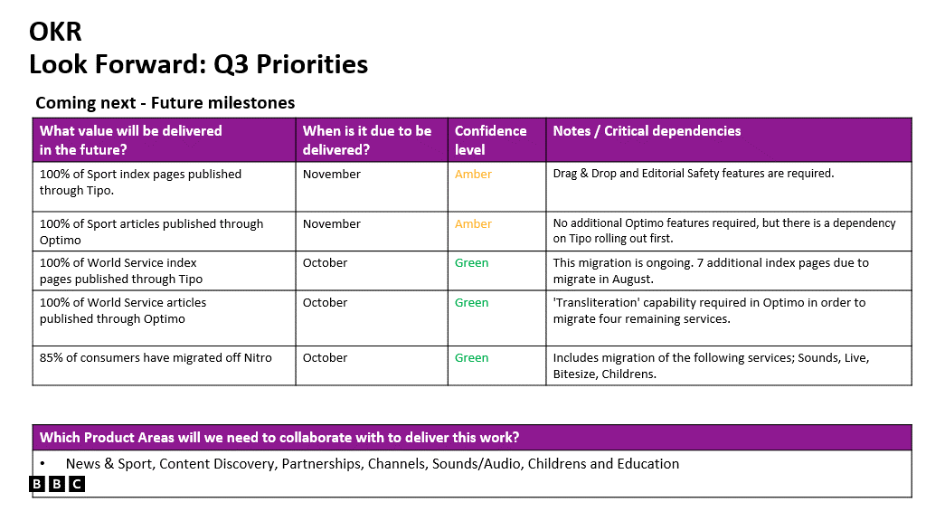
Q3 Context Setting for Product Group
Programs to be aware of
Welsh Language
* Goal to roll out across all, but start with our largest partners

Slide 24
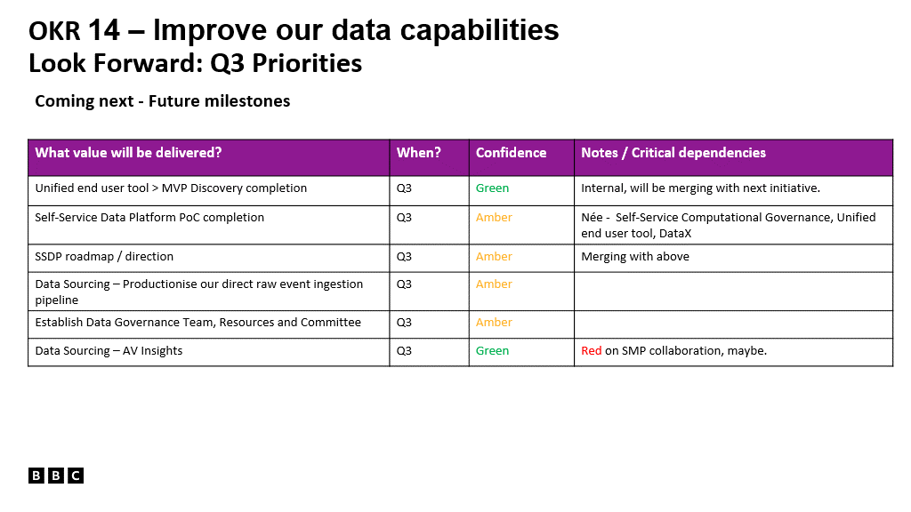
Q3 Context Setting for Product Group
Programs to be aware of
Welsh Language
* Goal to roll out across all, but start with our largest partners

Slide 25
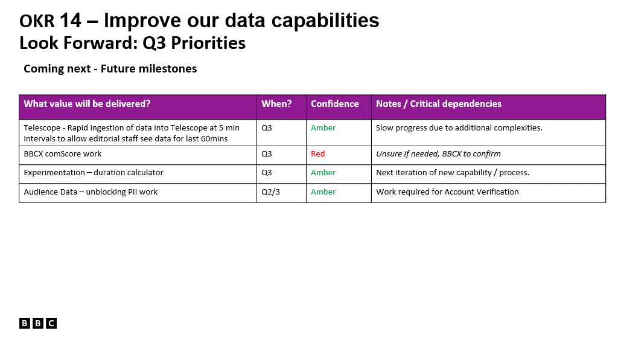
Q3 Context Setting for Product Group
Programs to be aware of
Welsh Language
* Goal to roll out across all, but start with our largest partners

Slide 26
Partnerships: FY23 OKRs
Partnerships work will either directly or indirectly contribute to the 25m growth OKR through reducing friction and fracture in our core product, as well as decommissioning older technology.
1
2
3
PLATFORM SIMPLIFICATION
PARTNER EXPERIENCE
GROWTH

Slide 27
FY23 COMMITTED ROADMAP by team
Partner Experience
Linear Experience
Discovery and personalisation
Increase Partners completing certification first time: Improvements to process, better visibility in changes of spec
Triggers: personalised context
Personalisation: continue watching discovery*
Red button text: Service review
Syndication: Drive users back to BBC ecosystem
Reduce time to complete certification: partner hub roll out
SVS decommission
ACT improvements
Re-platform triggers
Decommission Salesforce
Nitro/CPS: decommissioning
Unified UI Partner TV integrations
NGP
Closing data gap: Discovery

