Slide 1
Name :- OM GUPTA
UNIVERSITY ROLL NUMBER:-15201219103
STREAM:- BCA
SEMESTER:-2nd
PAPER NAME:-BUSINESS PRESENTATION AND LANGUAGE LAB
PAPER CODE:-HUN291

Slide 2
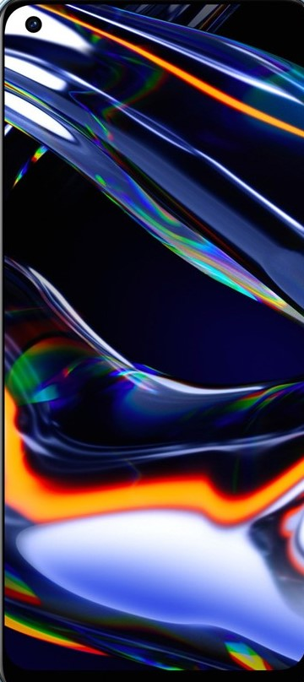
Gupta smart phone2020 series launch
REALME7pro
REALME 7
REDMI Note 9 Pro
idea by
.Sunil Shaw
.Ankit Gupta
.Ashish ray
.Amit Rao

Slide 3
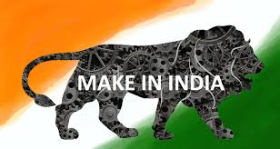
Launching smart phone in India
. A brief introduction:- This is a presentation on analysis of market , shares analysis, and s.w.o.t analysis for launching new smartphone in the market.
. Our company name:-REALME
. Our product name:-realme7 and realme7pro
.manufacture:- Sky Li

Slide 4


New era of smartphone with new smart feature
.REALME ai detection security
.6 GB RAM | 128 GB ROM | Expandable Upto 256 GB
.16.26 cm (6.4 inch) Full HD+ Display
.64MP + 8MP + 2MP + 2MP | 32MP Front Camera
.cloud facillites
.smart ai image resolution

Slide 5
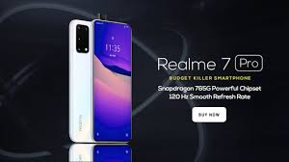
Specification of realme7 and realme7 pro
.5W65W Super Dart Charge
.Sony 64MP Quad Camera
.Qualcomm Snapdragon 720G
.Super AMOLED Fullscreen
.32MP In-display Selfie
.Dual Stereo Speakersrge
.8nm Gaming Processor

Slide 6
Major competitor of realme7 series
Samsung
HTC
XIAOMI
SONY
OPPO
LENEVO
MICROMAX
MICROSOFT
SONY
XIAOMI
OPPO
Samsung
HTC
LENEVO

Slide 7
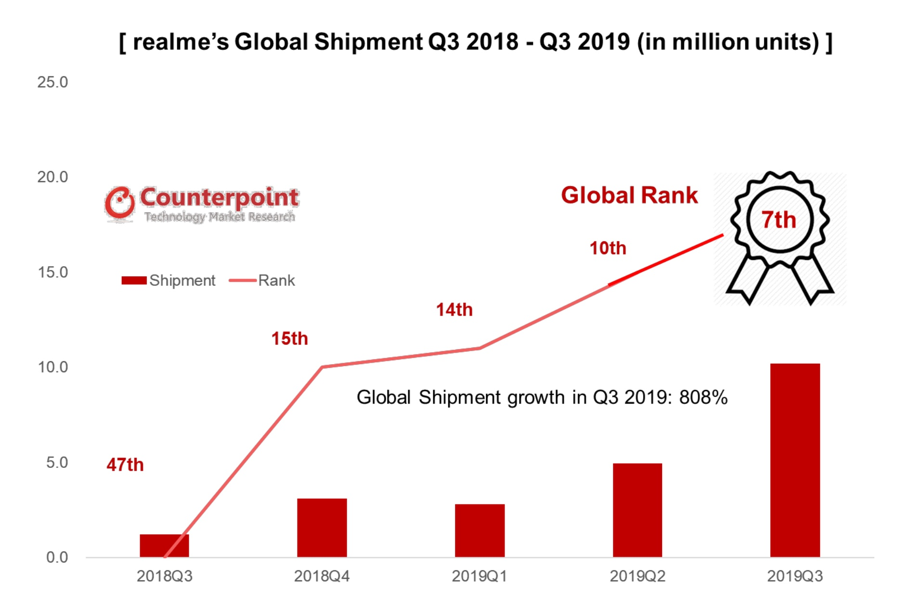
Competitive brand and their global market shares
#Market of REALME from 2018-19 in India.

Slide 8
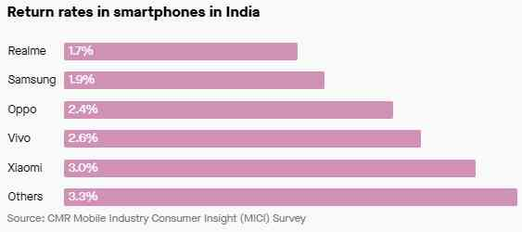
Marketing policy of realmeseries
“REALME uses viral media and social marketing campaigns to target younger consumers like students,” said Neil , executive director of wireless device strategies at Strategy Analytics. YUGAL JOSHI, vice-president at Texas-based consultancy Everest Group, adds that in addition to digital marketing, REALME “seems to target the young crowd and focus on colleges, events, cultural festivals, etc.”
Though there are concerted efforts, the big question is whether REALME has had some beginner’s luck or if it’s here for the long haul.
“REALME is racing to the bottom on smartphone pricing and we question whether its breakneck growth is sustainable,” NEIL said. “We think REALME is in danger of over-shipping and building too much inventory in India. Next year will be much harder for REALME.”

Slide 9

Price and warranty of smartphone
Price is a key factor of selling the product , and it. Usually that one that is open to most change based on different pricing strategies. The three main factor affecting the amount charged for a product or service are cost of production and customer demand and competition . we launch our realme7 and realme7pro(approximately 21,999 or 313 dollar globally) including 0.8% GST.

Slide 10
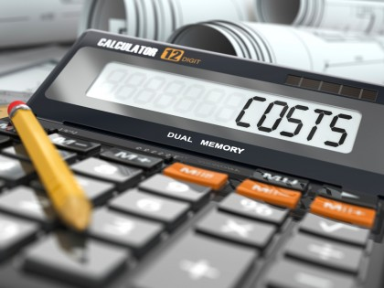
ESTIMATE BUSINESS COST
The estimate cost of this product across the country is about 8 crores.
. 6 crores for setting up of manufacturing plant of this product.
.2 crores for setting up of various service center and data center across the country.

Slide 11

Discount in shopping website
Amazon give over 10%-15% discount in great Indian festival sell.
Flipkart give over 9%- 13.5% discount in big billions days
For showroom like electronic shop and shopping complex give 5%-8% discount.
Other offer like cady gear headset free for 100 lucky customer

