Slide 1

Malicious JavaScript code detection using Convolutional Neural Networks
Presented by:
Neama Kamaleldin
Nourhan Hassan
Osama Ghozlan

Slide 2
Agenda
Motivation
Related work
Proposed Solution
Results
Conclusion & Future work

Slide 3
We’re entering a time when XSS has become the new Buffer Overflow, and JavaScript Malware is the new shellcode.
Jeremiah Grossman

Slide 4
Motivation
1

Slide 5
Motivation
Internet browsers are installed on almost every modern device
When a user accesses a web page, any code written in JavaScript can be executed.
Notes:
https://www.researchgate.net/publication/221609264_Preventing_drive-by_download_via_inter-module_communication_monitoring

Slide 6
Motivation
Due to degradation in performance, in-browser solutions are not widely implemented (Custom extensions)
Majority all large-scale successful malware attacks are JavaScript based.
Notes:
https://www.researchgate.net/publication/221609264_Preventing_drive-by_download_via_inter-module_communication_monitoring

Slide 7
Related work
2

Slide 8
Related work
ADD STUFF HERE, NOURHAN OR WHOEVER IS GOING TO SAY THIS.

Slide 9
Proposed Solution
3

Slide 10
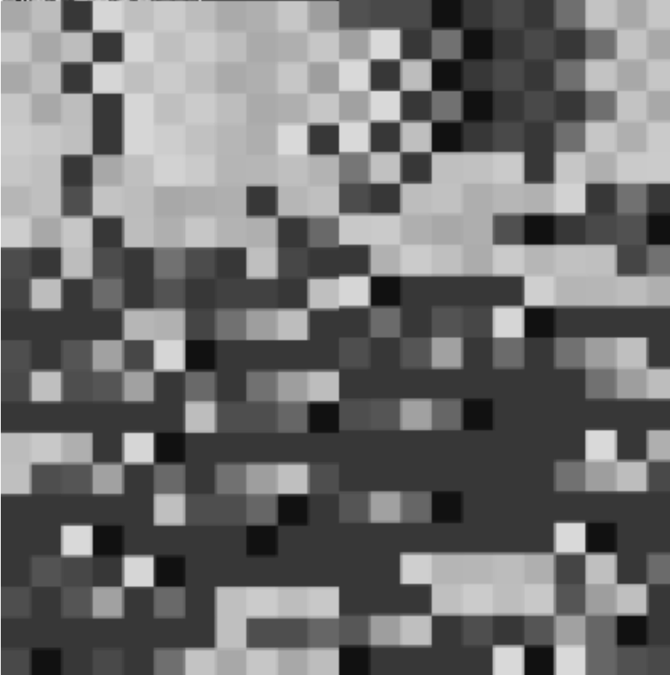
“A picture is worth a thousand words”
Given the advancement in technologies regarding image classification, our work leverages these advancements in order to solve a classification problem by mapping it into the form on an image
Illustration of a JavaScript file as an image

Slide 11

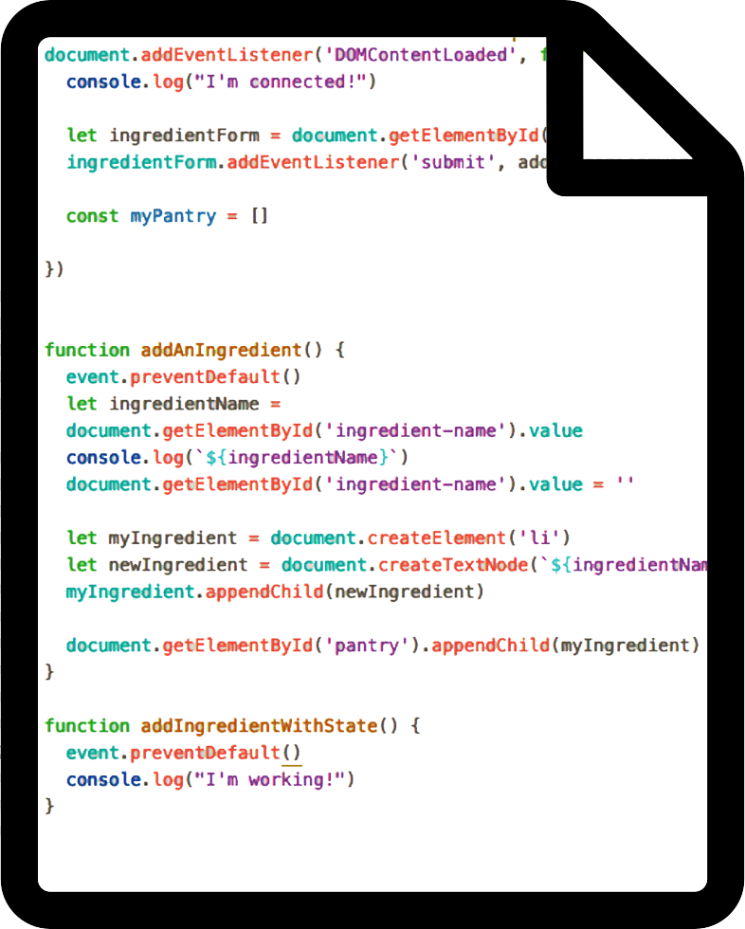

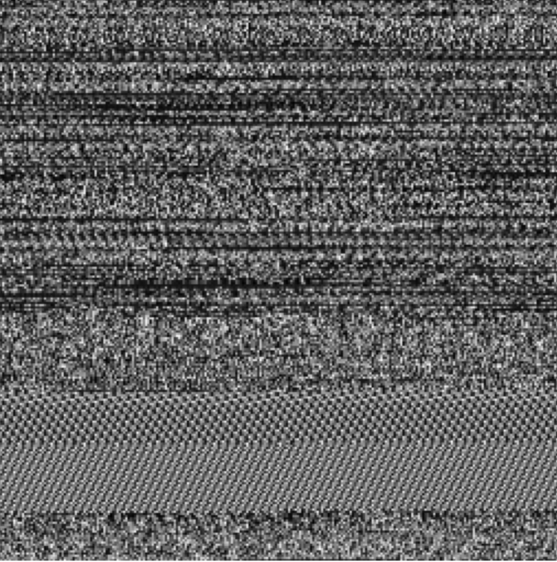

Proposed Solution: Pipeline
JavaScript
File
V8 Engine
Bytecode
Image
JavaScript to image transformation process
Notes:
V8 Engine used in Chrome, Electron, Brave, Opera, Microsoft Edge, Electron
Second is SpiderMonkey, mostly used by Mozilla

Slide 12
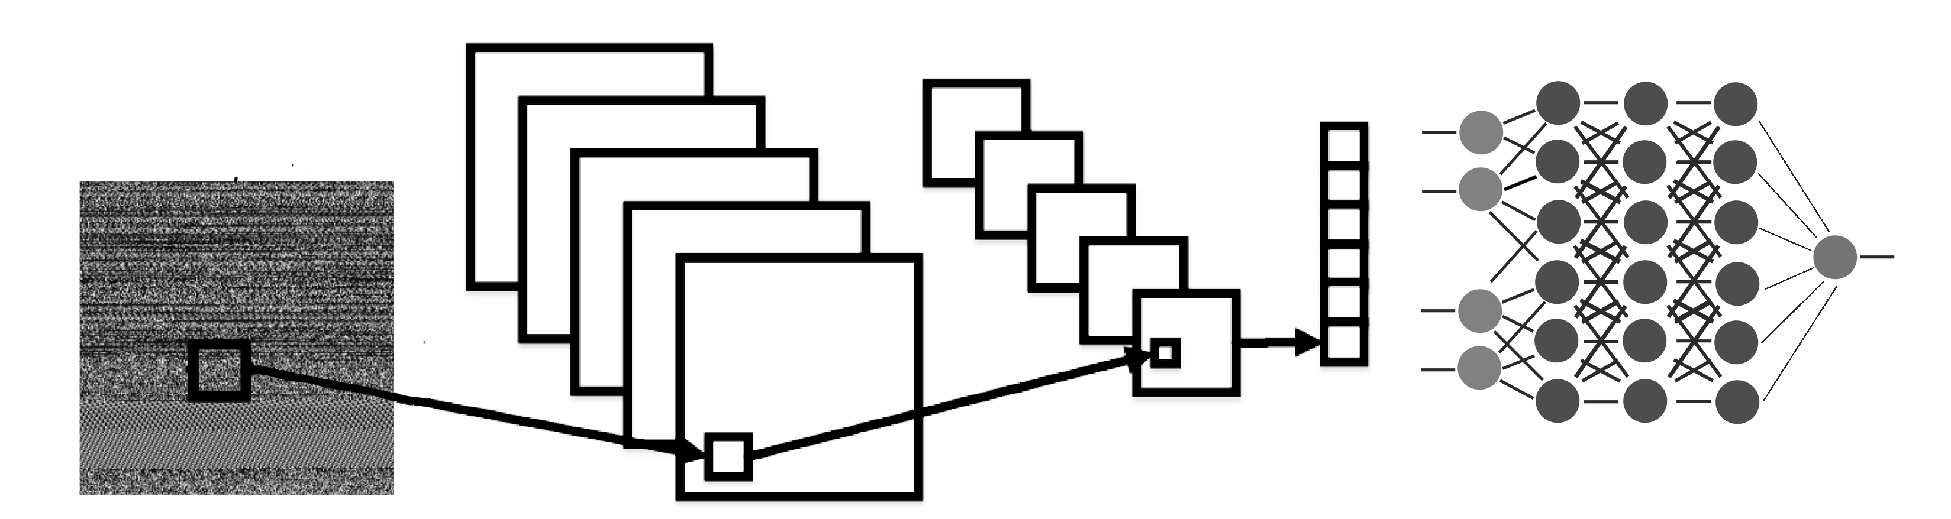
Proposed Solution: Pipeline (Cont’d)
Benign
Malicious
Convolution
Pooling
Flatten
Fully-Connected
Image
Illustration of Neural Network used in our solution

Slide 13
Proposed Solution: Dataset
Dataset was collected from GitHub and was split as follows during the experiment:
Training set: 1706 (Malicious: 1305, Benign: 401)
Validation set: 1002 (Malicious: 783, Benign: 219)
Testing set: 677 (Malicious: 537, Benign: 140)
*Due to the imbalance in number of samples, benign samples were repeated by a factor of 2 to avoid potential overfitting that may arise from random undersampling of the majority class (Malicious)
Notes:
Shannon diversity index: 0.768335

Slide 14
Results
4

Slide 15
Results
 | VGG16 | ResNet50 | Inception V3 | Our Model | Our Model (Raw JS) | Our Model (Raw JS + No balance) | Our Model (Bytecode + No balance)
Accuracy | 0.987768 | 0.976555 | 0.978593 | 0.966361 | 0.802243 | 0.926145 | 0.977843
F1-Score | 0.988701 | 0.977821 | 0.979827 | 0.968177 | 0.845295 | 0.955277 | 0.985889
False Discovery Rate | 0.020522 | 0.007828 | 0.009709 | 0.017613 | 0.267956 | 0.080895 | 0.005693
False Negative Rate | 0.001901 | 0.036122 | 0.030418 | 0.045627 | 0.000000 | 0.005587 | 0.022388
False Positive Rate | 0.024176 | 0.008791 | 0.010989 | 0.019780 | 0.430155 | 0.335714 | 0.021277
Matthews Correlation Coefficient | 0.975575 | 0.953415 | 0.957274 | 0.932957 | 0.645873 | 0.764741 | 0.935085

Slide 16
Results
Notes:
Spikes = mini-batches

Slide 17
Results: Accuracy

Slide 18
Results: Matthews Correlation Coefficient

Slide 19
Results: False Negative Rate

Slide 20
Results: False Positive Rate

Slide 21
Conclusion & Future work
5

Slide 22
Conclusion & Future work
Our proposed model provided comparable results to the pre-trained models while having a significantly smaller number of parameters (24,401 compared to smallest of the pre-trained (Inception V3) which has 23,885,392)
Notes:
Inception V3: 23,885,392
ResNet50: 25,636,712
VGG16: 138,423,208

Slide 23
Conclusion & Future work
Future work would involve testing various methods to normalize data and measure its effect
Revisiting regularization parameters to lower False Negative Rate

Slide 24
Thank you for your attention
Questions?

Slide 25
Appendix
2

Slide 26
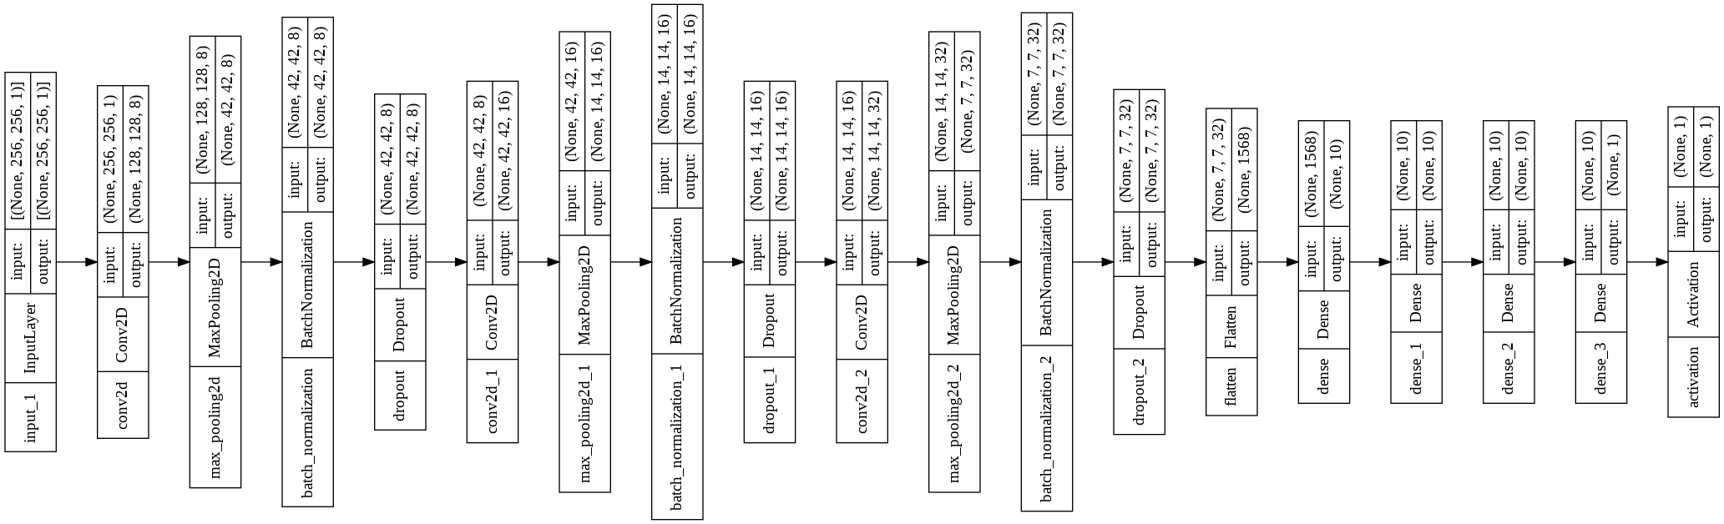
Our proposed model

Slide 27
Table of metrics (Cont’d)
 | VGG16 | ResNet50 | Inception V3 | Our Model | Our Model (Raw JS) | Our Model (Raw JS + No balance) | Our Model (Bytecode + No balance)
Negative Predictive Value | 0.997753 | 0.959574 | 0.965665 | 0.948936 | 1.000000 | 0.968750 | 0.920000
Precision | 0.979478 | 0.992172 | 0.990291 | 0.982387 | 0.732044 | 0.919105 | 0.994307
Sensitivity | 0.998099 | 0.963878 | 0.969582 | 0.954373 | 1.000000 | 0.994413 | 0.977612
Specificity | 0.975824 | 0.991209 | 0.989011 | 0.980220 | 0.569845 | 0.664286 | 0.978723

Slide 28
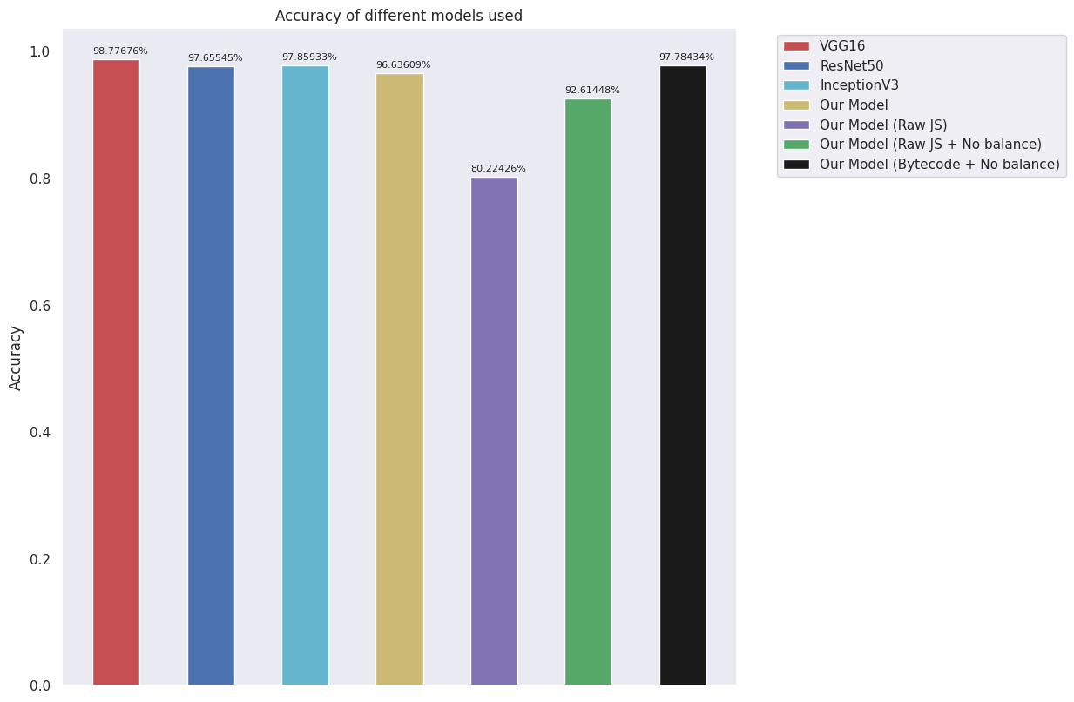
Results

Slide 29
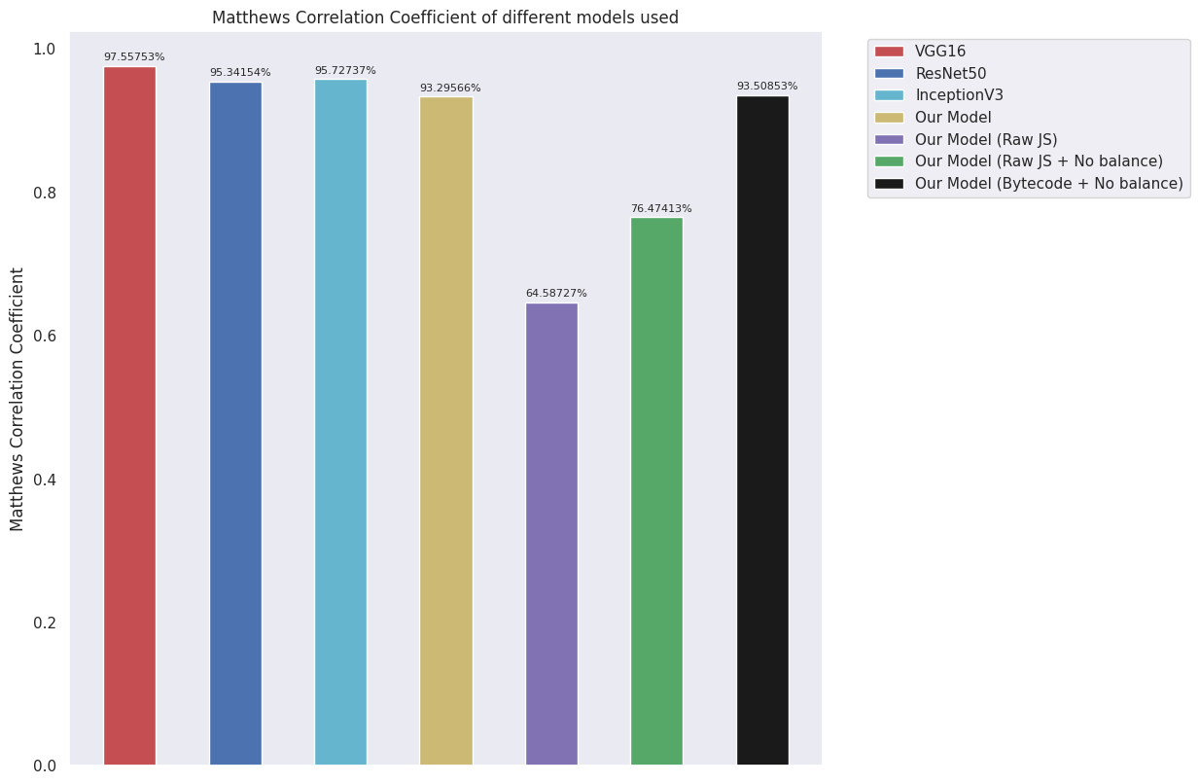
Results

Slide 30
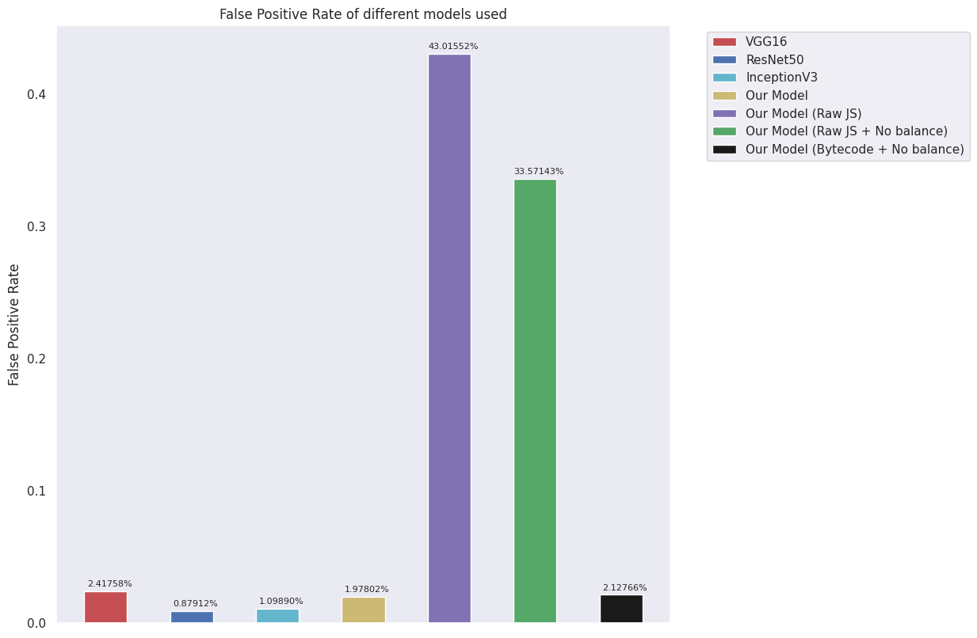
Results

Slide 31
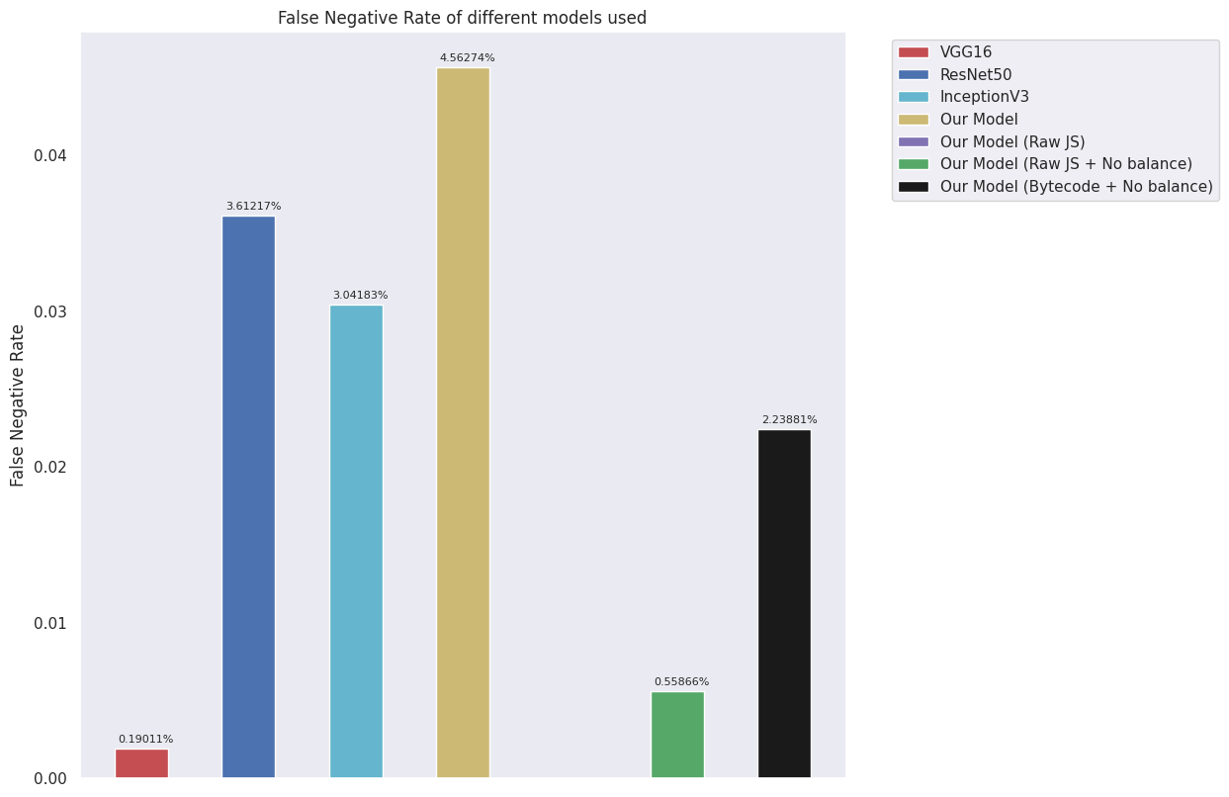
Results

Slide 32
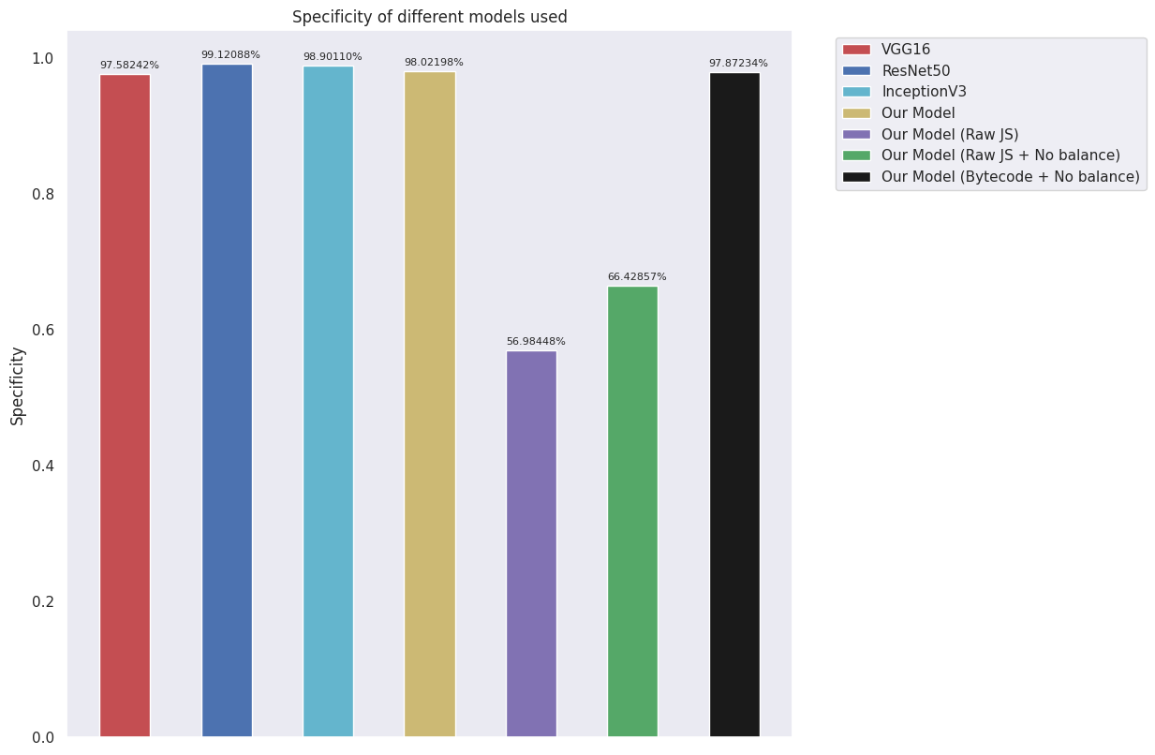
Results

Slide 33
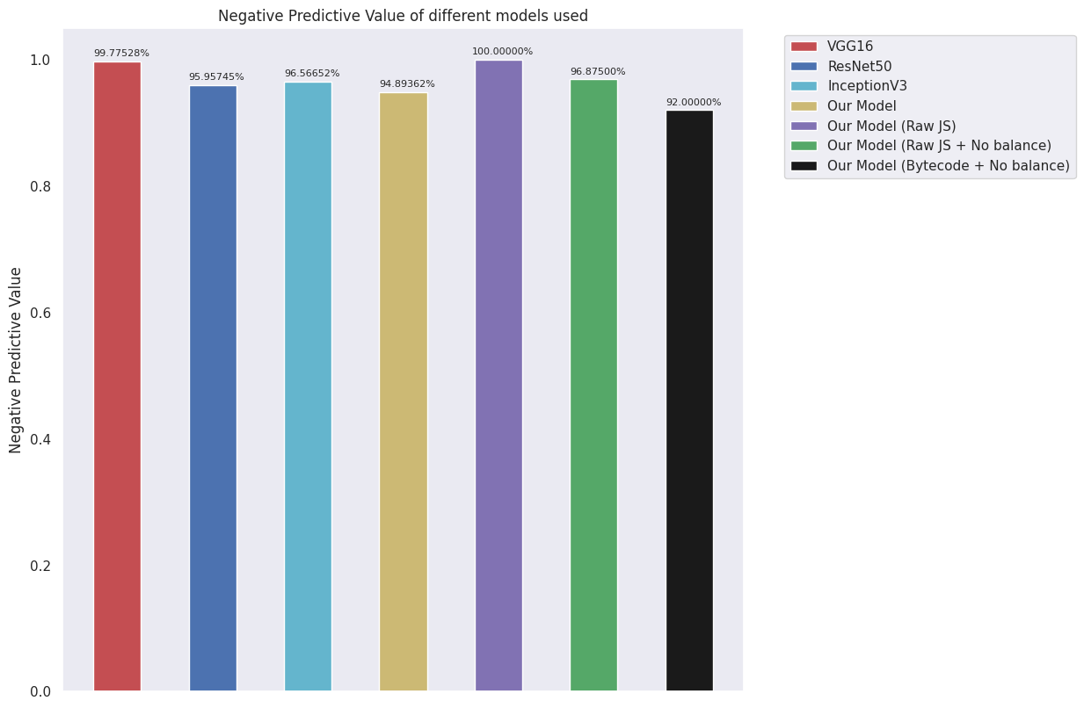
Results

Slide 34
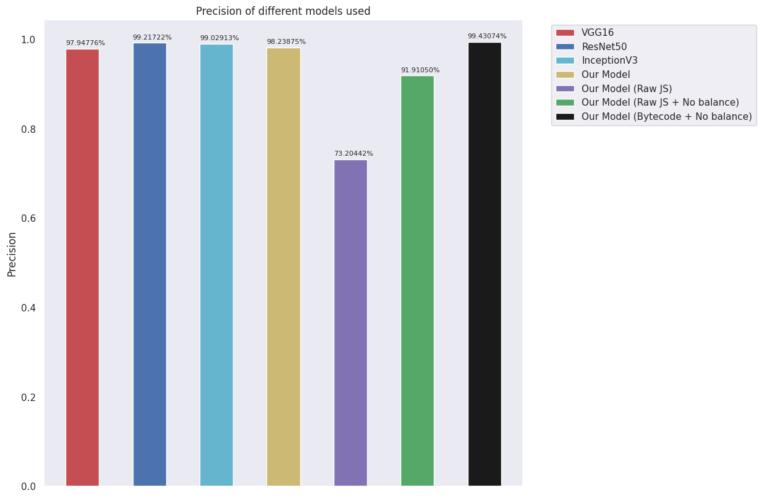
Results

Slide 35
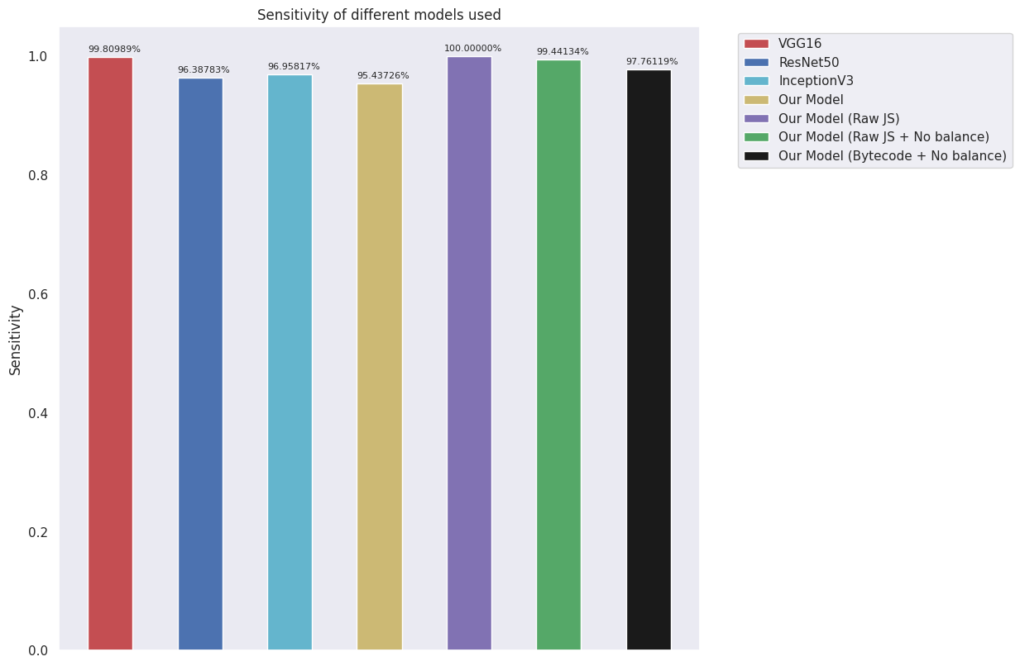
Results

Slide 36
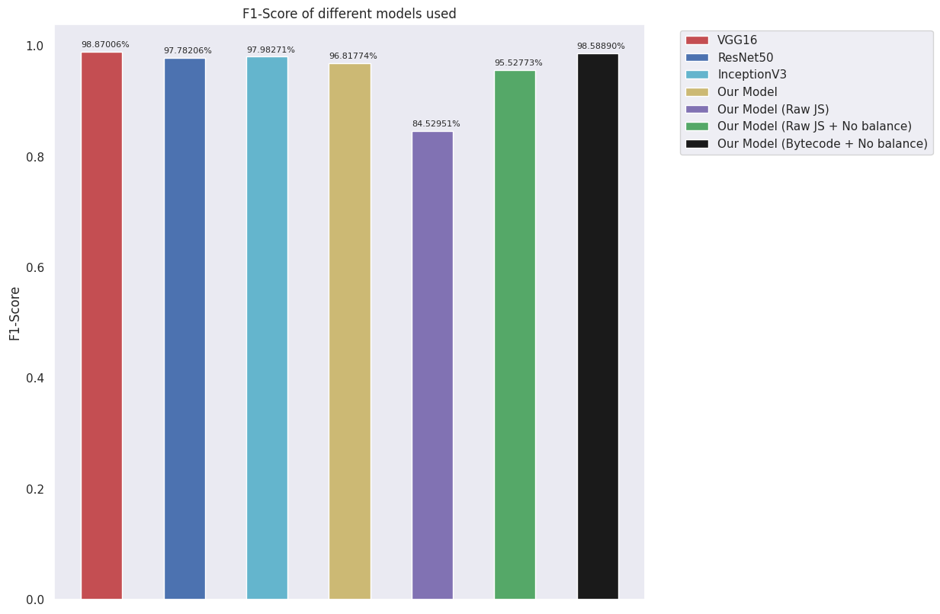
Results

Slide 37
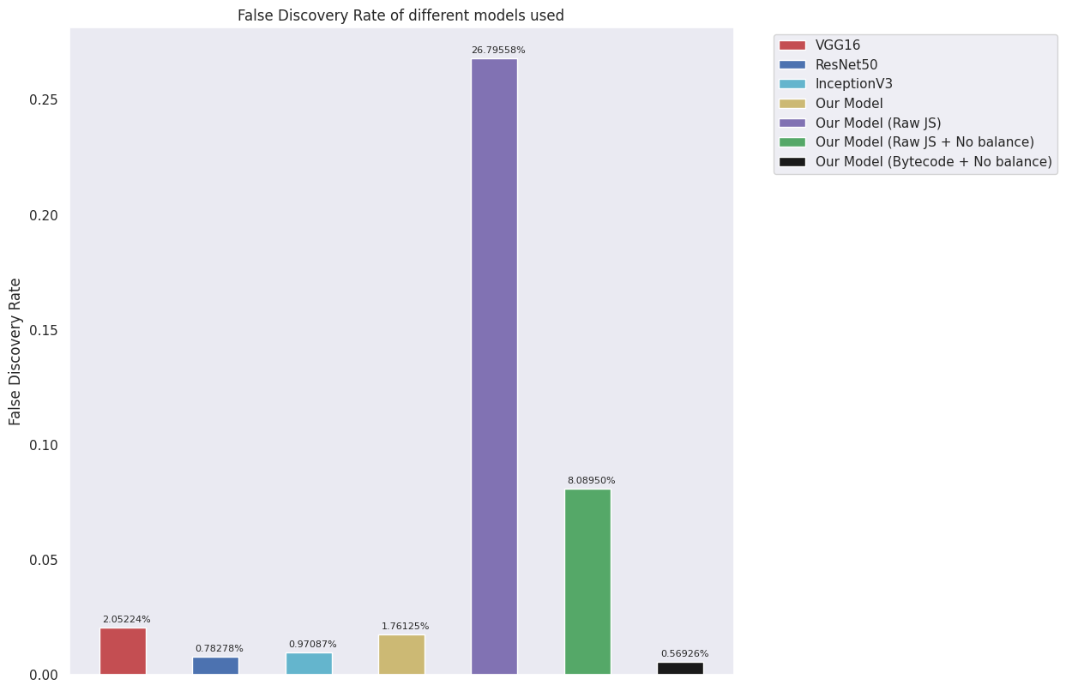
Results

