Slide 1
Software Group Project (SGP)
AY: 2026-27 Semester – 5 CE
Indus11 — AI Financial Risk & Fraud Decision Engine
Prepared by : Project ID: PRJ_CE_5_2026_7 Joshi Om (24DCE052) Krish Gajera (24DCE040) Drashti Dedaniya (24DCE029) | Internal Guide: Dr. Deven Gol Assistant Professor Computer Engineering DEPSTAR, CHARUSAT | Review: Review 1 Exam — Technical Progress 8 August 2026

Slide 2
Outline of Presentation
1. Review Comments & Actions (Proposal · Review 1 · Mid-Semester)
2. Problem Statement & Objectives
3. System Architecture
4. Process Flow / Data-Flow Diagram (DFD)
5. Literature Review & Existing Solutions
6. Implementation Progress (Screenshots + Code)
7. Challenges Faced & Future Work
8. Conclusion
9. References
10. Team Contributions

Slide 3
Project Proposal Review — Comments & Actions
01 · PROPOSAL REVIEW
Comments received
  Show measured evidence, not just a working demo
  SRS: correct DFD notation and UML diagrams
  Single spacing; each chapter on a new page
  Conclusion, References, Definitions last, unnumbered
  Abstract must be written by the team
  Keep the repository updated for review
Action taken
  Evaluation harness built; the measured results are in this deck
  DFDs redrawn in Gane-Sarson notation; 7 UML diagrams
  Document reformatted to the prescribed style
  Sections reordered as instructed
  Abstract written by the team, not generated
  Repository public; continuous integration runs 113 tests on every push

Slide 4
Review 1 — Comments & Actions
02 · REVIEW 1
Comments received
  Fourteen seconds end to end: the language-model call sat inside the decision path
  No defined behaviour if the graph database fails mid-session
  The written explanation can contradict the signals that actually fired
  Which graph pattern produces the most false positives?
  Why is the score weighted 40 / 30 / 30?
  Does an identical transaction score identically every time?
Action taken
  Decision returns on the rule and graph layers alone; the model runs after the reply
  Measured: median 114 ms, p95 189 ms, 29 of 29 inside the 500 ms budget (was 14,046 ms)
  A graph failure is caught, scored as a failed layer, and lifts approve to review
  The explanation is checked against the fired signals; the flags stand alone if it drifts
  Answered with figures: shared device, the loosest check, needing no corroboration
  Model temperature fixed at zero — the same transaction now scores the same every time

Slide 5
Mid-Semester Review — Comments & Actions
03 · MID-SEMESTER REVIEW
Comments received
  Study the anomalies banks actually watch for and add them to the rule engine
  Validate on a real or public dataset, not only on data we generated ourselves
  Name the member responsible for each chapter of the report
  Consider writing a conference paper on the work
Action taken
  Fifty anomaly types catalogued from FIU-IND, RBI and FATF; twenty-five implemented
  Thirty-five of the fifty are now detected; the fifteen that are not are listed with the data each would need
  PaySim chosen and the replay written — the dataset run itself is still outstanding, and is reported as outstanding rather than as done
  The responsible member is printed under each chapter heading in the report
  Not pursued this semester; the time went into the dataset and anomaly work instead

Slide 6
Problem Statement & Objectives
02 · PROBLEM & OBJECTIVES
The problem
  Banks must approve or block a payment in milliseconds
  Rule-only systems miss new & coordinated fraud
  Pure ML systems cannot explain why they blocked
  Analysts & regulators need a reason for every decision
Our objectives
  Score each transaction 0–100 → APPROVE / REVIEW / BLOCK
  Combine three engines — rules, graph, RAG-LLM
  Attach a plain-English explanation to every decision
  Detect fraud rings single checks cannot see
  Deliver a live analyst dashboard on one machine

Slide 7
Functional Requirements
28 requirements across two tables, each traceable to the module that implements it (SRS Chapter 3, Tables 3.1-3.2) — a representative selection:
ID | Requirement | Module
FR-1 | Accept a transaction over HTTP POST with sender, receiver, amount and context fields | routes/transactions
FR-5 | Score 0-40 on blacklist, velocity, amount-anomaly, merchant and risk-tier rules | services/rule_engine
FR-7 | Score 0-30 by detecting shared devices, circular flows and fee-skimming chains | services/graph_analyzer
FR-9 | Score 0-30 via RAG retrieval and an LLM explanation, degrading to 0 if unreachable | services/rag_pipeline
FR-10 | Execute the three scoring layers concurrently | routes/transactions
FR-12 | Map the composite score to APPROVE, REVIEW or BLOCK | services/decision_engine
FR-17 | Allow an analyst to override a decision | routes/transactions
FR-20 | Propagate fraud labels to accounts within two hops | services/graph_analyzer
FR-23 | Replay a labelled dataset and report precision, recall, F1 and ring detection | scripts/evaluate
FR-28 | Display metrics, decision mix, accuracy and flagged transactions on the dashboard | dashboard
Full list: SRS §3.1, Tables 3.1 (FR-1 to FR-17) and 3.2 (FR-18 to FR-28).

Slide 8
Non-Functional Requirements
Measured performance
  Rule engine: 8 ms · Graph analyzer: 48 ms warm
  Complete pipeline: 14,046 ms (13.9 s in the language model)
  Deterministic layers complete within 500 ms; latency is bounded by the slowest layer, not the sum
Reliability & maintainability
  No state held between requests; an instance restarts without loss
  An unavailable component never approves a transaction silently
  Every decision persisted with its explanation for audit
Testability & portability
  Automated tests run with no database or network access
  The entire stack starts with one command via Docker Compose
Software quality attributes (SRS Table 3.4)
  Reliability — pipeline degrades one component at a time; a duplicate submission returns a defined conflict response
  Maintainability — each layer is one function, one input, one output type; replaceable independently
  Testability — 27 automated tests, no database or network
  Portability — the whole stack is one container composition file
  Usability — every decision is accompanied by a written explanation
  Accuracy — 93.8% precision, 86.5% recall, F1 0.90 over 208 transactions (see the Detection Accuracy slide)

Slide 9
System Architecture — 5-Layer Pipeline
03 · ARCHITECTURE
Client · React Dashboard (analyst UI)
Layer 1 — FastAPI Gateway
validate payload · load profile (Redis → MongoDB)
run concurrently — asyncio.gather()
Layer 2 · Rule Engine
velocity · amount · blacklist · merchant
score 0–40
Layer 3 · Graph Analyzer
Neo4j — fraud rings, shared device/IP
score 0–30
Layer 4 · RAG Pipeline
ChromaDB + LLM (Ollama) — explains
score 0–30
Layer 5 — Decision Engine
composite 0–100 → APPROVE / REVIEW / BLOCK + explanation
MongoDB
Neo4j
Redis
ChromaDB

Slide 10
Process Flow / DFD — Transaction to Decision
04 · PROCESS FLOW
1
Client submits a transaction POST /api/v1/transactions/analyze (sender, receiver, amount, device, IP)
2
Validate & load context Pydantic schema check · fetch account profiles from Redis, fallback MongoDB
3
Run three engines concurrently Rule Engine + Neo4j Graph Analyzer + RAG Pipeline via asyncio.gather()
4
Aggregate the scores Decision Engine sums rule (0–40) + graph (0–30) + AI (0–30) = 0–100
5
Decide & explain map to APPROVE (0–39) / REVIEW (40–69) / BLOCK (70+) + plain-English reason
6
Persist & respond save record to MongoDB · return JSON (decision, score, breakdown)
7
Dashboard reads results stats endpoints feed live charts and the flagged-transactions table

Slide 11
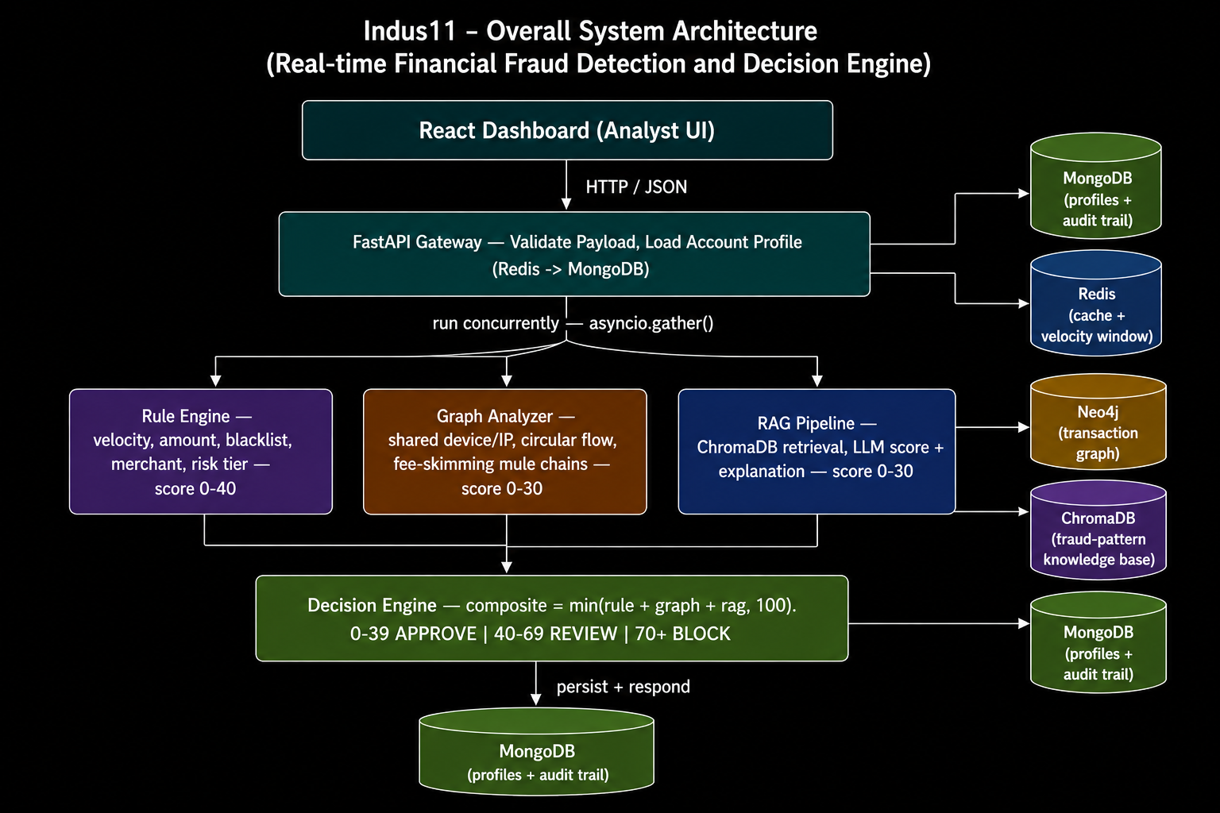
System Architecture — Five-Layer Pipeline

Slide 12
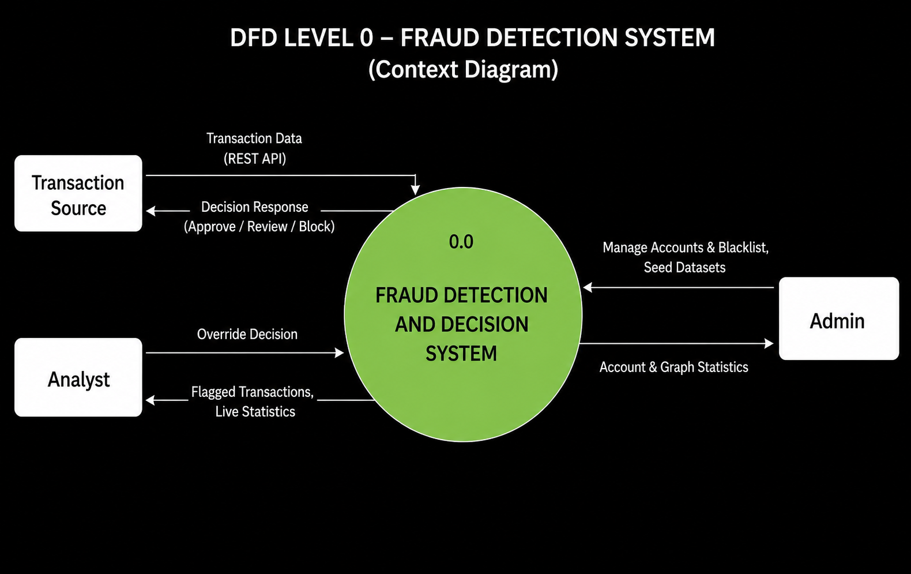
Data Flow Diagram — Level 0 (Context Diagram)

Slide 13
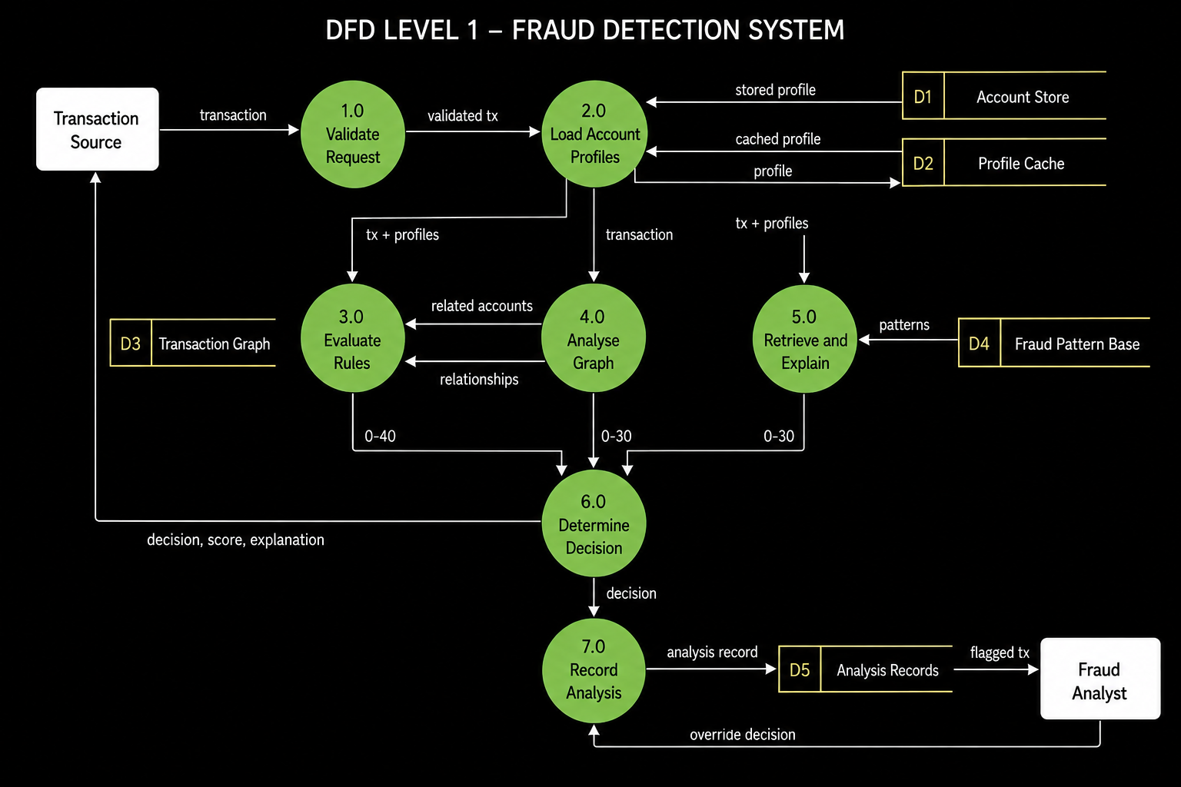
Data Flow Diagram — Level 1

Slide 14
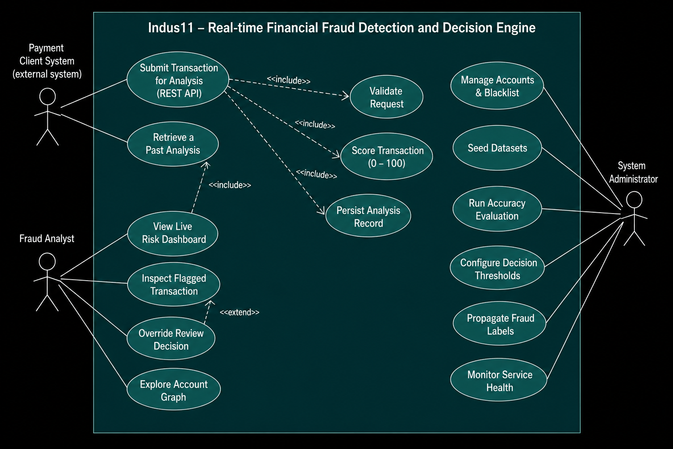
Use Case Diagram

Slide 15
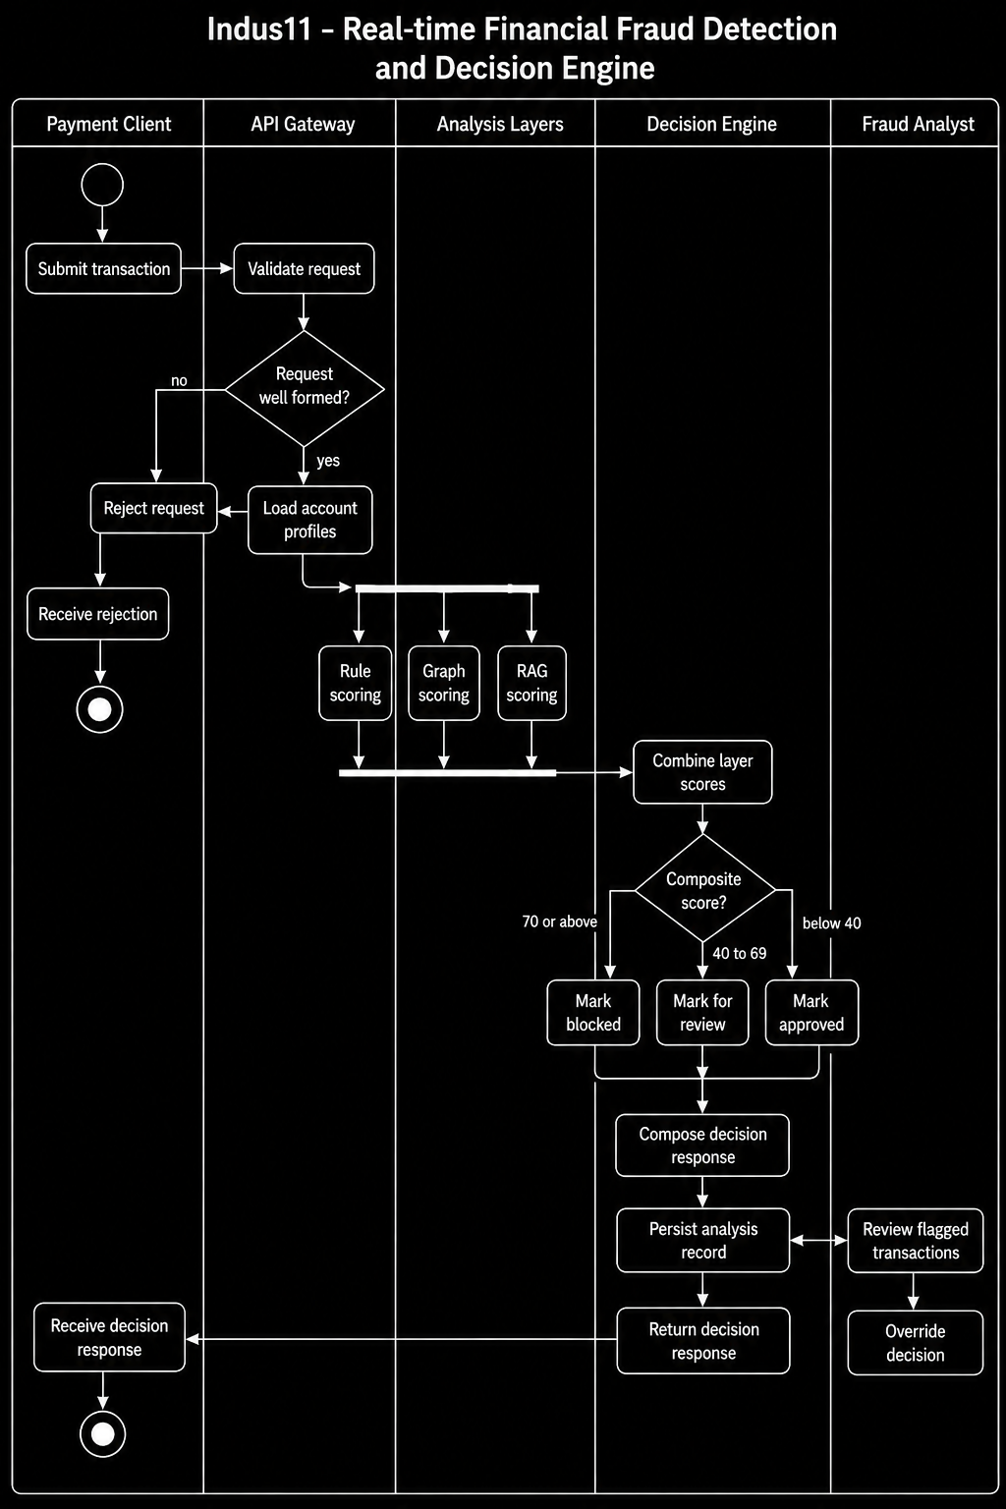
Activity Diagram — Transaction Analysis Workflow

Slide 16
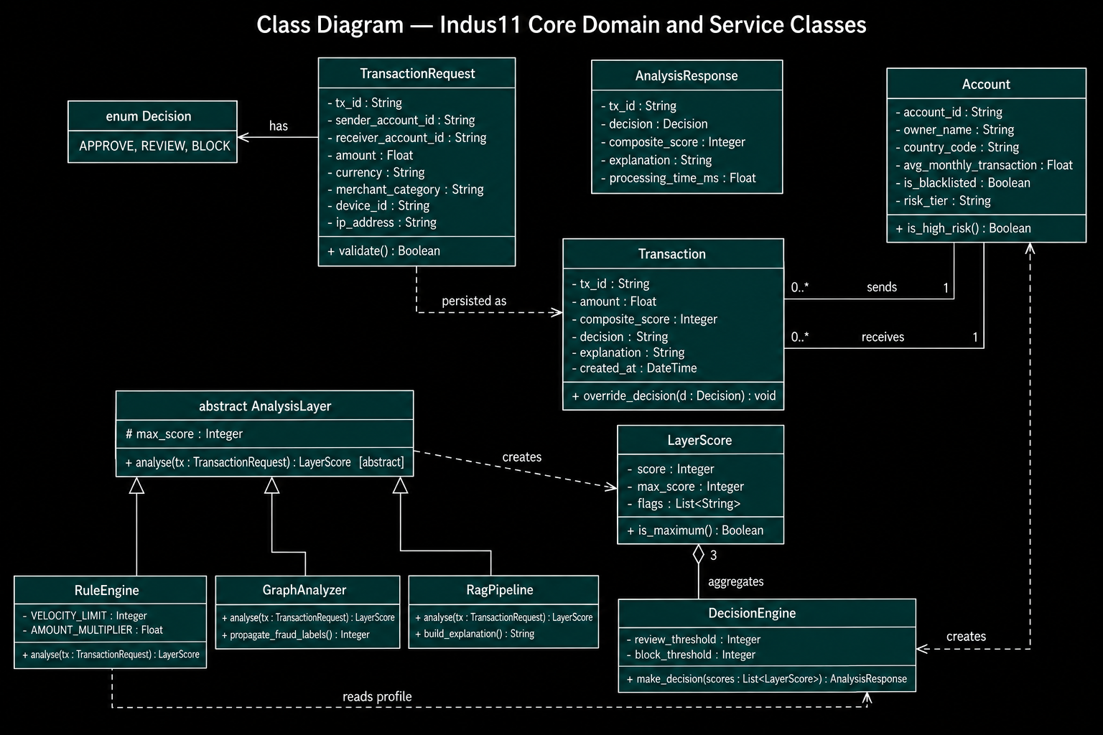
Class Diagram — Core Domain and Service Classes

Slide 17
Literature Review & Existing Solutions
05 · LITERATURE REVIEW
System | Approach | Explains why? | Open / on-prem
FICO Falcon | Neural nets on shared bank data | Limited — black box | No — proprietary
Feedzai | ML risk platform (RiskOps) | Limited | No — commercial
Featurespace ARIC | Adaptive behavioural analytics | Limited | No — commercial
Traditional rule engines | Static hand-written rules | Yes, but rigid | Varies
Indus11 (ours) | Rules + graph + RAG-LLM ensemble | Yes — every decision | Yes — open, local
Research basis
The APATE study (Van Vlasselaer et al., 2015) shows that combining graph-based features with traditional features reaches AUC > 0.98 — evidence that our rules-plus-graph design outperforms either approach alone.

Slide 18
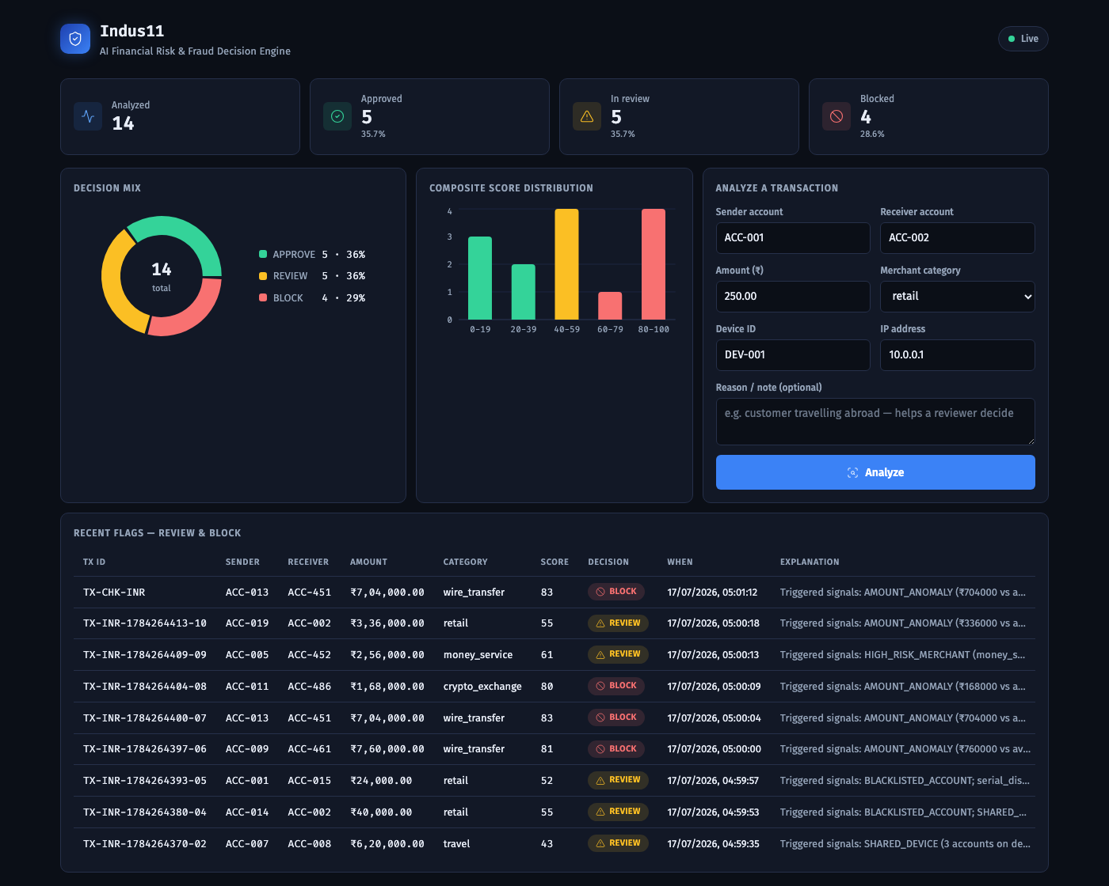
Implementation — Live Dashboard & API
06 · IMPLEMENTATION
React dashboard
• Live risk metrics & decision mix
• Score-distribution chart
• Flagged-transactions feed
• Click a transaction → full detail + reason
• Approve / Block override on REVIEW
FastAPI backend
• 12 documented REST endpoints
• health · transactions · accounts
• graph · stats
• Swagger UI at /docs
• All engines run via asyncio.gather()

Slide 19
Implementation — Structure, Code & Stack
06 · IMPLEMENTATION
Project structure
app/
main.py FastAPI app + startup
config.py settings (.env)
api/routes/ transactions · accounts
graph · stats · health
core/ db · neo4j · redis · rate
models/ Beanie documents
schemas/ Pydantic contracts
services/ rule_engine · graph_analyzer
rag_pipeline · decision_engine
dashboard/ React + Vite + Recharts
scripts/ seed_mongo · seed_neo4j
tests/ test_fraud.py (8 tests)
docker-compose.yml
Decision Engine — composite scoring
composite = rule.score + graph.score + rag.score
composite = min(composite, 100)
if composite >= BLOCK_THRESHOLD: # 70+
decision = Decision.BLOCK
elif composite >= REVIEW_THRESHOLD: # 40-69
decision = Decision.REVIEW
else:
decision = Decision.APPROVE # 0-39
Live example ₹7,04,000 wire → known fraud ring BLOCK 83/100 = rule 25 + graph 30 + AI 28
Stack: Python · FastAPI · MongoDB · Neo4j · Redis · ChromaDB · LangChain+Ollama · React · Docker · pytest (8/8)

Slide 20
Detection Accuracy — Measured Results
208 labelled synthetic transactions — 52 fraudulent, 156 legitimate — replayed through the complete pipeline
93.8%
Precision
of flagged were fraud
86.5%
Recall
of fraud was caught
0.90
F1 score
combined measure
36/36
Ring recall
mule-ring hops detected
Decision | Actually fraud | Actually legitimate
APPROVE | 7 | 153
REVIEW | 45 | 3
BLOCK | 0 | 0
Key finding
No transaction reached the block threshold of 70.
Every detection is routed to a human analyst; nothing is blocked automatically. Lowering the band would automate blocking — but would also auto-block the three false positives. That is a policy decision, not a configuration change.
Measured on synthetic data in which fraud is far denser than a real payment feed, so precision here is optimistic — it measures the separation between the engines, not production performance.

Slide 21
Progress Since the Last Review
Specification
  Front matter numbered in roman (i-ix); body restarts at 1
  Every reference cited in the text at its point of use, IEEE style
  Tables restyled — caption above, columns sized to content, none split across a page break
  32 functional requirements consolidated to 28 real, distinct ones
  Diagram set re-checked against the guide's notation comments and against the running code
Product
  Flagged-transactions table made interactive — filters, search, sortable columns
  Entrance and count-up motion, with an automatic reduced-motion fallback
  Static demo mode: the dashboard runs from a snapshot with no live backend
  Weekly-report generator with an automatic duplicate-reference check across weeks

Slide 22
Challenges Faced & Future Work
07 · CHALLENGES & FUTURE WORK
Challenges faced
  Coordinating four data stores on one machine
  Keeping model output consistent — solved with a 30-point cap
  Writing Cypher queries for circular money-mule flows
  Two defects the benchmark exposed: a repeated request returned
  a server error, and a parsing fault silently zeroed the AI
  score — both fixed and covered by tests
Future work
  Resolve the block-threshold trade-off from recorded scores
  Add API authentication and request logging
  Fraud-ring visualisation on the graph endpoint
  Investigate the 7 undetected frauds; fan-in / fan-out patterns
  Train a supervised classifier as a fourth signal
  Reduce latency, presently dominated by the local model

Slide 23
Conclusion — Where the Project Stands
Measured, not asserted
93.8% precision, 86.5% recall, F1 0.90 on 208 labelled transactions.
The graph layer earns its place
All 36 planted mule-ring transactions were detected.
A finding worth reporting
Nothing reaches the block threshold; every catch reaches an analyst.
Engineering discipline
27 automated tests, continuous integration, one-command deployment.

Slide 24
References
[1] Van Vlasselaer, V. et al. (2015). APATE: A novel approach for automated credit card transaction fraud detection using network-based extensions. Decision Support Systems, 75, 38–48.
[2] FICO. Falcon Fraud Manager — product documentation. fico.com.
[3] Feedzai. RiskOps platform overview. feedzai.com.
[4] Featurespace. ARIC Risk Hub — adaptive behavioural analytics. featurespace.com.
[5] Neo4j. Graph algorithms for fraud detection — developer guide. neo4j.com.
[6] LangChain & ChromaDB documentation — retrieval-augmented generation.

Slide 25
Team Contributions
JO
KG
DD
Joshi Om
24DCE052 · Platform & Documentation
Krish Gajera
24DCE040 · Graph & Fraud Detection
Drashti Dedaniya
24DCE029 · AI & Dashboard
• FastAPI gateway, MongoDB/Beanie schema, Redis caching and rate limiting
• Rule Engine — velocity, amount, blacklist, merchant, risk-tier checks
• Docker Compose stack for all five services
• SRS requirements and database design; verified every schema table against the running code
• Neo4j schema and Cypher queries for rings, circular flow, fee-skimming
• Graph Analyzer — shared device/IP clustering, fraud-label propagation
• Synthetic fraud dataset generator — 500 accounts, 3 planted mule rings
• LangChain RAG pipeline, ChromaDB knowledge base, prompt engineering
• Decision Engine — score aggregation and threshold mapping
• UML and DFD diagram set for the specification
• React dashboard — charts, interactive table, motion, demo mode
• Review-2 deck and the standalone speaking script

Slide 26
Thank You
Questions · Suggestions · Comments

