Slide 1
Software Group Project (SGP)
AY: 2026-27 Semester – 5 CE
Indus11 — AI Financial Risk & Fraud Decision Engine
Prepared by : Project ID: PRJ_CE_5_2026_7 Joshi Om (24DCE052) Krish Gajera (24DCE040) Drashti Dedaniya (24DCE029) | Internal Guide: Dr. Deven Gol Assistant Professor Computer Engineering DEPSTAR, CHARUSAT | Review: Review 1 Exam — Technical Progress 8 August 2026

Slide 2
Outline of Presentation
1. Mentor Feedback & Improvements
2. Problem Statement & Objectives
3. System Architecture
4. Process Flow / Data-Flow Diagram (DFD)
5. Literature Review & Existing Solutions
6. Implementation Progress (Screenshots + Code)
7. Challenges Faced & Future Work
8. Conclusion
9. References
10. Team Contributions

Slide 3
Guide Feedback & Improvements
01 · FEEDBACK
Feedback received
Show measured evidence, not just a working demo
SRS: correct DFD notation and UML diagrams
Single spacing; each chapter on a new page
Conclusion, References, Definitions last, unnumbered
Abstract must be written by the team
Keep the repository updated for review
Action taken
Built an evaluation harness; results in this deck
DFDs redrawn in Gane-Sarson notation; 7 UML diagrams
Document reformatted to the prescribed style
Sections reordered as instructed
Abstract being written by the team
Repository public with continuous integration

Slide 4
Problem Statement & Objectives
02 · PROBLEM & OBJECTIVES
The problem
Banks must approve or block a payment in milliseconds
Rule-only systems miss new & coordinated fraud
Pure ML systems cannot explain why they blocked
Analysts & regulators need a reason for every decision
Our objectives
Score each transaction 0–100 → APPROVE / REVIEW / BLOCK
Combine three engines — rules, graph, RAG-LLM
Attach a plain-English explanation to every decision
Detect fraud rings single checks cannot see
Deliver a live analyst dashboard on one machine

Slide 5
Functional Requirements
28 requirements across two tables, each traceable to the module that implements it (SRS Chapter 3, Tables 3.1-3.2) — a representative selection:
ID | Requirement | Module
FR-1 | Accept a transaction over HTTP POST with sender, receiver, amount and context fields | routes/transactions
FR-5 | Score 0-40 on blacklist, velocity, amount-anomaly, merchant and risk-tier rules | services/rule_engine
FR-7 | Score 0-30 by detecting shared devices, circular flows and fee-skimming chains | services/graph_analyzer
FR-9 | Score 0-30 via RAG retrieval and an LLM explanation, degrading to 0 if unreachable | services/rag_pipeline
FR-10 | Execute the three scoring layers concurrently | routes/transactions
FR-12 | Map the composite score to APPROVE, REVIEW or BLOCK | services/decision_engine
FR-17 | Allow an analyst to override a decision | routes/transactions
FR-20 | Propagate fraud labels to accounts within two hops | services/graph_analyzer
FR-23 | Replay a labelled dataset and report precision, recall, F1 and ring detection | scripts/evaluate
FR-28 | Display metrics, decision mix, accuracy and flagged transactions on the dashboard | dashboard
Full list: SRS §3.1, Tables 3.1 (FR-1 to FR-17) and 3.2 (FR-18 to FR-28).

Slide 6
Non-Functional Requirements
Measured performance
Rule engine: 8 ms · Graph analyzer: 48 ms warm
Complete pipeline: 14,046 ms (13.9 s in the language model)
Deterministic layers complete within 500 ms; latency is bounded by the slowest layer, not the sum
Reliability & maintainability
No state held between requests; an instance restarts without loss
An unavailable component never approves a transaction silently
Every decision persisted with its explanation for audit
Testability & portability
Automated tests run with no database or network access
The entire stack starts with one command via Docker Compose
Software quality attributes (SRS Table 3.4)
Reliability — pipeline degrades one component at a time; a duplicate submission returns a defined conflict response
Maintainability — each layer is one function, one input, one output type; replaceable independently
Testability — 27 automated tests, no database or network
Portability — the whole stack is one container composition file
Usability — every decision is accompanied by a written explanation
Accuracy — 93.8% precision, 86.5% recall, F1 0.90 over 208 transactions (see the Detection Accuracy slide)

Slide 7
System Architecture — 5-Layer Pipeline
03 · ARCHITECTURE
Client · React Dashboard (analyst UI)
Layer 1 — FastAPI Gateway
validate payload · load profile (Redis → MongoDB)
run concurrently — asyncio.gather()
Layer 2 · Rule Engine
velocity · amount · blacklist · merchant
score 0–40
Layer 3 · Graph Analyzer
Neo4j — fraud rings, shared device/IP
score 0–30
Layer 4 · RAG Pipeline
ChromaDB + LLM (Ollama) — explains
score 0–30
Layer 5 — Decision Engine
composite 0–100 → APPROVE / REVIEW / BLOCK + explanation
MongoDB
Neo4j
Redis
ChromaDB

Slide 8
Process Flow / DFD — Transaction to Decision
04 · PROCESS FLOW
1
Client submits a transaction POST /api/v1/transactions/analyze (sender, receiver, amount, device, IP)
2
Validate & load context Pydantic schema check · fetch account profiles from Redis, fallback MongoDB
3
Run three engines concurrently Rule Engine + Neo4j Graph Analyzer + RAG Pipeline via asyncio.gather()
4
Aggregate the scores Decision Engine sums rule (0–40) + graph (0–30) + AI (0–30) = 0–100
5
Decide & explain map to APPROVE (0–39) / REVIEW (40–69) / BLOCK (70+) + plain-English reason
6
Persist & respond save record to MongoDB · return JSON (decision, score, breakdown)
7
Dashboard reads results stats endpoints feed live charts and the flagged-transactions table

Slide 9
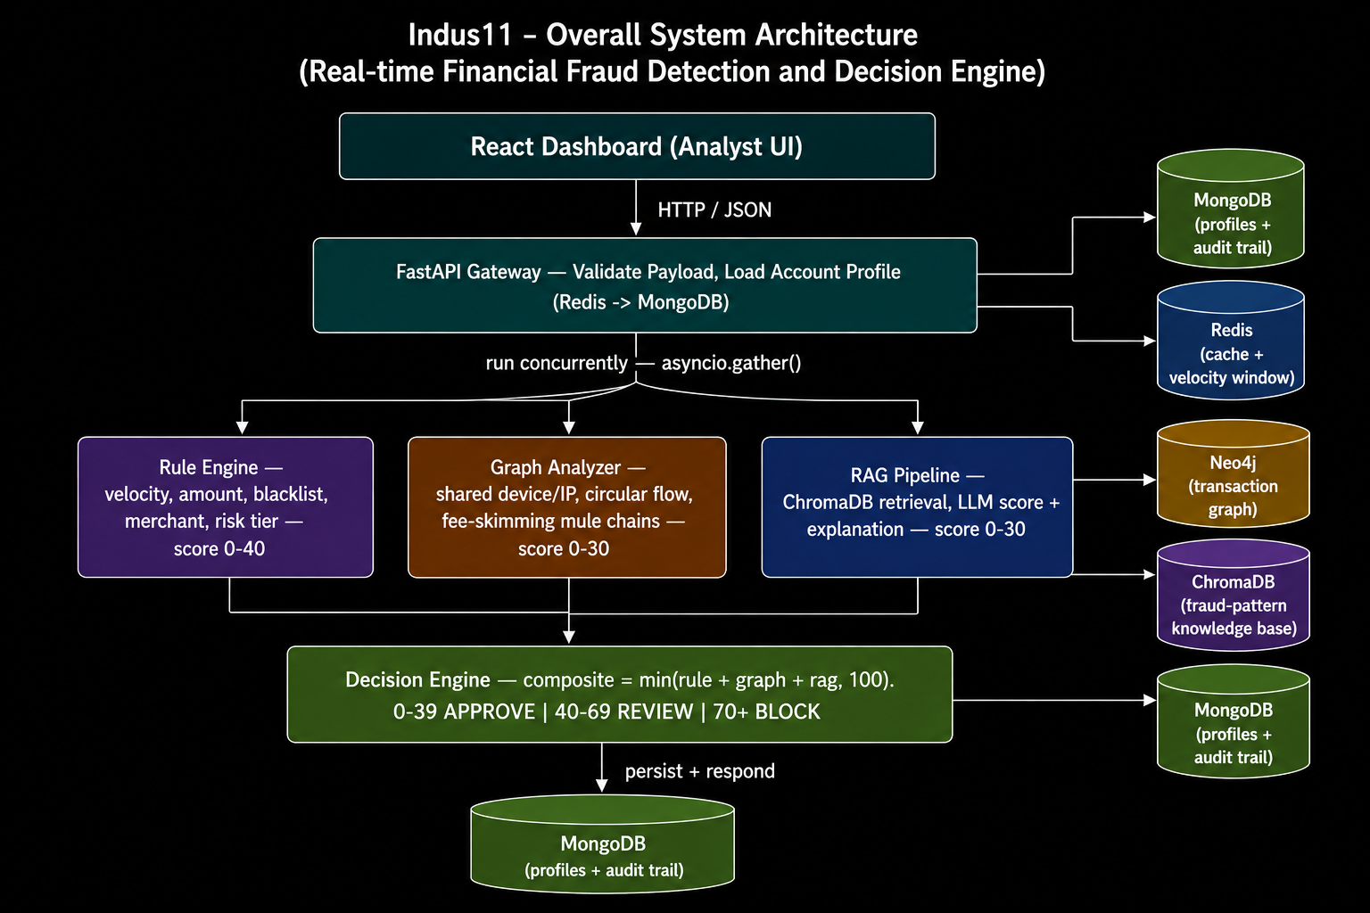
System Architecture — Five-Layer Pipeline

Slide 10
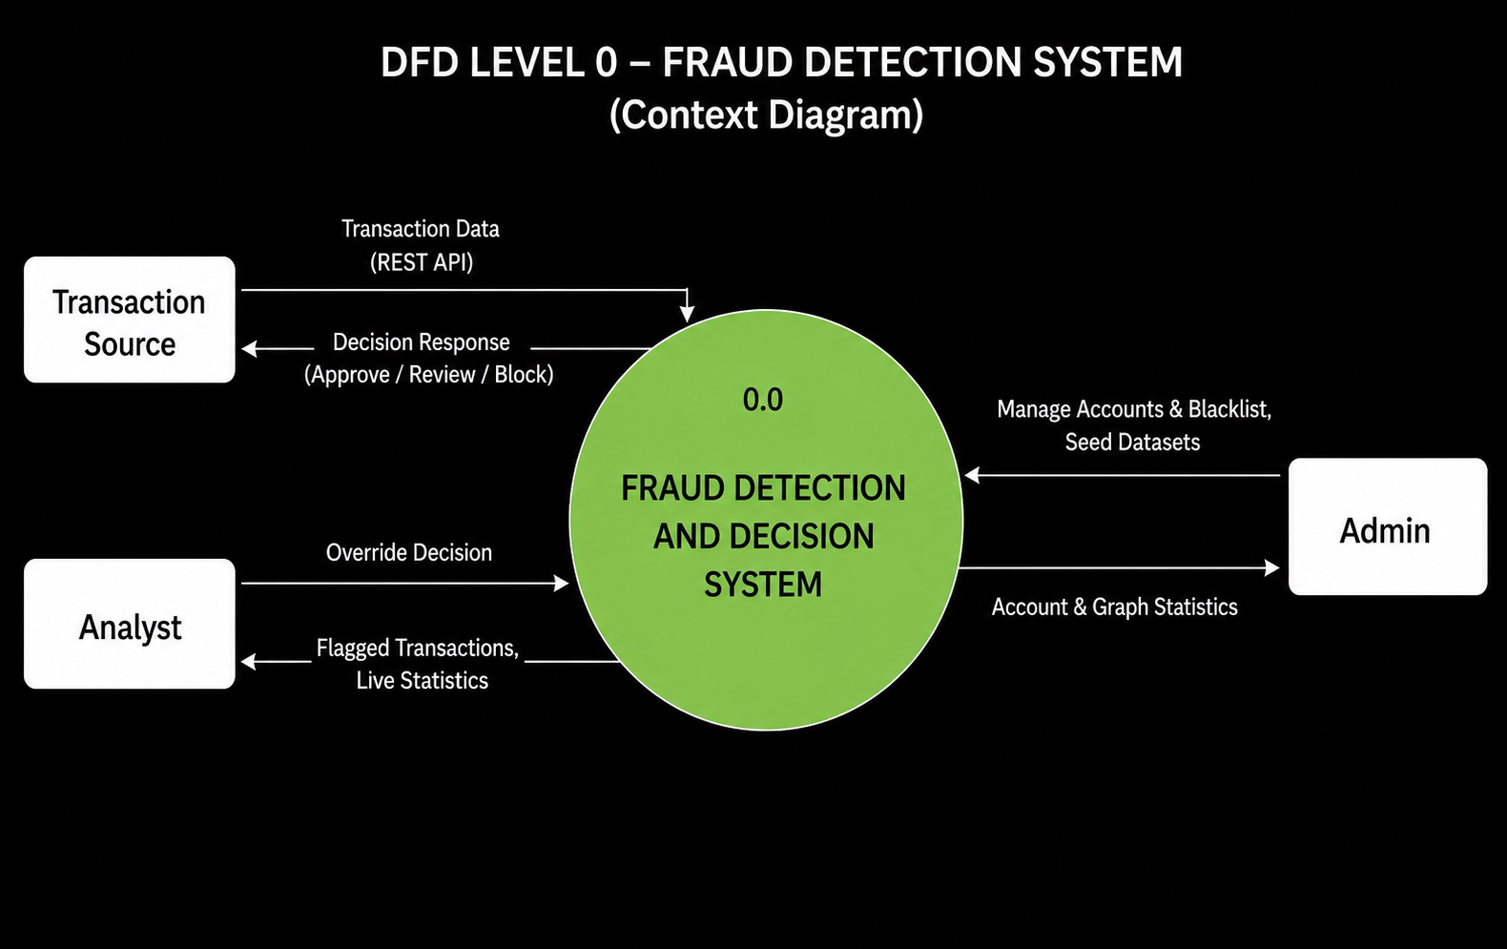
Data Flow Diagram — Level 0 (Context Diagram)

Slide 11
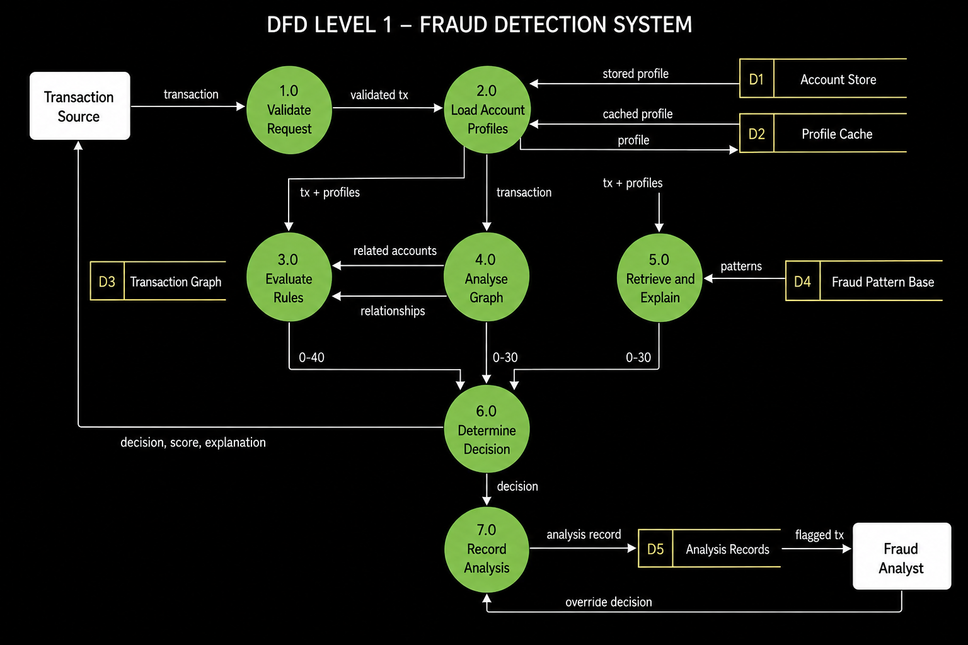
Data Flow Diagram — Level 1

Slide 12
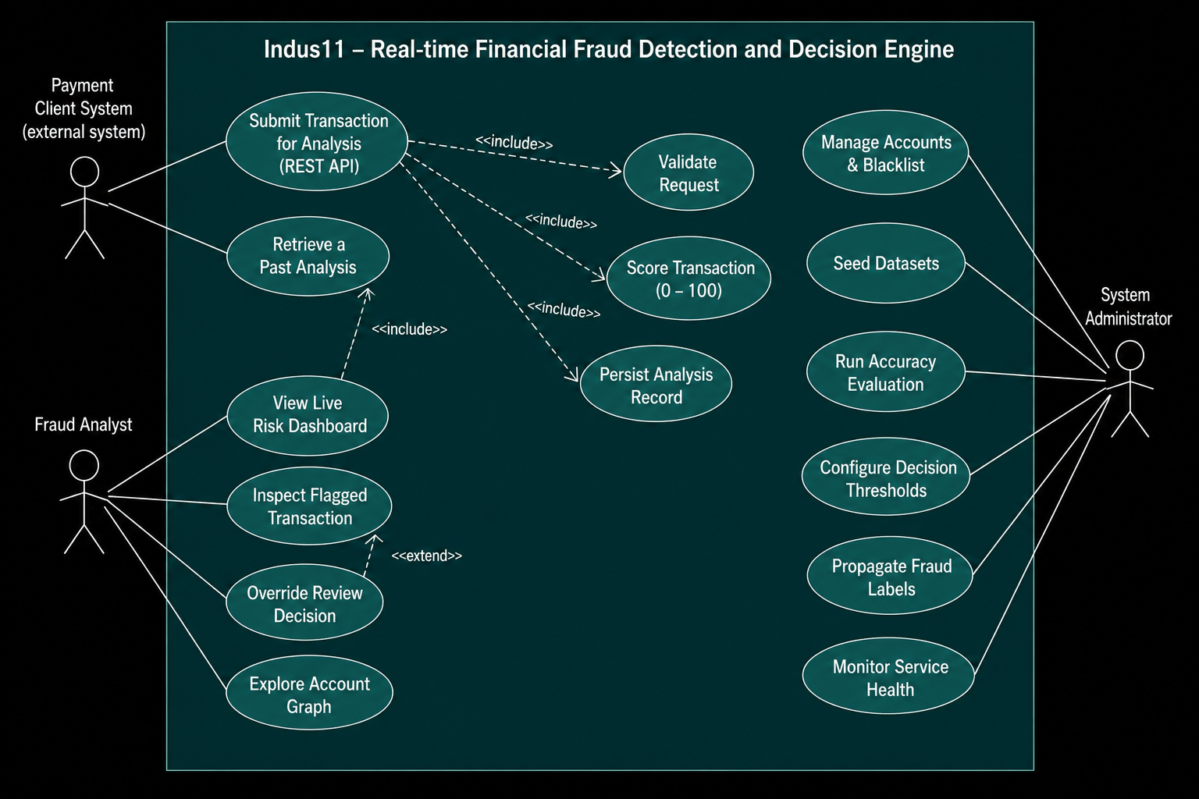
Use Case Diagram

Slide 13
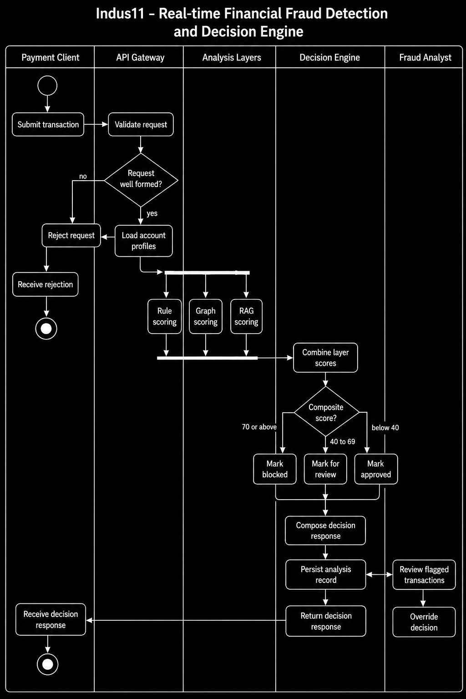
Activity Diagram — Transaction Analysis Workflow

Slide 14
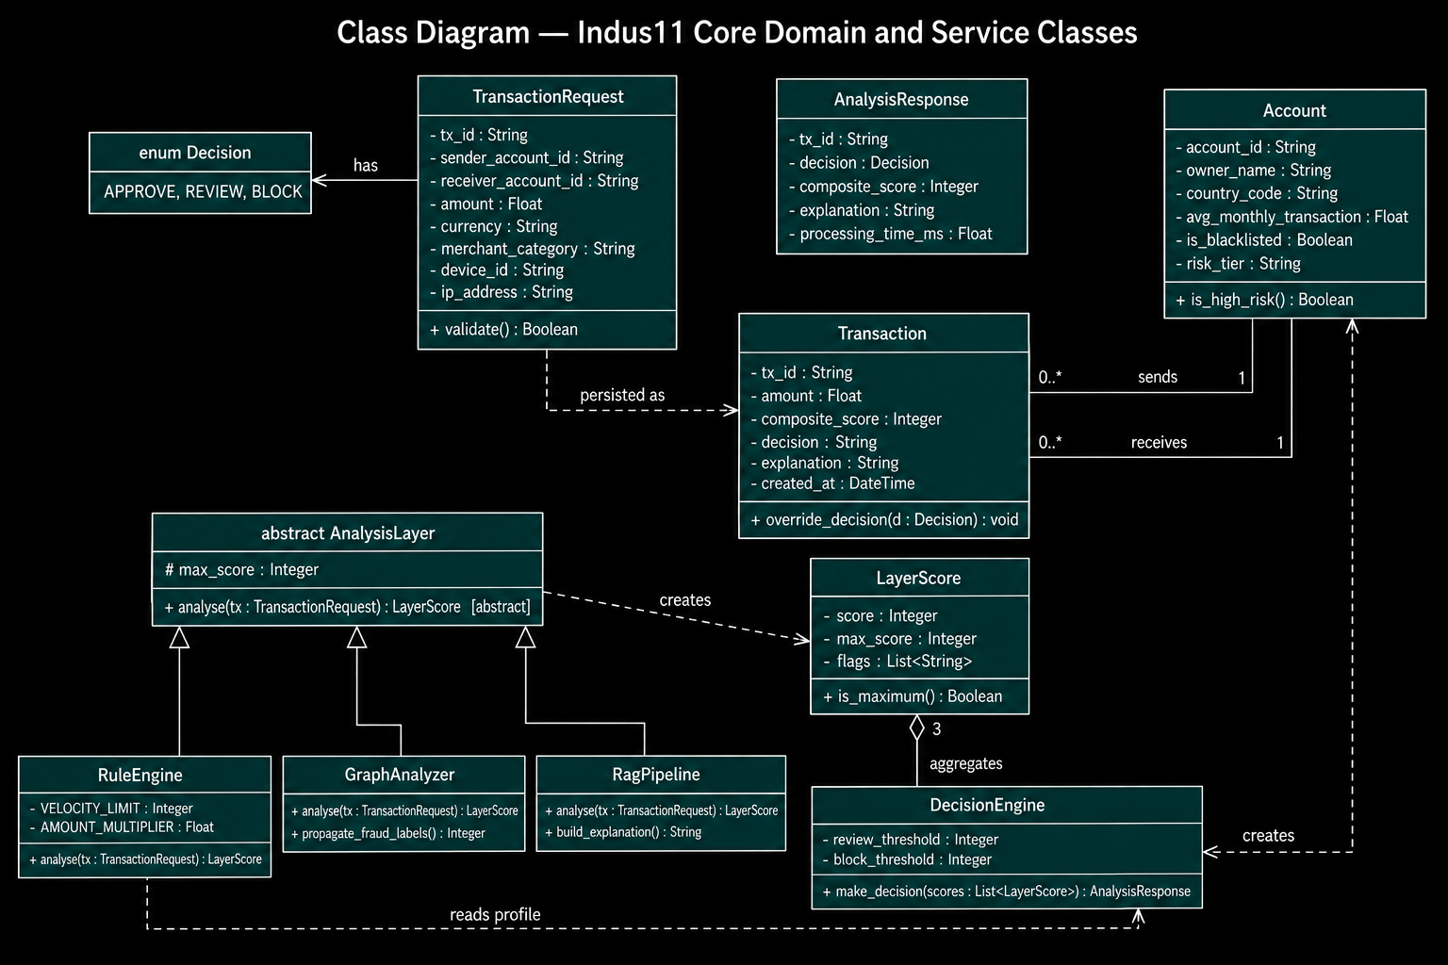
Class Diagram — Core Domain and Service Classes

Slide 15
Literature Review & Existing Solutions
05 · LITERATURE REVIEW
System | Approach | Explains why? | Open / on-prem
FICO Falcon | Neural nets on shared bank data | Limited — black box | No — proprietary
Feedzai | ML risk platform (RiskOps) | Limited | No — commercial
Featurespace ARIC | Adaptive behavioural analytics | Limited | No — commercial
Traditional rule engines | Static hand-written rules | Yes, but rigid | Varies
Indus11 (ours) | Rules + graph + RAG-LLM ensemble | Yes — every decision | Yes — open, local
Research basis
The APATE study (Van Vlasselaer et al., 2015) shows that combining graph-based features with traditional features reaches AUC > 0.98 — evidence that our rules-plus-graph design outperforms either approach alone.

Slide 16
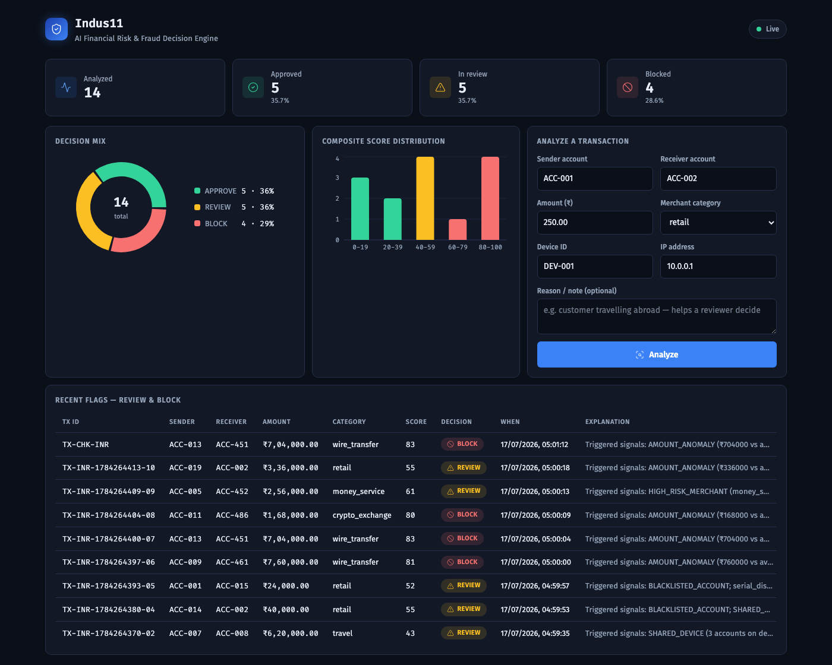
Implementation — Live Dashboard & API
06 · IMPLEMENTATION
React dashboard
• Live risk metrics & decision mix
• Score-distribution chart
• Flagged-transactions feed
• Click a transaction → full detail + reason
• Approve / Block override on REVIEW
FastAPI backend
• 12 documented REST endpoints
• health · transactions · accounts
• graph · stats
• Swagger UI at /docs
• All engines run via asyncio.gather()

Slide 17
Implementation — Structure, Code & Stack
06 · IMPLEMENTATION
Project structure
app/
main.py FastAPI app + startup
config.py settings (.env)
api/routes/ transactions · accounts
graph · stats · health
core/ db · neo4j · redis · rate
models/ Beanie documents
schemas/ Pydantic contracts
services/ rule_engine · graph_analyzer
rag_pipeline · decision_engine
dashboard/ React + Vite + Recharts
scripts/ seed_mongo · seed_neo4j
tests/ test_fraud.py (8 tests)
docker-compose.yml
Decision Engine — composite scoring
composite = rule.score + graph.score + rag.score
composite = min(composite, 100)
if composite >= BLOCK_THRESHOLD: # 70+
decision = Decision.BLOCK
elif composite >= REVIEW_THRESHOLD: # 40-69
decision = Decision.REVIEW
else:
decision = Decision.APPROVE # 0-39
Live example ₹7,04,000 wire → known fraud ring BLOCK 83/100 = rule 25 + graph 30 + AI 28
Stack: Python · FastAPI · MongoDB · Neo4j · Redis · ChromaDB · LangChain+Ollama · React · Docker · pytest (8/8)

Slide 18
Detection Accuracy — Measured Results
208 labelled synthetic transactions — 52 fraudulent, 156 legitimate — replayed through the complete pipeline
93.8%
Precision
of flagged were fraud
86.5%
Recall
of fraud was caught
0.90
F1 score
combined measure
36/36
Ring recall
mule-ring hops detected
Decision | Actually fraud | Actually legitimate
APPROVE | 7 | 153
REVIEW | 45 | 3
BLOCK | 0 | 0
Key finding
No transaction reached the block threshold of 70.
Every detection is routed to a human analyst; nothing is blocked automatically. Lowering the band would automate blocking — but would also auto-block the three false positives. That is a policy decision, not a configuration change.
Measured on synthetic data in which fraud is far denser than a real payment feed, so precision here is optimistic — it measures the separation between the engines, not production performance.

Slide 19
Progress Since the Last Review
Specification
Front matter numbered in roman (i-ix); body restarts at 1
Every reference cited in the text at its point of use, IEEE style
Tables restyled — caption above, columns sized to content, none split across a page break
32 functional requirements consolidated to 28 real, distinct ones
Diagram set re-checked against the guide's notation comments and against the running code
Product
Flagged-transactions table made interactive — filters, search, sortable columns
Entrance and count-up motion, with an automatic reduced-motion fallback
Static demo mode: the dashboard runs from a snapshot with no live backend
Weekly-report generator with an automatic duplicate-reference check across weeks

Slide 20
Challenges Faced & Future Work
07 · CHALLENGES & FUTURE WORK
Challenges faced
Coordinating four data stores on one machine
Keeping model output consistent — solved with a 30-point cap
Writing Cypher queries for circular money-mule flows
Two defects the benchmark exposed: a repeated request returned
a server error, and a parsing fault silently zeroed the AI
score — both fixed and covered by tests
Future work
Resolve the block-threshold trade-off from recorded scores
Add API authentication and request logging
Fraud-ring visualisation on the graph endpoint
Investigate the 7 undetected frauds; fan-in / fan-out patterns
Train a supervised classifier as a fourth signal
Reduce latency, presently dominated by the local model

Slide 21
Conclusion — Where the Project Stands
Measured, not asserted
93.8% precision, 86.5% recall, F1 0.90 on 208 labelled transactions.
The graph layer earns its place
All 36 planted mule-ring transactions were detected.
A finding worth reporting
Nothing reaches the block threshold; every catch reaches an analyst.
Engineering discipline
27 automated tests, continuous integration, one-command deployment.

Slide 22
References
[1] Van Vlasselaer, V. et al. (2015). APATE: A novel approach for automated credit card transaction fraud detection using network-based extensions. Decision Support Systems, 75, 38–48.
[2] FICO. Falcon Fraud Manager — product documentation. fico.com.
[3] Feedzai. RiskOps platform overview. feedzai.com.
[4] Featurespace. ARIC Risk Hub — adaptive behavioural analytics. featurespace.com.
[5] Neo4j. Graph algorithms for fraud detection — developer guide. neo4j.com.
[6] LangChain & ChromaDB documentation — retrieval-augmented generation.

Slide 23
Team Contributions
JO
KG
DD
Joshi Om
24DCE052 · Platform & Documentation
Krish Gajera
24DCE040 · Graph & Fraud Detection
Drashti Dedaniya
24DCE029 · AI & Dashboard
• FastAPI gateway, MongoDB/Beanie schema, Redis caching and rate limiting
• Rule Engine — velocity, amount, blacklist, merchant, risk-tier checks
• Docker Compose stack for all five services
• SRS requirements and database design; verified every schema table against the running code
• Neo4j schema and Cypher queries for rings, circular flow, fee-skimming
• Graph Analyzer — shared device/IP clustering, fraud-label propagation
• Synthetic fraud dataset generator — 500 accounts, 3 planted mule rings
• LangChain RAG pipeline, ChromaDB knowledge base, prompt engineering
• Decision Engine — score aggregation and threshold mapping
• UML and DFD diagram set for the specification
• React dashboard — charts, interactive table, motion, demo mode
• Review-2 deck and the standalone speaking script

Slide 24
Thank You
Questions · Suggestions · Comments

