Slide 1

Omkar Rajendra Patil
232010045
Heart Disease Prediction Using Machine learning :
A Data-Driven Approach

Slide 2
(1)Introduction
1)Heart Disease
1)Heart disease is one of the main causes of death around the world.
2)According to the World Health Organization (WHO), about 17 million people die each year from heart-related diseases
2)Importance of Early Detection:
1)The number of people getting heart disease is rapidly growing because of factors like getting older, eating unhealthy food, obesity, smoking, and high blood pressure
2)As heart disease continues to increase, it’s very important to detect it early and predict it correctly to help reduce the number of deaths and improve patient care.
3)Machine Learning (ML):
1)In the past, diagnosing heart disease required tests like angiography, which are expensive and need skilled doctors to interpret the results.
2)But machine learning (ML) provides a simple way to predict heart disease early by analyzing large amounts of data.

Slide 3
2)Problem Statement
1)Traditional Methods Have Limitations
Old methods sometimes give late or wrong results, which can delay heart disease treatment.
2)Imbalanced Data Affects Predictions
If the data has more healthy people, the system may wrongly say a sick person is healthy.
3)Missing Information in Healthcare Data
Missing test details or patient history can lead to wrong treatment or poor predictions.
4)Complexity of Heart Diseases
Heart diseases depend on many factors, which makes it hard for doctors to diagnose correctly.
5)Need for New Data-Driven Methods
We need smarter tools like machine learning to support doctors and improve decisions.

Slide 4
(3)Overview of Heart Disease
(1)Causes of Heart Disease
1)High Blood Pressure – When your blood moves through your body with too much force, it can damage your heart.
2)High Cholesterol – Too much fat in your blood can block your heart’s blood vessels.
3)Chest Pain (Angina) – This happens when your heart doesn’t get enough blood.
4)Unhealthy Habits – Eating junk food, smoking, or not exercising can make heart problems worse.
2)Risk Factors
1)Age – Older people are at higher risk.
2)Gender – Men are more likely to get heart disease earlier than women.
3)Family History – If your parents or grandparents had heart problems, you may be at higher risk.
4)Lifestyle – Eating too much unhealthy food, not exercising, or being stressed can increase the risk.

Slide 5
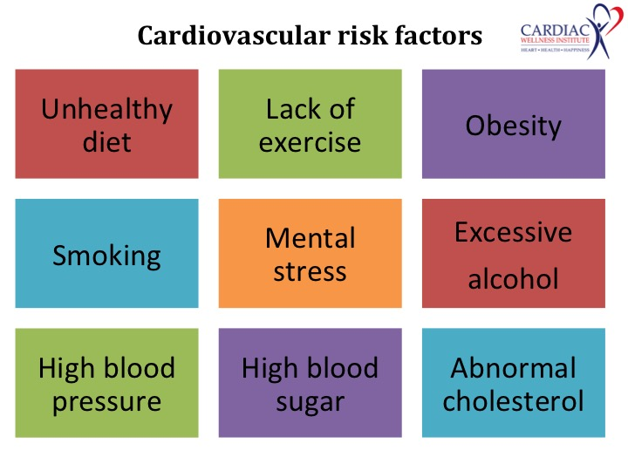
(4)Cleveland Heart Disease Dataset
1)The Cleveland Heart Disease Dataset is commonly used in heart disease research
2)It contains data from 920 patients with 76 features.
3)Many studies focus only on 14 important features that are most useful for predicting heart disease.
4)These features include age, gender, cholesterol levels, blood pressure, maximum heart rate, and exercise-induced chest pain etc.
5)These factors give us valuable information about heart health and improve the accuracy of machine learning models.
6)By studying these factors, doctors can identify people who are at high risk and create better prevention plans.

Slide 6
5)Why Preprocess the Data
1)Removes Errors:
Preprocessing helps fix wrong or missing values in the data.
2)Improves Accuracy:
Clean and organized data helps the model make better predictions.
3)Speeds Up Training:
Properly prepared data allows the model to learn faster.
4)Balances Data:
Preprocessing ensures no feature (like age or salary) dominates the results.
5)Reduces Noise:
It removes useless or extra information that can confuse the model.

Slide 7
6)Data Preprocessing
1)Handling Missing Data:
1)SimpleImputer: Fills missing values with the average (mean), most common value, or zero.
2)KNNImputer: Looks at similar data points (neighbors) and guesses the missing value based on them.
2)Feature Scaling:
1)Height may be in centimeters (like 170 cm).
2)Weight may be in kilograms (like 65 kg).
3)This adjusts all values to a similar range, ensuring fair comparisons.
3)Data Cleaning:
1)Incorrect entries (e.g., someone’s age recorded as 200 years).
2)Duplicate records (e.g., the same student’s data appearing twice)
3)Ensuring the dataset is ready for accurate predictions.

Slide 8
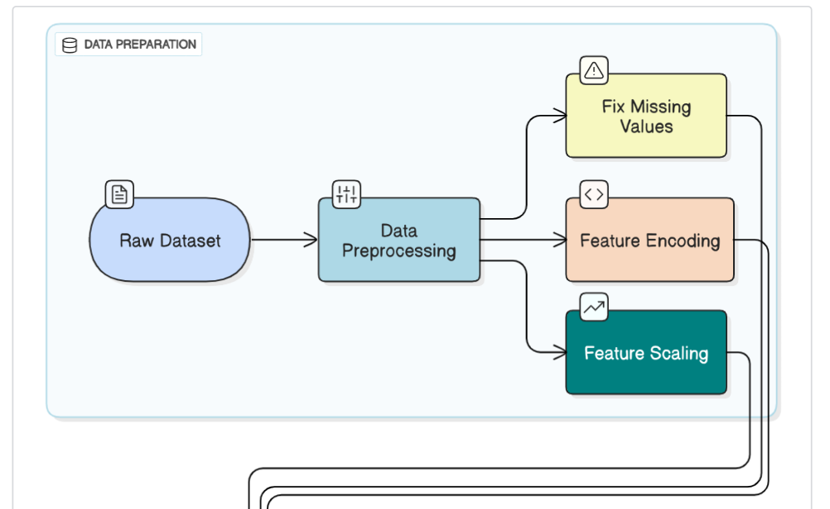
7)Data Preprocessing Work flow diagram

Slide 9
(8)Model Selection and Training(1)
1)Random Forest:
1)This model uses decision trees to make predictions.
2)This model was good at making predictions without overfitting.
3)This means it gave stable results, even when tested with new data.
4)The model’s 84% accuracy shows it can predict well, even for data it has never seen before.
5)This model is great when you want reliability and simplicity over super-high accuracy.

Slide 10
(9)Model Selection and Training(2)
1)XGB Classifier :
1)This model uses gradient boosting to improve accuracy.
2)The XGB Classifier did slightly better than the Random Forest model, with 86% accuracy.
3)It was better at finding more complex patterns in the data.
4)This made it a good choice when we wanted the model to be as accurate as possible.
5)especially when the patterns in the data are complicated.

Slide 11
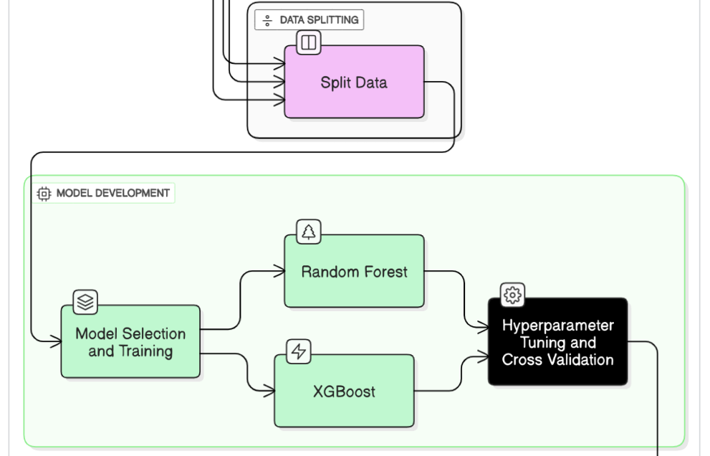
(10)Model Selection and Training Work flow diagram

Slide 12
11)Model Evaluation(1)
1)Accuracy
1)Accuracy tells us how many predictions were correct out of all the predictions made.
2)If a model predicts 100 test cases, and 90 of them are correct, the accuracy is 90%.
3)Higher accuracy = Better model (in simple cases).
2)Precision
1)Precision shows how many of the positive predictions were actually correct.
2)Imagine a heart disease detection model predicted 10 people have heart disease, but only 8 of them were true cases.
3)Precision = 8/10 = 0.8 (or 80%)
4)Higher precision = Fewer false alarms.
3)Recall (Sensitivity)
1) Recall shows how well the model finds actual positive cases (e.g., actual heart disease patients).
2)If there are 20 real heart disease cases and the model found 18 of them, recall = 18/20 = 0.9 (or 90%)
3)Higher recall = Fewer missed cases.

Slide 13
12)Model Evaluation(2)
4)F1-Score
1)F1-Score is a balance between precision and recall.
2)It’s useful when both precision and recall are important.
3)Higher F1-Score = Better overall performance.
5)Confusion Matrix
1)True Positives (TP): Correctly predicted positive cases.
2)True Negatives (TN): Correctly predicted negative cases.
3)False Positives (FP): Incorrectly predicted positive cases.
4)False Negatives (FN): Missed positive cases.
5)The confusion matrix helps you understand exactly where the model is making mistakes.

Slide 14
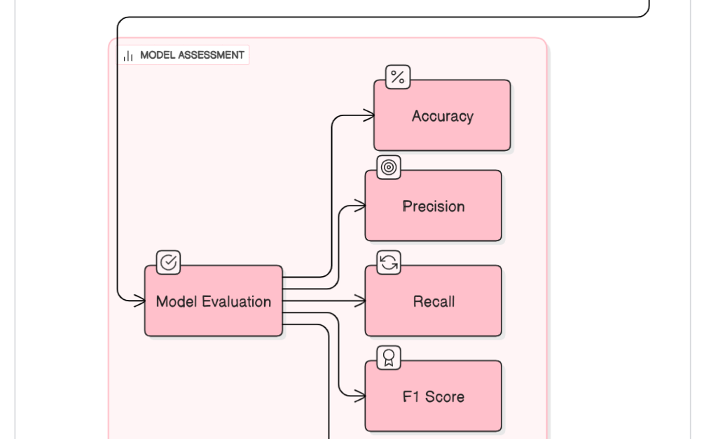
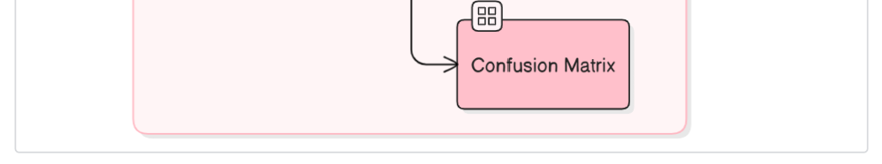
13)Model Evaluation Work flow diagram

Slide 15
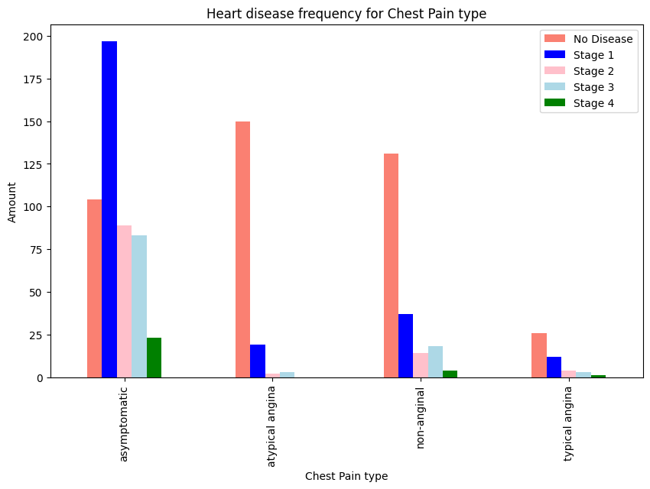
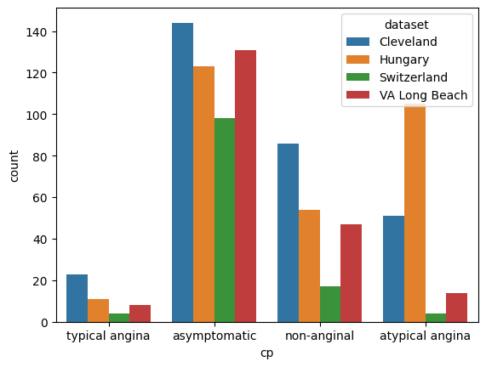
14)Experimental results (1)
Figure 4: Visualizing the Relationship Between Chest Pain Type and Heart Disease Level
Figure 5: Visualizing Chest Pain Types by Dataset Using Seaborn

Slide 16
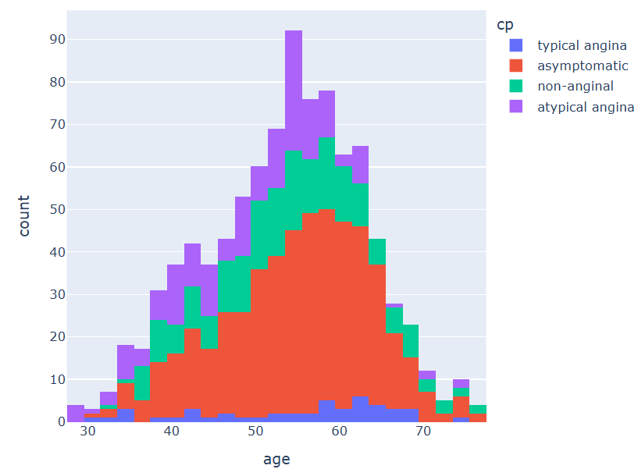
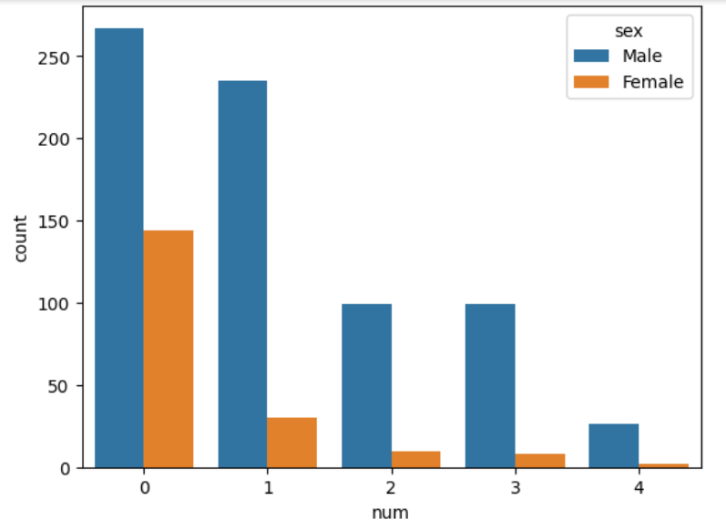
15)Experimental results (2)
Figure 7: Plotting Age Distribution Grouped by Chest Pain Type using Plotly Histogram
Figure 8: Comparing Gender with Heart Disease Presence

Slide 17
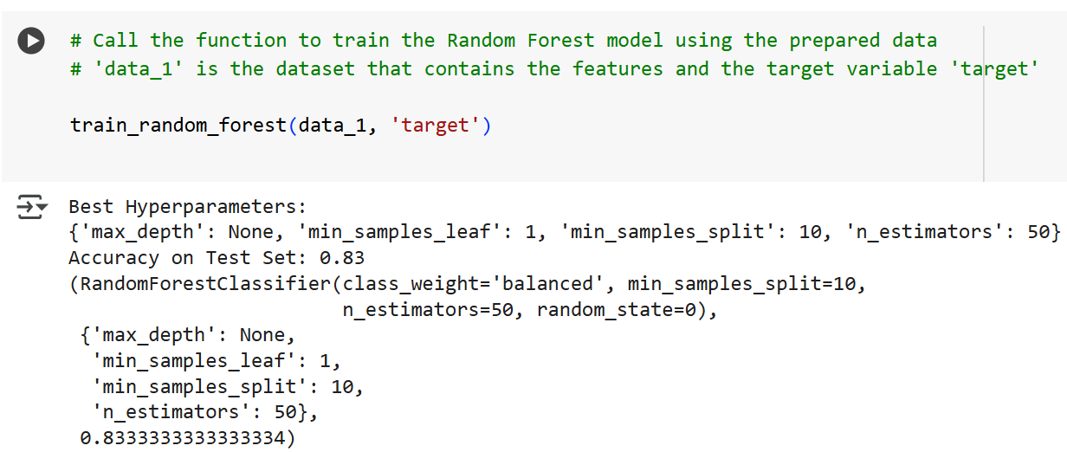
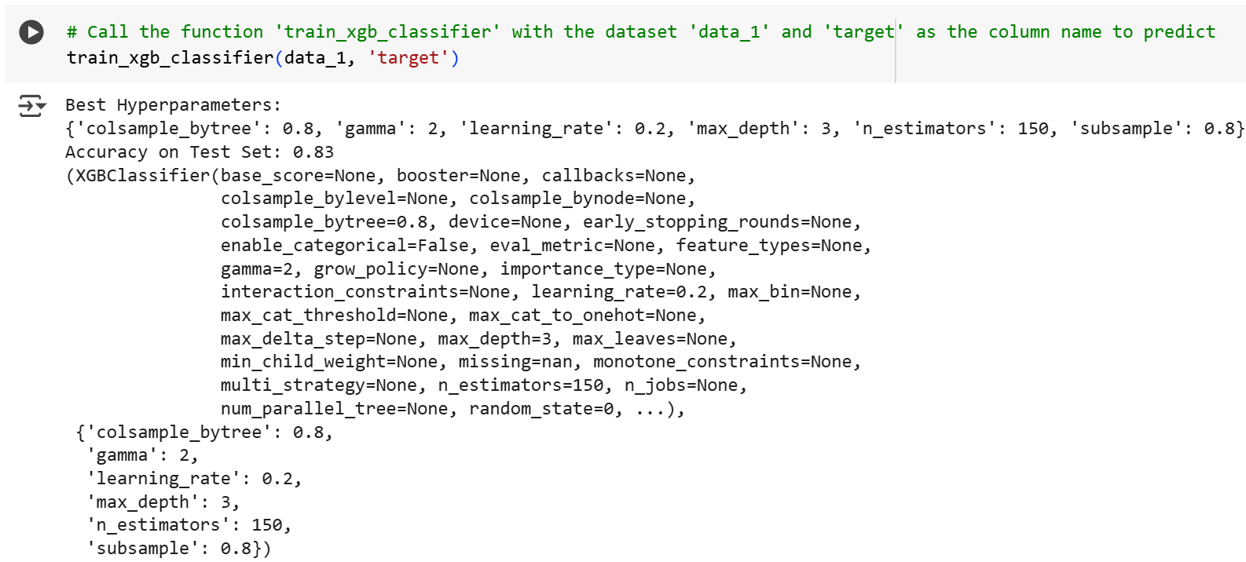
16)Final Results
1)Random Forest:
83% accuracy, stable, and good for simple predictions.
2)XGB:
83% accuracy, better at complex pattern recognition.
3)Key Findings:
Blood pressure, chest pain type, and age are critical in predictions.

Slide 18
17)Challenges
1)Data Imbalance:
1)More cases of no heart disease than those with heart disease.
2)Imagine a classroom with 95 healthy students and 5 sick students.
3)If a model predicts that everyone is healthy, it will still be 95% accurate, but it completely missed the 5 sick students.
4)This happens when one group (like "no heart disease" cases) is much larger than the other (like "heart disease" cases).
2)Model Interpretability:
1)Understanding how the model makes decisions is difficult.
2)Some models, like Random Forest or XGBoost, are like "black boxes."
3)This means they predict well but don’t clearly explain why they made a certain prediction.
4)For example, if the model says "This person has heart disease", it's hard to understand which factors (like age, blood pressure, etc.) influenced that decision.

Slide 19


18)Future Scope
The system can connect with hospitals to give live predictions.
1)We can try more models like Logistic Regression, SVM, or Deep Learning.
2)Combining models using Voting or Stacking can give better results.
3)Adding more patient data will improve accuracy.
4)We can build a web or mobile app for real-time heart risk check.
5)The system can connect with hospitals to give live predictions.
6)We can use Explainable AI to show why a result was given.

Slide 20

19)Conclusion
1)We used two machine learning models — Random Forest and XGB Classifier — to predict heart disease.
2)Both models gave good results, but XGB was a little better in accuracy.
3)Chest pain type, age, and blood pressure were the most important health factors.
4)These models help doctors find heart problems early and make better decisions.
5)Random Forest is simple and stable, while XGB gives more accurate results.
6)This system can save lives by giving faster and smarter heart disease predictions.

