Slide 1

SMART INDIA HACKATHON 2026
TITLE PAGE
Problem Statement ID – SIH26012
Problem Statement Title- AI-Based Automated Urban Parcel Mapping and Cadastral Feature Extraction System using Drone Imagery
Theme- Smart Automation
PS Category- Software
Team ID- [ enter Team ID ]
Team Name- SuperSix

Slide 2
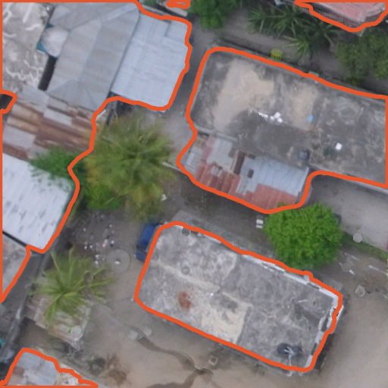
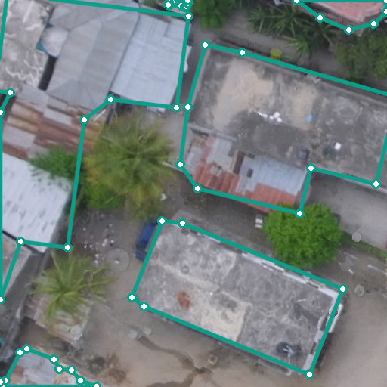
IDEA TITLE
SuperSix
GeoParcel AI — drone & satellite imagery → verification-ready building-parcel maps
➤ Proposed Solution
An end-to-end AI pipeline that turns an orthomosaic (or a satellite map) into clean, georeferenced building-footprint polygons — the parcel candidates a surveyor verifies instead of tracing by hand.
Scale-aware AI segmentation: U-Net with ResNet-34 encoder labels every pixel as building / background; overlapping 512-px tiled inference handles images of any size.
Works from drone to satellite: multi-scale model trained at 7–45 cm/pixel; GeoTIFF resolution is read automatically.
Rectilinear regularisation: jagged masks become right-angled polygons (~27× fewer vertices) through orientation snapping, least-squares edge refits and an IoU fidelity guard.
GIS-ready output: GeoJSON in the image's own CRS (UTM / WGS84), ready for QGIS, Web-GIS and the NAKSHA workflow.
Surveyor in the loop: every polygon is tagged “candidate – needs field verification”; corrections feed retraining.
Raw AI contour
~240 vertices per building
GeoParcel AI polygon
~10 vertices, right-angled
➤ How it addresses the problem
➤ Innovation & uniqueness
0.80
27×
0.14→0.61
Removes the bottleneck: manual digitisation sits between the drone flight and the property record; we automate it.
Consistent & auditable: the same model and rules for every ward, with per-polygon review status.
Scales nationally: NAKSHA covers 152 ULBs in 26 States + 3 UTs; SVAMITVA has surveyed 3.29 lakh villages.
Multi-resolution: one model for 7 cm drone and ~45 cm satellite imagery (IoU 0.14 → 0.61 at 45 cm).
Shape-aware post-processing: polygons a surveyor can edit, not pixel blobs.
Proven, not proposed: working prototype, open code, public live demo.
Low cost: trained on one laptop GPU; runs on free cloud hardware.
pixel IoU on an unseen neighbourhood
fewer vertices per polygon
IoU on 45 cm satellite-like imagery
Working prototype — try it live
Demo: huggingface.co/spaces/omeow/geoparcel-ai
Code: github.com/OMMEOW/SIH26_PS26012
Upload a drone tile or satellite screenshot → polygons + GeoJSON download.

Slide 3
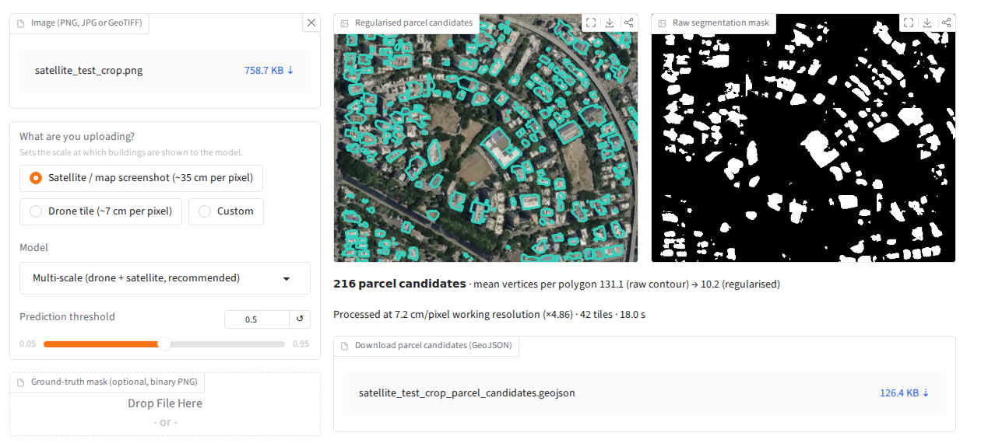
TECHNICAL APPROACH
SuperSix
➤ Technologies to be used
➤ Methodology & process flow
Layer | Technology
AI / ML | PyTorch · segmentation_models_pytorch (U-Net, ResNet-34) · timm · Dice + BCE loss
Geospatial | Rasterio / GDAL · GeoPandas · Shapely · PyProj (WGS84 ↔ UTM)
Vision & maths | OpenCV · NumPy · SciPy · Albumentations (augmentation)
Applications | Gradio (public web app) · Streamlit (operator console)
Deployment | Hugging Face Spaces (ZeroGPU) · Docker · GitHub Releases (weights)
Output standard | GeoJSON in source CRS → QGIS / Web-GIS / NAKSHA portal
Data | Open Cities AI Challenge drone orthomosaics, 4–7 cm/pixel (ODbL)
1 Input
Drone GeoTIFF or satellite screenshot
2 Scale normalise
Resample to 7.2 cm/px working scale
3 Tiled U-Net
512-px tiles, 64-px overlap, averaged
4 Building mask
per-pixel probability → binary mask
8 Feedback loop
corrections → retraining data
7 Surveyor review
Web-GIS check & field verification
6 GeoJSON export
polygons in source CRS (UTM/WGS84)
5 Regularise
snap to dominant axis, LSQ refit, IoU guard
➤ Model development
CRS-aligned tiling
WGS84 labels reprojected to UTM before rasterising (else masks are empty)
Base training
5,008 tiles · 7.2 cm · 10 epochs · best val IoU 0.63
Multi-scale fine-tune
2 more scenes at 7.2–45 cm · JPEG/blur/colour aug · 6 epochs
Evaluation
held-out tiles · unseen 396 m scene · accuracy per resolution
Workflow fit
Drone survey → orthomosaic → GeoParcel AI → surveyor → land record
Speed
640×520 px satellite screenshot (42 tiles): ~4 s on a shared GPU, ~18 s on CPU.
Project links (working prototype)
Live demo: https://huggingface.co/spaces/omeow/geoparcel-ai
GitHub: https://github.com/OMMEOW/SIH26_PS26012
Model weights: https://github.com/OMMEOW/SIH26_PS26012/releases/tag/weights-v1
Live web app: upload → polygons → GeoJSON

Slide 4
FEASIBILITY AND VIABILITY
SuperSix
➤ Feasibility (already demonstrated)
➤ Challenges, risks & mitigation
Technical: full pipeline built and tested on real drone imagery. Pixel IoU 0.60 on 502 held-out tiles; 0.80 on a never-seen 396 m × 396 m neighbourhood; 427 GeoJSON candidates produced end to end.
Economic: open-source stack, no licence fees; trained on a single laptop GPU; hosted on free cloud tier.
Operational: standard inputs (GeoTIFF) and outputs (GeoJSON) — slots into existing GIS tools; simple web UI for field teams.
Deployable anywhere: Docker image for State data centres / NIC cloud, so imagery need not leave government servers.
Challenge | Risk | Mitigation strategy
Indian building stock (roofs, high-rise towers) | Missed buildings | Fine-tune on NAKSHA / SVAMITVA orthomosaics; active learning from surveyor edits
Touching buildings with shared walls | Merged parcels | Boundary-aware loss / instance segmentation; split tool in review UI
Mixed image resolutions & sources | Accuracy drop | Multi-scale training (done); resolution read from GeoTIFF metadata
Legal acceptance of AI output | Disputes | Outputs are candidates only; mandatory field verification & audit trail
Data security & sovereignty | Data leakage | On-premise Docker deployment; no third-party APIs needed
Scale (crores of parcels) | Compute cost | Tiled batch inference on GPU nodes; CPU fallback; process per ward
➤ Viability
Clear demand: NAKSHA urban survey (152 ULBs, 26 States + 3 UTs) and SVAMITVA (3.29 lakh villages surveyed) both generate drone orthomosaics that need digitising.
Incremental adoption: starts as decision support for surveyors; accuracy improves with every verified correction.
SUPPORTING FACTS (measured on our prototype)
Regularisation: 213 → 7.9 vertices per polygon; right-angle corners 17% → 35%; polygon IoU preserved (0.47 → 0.46).
Multi-scale model: pixel IoU 0.61 → 0.67 at 7.2 cm and 0.14 → 0.61 at 45 cm on an unseen scene.
No loss on the original drone validation set (0.642 → 0.643).
Roll-out plan
Pilot: one NAKSHA ULB — compare against manual digitisation (time, accuracy).
Adapt: fine-tune on Indian orthomosaics + surveyor corrections.
Scale: State-level deployment, then plot boundaries (walls, fences, roads).

Slide 5
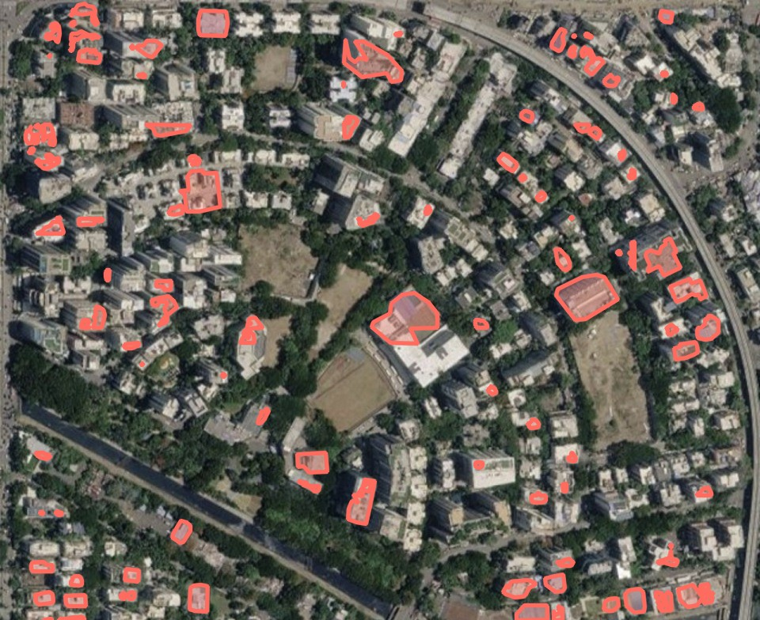
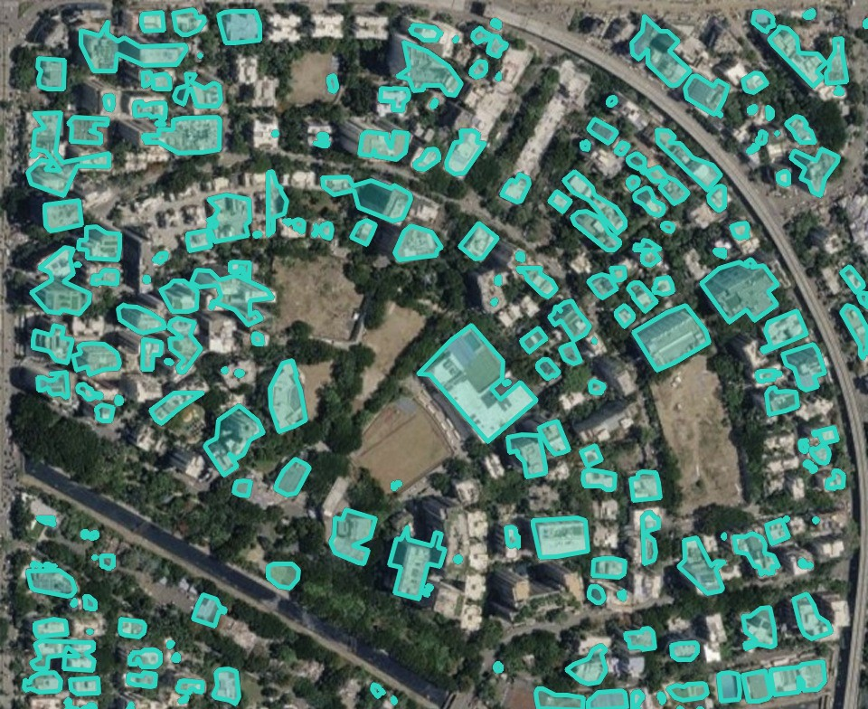
IMPACT AND BENEFITS
SuperSix
➤ Potential impact on the target audience
➤ Measured accuracy: drone → satellite resolution
DoLR / State Revenue & Survey depts: faster conversion of drone surveys into digital land records.
Urban Local Bodies: up-to-date building footprints for property tax, planning and encroachment checks.
Surveyors: verify and correct instead of tracing every outline; more wards covered per team.
Citizens: quicker property cards → easier loans, fewer boundary disputes.
Banks & planners: standard GeoJSON data for credit, infrastructure and disaster planning.
Disaster response: rapid building inventories from post-event drone flights (the Open Cities data was built for this).
Indian city, satellite map (~35 cm/px)
Left: drone-only model — most buildings missed.
Right: multi-scale model — mid-rise and large flat roofs found.
No ground truth here: qualitative.
Unseen scene 353093 resampled to each resolution; up to 300 tiles each.
➤ Benefits of the solution
Type | Benefit | How GeoParcel AI delivers it
Social | Faster, more transparent property records; fewer boundary disputes | Uniform, auditable polygons with surveyor sign-off feed SVAMITVA / NAKSHA property cards
Economic | Surveyor time moves from tracing to verification; better property-tax base for ULBs | Automatic footprints + GeoJSON export; open-source, runs on commodity hardware
Environmental | Fewer repeat field visits; reuses imagery already captured | Works on existing drone and satellite orthomosaics — no new flights needed
Governance | Standard, machine-readable land data | Georeferenced GeoJSON in source CRS, ready for Web-GIS and Digital India Land Records

Slide 6
RESEARCH AND REFERENCES
SuperSix
➤ Research papers & methods
➤ How we compare
a. Ronneberger, O., Fischer, P., Brox, T. (2015). U-Net: Convolutional Networks for Biomedical Image Segmentation. MICCAI. arxiv.org/abs/1505.04597
b. He, K., Zhang, X., Ren, S., Sun, J. (2016). Deep Residual Learning for Image Recognition. CVPR. arxiv.org/abs/1512.03385
c. Douglas, D., Peucker, T. (1973). Algorithms for the reduction of the number of points required to represent a digitized line or its caricature. The Canadian Cartographer, 10(2).
d. Zero-Shot Building Footprint Extraction and Regularization Based on Segment Anything Model with Mesh Model.
e. UrbanSAM: Learning Invariance-Inspired Adapters for Segment Anything Models in Urban Construction.
f. The Segment Anything Model (SAM) for Remote Sensing Applications: From Zero to One Shot.
g. Enhancing Conventional Land Surveying for Cadastral Documentation in Romania with UAV Photogrammetry and SLAM.
Capability | GeoParcel AI | Manual GIS tracing | Raw AI mask
Automatic building extraction | ✔ | ✘ | ✔
Clean right-angled polygons | ✔ | ✔ | ✘
Georeferenced GeoJSON output | ✔ | ✔ | ✘
Handles drone + satellite resolutions | ✔ | ✔ | ~
Same rules for every ward / operator | ✔ | ~ | ✔
Surveyor verification step | ✔ | ✔ | ✘
“Raw AI mask” = a segmentation model without our regularisation and GIS export.
➤ Data, programmes & tools
Open Cities AI Challenge dataset — GFDRR Labs (2020), drone imagery + building labels, ODbL-1.0. source.coop/open-cities
NAKSHA urban land survey pilot — 152 ULBs, 26 States + 3 UTs (DoLR, Feb 2025). newsonair.gov.in
SVAMITVA — drone survey done in 3.29 lakh of 3.44 lakh villages (PIB, 11 Mar 2026). PIB India
segmentation_models_pytorch, Rasterio, GeoPandas, Shapely, Gradio (open source).
➤ Research flow
Problem study
Literature review
Data & CRS alignment
Model training
Project links (live prototype)
Live demo: https://huggingface.co/spaces/omeow/geoparcel-ai
GitHub: https://github.com/OMMEOW/SIH26_PS26012
Deployment & demo
Multi-scale fine-tune
Regularisation

