Slide 1

TRAIN TICKET BOOKING SYSTEM
(Developed by using Java and JDBC)
SUBMITTED BY:
NAME | REGD NO.
OMM PRAKASH MOHANTY | 2201020019
BADITHI SANMUKH | 2201020193

Slide 2
CONTENTS
INTRODUCTION
TECHNOLOGY USED
FEATURES OF THE SYSTEM
CODE IMPLEMENTATION
CODE
OUTPUT
ADVANTAGES AND LIMITATIONS
CONCLUSION

Slide 3
INTRODUCTION
The Train Ticket Booking System is a console-based Java application designed to streamline the process of train ticket reservations using JDBC (Java Database Connectivity). This system serves as an efficient alternative to traditional manual booking methods by providing an automated way to search for trains, check seat availability, book tickets, view reservations, and cancel tickets.
With the rapid advancement in technology, railway ticketing systems must ensure speed, accuracy, and reliability. This project eliminates the inconvenience of waiting in long queues and reduces human errors in ticket allocation. By leveraging Oracle Database, it ensures secure and organized data storage for train schedules, passenger details, and booking records.
This system is built on Object-Oriented Programming (OOP) principles, providing a modular and scalable approach. The use of SQL queries with JDBC allows smooth interaction between the Java application and the database.

Slide 4
TECHNOLOGY USED
Our Train Ticket Booking System is built using a robust and efficient set of technologies that ensure seamless data processing, secure transactions, and smooth user interaction.
1. Programming Language: Java
Used for backend logic and database connectivity.
Implements Object-Oriented Programming (OOP) principles for modular and scalable code.
Provides exception handling and multithreading for efficient processing.
2. Database Management System: Oracle Database
Stores train details, passenger records, and ticket reservations.
Ensures data consistency, security, and integrity.
Supports SQL queries for fast and efficient data retrieval and updates.
3. Java Database Connectivity (JDBC)
Acts as a bridge between Java and the Oracle Database.
Enables secure and dynamic SQL execution.
Facilitates query execution, transaction management, and error handling.
4. Development Environment & Tools
JDK (Java Development Kit): For compiling and running Java programs.
Eclipse/IntelliJ IDEA: IDE for writing and debugging code efficiently.
SQL Developer: Tool for managing the Oracle database.

Slide 5
FEATURES OF THE SYSTEM
View Available Trains: Users can check all available trains with details like source, destination, available seats, and price.
Book Ticket: Passengers can book tickets for a specific train, and seat availability is updated accordingly.
Cancel Ticket: Users can cancel their ticket, and the seat is reallocated to other passengers.
View My Tickets: Passengers can check their booked tickets along with train details and seat numbers.
Real-time Seat Availability Update: Every booking or cancellation updates the database to reflect current seat availability.
Secure Transactions: Ensures data integrity with proper database constraints and SQL execution.
User-friendly Console Interface: Easy-to-use text-based menu for seamless navigation.

Slide 6
CODE IMPLEMENTATION
The Train Reservation System is developed in Java using JDBC to facilitate interaction with an Oracle Database. The implementation consists of the following key modules:
Database Connection
Establishes a secure connection between the Java program and the Oracle database using JDBC.
Ensures authentication and allows execution of SQL queries.
Viewing Available Trains
Retrieves train details from the database, including train number, name, source, destination, available seats, and ticket price.
Displays the data in a structured format for easy user access.
Booking a Ticket
Takes passenger details and the selected train number as input.
Checks seat availability before confirming the booking.
Inserts booking details into the database and updates seat availability in real time.
Canceling a Ticket
Allows users to cancel their booked ticket by providing their name.
Deletes the corresponding record from the database and updates the seat count to make it available for other passengers.
Viewing Booked Tickets
Enables passengers to check their booked tickets by entering their name.
Retrieves and displays details such as train number, seat number, and fare paid.

Slide 7
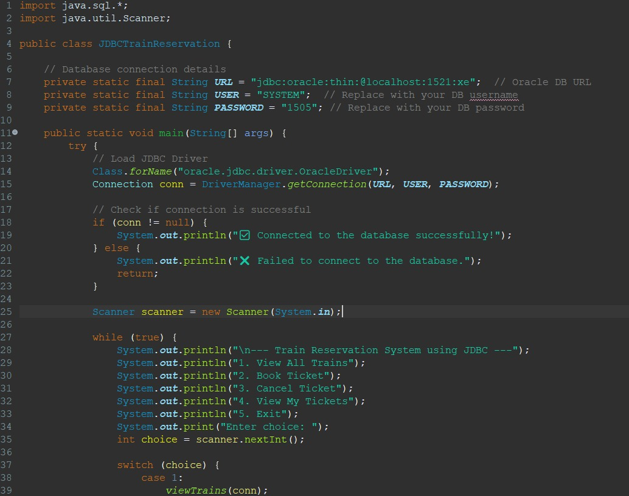
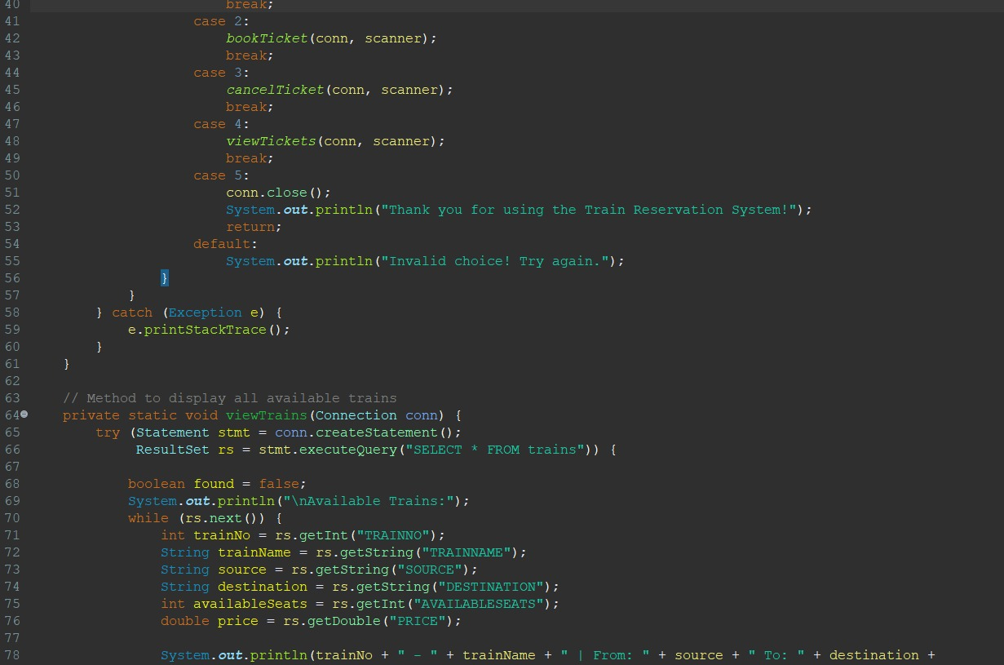
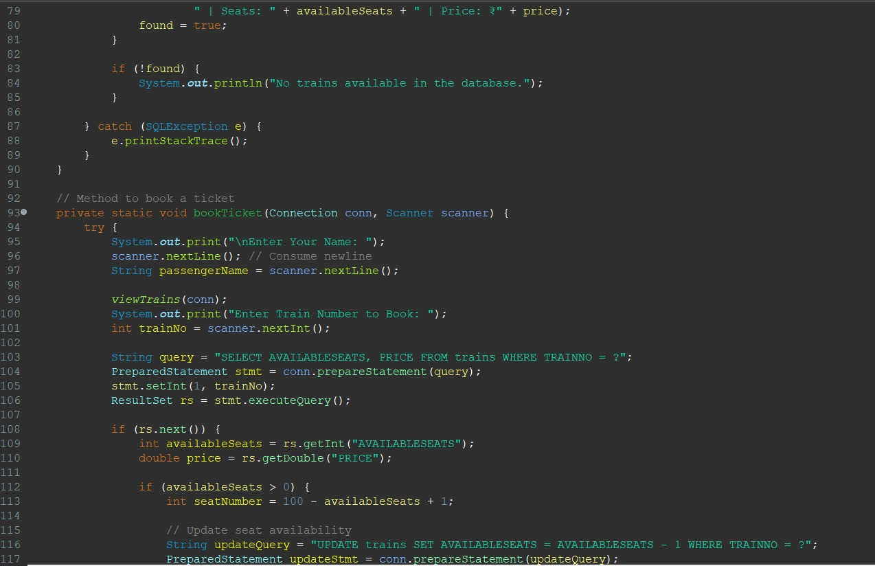
CODE

Slide 8
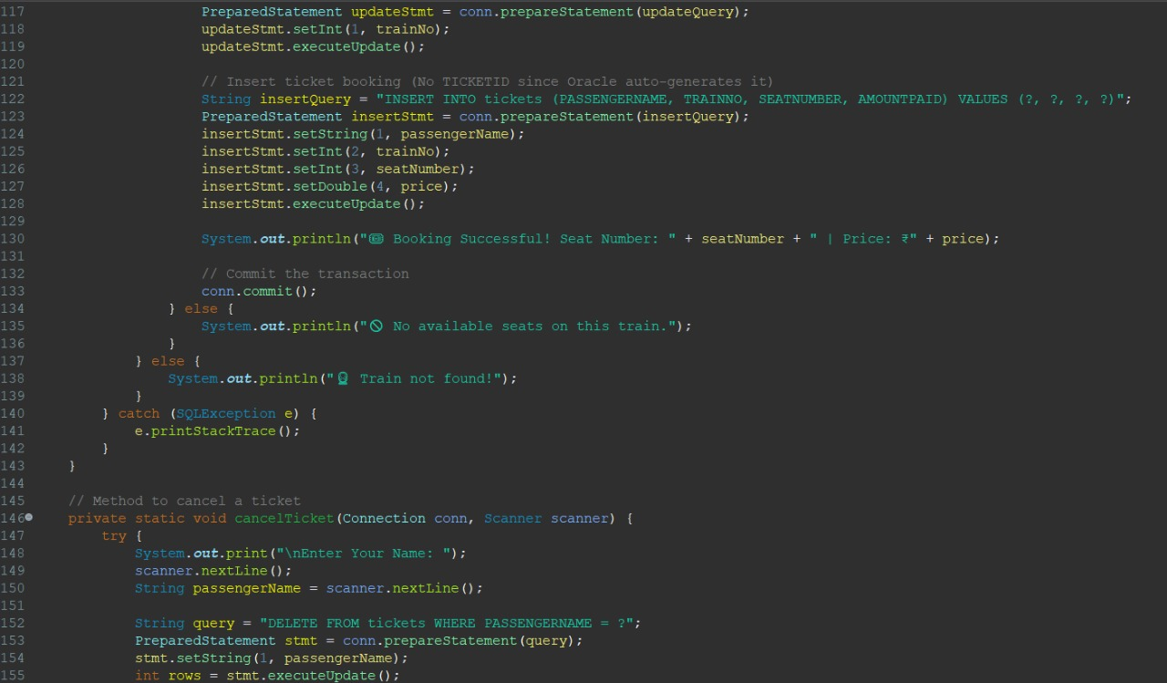
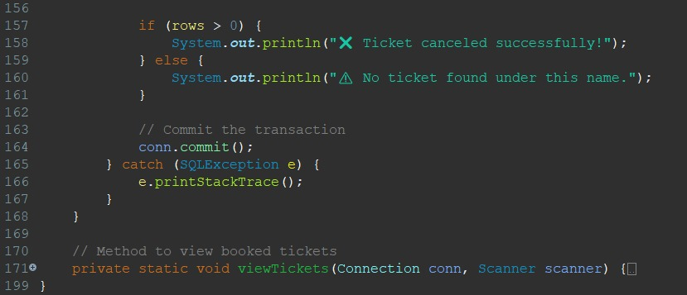

Slide 9
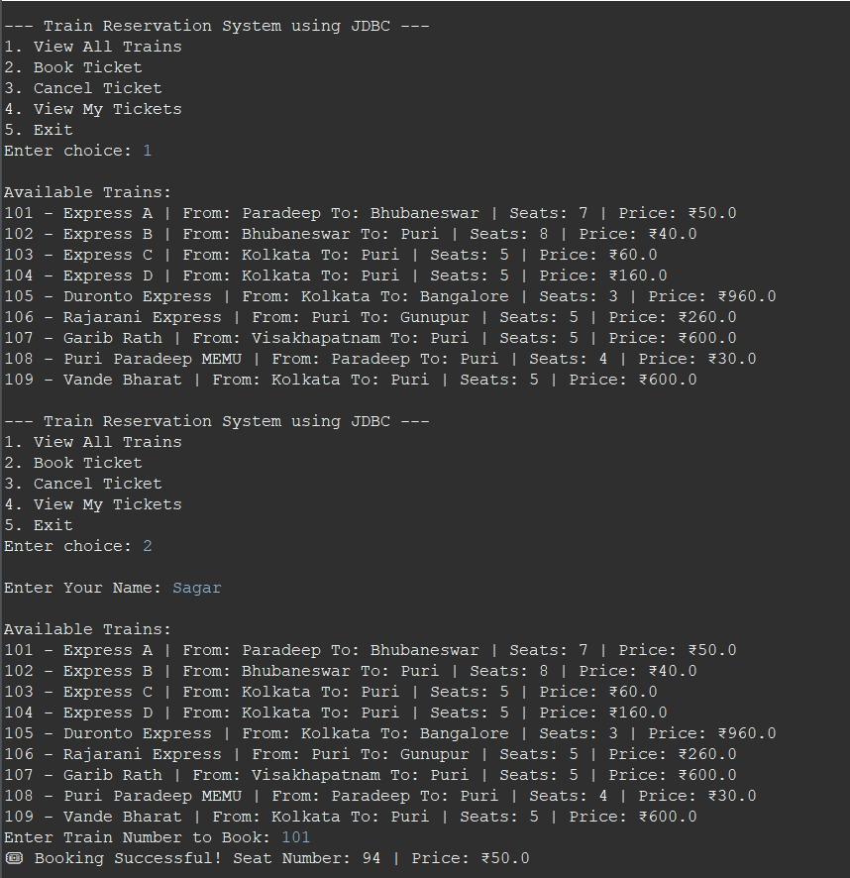
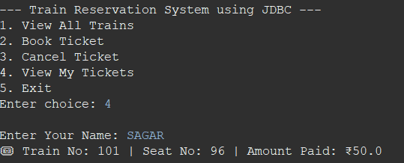
OUTPUT

Slide 10
Advantages of Train Ticket Booking System
Automated Booking Process
Eliminates manual reservations, reducing human errors and processing time.
Real-time Seat Availability Update
Ensures accurate seat allocation and prevents overbooking.
User-Friendly Interface
Simple menu-driven console application for easy navigation.
Secure Transactions
Uses SQL queries with Prepared Statements to prevent SQL injection attacks.
Database Integrity
Ensures data consistency with proper constraints and relationships between tables.
Scalability
Can be extended to support multiple users, advanced UI (JavaFX/Swing), or online payments.
,
LIMITATIONS
Basic Console-Based UI
No graphical user interface (GUI); only text-based interaction.
No User Authentication
Any user can book or cancel a ticket without logging in.
Limited Error Handling
May not handle all invalid inputs or database connection failures effectively.
Fixed Seat Assignment Logic
Seat assignment is automatic and does not allow user selection.
No Online Payment Integration
Payment processing is not included, requiring cash or manual payment methods.

Slide 11
CONCLUSION
The Train Ticket Booking System is a robust and efficient application designed to simplify the railway reservation process. By utilizing Java, JDBC, and an Oracle database, the system enables users to view available trains, book tickets, cancel reservations, and check booking details in real time. The automation of ticket management reduces manual errors, enhances data security, and ensures accurate seat allocation.
This system provides a structured and scalable approach to train reservations, making it easy for passengers to book tickets without hassle. The integration with a relational database ensures data integrity and reliability, allowing for seamless operations. Additionally, the console-based interface offers a simple yet effective way to interact with the system.
Despite its advantages, the system has certain limitations, such as the lack of a graphical user interface (GUI), online payment integration, and multi-user support. However, these features can be incorporated in future enhancements to improve usability and scalability.
Moving forward, the system can be expanded to include real-time train tracking, seat selection, user authentication, and mobile app integration, making it a fully digital railway reservation solution.

Slide 12
Thank You!

