Slide 1
INDIAN INSTITUE OF TECHNOLOGY, KHARAGPUR
October 11, 2026
O P E N I I T
DATA
ANALYTICS
IN ASSOCIATED WITH perfios

Slide 2
TABLE OF
CONTENT
Problem Statement & Collections Reality
Solution Architecture & Decoupled Thought
Pre-Contact Feature Engineering (No-Leakage)
Model Selection & Counterfactual Debiasing (IPW)
Hyperparameter Tuning & Probability Calibration
Model Evaluation, AUC & Calibration Curves
Policy Engine & Multi-Channel Operations (Tele & Field)
Value-of-Information (VoI) Skip-Trace Optimization
Benchmark Results, Financial ROI & Regulatory Impact

Slide 3
Problem Statement
& Collection Reality
Industry Context: Collections operational cost varies across channels: SMS/WhatsApp (<₹1), AI voice bots (₹1–3), tele-callers (₹15–30), field visits (₹150–400), and skip-tracing (₹89).
The Core Inefficiencies:
  Traditional dialers waste >60% of call attempts repeatedly dialing dead numbers or futilely calling avoiding borrowers.
  Skip-tracing is triggered by rigid heuristics (e.g., waiting for 15 failed dials), wasting ₹89 on accounts that don't need it and acting too late on dead lines.
Regulatory Guardrails: RBI Fair Practices Code strictly mandates zero third-party debt disclosure, and the DPDP Act requires all automated decisions to be explainable and auditable.

Slide 4



Why Naive Classifiers Fail: Treating call outcomes as a flat multi-class problem fails because non-contacts dominate the dataset, and an avoiding borrower looks identical to a dead line on the surface (both result in 0 connects).
The Two Core Dilemmas Resolved: Problem A (Avoiding vs. Dead): High $P\left(\text{Active}\right)$but low responsiveness $→$ Switch Channel (WhatsApp/Field); low $P\left(\text{Active}\right)→$ Skip-Trace.
Problem B (Switched Off Long-Term): Multi-day streak tracking identifies persistent switch-offs and cascades to backup numbers on file before triggering trace.
The Decoupled Formulation: $\text{Observed Connect}=P\left(\text{Active Line}\right)×P\left(\text{Borrower Willingness to Answer}∣\text{Active Line}\right)$
SOLUTION &
Architecture

Slide 5


Strict Temporal Integrity: 77 features extracted strictly using prior attempt history ($0…k−1$). Current attempt outcomes never leak into pre-dial features.
Key Feature Domains:
Telephony Physics: Customer hangup count (hangup_by == 'customer'), full 30–45s ring vs. 0–2s instant circuit drops, unbroken switched-off streaks (consecutive_switched_off).
Lineage & Graph Collisions: Masked phone numbers appearing across multiple unrelated accounts (identifies recycled/stranger lines).
Account Financial Distress: DPD, debt burden ratio, bounce reasons, ability-to-pay estimate, and historical PTP break rate.
Cross-Channel Corroboration: Historical
field visit outcomes (locked_premises,
met_family) and digital UPI payments
proving the borrower is active .
Feature Engineering

Slide 6
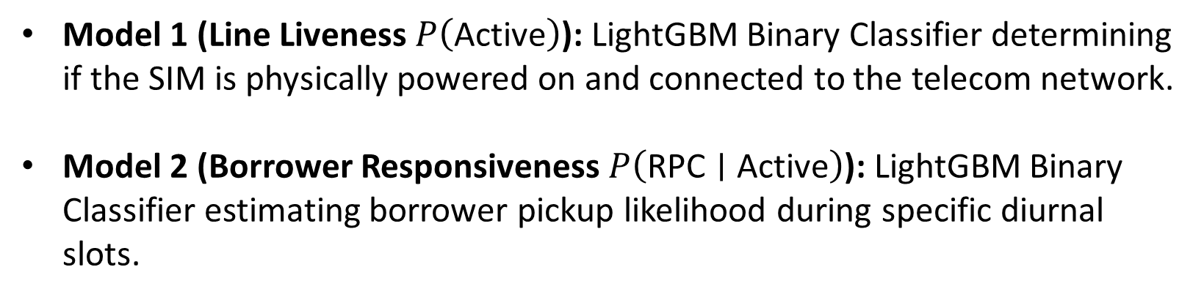
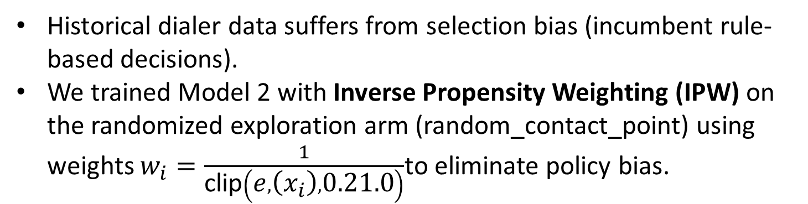
SELECTION
MODEL
Model Suite :
Model 1 (Line Liveness $P\left(\text{Active}\right)$): LightGBM Binary Classifier determining if the SIM is physically powered on and connected to the telecom network.
Model 2 (Borrower Responsiveness $P\left(\text{RPC}∣\text{Active}\right)$): LightGBM Binary Classifier estimating borrower pickup likelihood during specific diurnal slots.
Counterfactual Debiasing via IPW :
Historical dialer data suffers from selection bias (incumbent rule-based decisions).
We trained Model 2 with Inverse Propensity Weighting (IPW) on the randomized exploration arm (random_contact_point) using weights $w_{i}=\frac{1}{\text{clip}\left(e , \left(x_{i}\right) , 0.21.0\right)}$to eliminate policy bias.

Slide 7
H y p e r p a r a m e t e r T u n i n g &
Probability Calibration
Hyperparameter configuration:
  n_estimators: 120 (Liveness) / 150 (RPC) with learning_rate: 0.04–0.05 and num_leaves: 31.
  Constrained tree depth and leaves prevent overfitting on noisy telephony connection logs.
Isotonic Probability Calibration :
Standard gradient boosted trees produce uncalibrated probabilities. We fitted Isotonic Regression (CalibratedClassifierCV(method='isotonic', cv=3)).
Brier Calibration Scores: 0.0789 for Liveness and 0.1338 for RPC (confirming predicted probabilities closely match empirical contact frequencies).

Slide 8
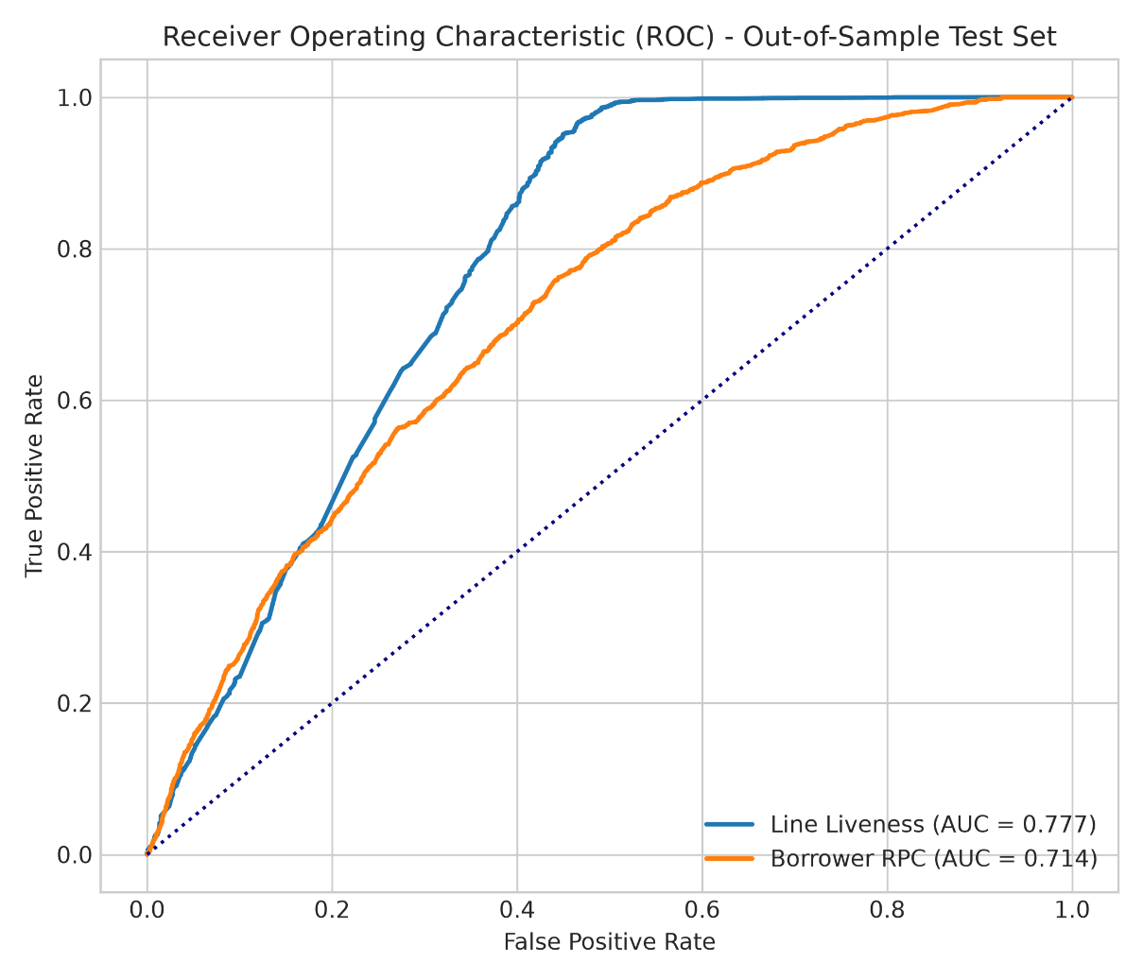
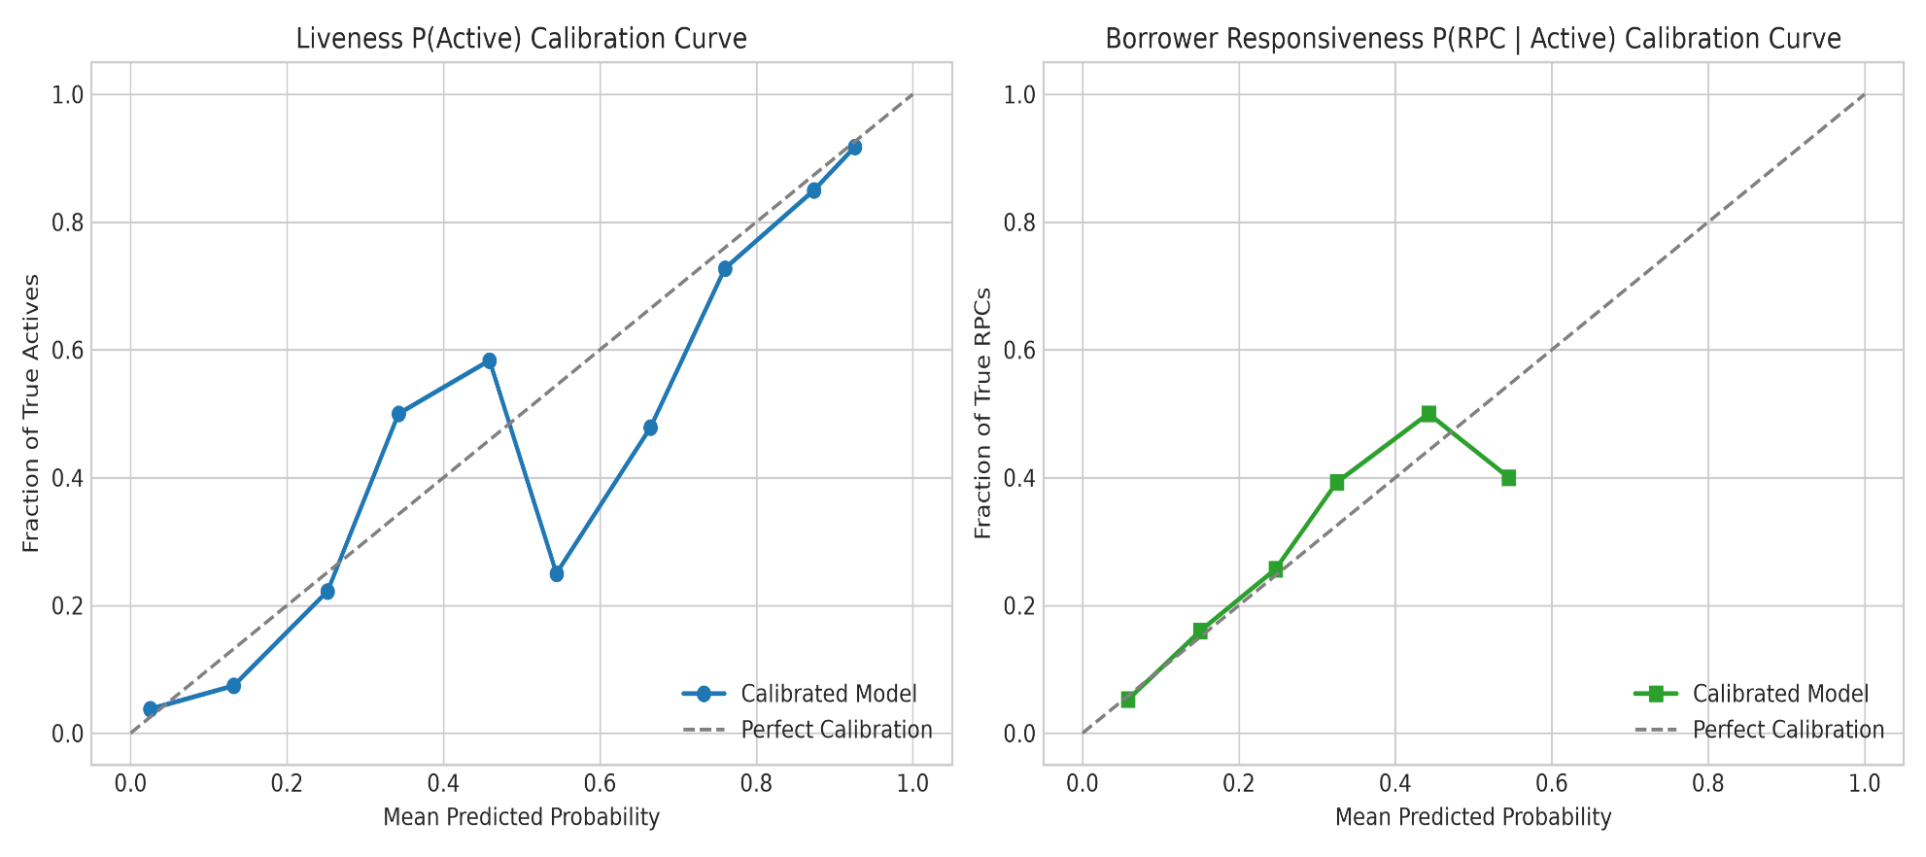
Out-of-Sample Test Performance :
Model 1 (Line Liveness): 91.95% Accuracy | ROC-AUC = 0.7771 | Brier Score = 0.0789.
Model 2 (Borrower Responsiveness): 83.69% Accuracy | ROC-AUC = 0.7140 | Brier Score = 0.1338.
Shows strong out-of-sample discrimination on unseen accounts.
Visual Diagnostics:
M o d e l
Eva l u a t i o n
AUC & calibration Curves
Demonstrates reliability curves closely tracking the perfect calibration line ($y=x$) for both models.

Slide 9
Policy Engine & Multi-Channel Operations (Tele & Field):
Telephony Channel Execution (7,407 Test Dials):
47.0% (3,478 dials): Switch channel (WhatsApp, field) — Stops dialer fatigue on avoiding borrowers.
17.5% (1,299 dials): Keep dialing, at best time slot — Concentrates calls on responsive targets.
11.8% (877 dials): Stop at once (Suppression) — Recycled numbers suppressed (0 FPC risk).
2.3% (171 dials): Move to another number on file — Multi-phone cascading on dead lines.
5.7% (423 dials): Trigger Skip-Trace — Targets confirmed dead lines and exhausted accounts.
Field Channel Operations (3,117 Addresses Evaluated):
73.6% Visit (Valid & occupied) | 15.3% Change visit time (Premises locked/family met) | 7.5% Resolve geocode (PS3) (Location hard to find) | 3.5% Trace new address (Borrower moved).

Slide 10
Economic VoI Formulation: $𝔼\left[\text{Net Value}\right]=P\left(\text{Hit}\right)×P\left(\text{RPC}∣\text{Found}\right)×\left(\text{Outstanding}×\text{Ability}×η\right)−C_{\text{trace}}\left(\text{₹}89\right)$
Multi-Channel Screening:
If an account has an active phone line, an avoiding phone reachable via WhatsApp,
or a verified residential address, it is disqualified from burning trace capital.
Screens out 2,000 low-priority accounts, saving >₹1.7 Lakhs in vendor fees while
isolating the 6 truly untraceable, high-balance accounts with positive expected
recovery.
Value of Information (VoI) Skip-Trace Optimization

Slide 11
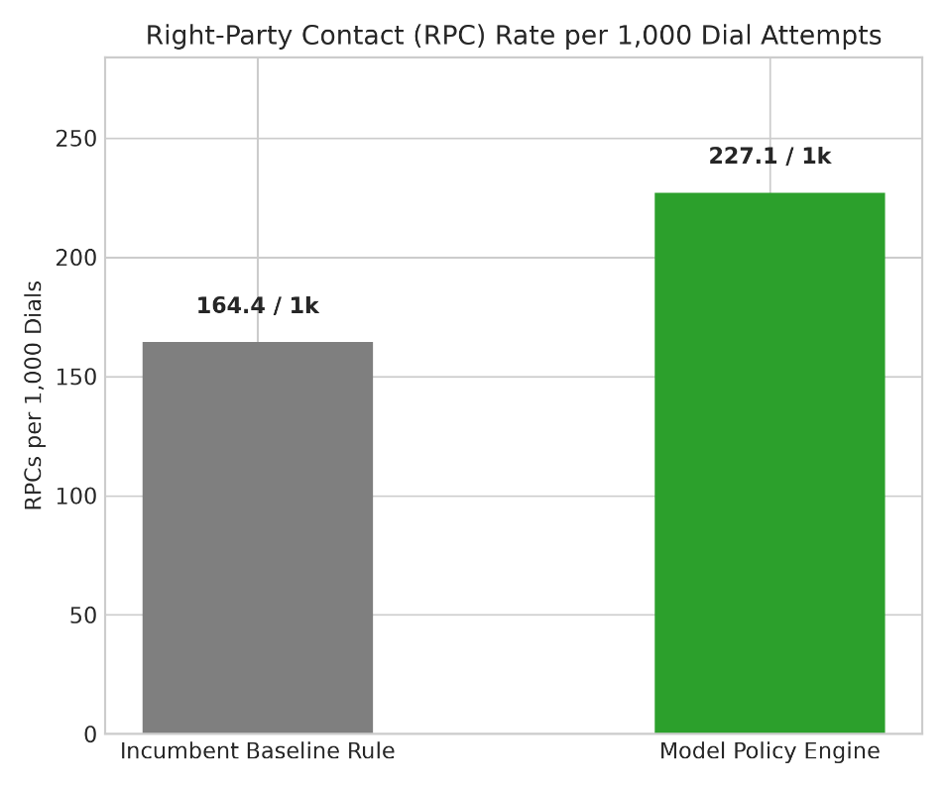
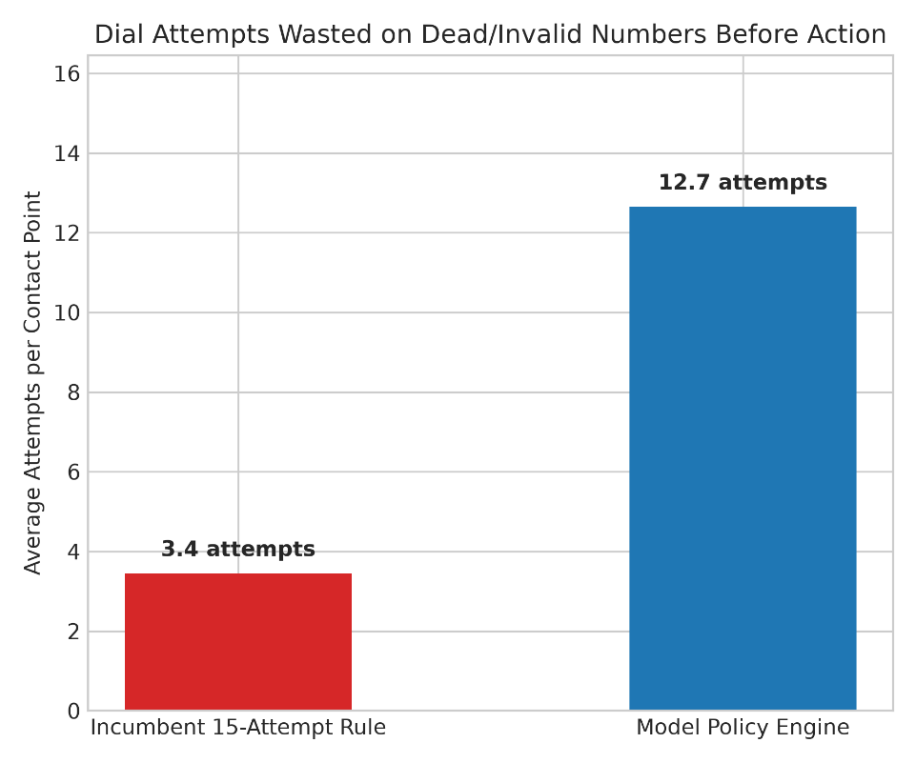
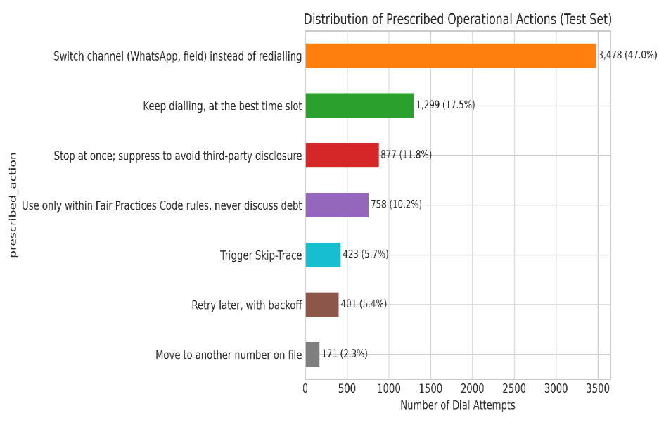
Compliance-First Decisions
Prescribed actions prioritize verified
contacts, responsible follow-ups, and
protection against third-party debt
disclosures.
+38.2% Borrower Contact Lift
Increased Right-Party Contacts from
164.4 to 227.1 per 1,000 dial attempts.
Fewer Wasted Calls
Reduced average attempts on dead or
invalid numbers, improving dialer
efficiency and lowering operational costs.
BENCHMARK
Financial ROI & Regulatory Impact

Slide 12
THANK
You
@DataGods_KGP

