Slide 1






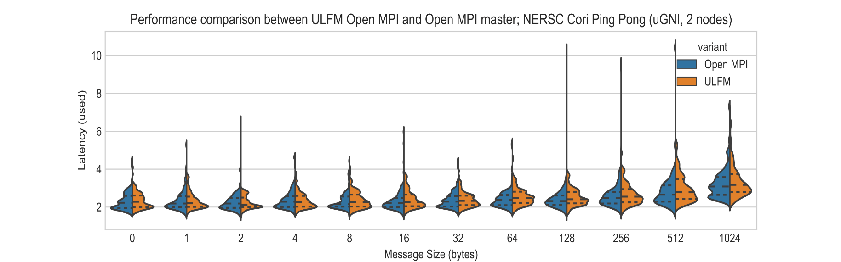
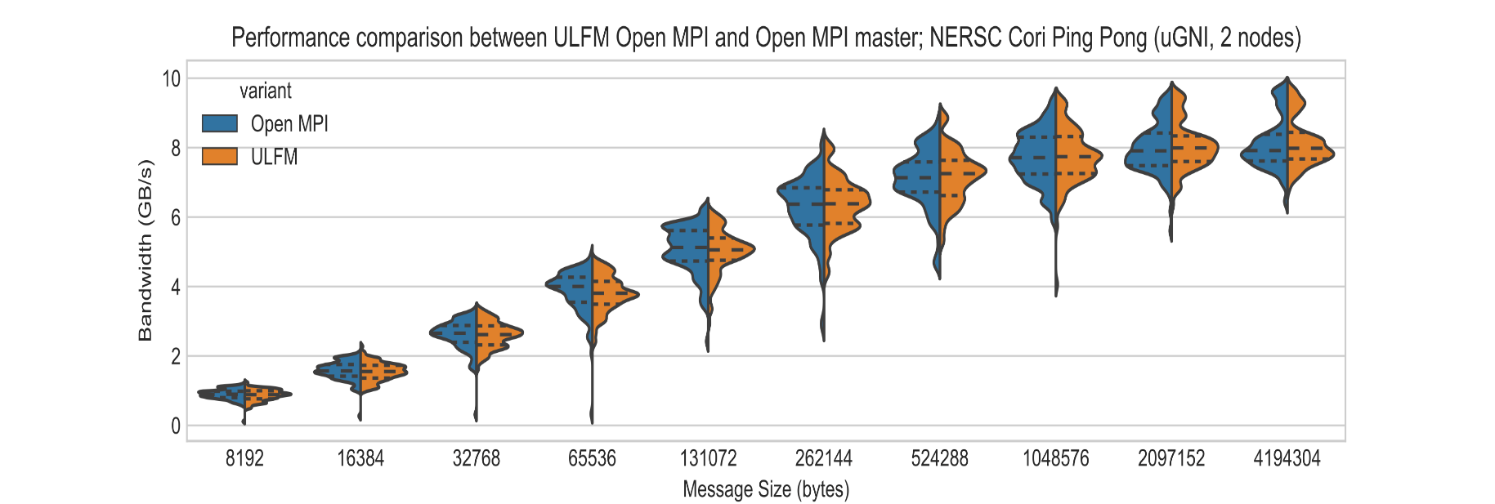

Interoperability for MPI-X and Beyond
Open MPI for Exascale (OMPI-X) ECP Project ST-2.3.1.11-OMPIX
Project Team
Institution | PI | Additional Participants
ORNL (Lead) | David Bernholdt (Lead) | Manju Gorentla, Terry Jones, Thomas Naughton, Geoffroy Vallee
LANL | Howard Pritchard | Nathan Graham, Nathan Hjelm
LLNL | Ignacio Laguna | Chris Chambreau, Murali Emani, Martin Schulz
SNL | Ron Brightwell | Ryan Grant
UTK | George Bosilca | Aurelian Bouteiller
In collaboration with the Open MPI Community (http://open-mpi.org)
Project Focus Areas
Focus Area | Topics | Technical Lead
Runtime Interoperability for MPI+X and Beyond | APIs for better sharing of threads between MPI and other thread-based runtimes. | Geoffroy Vallee (ORNL)
Extending the MPI Standard to Better Support Exascale Architectures | Endpoints, Finepoints, Sessions | Ryan Grant (SNL)
Open MPI Scalability and Performance | Memory footprint, collectives, message matching, one-sided, PMIx | Thomas Naughton (ORNL)
Supporting More Dynamic Execution Environments | Intelligent process placement and contention management | Terry Jones (ORNL)
Resilience in MPI and Open MPI | ULFM, ReInit, resilience in PMIx | George Bosilca (UTK)
MPI Tool Interfaces | MPI_T, PMPI replacement | Chris Chambreau (LLNL)
Quality Assurance for Open MPI and New Developments | Test infrastructure deployed to ECP-relevant systems. Regular testing of Open MPI and OMPI-X developments | Howard Pritchard (LANL)
Qthreads | Light-weight threading | Stephen Olivier (SNL)
Recent Progress
MPI Finepoints - Partitioned Multi-threaded MPI Communication
Qthreads
Closely-related ECP ST project, merging into OMPI-X
Qthreads online at github.com/Qthreads
MPI + OpenMP
Modify the OpenMP LLVM compiler to interface with PMIx
Data exchange between the MPI and OpenMP runtimes via PMIx
Implement a placement policy based on the number of MPI ranks and available cores/HT per node
Joint experiments for evaluation and implementation of more advanced policies (collaboration with ECP SOLLVE project)
MPI + Qthreads
Coupling MPI with Qthreads, a user-level lightweight threading library
Investigating use of Qthreads in lieu of pthreads as an Open MPI threading layer
Finepoints
New MPI multi-threading interface
Better efficiency with minimal app changes
Leverages hardware capabilities
Allows new type of overlap in communication
Early prototype demonstrated with ECP mini-app
~5% improvement in runtime
~25% improvement in communication
Using Qthreads with MPI Finepoints
Collaborations with EU Intertwine project
A baseline test shows the Finepoints library performing similarly with Qthreads and with OpenMP (2 nodes, 1 process / node , 64 threads / MPI process).
ECP miniapp running on a KNL with MPI procs x threads, with 4 MPI procs to 1 MPI proc. The miniapp is controlled for noise and artificial noise injected to demonstrate good performance in practice (real noise on systems is in the 3% range).
Connections: SOLLVE, UPC++/GASnet, PMIx, Qthreads
Connections: Qthreads, Intertwine
User-Level Fault Mitigation (ULFM) in Open MPI
MPI Performance and Scalability Improvements
Resilience in varied application types
Malleable applications enjoy a cheap, tailored recovery procedure
Non-malleable applications can restore complete MPI capabilities without redeployment
Integration of ULFM resilience shows no overhead on raw communication performance on ECP hardware
Stable resilience; tested deployments on ECP hardware with support for job schedulers and accelerated networks
Support for resilience with threads, non-blocking collective operations, RMA operations
Recent Progress
PMIx/SCON failure detection and reliable information propagation
Asynchronous recovery: ISHRINK repairs a communicator asynchronously
Scoped error management: user-controlled scope for error reporting: uniform reporting in collective operations; report for errors at any rank, etc.
Impacts
Large application community using Open MPI ULFM to explore resilience in HPC
Industry users (databases, MapReduce) also use Open MPI ULFM to explore non-HPC workloads over MPI
User documentation and education helps ECP applications move forward on resilience
Remote Memory Access
New RMA implementation allows scaling
Application performance similar to highly tuned vendor implementations
MPI Message Matching
Initial prototype perf. up to 2X
Integration plan underway
Multi-threading
Multiple improvements completed
Memory profiling
Gather baseline memory data via Tau
Non-blocking Collectives
Connections: PMIx, VeloC
Distribution of latency (top) and bandwidth (bottom) on uGNI (NERSC Cori) without fault tolerance (blue) and with fault tolerance active (orange): mean and variance are similar, demonstrating no overhead for enabling resilience.
Open MPI+PMIx+SCON for Scalability
Topology and Congestion Awareness
Continuous Integration/Nightly Testing
Initial evaluation of scalable startup performance showing 3x improvement in launch time for PMIx Open MPI vs Cray ALPS Open MPI (presented during PMIx BoF at SC’17)
PMIx event notification API in the PMIx standard document
Event notification API used in fault-tolerant Open MPI (ULFM)
Generic failure detector API defined
Transfer failure detector capability from Open MPI to PMIx (prototyping started)
Implement SCON, scalable overlay network library that provides communication capabilities for PMIx (API design in progress)
Developing module to gather the communication weights between processes
Capability to distinguish between pt2pt collective file IO or RMA)
Developing module to reorder processes based on weights
Initial implementation available in Open MPI GitHub master
Resolved issues with next generation Nightly tester (MTT) reporting results to community database at AWS
Added plugin to next generation MTT to test nightly tarball bills from https://open-mpi.org/downloads
Deployed current MTT on ORNL summit-dev platform
Participating in the ECP ST facilities WG evaluation of CI RFP responses
Connections: PMIx
Connections: ECP CI Testing, Facilities

