Slide 1







Open MPI for Exascale (OMPI-X) part of the DOE Exascale Computing Project
David E. Bernholdt, ORNL for the team

Slide 2

ECP: Exascale Computing Project
From https://exascaleproject.org...
ECP is chartered with accelerating delivery of a capable exascale computing ecosystem to provide breakthrough modeling and simulation solutions to address the most critical challenges in scientific discovery, energy assurance, economic competitiveness, and national security.
This role goes far beyond the limited scope of a physical computing system. ECP’s work encompasses the development of an entire exascale ecosystem: applications, system software, hardware technologies and architectures, along with critical workforce development.
Funded by DOE Office of Science and NNSA
Deliver “capable” exascale system by 2023
Capable: 50x performance for apps, 20-30 MW, MTTAI ~1 week, general software stack
Initial advanced architecture exascale system by 2021

Slide 3
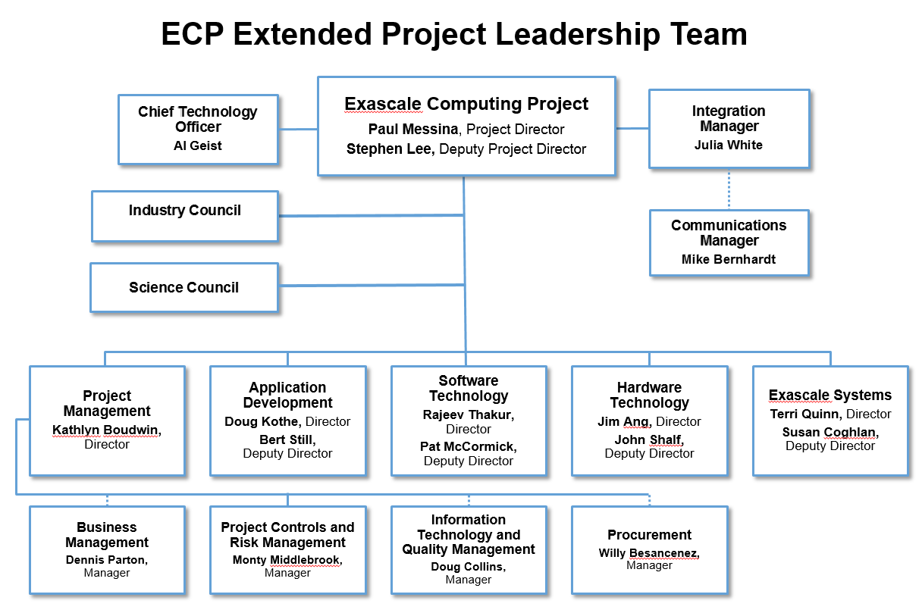
ECP Organization

Slide 4
AD and ST Breakdowns and Project Counts
Application Development
Software Technology
15+3 applications
7+0 “seed” applications
4+0? co-design centers
Initially funded for 4 years
35+31 projects in total
Programming models and runtimes (10+2)
Tools (5+7)
Mathematical and Scientific Libraries (8+7)
Data Management and Workflows (7+4)
Data Analytics and Visualization (2+2)
System Software (3+7)
Resilience and Integrity (0+1)
Co-design and Integration (0+1)
Initially funded for 3 years
Note: project counts are shown as “e+a” where e are the Office of Science funded projects and a are the NNSA ATDM projects.

Slide 5
OMPI-X Team
ORNL
David Bernholdt (Lead PI)
Manju Gorentla Venkata
Terry R. Jones
Thomas J. Naughton III
Geoffroy R. Vallee
LANL
Nathan Graham
Evan Harvey
Nathan Hjelm
Howard Pritchard
LLNL
Chris Chambreau
Murali Emani
Martin Schulz
SNL
Ron Brightwell
Ryan Grant
UTK
George Bosilca
Aurelian Bouteiller
Key:
Institutional PI
Attending this meeting
Officially started Oct 2016
Funds arrived ~mid-January 2017

Slide 6
OMPI-X Focus Areas
Runtime Interoperability for MPI+X and Beyond [Vallee]
APIs for better sharing of threads between MPI and other thread-based runtimes
Intend collaboration with ExaMPI [MPICH] and SOLLVE [OpenMP]
Extending the MPI Standard to Better Support Exascale Architectures [Grant]
Endpoints, Finepoints, Sessions
Open MPI Scalability and Performance [Gorentla]
Memory footprint, collectives, message matching, one-sided, PMIx
Supporting More Dynamic Execution Environments [Jones]
Intelligent process placement and contention management
Resilience in MPI and Open MPI [Bosilca]
ULFM, ReInit, resilience in PMIx
MPI Tool Interfaces [Schulz]
MPI_T, PMPI replacement
Quality Assurance for Open MPI and New Developments [Pritchard]
Test infrastructure deployed to ECP-relevant systems
Regular testing of Open MPI and OMPI-X developments

