Slide 1
Recent progress on the Open MPI implementation
George Bosilca
University of Tennessee, Knoxville
the OMPI-X team and the OMPI community
All over

Slide 2
OMPI-X overview
The OMPI-X project ensures that the Message Passing Interface (MPI) standard, and its specific implementation in Open MPI meet the needs of the ECP community in terms of performance, scalability, and capabilities or features.
The OMPI-X team is active in both the MPI Forum and the Open MPI community
The OMPI-X project is focusing on prototyping and demonstrating exascale-relevant proposals under consideration by the MPI Forum, as well as improving the fundamental performance and scalability of Open MPI, particularly for exascale-relevant platforms and job sizes.
MPI users will be able to take advantage of these enhancements simply by linking against recent builds of the Open MPI library.

Slide 3

Progress so far
Visible goodies
MPI_T extensions
Memory allocations
Software Performance Counters
Out-of-sequence messages, time to match, number of unexpected, instant bandwidth, collective bins
Exposed via MPI_T, or PAPI SDE or shared file via PMIx plugins
Quality control (CI, nightly testing, …)
Invisible goodies
Added communication support for UCX both as a PML (message layer) and as a BTL (byte transfer layer).
OpenUCX (openucx.org) is now the preferred method for InfiniBand support
RMA improvements: Faster, more scalable and thread safe
Architecture benefits: datatype engine (taskfied, AVX), improved MPI ops (architecture aware, AVX)
Performance and scalability of Open MPI
Improved MPI matching, sparse groups, lazy initialization

Slide 4
Ongoing efforts
MPI Explorations (cool things not yet blessed by the MPI standard)
Persistent communications
Better threading support (more to come)
MPI_Finepoints
Resilience
MPI_Reinit and ULFM 2.0 implementation (in sync with master)
More scalable revocation, agreement
Non-blocking constructs for resilience, process management
Noise resistant, topology aware collective communication

Slide 5
MPI + X
Runtime level
Involvement in PMIx
Involvement in the MPI Forum topology WG
Topology awareness plus improved support for process/thread placement
Better isolation on the same process - MPI_Session
Communication level
Threading improvements
Better completion
Exploration: Build other completion mechanisms than MPI_Wait* / MPI_Test*
Exploration: Callbacks

Slide 6
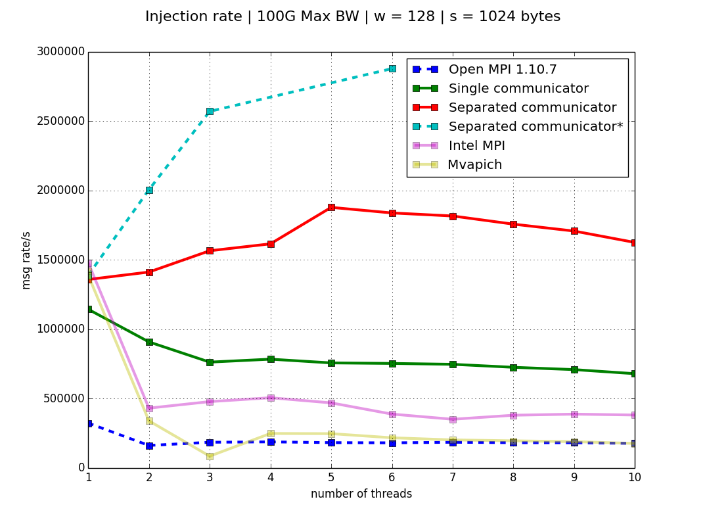
Threading support
th 0
th 0
th 1
th 1
th 2
th 2
th 3
th 3
th 4
th 4
Rank 0
Rank 1
Improvements:
Synchronization primitive
Unrestricted progress (protections done at the lowest level)
Credit management
Requests memory management
Out-of-sequence management (limited bypass)
P2P ~60%
Open MPI 4.1 (with different communicators)
~45%
~20%
Open MPI 4.0 (with different communicators)
~10%
MPI WAITALL
(4)
MPI
WAITALL (16)
MPI
WAITALL (100)
MPI
WAITALL (5)
Open MPI 4.0
~4%
~2%
Intel MPI
Open MPI 1.10.7
MVAPICH
PROGRESS
PROGRESS
PROGRESS
PROGRESS
NETWORK LAYER
NETWORK LAYER
NETWORK LAYER
NETWORK LAYER

Slide 7
Collective communications
Dataflow collective: different algorithms compose naturally (using a dynamic granularity for the pipelining fragments)
Architecture aware: Each level reshape tuned collective to account for architecture capabilities
The algorithm automatically adapts to network conditions
Resistant to system noise
MCA allows vendor specific collective libraries (hear SHARP, NCCL)
Collective Op
Collective Op
Collective Op

Slide 8
Collective Communication
Synchronization Dependency:
Segment independence
Rebalance
Decouple receiving of next segment and sending of current segment
Child independence
Decouple the data transfer from different children
Process location
Noise Reduction
Shared Memory
Hybrid Architecture

Slide 9
Collective Communication
Synchronization Dependency:
Segment independence
Rebalance
Decouple receiving of next segment and sending of current segment
Child independence
Decouple the data transfer from different children
Process location
Noise Reduction
Shared Memory
Hybrid Architecture

Slide 10
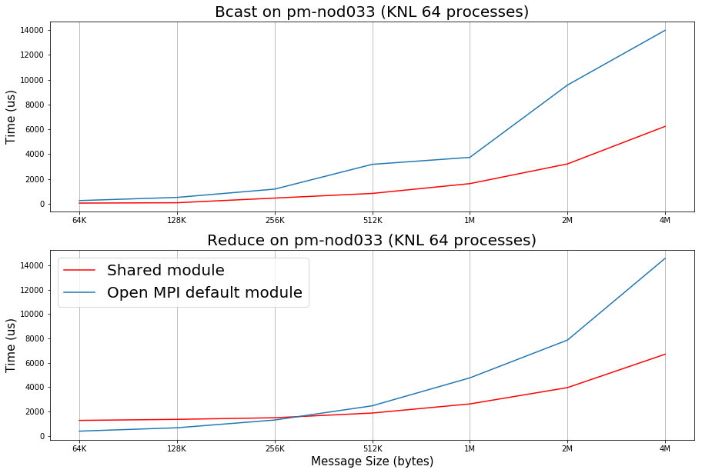
Collective Communication
Data Dependency:
same as previous implementation.
Synchronization Dependency:
Segment independence
Rebalance
Decouple receiving of next segment and sending of current segment
Child independence
Decouple the data transfer from different children
Process location
Noise Reduction
Shared Memory
Hybrid Architecture

Slide 11
Collective Communication
Data Dependency:
same as previous implementation.
Synchronization Dependency:
Segment independence
Rebalance
Decouple receiving of next segment and sending of current segment
Child independence
Decouple the data transfer from different children
Process location
Noise Reduction
Shared Memory
Hybrid Architecture
PSG Cluster:
4*K40/node
FDR IB

Slide 12
Collective Communication

Slide 13
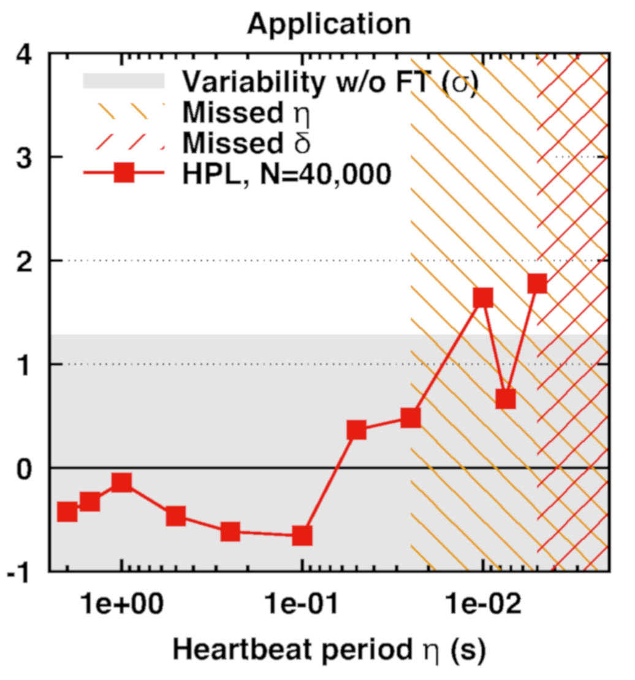
Resilience - User Level Failure Mitigation (ULFM)
Move the underlying resilient mechanisms outside ULFM/OMPI
Failure detector and reliable broadcast in PMIx
Used in OMPI ULFM and SUNY OpenSHMEM
ULFM 2.1 released
Based on OMPI master (will remain in sync)
Transition to integrate ULFM in OMPI master
Scalable fault tolerant algorithms demonstrated in practice for revoke, agreement, and failure detection (SC’14, EuroMPI’15, SC’15, SC’16)
Point to point performance unchanged with FT enabled
Failure detector
(under 1/10 sec heartbeat)

