Slide 1




EDUPULSE
Under the guidance of
MR.CHAITANYA DAHALE SIR
By :
OM THOMBARE
SAMEER BHOR
RAMESH RATHOD

Slide 2

CONTENTS
1.Introduction
2.Problem Statement
3.Technology Overview
4.Dataset Information
5.Exploratory Data Analysis
6.Feature selection and Model Comparision
7.Model Evaluation Results
8.Key Insights & Result Analysis
9.Conclusion & Future Directions

Slide 3
INTRODUCTION
EduPulse
-Tracking the heartbeat of academic performance
Education systems often struggle to identify students who may underperform until final results are declared. Traditional evaluation methods rely heavily on manual observation and periodic assessments, which may delay timely academic intervention.
This project applies machine learning techniques to analyze student academic, behavioral, and social attributes to predict final grades (G3). The objective is to assist educators in identifying students who may require early support, thereby improving learning outcomes.

Slide 4
PROBLEM STATEMENT
Manual assessment methods are time-consuming, subjective, and reactive rather than proactive. By using data-driven models, we can predict academic performance early, allowing timely academic intervention.
PROJECT GOAL :To develop a machine learning model that accurately predicts a student's final grade (G3) based on historical academic performance and related factors.

Slide 5
TECHNOLOGY OVERVIEW
EduPulse is developed using modern Python-based technologies combined with Data Science and Machine Learning to analyze and predict student academic performance effectively.
Flask (Python) used for building a lightweight and scalable web application
Handles user requests, data processing, and ML model integratio
RESTful APIs for seamless frontend–backend communication
Data Science
Data collection and preprocessing using Python libraries
Exploratory Data Analysis (EDA) to identify patterns in student performance
Feature engineering to improve prediction accuracy
Machine Learning
ML algorithms used to predict final grades and performance trends
Models trained on historical academic data
Enables early identification of at-risk students

Slide 6
DATASET INFORMATION
33 - FEATURES
350 - STUDENT RECORDS
1 - TARGET VARIABLE
Feature Categories
•Academic: G1, G2, failures, studytime
•Behavioral: absences, activities, freetime
•Social: internet, paid classes, family support
•Health & Lifestyle: health, alcohol consumption

Slide 7
EXPLORATORY DATA ANALYSIS INSIGHTS
Strong Correlation
G1 and G2 show a strong positive correlation with G3, indicating previous performance is a reliable predictor.
Study Time Impact
Study time has a moderate positive impact on final grades, though less significant than previous grades.
Absence Effects
Absences negatively affect performance but contain outliers that require careful handling during preprocessing.
Binary Features
Binary features like internet access and paid classes show indirect influence on academic outcomes.

Slide 8
FEATURE SELECTION & MODEL COMPARISON
Feature Selection Rationale
Based on correlation analysis, visualization, and feature importance:
Strong Predictors
G1, G2, failures, studytime, absences
Moderate Predictors
Internet, paid, activities, family support, health
Excluded Features
Weak or redundant features were excluded to reduce noise and improve model generalization
Three Regression Models :
Linear Regression
Decision Tree Regressor
Random Forest

Slide 9
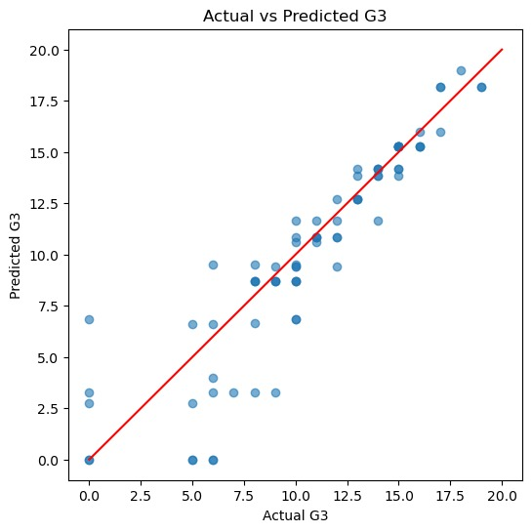
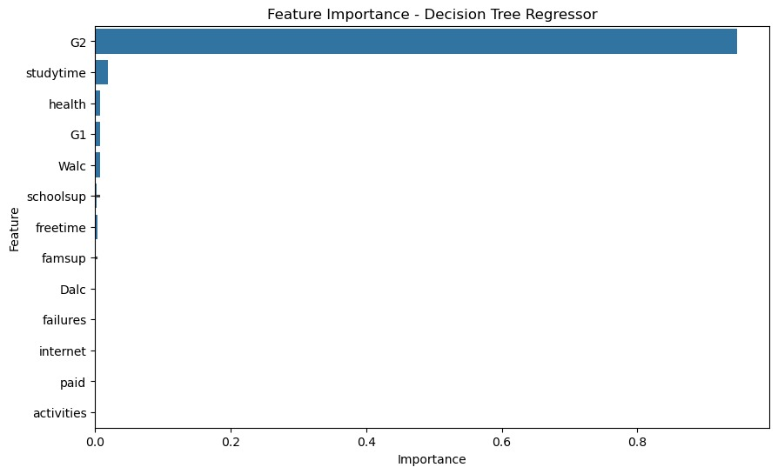
GRAPHS
GRAPH 1
GRAPH 2

Slide 10
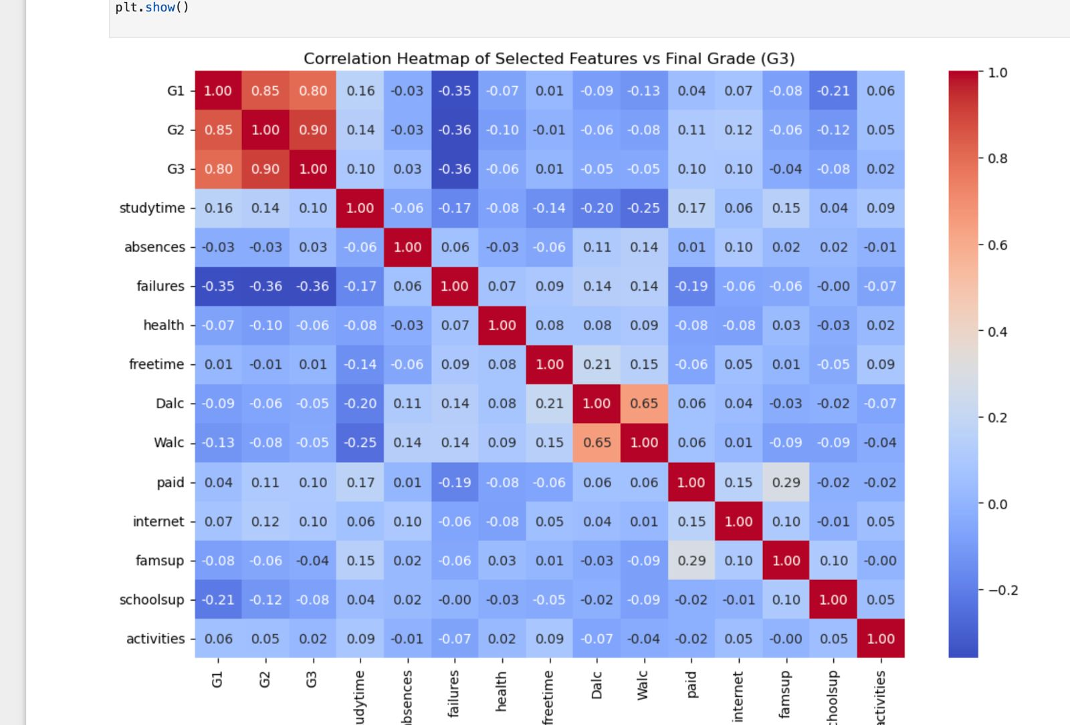
HEATMAP GRAPH

Slide 11
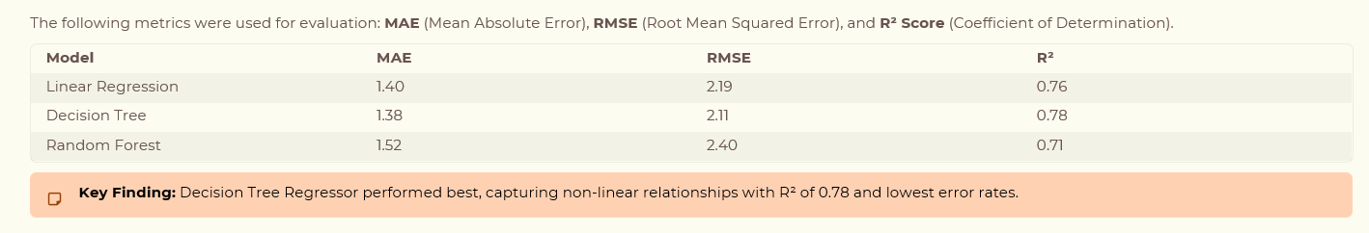
MODEL EVALUATION RESULTS

Slide 12
KEY INSIGHTS & RESULT ANALYSIS
Strongest Indicator
Early academic grades (G1 & G2) are the strongest predictors of final performance, with high correlation observed.
Incremental Value
Behavioral factors add incremental predictive value when combined with academic performance data.
Early Intervention
Machine learning models can support early intervention strategies before final results are declared.
Human Context
Prediction is feasible but not absolute—external factors and human context still play crucial roles.

Slide 13
CONCLUSION & FUTURE DIRECTIONS
Project Success
This project successfully demonstrates how machine learning can be used to predict student performance with reasonable accuracy. The results confirm that combining academic and behavioral features provides meaningful insights and supports data-driven decision making in education.
Future Improvements :
Hyperparameter tuning
Cross-validation
Inclusion of psychological or attendance-quality metrics

Slide 14
THANK YOU!!

