Slide 1


Minor Project
Title:
Predicting Human-Animal Conflict
Presented by:
Panchika Gupta, R2142220121, B.tech CSE (CCVT)
Rakshan Sharma, R2142220142, B.tech CSE (CCVT)
Kunal Sinha, R2142220107, B.tech CSE (CCVT)
Om Vats, R2142220269, B.tech CSE (Dev-Ops)
Guided by:
Dr. Saurabh Shanu
Assistant Professor
Selection Grade
School of Computer Science

Slide 2
Content
Introduction
Problem Statement
Motivation
Objective
Methodology
Technology Stack
Data Collection Approach
PERT Chart
References

Slide 3
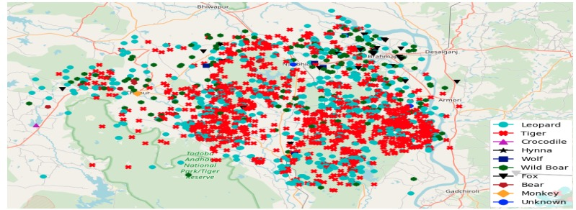
1. Introduction
What is Human-Animal Conflict (HAC)?
Human-Animal Conflict (HAC) arises when wildlife and human activities overlap, leading to economic losses such as crop destruction, livestock predation, property damage, and the death of humans or animals. Ecological, economic, and social parameters such as habitat destruction, climate change, and urban expansion have significantly increased these conflicts, thereby endangering biodiversity and human civilizations.
Traditional measures for mitigating such conflicts, such as fences, patrols, or animal relocation, seem not only ineffective and reactive but also extremely resource-intensive, given that an increasing human population is still expanding into wildlife habitats. Such approaches do not always succeed in averting conflicts before they appear, causing delayed responses and thus economic losses.
Figure 1: GPS plot of human-animal conflicts in the Bramhapuri Forest Division, India from 2014 to 2017

Slide 4
1. Introduction (contd.)
Technology as a Solution !
Taking the opportunity for evolving human-animal conflict management using IoT, AI, and cloud computing towards reaching real-time monitoring and predictive capability. Use innovative IoT-enabled sensor and GPS tracking technologies to predict potential hotspots, give alerts, and provide actionable geospatially mapped insights to conservation authorities and local communities via an interactive dashboard.
Through this technology-driven approach, we strive to:
Minimize casualties and economic losses by predicting and preventing conflicts.
Enhance conservation efforts while maintaining ecological balance.
Promote human-wildlife coexistence using data-backed decision-making.
Our goal is to shift from reactive conflict management to a proactive and predictive approach, ensuring both wildlife conservation and human safety.
By integrating cutting-edge technologies, our project presents a scalable and efficient model for sustainable wildlife conservation and human safety.

Slide 5
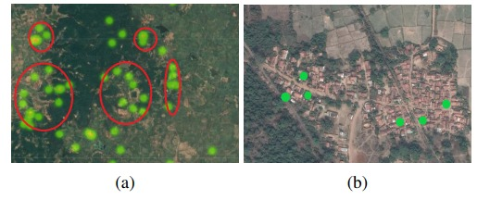
2. Problem Statement
This project aims to develop a cloud-based predictive system using IoT sensors, GPS tracking, satellite imagery, and machine learning to identify high-risk zones. DevOps integration will ensure scalability, real-time updates, and automated alerts. The goal is to reduce conflicts, enhance early warning systems, and protect both humans and wildlife through data-driven decision-making.
Figure 2: Green dots highlight individual conflicts.
(a) Clustered conflicts (highlighted in red) appear near the intersection of terrains. The darker green areas denote dense forested areas, while the lighter areas have sparse vegetation.
(b) Conflicts at the boundary of human settlements and forests.

Slide 6
3. Motivation
1. Rising Conflict Cases: Increased human settlements near wildlife habitats have led to frequent encounters, causing loss of life and property.
2. Inefficiency of Reactive Measures: Current methods mainly involve after-the-fact mitigation, lacking predictive capabilities.
3. Advancements in Technology: The integration of AI, IoT, and cloud computing allows for real-time monitoring and data-driven decision-making.
4. Environmental and Ethical Responsibility: A proactive approach benefits conservation efforts while maintaining biodiversity and ecological stability.
This project bridges the gap between technology and conservation, offering an innovative and scalable solution to minimize human-wildlife conflicts effectively.

Slide 7
4. Objective
To Develop a cloud-based, AI-driven predictive system to identify high-risk human-animal conflict zones and provide real-time alerts for mitigation.
Sub-Objectives:
1. Real-Time Data Collection: Deploy IoT sensors, GPS collars, and satellite imagery
to track animal movements and environmental changes affecting conflict probability.
2. Predictive Analytics Using Machine Learning: Use classification, clustering, and
reinforcement learning algorithms to detect patterns and forecast high-risk human
animal conflict areas.
3. Cloud-Based Data Processing & Storage: Utilize AWS/Azure for scalable storage
and processing, ensuring secure, real-time access to conflict prediction data.
4. DevOps Integration for Scalability & Reliability: Implement CI/CD pipelines,
containerization, and monitoring tools to ensure system scalability, reliability, and
continuous updates.
5. Community & Government Collaboration: Provide data-driven insights to forest
officials, NGOs, and policymakers for improved conservation strategies and conflict
mitigation.

Slide 8
5. Methodology
1. Data Collection
• Deploy IoT-enabled sensors, camera traps, and GPS collars to monitor animal movements.
2. Data Processing & Cloud Infrastructure
• Store and process data using AWS/Azure cloud services for scalability and security.
• Implement serverless computing (AWS Lambda, Azure Functions) for real-time event
driven processing.
3. Predictive Analytics & Machine Learning
• Apply classification models to identify high-risk zones.
• Use clustering techniques to detect conflict hotspots.
4. Visualization & Alert System
• Develop cloud-based dashboards (Power BI / Tableau) for real-time data visualization.
5. DevOps & System Automation
• Set up CI/CD pipelines (Jenkins, GitHub Actions) for continuous model updates and system
improvements.
• Use Docker and Kubernetes for scalable and efficient model deployment.

Slide 9
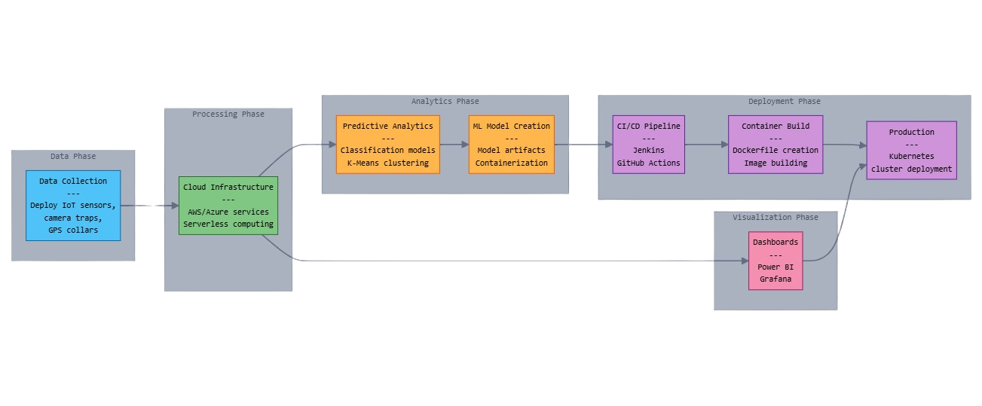
5. Methodology (contd.)
Fig.3 Methodology Chart

Slide 10


6. Technology Stack
1. Cloud Computing & Storage
Cloud platforms store and process real-time and historical data on animal movements and conflicts, enabling quick decision-making and collaboration among conservationists and authorities.
2. IoT & Data Collection
IoT devices like GPS collars and sensors track wildlife movements and human interactions, transmitting real-time data for early detection and timely conflict prevention.
3. Machine Learning & AI
AI analyses data to predict high-risk zones, generating early warnings based on patterns in animal behaviour, weather, and past conflicts, enabling proactive mitigation measures.
4. DevOps & Automation
DevOps automated data processing, model updates, and system monitoring, ensuring continuous accuracy, real-time alerts, and efficient resource deployment for conflict prevention.

Slide 11
7.Data Collection approach
Region | Conflict species | Parameter
Jim Corbett (UK) | Bengal Tiger, Elephant, Leopard, Sambar Deer | Prey Density, Water Sources, Shrinking Core Forests
Dudhwa(UP) | Swamp Deer, Bengal Tiger, Rhino, Sloth Bear | Flooding, Encroachment, Food Scarcity
Pilibhit(UP) | Bengal Tiger, Leopard, Chital, Hog Deer | Agricultural Expansion, Shrubland, Cattle Population
Valmiki (Bihar) | Bengal tiger, Bison , Black bear, Leopard cat | Deforestation, Human Disturbance, Livestock Interaction
Rajaji (UK) | Elephant, Tiger, Black Bear, Hyena | Crops, Road Expansion, Nighttime Activity

Slide 12
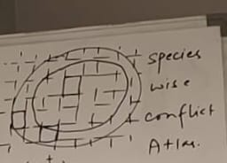
7. 1 Image Showing the format of atlas(grid form)

Slide 13
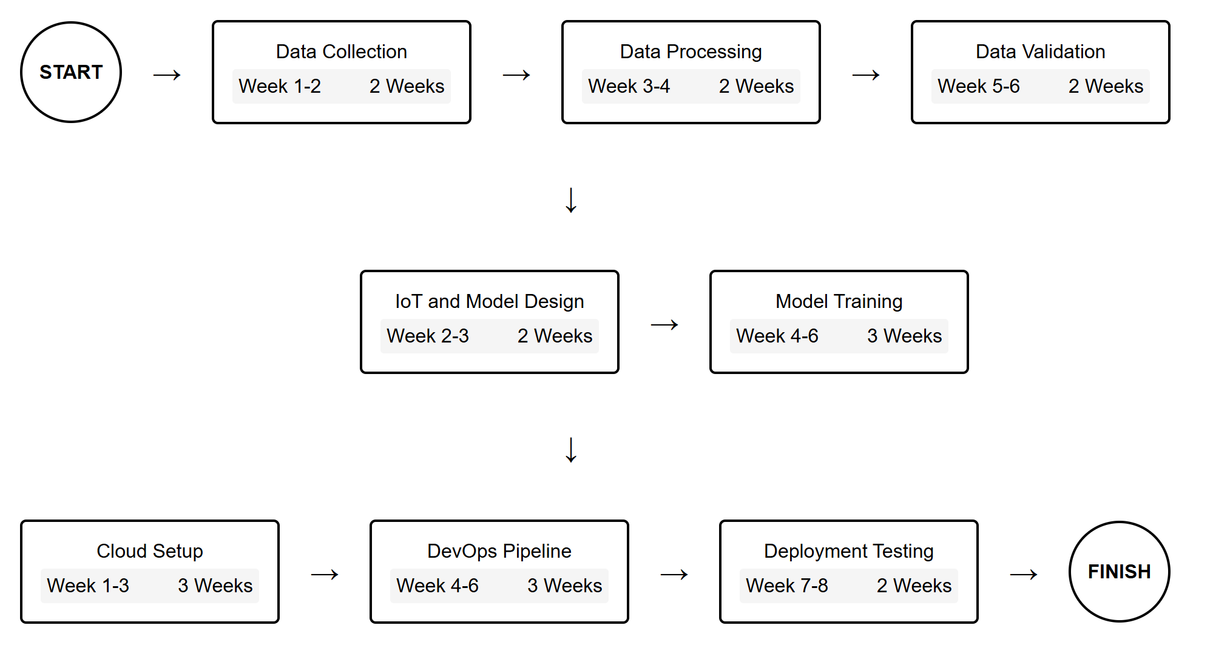
8. PERT Chart
Fig.4 Program Evaluation Review Technique Chart

Slide 14
9. References
1. Joshi, A., & Singh, P. (2018). GIS-based predictive modeling for human-animal conflict zones. Wildlife Conservation Journal, 12(3), 45-59.
2. Kumar, R., Patel, S., & Sharma, D. (2021). Integrating satellite imagery and tracking data for conflict prediction. Environmental Monitoring and Assessment, 189(4), 102-118.
3. Sharma, V., & Rao, M. (2022). Deep learning applications in wildlife movement and human encroachment analysis. International Journal of AI in Conservation, 9(1), 23-38.
4. Patel, N., Verma, S., & Rao, K. (2019). Cloud computing for real-time wildlife monitoring: A case study. Cloud and IoT Journal, 7(2), 54-69.
5. Gupta, P., Mehta, R., & Roy, L. (2020). Machine learning approaches for predicting wildlife movement and conflict risk. AI in Ecology Research, 6(4), 78-94.
6. Desai, H., Banerjee, A., & Choudhury, T. (2023). CNN-based wildlife species identification for conflict mitigation. Journal of Applied Machine Learning, 15(3), 112 130.
7. Nair, K., & Sharma, V. (2019). DevOps for efficient AI model deployment in conservation efforts. Computational Sustainability Review, 5(1), 29-45.
8. Banerjee, S., & Choudhury, P. (2021). Scalable wildlife data processing using containerization and cloud platforms. Journal of Cloud Computing in Ecology, 8(2), 37 52.

Slide 15
Thankyou !

