Slide 1

ArtGuard
Risk assessment, prototype and investment pitch
Introduction to Finance
Astana IT University · Team 03 · SE-2533
Supervisor: Nurkhat Ibadildin, Associate Professor
8 November 2026
Assan Dairabaev · Demezhan Kaidar
Yevgeniy Tyo · Kalybek Zhumabekov
GitHub: https://github.com/ONI-COLLI/Artguard
University OneDrive video: upload and institutional sharing pending
Educational simulation. Fictional customers, planning figures and test ETH only.
Responsible student: Assan Dairabaev
1
Notes:
Team title. Formal links remain pending. The university identity appears only on this title slide. This is an educational simulation.

Slide 2
The licensing problem
Creators need clear evidence of the work and the agreed usage terms.
Buyers need a licence and a reliable delivery process.
Co-authors need a traceable record of their agreed shares.
The first proposed market is visual creators and small-business buyers in Kazakhstan. Demand and willingness to pay still need validation.
Sources: Ciriello et al. (2023); Frattolillo (2024).
Responsible student: Assan Dairabaev
2
Notes:
Research supports rights-management design concerns, not our customer forecast. No market-size statistic, survey result or actual paying customer is claimed.

Slide 3
Creator plans and service revenue
Table 1. Monthly creator plans
Plan | Price per month | Sales commission
Free | $0 | 10%
Premium | $10 | 5%
Business | $50 | 0%
Promotion: $5 for seven days. Base forecast assumes no promotion revenue until demand is validated.
Source: implemented plan rules. USD prices are reference prices; prototype payments use test ETH.
Responsible student: Yevgeniy Tyo
3
Notes:
One account can buy and create. Plan mix is a share of sales value, not simply the subscriber headcount. Promotion placement does not guarantee sales.

Slide 4
The implemented local architecture
React and wallet
Express and SQLite
Anvil EVM
→
→
Forms, signatures
and per-tab sessions
Accounts, quotes
and protected files
Hashes, escrow
and wallet licences
Files stay off-chain. The local operator controls Anvil. Built-in demo wallets use the server’s restricted custodial signer.
Figure 1. Actual application and blockchain boundaries
Source: current repository. Foundry (n.d.); OpenZeppelin (n.d.).
Responsible student: Demezhan Kaidar
4
Notes:
This is SQLite and Anvil, not PostgreSQL or Hardhat. Polygon PoS is a hypothetical future public platform compared with permissioned BFT in the report.

Slide 5
Escrow separates payment from acceptance
1 Register
2 Deposit
3 Deliver
Creator records file
and terms fingerprints.
Buyer locks the exact
quoted test ETH amount.
Seller confirms within
72 hours.
4 Review
5 Release
6 Withdraw
Buyer has 24 hours
to accept or dispute.
Acceptance starts the
licence and credits shares.
Each recipient withdraws
in a separate transaction.
Figure 2. Current escrow sequence. A dispute blocks ordinary release; unresolved disputes permit refund after seven days.
Source: EscrowLicenseMarketplace.sol. All amounts use local test ETH.
Responsible student: Demezhan Kaidar
5
Notes:
Timers enable transactions, not automatic transfers. After review expiry anyone can trigger release of an undisputed order. A trusted platform arbiter decides disputes. Refund credits and withdrawals are separate.

Slide 6
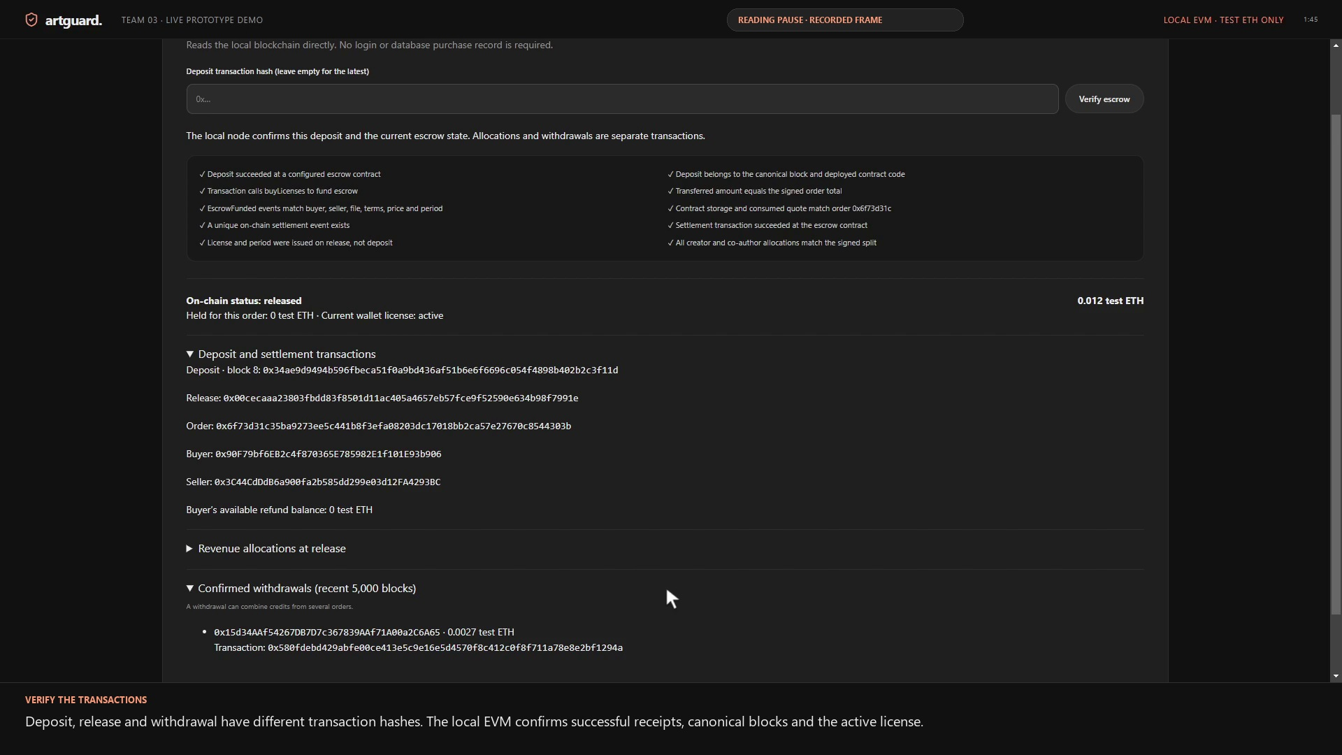
Recorded deployment and purchase
Play Team03_FP_Demo.mp4
3:00 exactly
English on-screen explanation
Deployment and local receipts
Escrow, licence and payout
Actual tests and passing results
Figure 3. Actual local recording. Source: saved defence run ccab5e4f-561c-473b-b35c-44019c1d437c.
Responsible student: Demezhan Kaidar
6
Notes:
Play the actual three-minute video, not the older simulated animations. The video records 21 selected application unit tests and 10 EVM escrow tests. A later complete client run passed 98 tests. Do not describe these as the same run.

Slide 7
Security controls and residual trust
Table 2. Controls that actually exist
Threat | Implemented control | Remaining risk
Reentrancy | Clear credit before transfer; nonReentrant | Independent audit remains planned
Tampered or replayed quote | EIP-712, buyer, expiry and quote ID checks | Trusted signer can authorise bad terms
Unauthorised settlement | Wallet and state-transition checks | Arbiter compromise affects disputes
No implemented multisig, emergency pause or signer rotation is claimed. The future audit budget is an assumption.
Sources: current contracts; Kushwaha et al. (2022a, 2022b); OpenZeppelin (n.d.).
Responsible student: Demezhan Kaidar
7
Notes:
The record is not proof of lawful authorship. A registration front-running strategy, recovery controls and hardened production operations remain future work.

Slide 8
Market alternatives and the proposed difference
Table 3. Competitor categories
Category | Existing focus | ArtGuard question
Stock licensing | Content discovery and usage terms | Does an escrow workflow add useful assurance?
Infringement services | Find and address unauthorised use | Can buyers and creators use licence evidence more easily?
NFT marketplaces | Token ownership and trading | Can a wallet-bound licence work without issuing a token?
These services are competitors or reference categories, not clients or partners. No adoption or market-share claim is made.
Sources: Adobe (n.d.); Pixsy (n.d.); Bhujel and Rahulamathavan (2022).
Responsible student: Assan Dairabaev
8

Slide 9
The main risks affect the investment decision
Table 4. Highest-priority risks
Risk | Score | Response
Weak demand | 20 | Validate retention and willingness to pay
Funding shortfall | 20 | Stage commitments and rerun downside cases
Signer or arbiter compromise | 15 | Independent review and recovery design
Regulatory classification | 15 | Model-specific Kazakhstan legal review
False authorship and delivery disputes | 12 | Clear evidence, takedown and appeal process
Legal pages demonstrate a workflow. Commercial activity needs a model-specific review under Kazakhstan law and any relevant AIFC rules.
Source: own risk matrix. Legal scope: Law No. 193-VII (2023), Law No. 94-V (2013), AIFC (n.d.).
Responsible student: Kalybek Zhumabekov
9
Notes:
Discuss Law No. 193-VII, Law No. 94-V and copyright law as hypothetical startup issues. No actual company registration or real assets are required for the course. AIFC is a separate regulatory route requiring assessment.

Slide 10
The forecast uses explicit assumptions
Table 5. Monthly demand anchors
Metric | Month 12 | Month 24 | Month 36
Licence sales | 400 | 1,300 | 2,500
Premium creators | 150 | 350 | 600
Business creators | 20 | 60 | 120
Average licence: $30. Sales-value mix: 50% Free, 30% Premium, 20% Business. Weighted commission: 6.5%.
Processing: 2.5% of gross buyer payments plus subscriptions. Frozen planning FX: 447.94 KZT/USD, not a current-rate claim.
Source: scripts/finance-model.mjs. All targets are hypothetical and require team review.
Responsible student: Yevgeniy Tyo
10
Notes:
No forecast is based on test ETH wallet balances. Marketing, salaries, legal review, audit, tools, gas and hosting are included. Promotion revenue is excluded from the base case. Tax and employment burdens are simplified planning inputs.

Slide 11
Revenue growth does not repay all build losses
Table 6. Three-year forecast
Metric | Year 1 | Year 2 | Year 3
Platform revenue | 6.50 | 34.39 | 71.39
Cash operating costs | 29.17 | 44.26 | 65.50
Operating free cash flow | -22.67 | -9.88 | 5.90
Cash after financing | 17.33 | 7.46 | 13.35
Gross licence volume is separate from platform revenue. Creator proceeds and locked escrow funds are not company profit.
Source: executable monthly model. Units: KZT million. Rounded values may not sum exactly.
Responsible student: Yevgeniy Tyo
11

Slide 12
The three-year investment case remains negative
KZT -21.43m
Three-year project NPV
First positive monthly EBITDA: Month 23.
Payback: not reached by Month 36.
NPV including a 5% terminal-growth case: KZT -5.58m.
A funded cash balance does not establish an attractive project return.
Source: own calculations at 25% annual discount rate. Development costs are already in Year 1 FCF.
Responsible student: Yevgeniy Tyo
12
Notes:
NPV discounts operating FCF, not equity financing. Do not subtract the 40 million funding again from already expensed development cash flows. Negative NPV is an analytical result, not something to conceal.

Slide 13
Downside scenarios require more funding
Table 7. Sensitivity of value and funding
Metric | Base | A | B | C
NPV Years 1–3 | -21.43 | -37.91 | -38.47 | -54.41
Peak cash need | 35.76 | 55.70 | 56.60 | 82.47
Extra above KZT 40m | 0.00 | 15.70 | 16.60 | 42.47
Payback by Month 36 | No | No | No | No
Reduced scope or delayed hiring needs a new forecast. Additional downside capital can dilute the proposed 26% stake.
Source: own model. A: customers −30%; B: operating costs +20%; C: combined. Units: KZT million.
Responsible student: Yevgeniy Tyo
13

Slide 14
Funding terms need evidence and repricing
Table 8. Proposal retained for critical evaluation
Term | Illustration
Funding | KZT 25m in Month 1 + KZT 15m in Month 10
Equity | 26% after both tranches
Implied post-money value | KZT 153.85m
Base peak cash need | KZT 35.76m
Illustrative investor return | 1.56× MOIC; 17.7% annual IRR
The assumed exit multiple is unverified. The illustrative IRR falls below the 25% hurdle. A staged pilot is the recommended next decision.
Source: own illustrative terms and cash-flow calculation. No real investment is solicited.
Responsible student: Assan Dairabaev
14
Notes:
Use both tranche dates for the investor IRR. A strategic sale or later investor buy-out is a possible exit, not a commitment. The model assumes no dilution in the base exit illustration.

Slide 15
The team must own and explain the work
Table 9. Review responsibilities
Member | Role | Area
Assan Dairabaev | CEO | Introduction, pitch and conclusion
Demezhan Kaidar | CTO | Architecture, contracts, security and technical evidence
Yevgeniy Tyo | CFO | Financial assumptions, model and sensitivity analysis
Kalybek Zhumabekov | COO | Operations, risk and regulatory analysis
Next: validate demand, review security and update the funding decision.
Each member provides their own commits and self-evaluation.
Source: roles confirmed by the project representative. Actual contribution remains individually documented.
Responsible student: Assan Dairabaev
15

Slide 16
Conclusion
The local prototype demonstrates registration, escrow, a wallet-bound licence and a real co-author withdrawal.
The commercial case remains conditional. The current three-year NPV is negative and downside scenarios exceed the proposed funding.
A staged validation pilot, independent review and revised economics should precede a hypothetical investment.
The course uses fictional data and test assets only.
Source: prototype, recorded local evidence and the revised financial model.
Responsible student: Assan Dairabaev
16

Slide 17
AI Disclosure Statement
AI assisted code, contracts, tests, interface explanations, demonstration tooling, English captions, report editing, references, financial-model code and presentation preparation.
This is substantial assistance. The team must review the design, assumptions, calculations and conclusions, and every member must explain the code independently.
No personal contribution, Scopus login, customer survey, coverage percentage or completed external audit is invented.
Tool and exact model supplied by the project representative: Codex, GPT-6.1 Sol.
Responsible student: Assan Dairabaev
17
Notes:
Remove the earlier incorrect Claude attribution. Add any other AI tool or model actually used. These claims describe assistance, not proof that students have completed their review.

Slide 18
References
Adobe. (n.d.). License information and terms of use. https://stock.adobe.com/license-terms
AIFC. (n.d.). Rules on digital asset activities. https://aifc.kz/legal-framework/aifc-rules-on-digital-asset-activities/
Bhujel, S., & Rahulamathavan, Y. (2022). A survey: Security, transparency, and scalability issues of NFT’s and its marketplaces. Sensors, 22(22), 8833. https://doi.org/10.3390/s22228833
Ciriello, R. F., Torbensen, A. C. G., Hansen, M. R. P., & Müller-Bloch, C. (2023). Blockchain-based digital rights management systems: Design principles for the music industry. Electronic Markets, 33(1), 5. https://doi.org/10.1007/s12525-023-00628-5
Foundry. (n.d.). Anvil overview. https://getfoundry.sh/anvil/overview
Frattolillo, F. (2024). Blockchain and smart contracts for digital copyright protection. Future Internet, 16(5), 169. https://doi.org/10.3390/fi16050169
Kushwaha, S. S., Joshi, S., Singh, D., Kaur, M., & Lee, H. N. (2022a). Systematic review of security vulnerabilities in Ethereum blockchain smart contract. IEEE Access, 10, 6605-6621. https://doi.org/10.1109/access.2021.3140091
Kushwaha, S. S., Joshi, S., Singh, D., Kaur, M., & Lee, H. N. (2022b). Ethereum smart contract analysis tools: A systematic review. IEEE Access, 10, 57037-57062. https://doi.org/10.1109/access.2022.3169902
Lashkari, B., & Musilek, P. (2021). A comprehensive review of blockchain consensus mechanisms. IEEE Access, 9, 43620-43652. https://doi.org/10.1109/access.2021.3065880
Law No. 193-VII. (2023). On digital assets in the Republic of Kazakhstan. https://adilet.zan.kz/eng/docs/Z2300000193
Law No. 94-V. (2013). On personal data and their protection. https://adilet.zan.kz/eng/docs/Z1300000094
OpenZeppelin. (n.d.). Contracts 5.x utilities. https://docs.openzeppelin.com/contracts/5.x/utils
Pixsy. (n.d.). Find and fight image theft. https://www.pixsy.com/
Polygon. (n.d.). Polygon PoS architecture overview. https://docs.polygon.technology/pos/architecture/overview
Retrieved 8 November 2026 for sources without DOI. Full details and additional legal sources appear in the report.
Responsible student: Assan Dairabaev
18
Notes:
Report references contain full author lists, the three Kazakhstan laws, AIFC rules and publisher indexing information. Five qualifying recent articles are the three IEEE Access papers, Sensors and Future Internet. References are sources actually used; no chatbot counts as literature.

