Slide 1

Wine Connoiseurs

Slide 2

Enjoyable shopping
experience
Wine Connoiseurs
description
Pham Han
Buy and sell yours, with deep colors and classical music.
Save more time, bring more conveniences
Aesthetic & culltural
JSA41
Inspiration & health
Diversity & abundance
Wine “world”” -

Slide 3
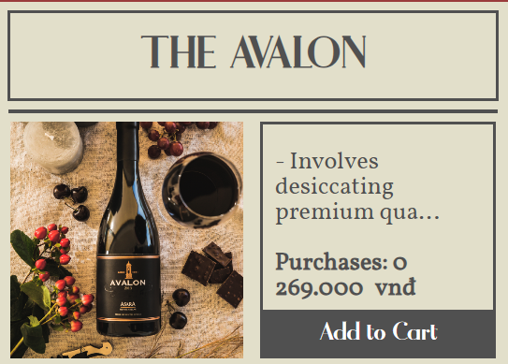
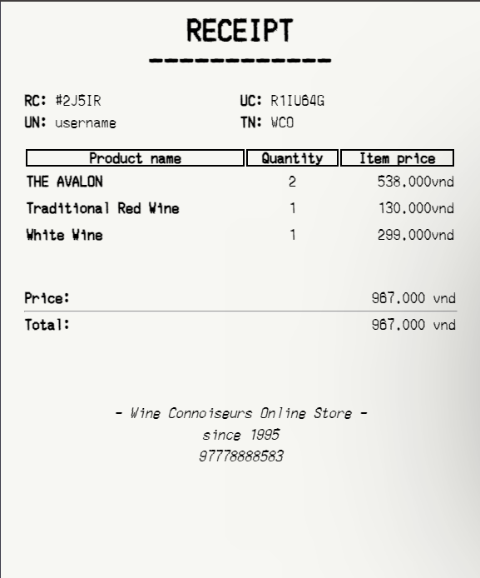
NEWS review
Pham Han
Enjoyable shopping
experience
Wine Connoiseurs
description
Reasons for choosing the topic
features
Save more time, bring more conveniences
Buy and sell yours, with deep colors and classical music.
Aesthetic & culltural
MO
DE
Inspiration & health
JSA41
Wine “world”” -
Diversity & abundance
“receipt” checkout ━

Slide 4
NEWS review
Enjoyable shopping
experience
Pham Han
Wine Connoiseurs
features
Reasons for choosing the topic
Buy and sell yours, with deep colors and classical music.
Save more time, bring more conveniences
Aesthetic & culltural
MO
DE
Inspiration & health
JSA41
“receipt” checkout ━
Diversity & abundance
Wine “world”” -

Slide 5
NEWS review
Pham Han
Wine Connoiseurs
Reasons for choosing the topic
features
DE
Aesthetic & culltural
MO
Inspiration & health
JSA41
Diversity & abundance
“receipt” checkout ━

Slide 6
Pham Han
Wine Connoiseurs
Reasons for choosing the topic
Aesthetic & culltural
DE
MO
Inspiration & health
i’ll keep secrets
JSA41
Diversity & abundance

