Slide 1

Real-Time Object Detection for Autonomous Vehicles
Prepared by:
Fahd Adly Abo Hamady
Abdelrahman Yousry Mohammed
Mohamed Hazem Alsherif
Esraa Mohammed Mohammed
Ghada Ahmed Alamir
Supervised by:
ENG. Ahmed Mostafa

Slide 2
Project Vision & Objective
Mission Statement:
To build a robust machine learning system capable of detecting and classifying critical road objects such as pedestrians, vehicles, and traffic signs to ensure safe autonomous navigation.
Key Goals:
Enhance Safety:
The primary focus is to improve decision-making processes in real-time driving scenarios to protect passengers and pedestrians.
Real-Time Performance:
Delivering high-speed inference (Frames Per Second) essential for immediate vehicle reaction times.
Reliability:
Creating a fail-safe system that operates efficiently across dynamic urban and highway environments.

Slide 3
Challenges & Technical Approach
The Challenges: Autonomous systems must perform accurately under unpredictable conditions, including:
Lighting Variations:
Operating effectively during night, day, and low-light scenarios.
Environmental Factors:
Handling diverse weather conditions like fog or rain, and various road textures.
Our Strategy:
Advanced Architectures:
Utilizing state-of-the-art models like YOLO or SSD to balance detection speed with high accuracy.
Transfer Learning:
Leveraging pre-trained weights from large-scale datasets (like COCO and KITTI) to accelerate learning and improve robustness.
Data Augmentation:
Simulating different driving conditions (flipping, cropping) to prepare the model for the unexpected.

Slide 4
Project Roadmap (End-to-End Pipeline)
The Development Journey:
Data Foundation:
Collecting and preprocessing diverse datasets (KITTI, Open Images) to create a clean, annotated training set.
Model Engineering:
Training and fine-tuning the detection model, optimizing for metrics like Mean Average Precision (mAP) and Intersection over Union (IoU).
Real-Time Deployment:
Integrating the model into an inference pipeline to process live camera feeds from the vehicle.
Continuous Evolution (MLOps):
Implementing monitoring pipelines to track performance drifts and trigger automated retraining, ensuring the model adapts to new data over time.

Slide 5
Milestone 1

Slide 6
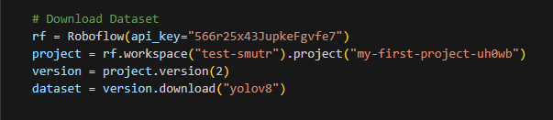
Project Overview
End-to-End YOLOv8 Data Pipeline
Dataset version of “bdd100K” downloaded via Roboflow
Preprocessing and directory structuring
Goal: prepare autonomous driving dataset for YOLOv8 training

Slide 7
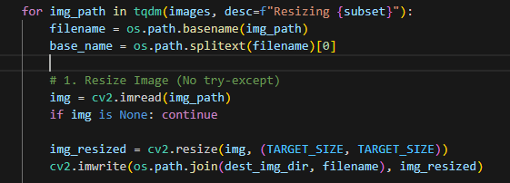

Preprocessing Workflow
Read images and YOLO label files
Optional resizing & bounding box adjustments
Validation of bounding boxes
Export cleaned data into train/valid/test

Slide 8
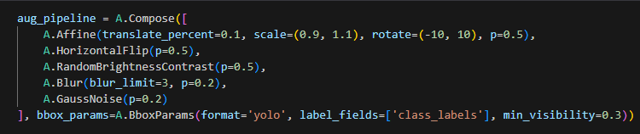
Augmentation
Augmentation Pipeline:
Random Crop, Flip, Brightness/Contrast, Motion Blur
Class distribution analysis
Save augmented images & labels

Slide 9
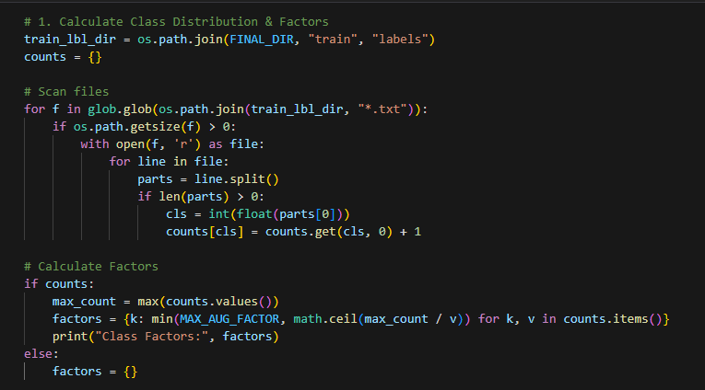
Class Distribution & Factors
Reads all label files to count how many samples each class has.
Identifies rare classes with low instance count.

Slide 10
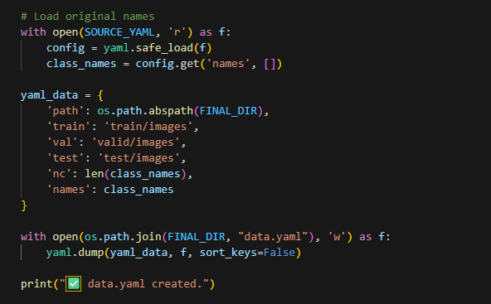
Generate Configuration
Loads class names from the original YAML file.
Builds the YOLOv8 “data.yaml” structure.

Slide 11
Milestone 2

Slide 12
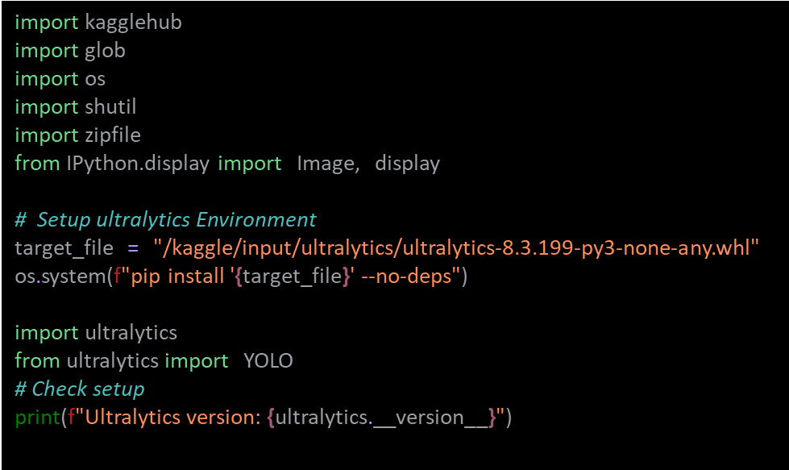
ENVIRONMENT SETUP & LIBRARY INSTALLATION
Installing and configuring Ultralytics YOLOv8 environment in Kaggle.
Ensuring reproducibility and environment compatibility with local wheel files.

Slide 13
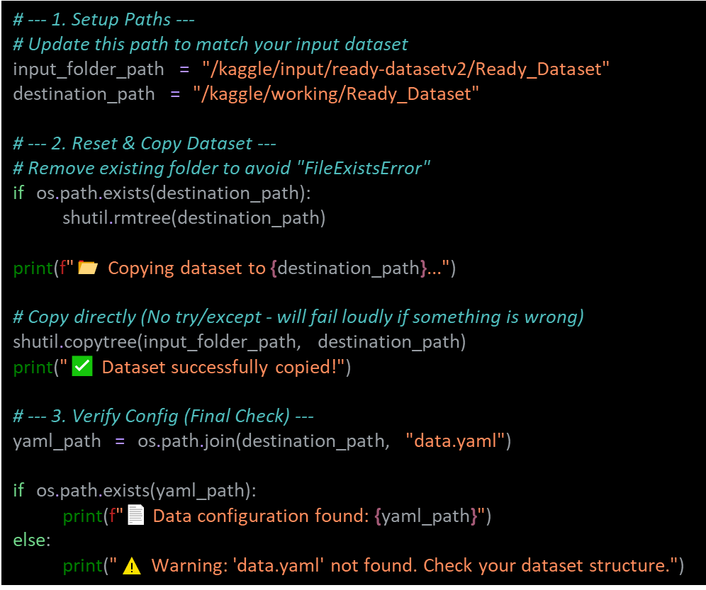
DATASET PREPARATION & VERIFICATION
Efficient copying of processed dataset to working directory.
Dataset structure validated with “data.yaml” file to ensure correct training input.

Slide 14
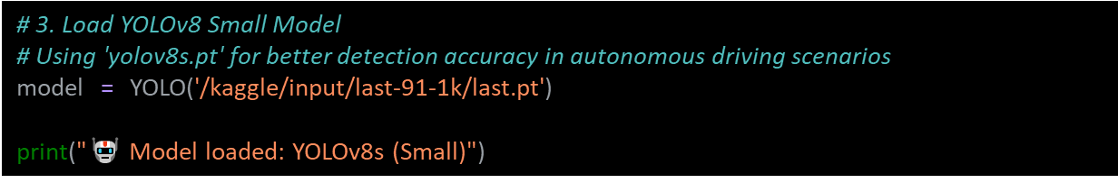
MODEL INITIALIZATION
Loading pretrained YOLOv8 Small weights optimized for traffic object detection.
Ensures faster convergence and better accuracy.

Slide 15
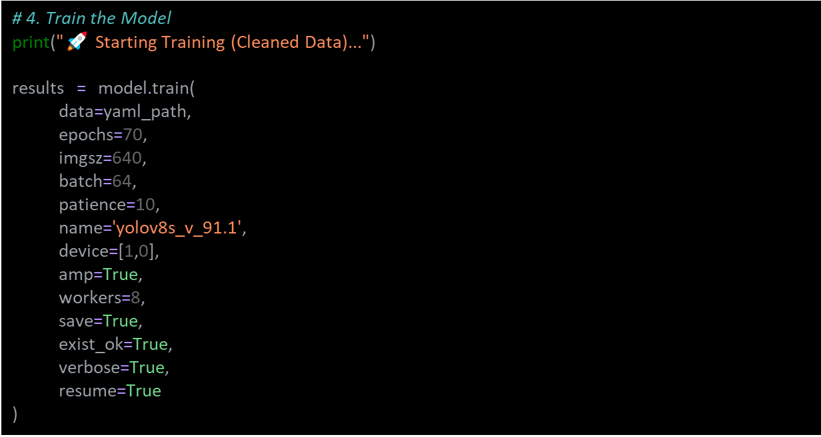
TRAINING CONFIGURATION & EXECUTION
Training parameters: 70 epochs, batch size 64, image size 640px.
Dual GPU training with AMP for speed and memory optimization.
Early stopping with patience 10 to prevent overfitting.

Slide 16
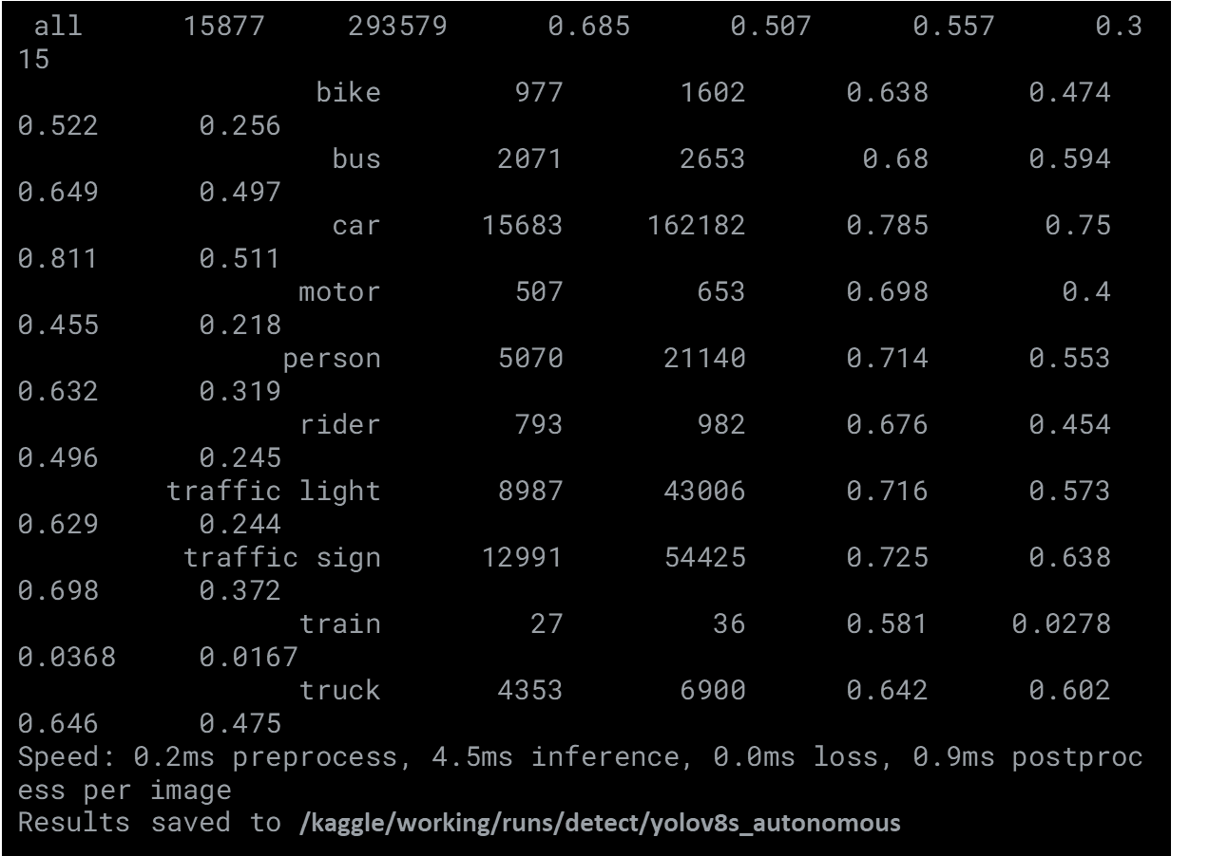
TRAINING PROGRESS MONITORING
Real-time display of loss, accuracy, and mAP metrics during training.
Logging results for post-training analysis.

Slide 17
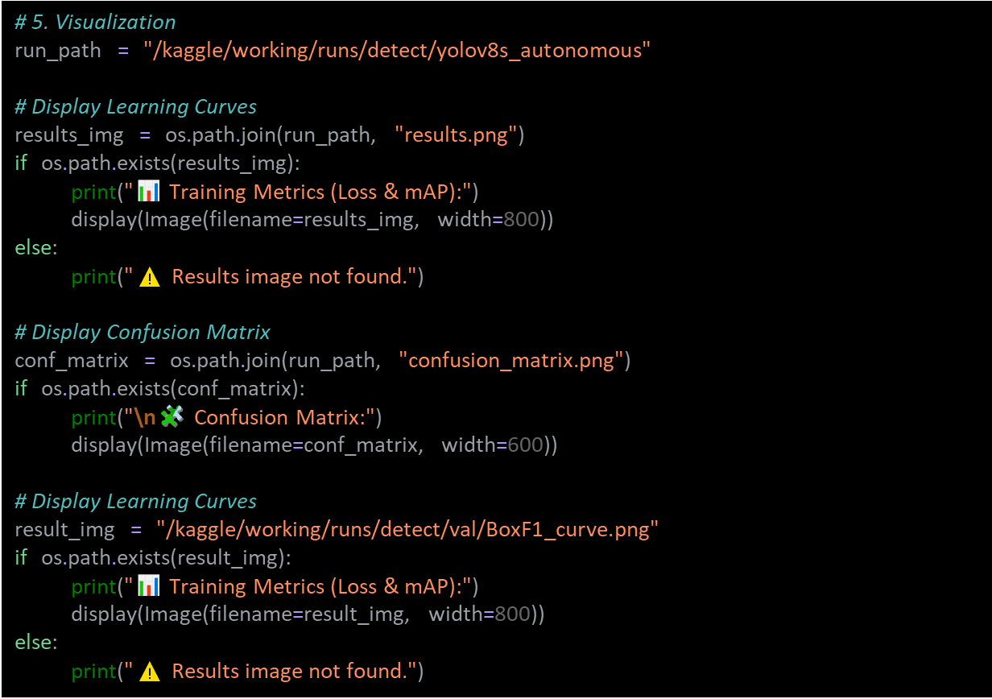
EVALUATION & VISUALIZATION
Real-time monitoring of training progress
Visualization of key metrics: loss, accuracy, and mAP
Graphs and charts for intuitive insight during training
Logging data for detailed post-training review

Slide 18
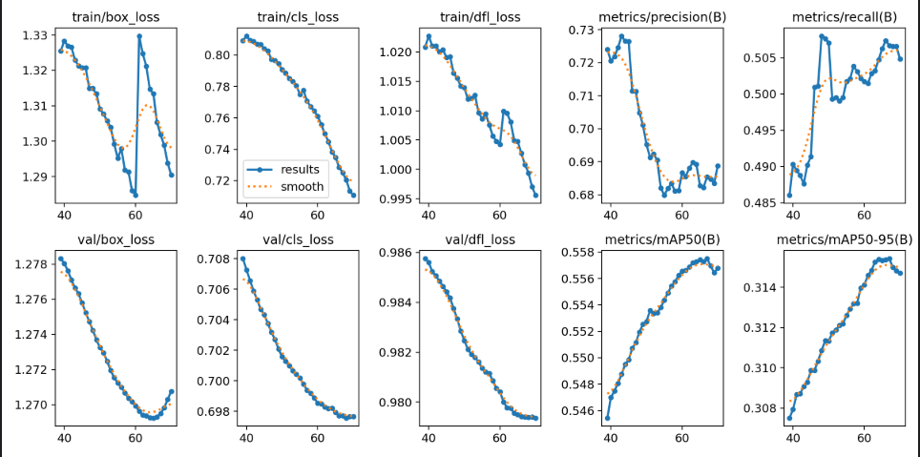
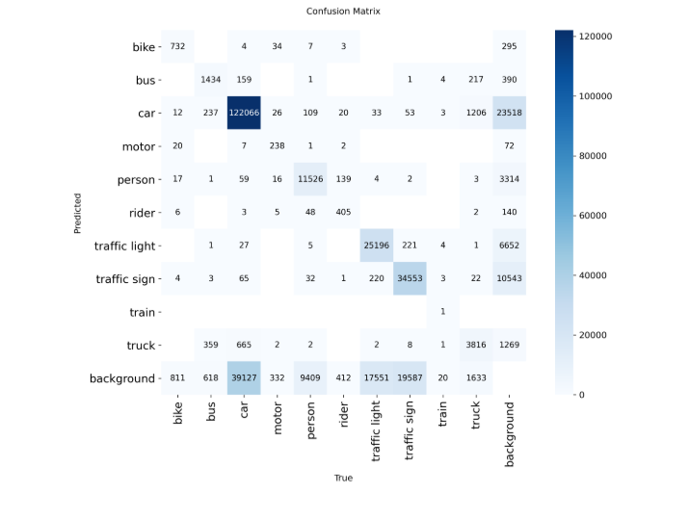
VISUALIZATION MAPS
Training Metrics (Loss & mAP)
Confusion Matrix

Slide 19
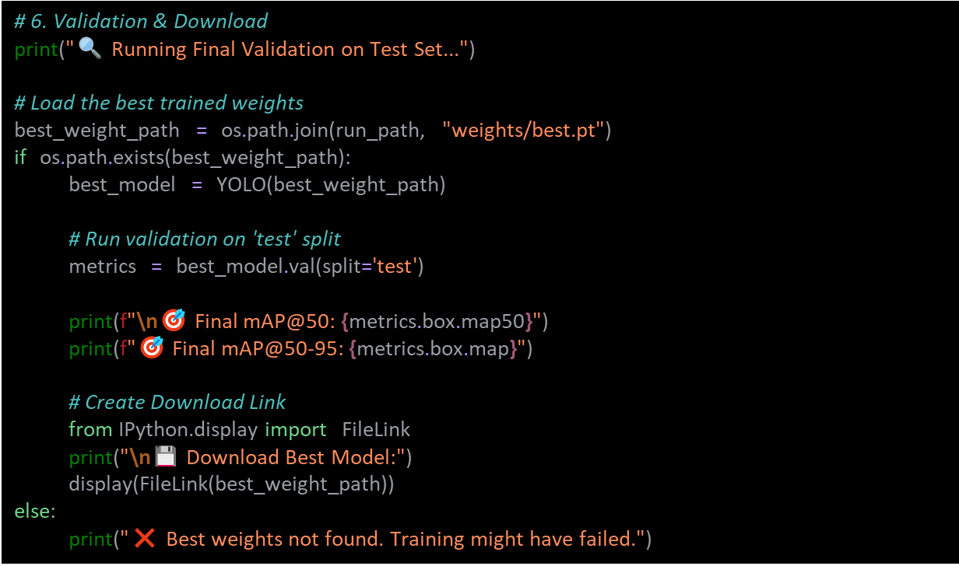
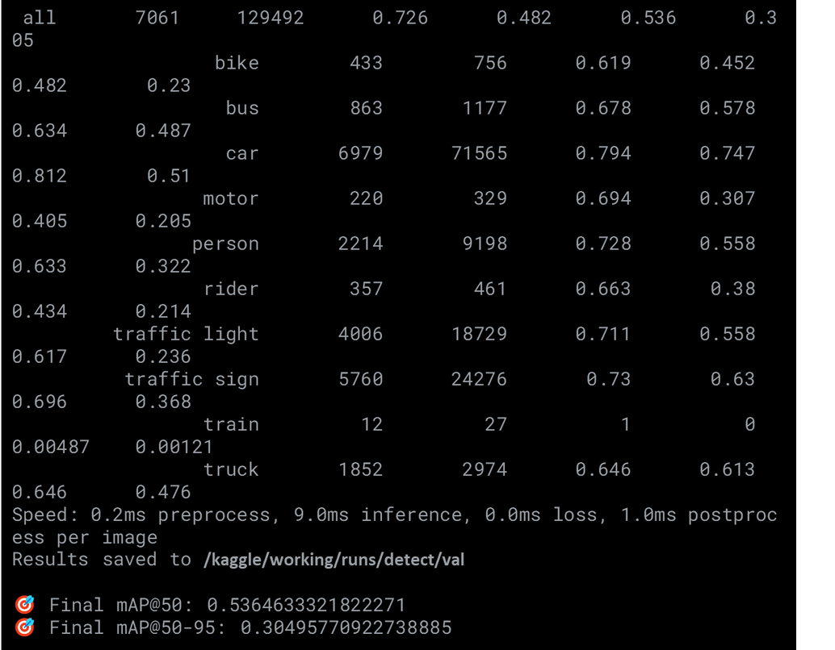
FINAL VALIDATION & DOWNLOAD
Comprehensive evaluation on the test dataset
Metrics reported: mAP@50 and mAP@50-95
Confusion matrix analysis to identify error types
Option to download trained model and results for deployment

Slide 20
Milestone 3.1

Slide 21
Inference Pipeline Overview
In this part, I implemented the inference pipeline used to run the model after training.
The pipeline supports image input, video input, and live webcam streaming.
We used the ONNX version of the model for faster real-time performance.
The system processes each frame, applies detection, and displays or saves the output.
This pipeline connects the trained model to real-world testing on the road.

Slide 22
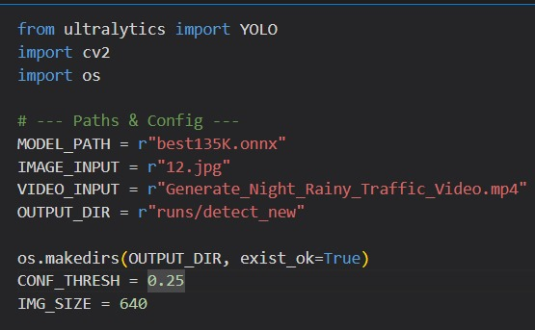
Setup & Configuration
This part sets up all paths for the model, input files, and output directory.
It creates the output folder if it doesn’t exist.
Key parameters like confidence threshold and image size are defined here.
Prepares the environment for running the inference pipeline.

Slide 23
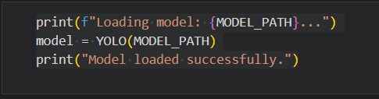
Model Loading
In this part, the ONNX model is loaded into the system.
The pipeline initializes the YOLO model so it’s ready for inference.
Simple status messages are printed to confirm that the model was loaded successfully.

Slide 24
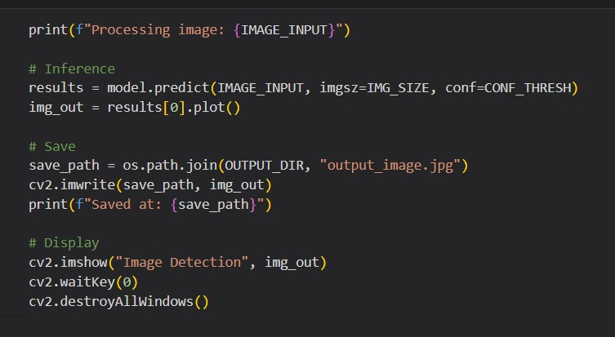
Image Detection
This part runs the model on a single image.
The pipeline detects objects in the image and draws bounding boxes.
The processed image is saved automatically and displayed on screen for review.

Slide 25
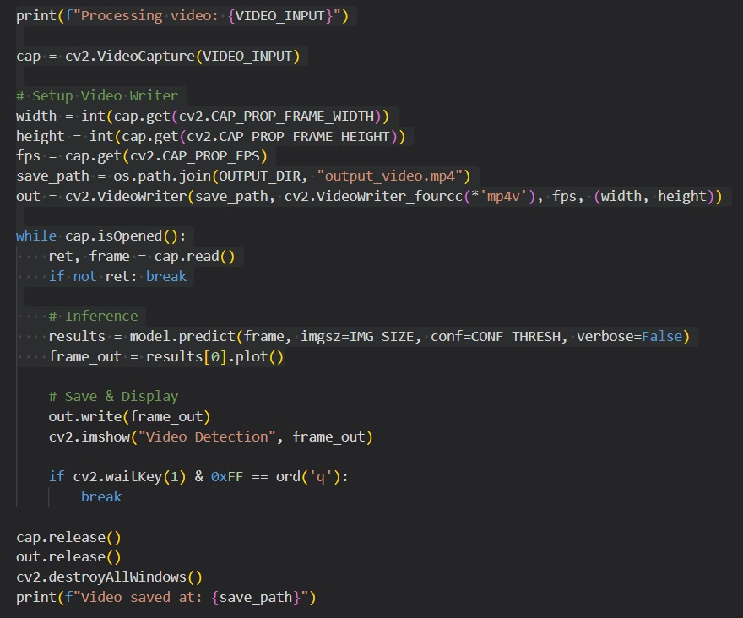
Video Detection
This part processes a video file frame by frame.
The model detects objects in each frame and draws bounding boxes.
The processed video is saved automatically and displayed in real-time.
Users can stop the video processing anytime by pressing Q.

Slide 26
Milestone 3.2

Slide 27
Inference Pipeline
Goal: Bridging the gap between model training and real-world application.
Versatile Media Handling:
Designed to process diverse input formats seamlessly.
Supports static Images, pre-recorded Videos, and live Webcam feeds.
Interoperability:
PyTorch (.pt): Native support for rapid research and development.
ONNX (.onnx): Optimized format for high-performance deployment across different hardware platforms.

Slide 28
Streamlit Dashboard Overview
Objective: To provide a professional-grade interface for demonstrating model capabilities.
Framework: Built using Streamlit, allowing for rapid deployment of data-centric web apps.
Design Philosophy:
Modern Automotive Aesthetic: Custom CSS injection used to enforce a "Dark Mode" theme, mimicking real in-car displays.
User-Centric Layout: Clean separation between controls and visualization.

Slide 29
User Interface Architecture
Control Panel (Sidebar):
Input Selection: Toggle between Image, Video, or Webcam
Dynamic Tuning: Adjustable Confidence Threshold slider (0.0 to 1.0) to filter detections in real-time without restarting the app.
2. Main View:
Visual Feed: Large display area for the processed output with bounding boxes.
Analytics Panel: Dedicated space for live statistics adjacent to the video feed.

Slide 30
Real-Time Key Performance Indicators (KPIs)
Metric | Function | Significance
FPS | Frames Per Second | Measures system latency and processing speed.
Object Count | Total Detections | Instant feedback on traffic density (cars, peds, etc.).
System Status | Active / Idle / Stopped | Immediate visual confirmation of pipeline health.

Slide 31
Milestone 4

Slide 32
Objectives & Overview
Objectives:
Implement Continuous Monitoring to track system latency (FPS) and model confidence.
Apply Active Learning by capturing "Hard Examples" (low-confidence frames) to improve the dataset.
Set up an Automated Retraining trigger to update the model when data drift is detected.
Key Tools:
Ultralytics YOLO: For object detection and training.
MLflow: For experiment tracking and metric logging.
OpenCV: For video processing and image capture.

Slide 33
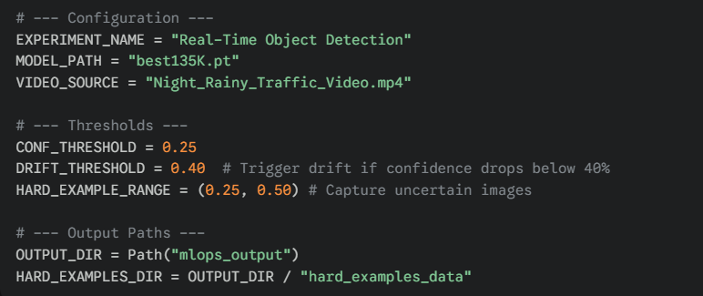
Configuration & Setup
We define centralized configurations to manage thresholds easily.
DRIFT_THRESHOLD determines when the model performance is considered degraded.
HARD_EXAMPLE_RANGE defines the confidence window for capturing edge cases.

Slide 34
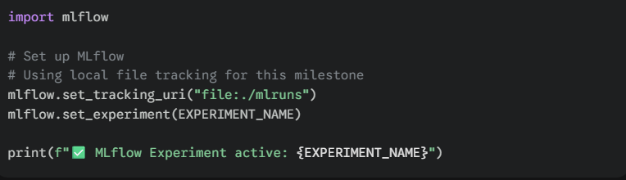
MLFlow Initialization
We initialize MLflow to track our experiment runs.
This allows us to log parameters (video source, model) and metrics (FPS, Accuracy) for comparison over time.

Slide 35
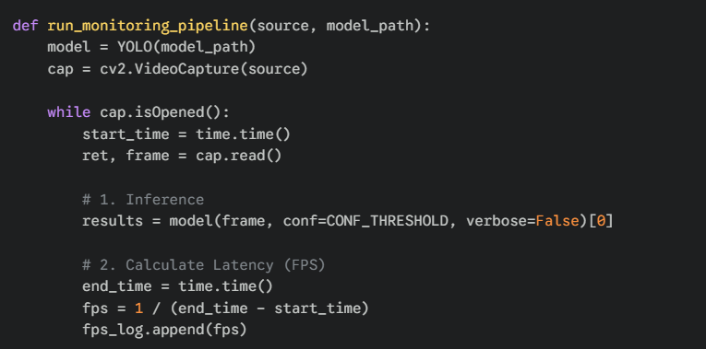
The Monitoring Pipeline
This function runs the inference loop on the video.
It calculates FPS (System Latency) for every frame.
It tracks the Confidence Score of every detection to monitor model stability.

Slide 36
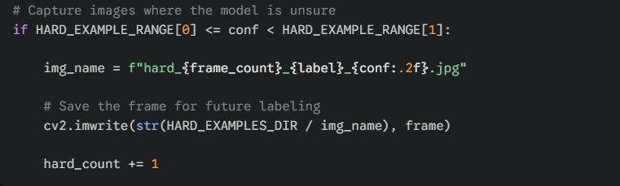
Active Learning (Hard Example Mining)
Inside the monitoring loop, we identify "Hard Examples“.
If a detection has low confidence (e.g., between 0.25 and 0.50), we save the image.
These images are used to label and retrain the model later.

Slide 37
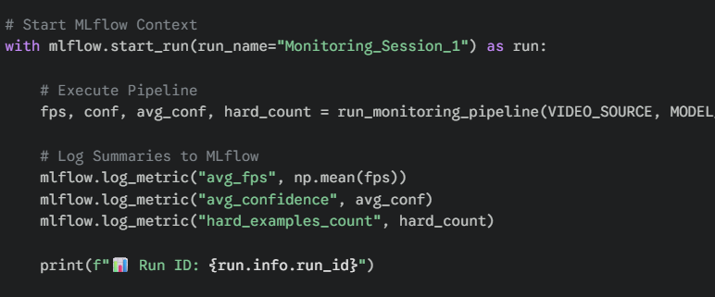
Execution & Logging
We execute the pipeline within an MLflow run context.
Key metrics (Average FPS, Average Confidence, and Hard Example Count) are logged.
This creates a permanent record of the model's performance on this specific video.

Slide 38
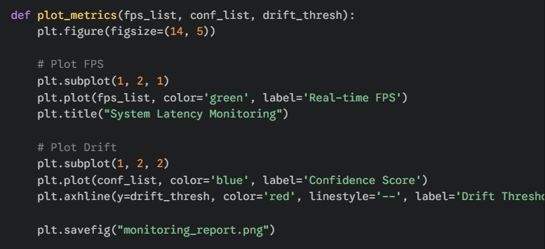
Reporting & Visualization
We visualize the system metrics to create a PDF/Image report.
Graph 1: Real-time FPS to check for latency issues.
Graph 2: Confidence scores vs. Drift Threshold to visualize degradation.

Slide 39
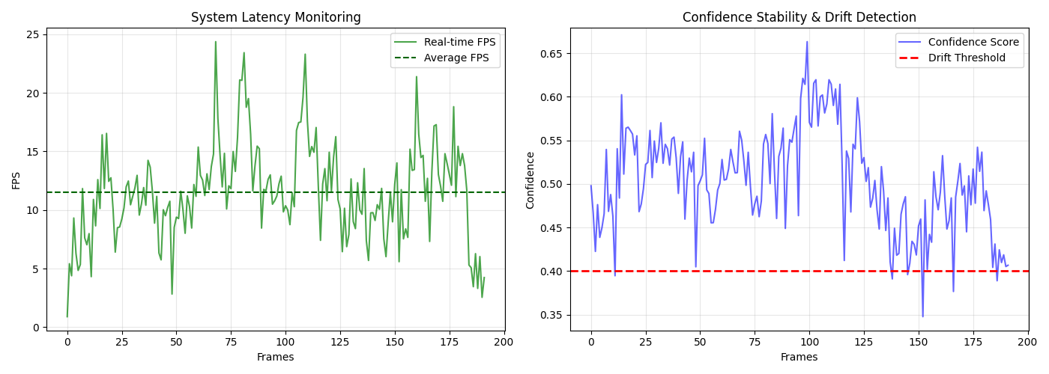

Slide 40
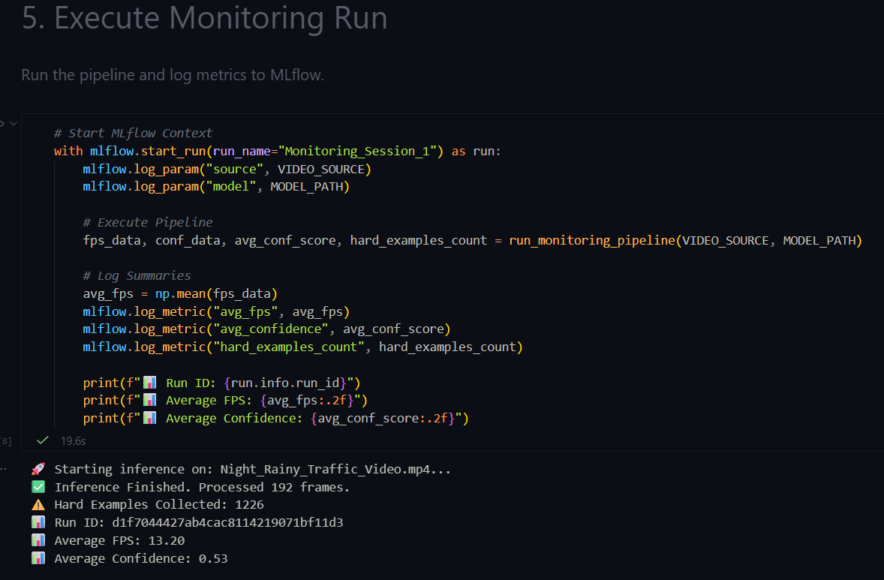
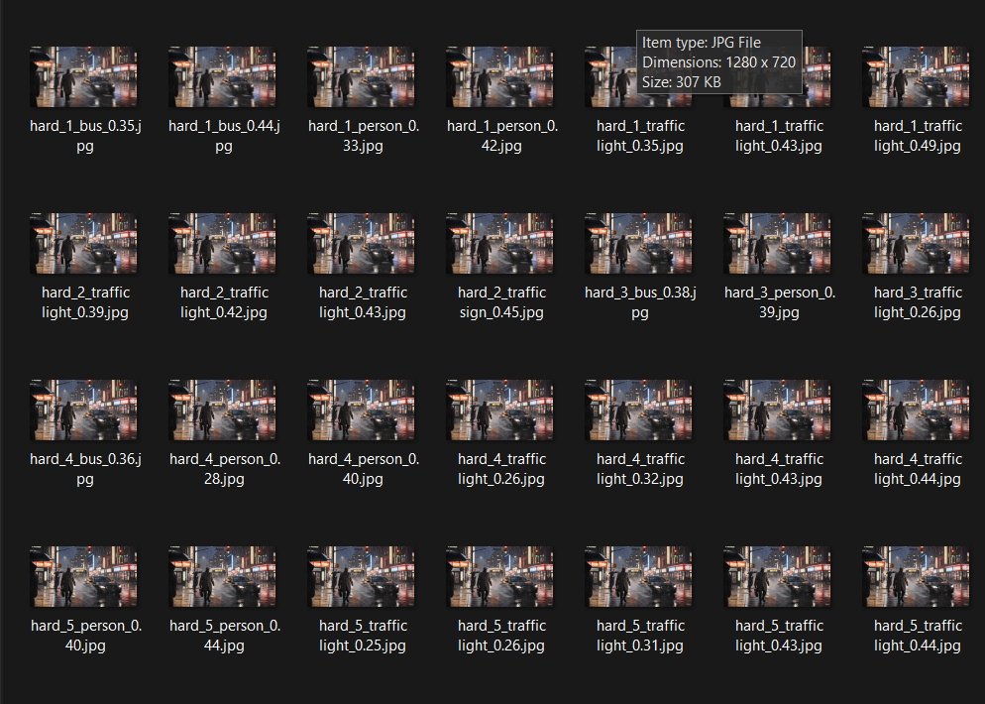

Slide 41
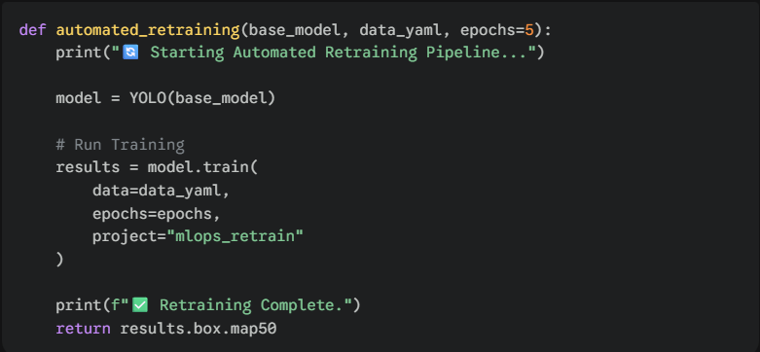
Automated Retraining Logic
This function automates the retraining process using the YOLO API.
It is designed to be triggered only when necessary (Drift Detected).
It saves the new weights to a new project folder.

Slide 42
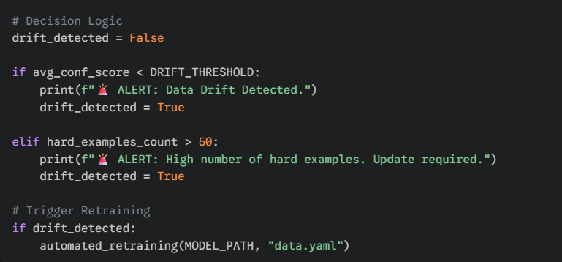
Drift Decision Trigger
The final step is the decision logic (The "Brain" of MLOps).
If Average Confidence drops below the threshold, or if too many Hard Examples are found, retraining is triggered.

