Slide 1

Welcome to: Tableau desktop
Level 1

Slide 2

INTRODUCTIONS:
Name, Company Name, Title, Job Responsibilities
Does your company already use Tableau?
Have you used Pivot Tables in Microsoft Excel?
Which Data Sources will you be using at work?
Did you receive the book for class today?
(Book: Tableau 10 for Beginners)

Slide 3
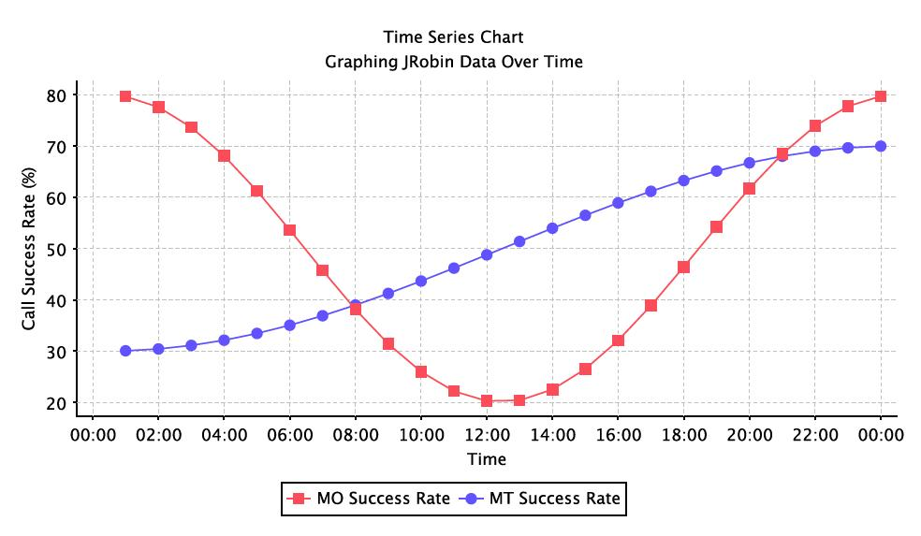
Logistics:
Class Hours (EST):
10:00AM – 4:45PM
Breaks:
Around 11:30AM
Around 3:30PM
Lunch: 12:15PM – 1:15PM
Wi-Fi – If your location has an ONLC Wi-Fi connection, the password is: 1234567890 (not all training centers have this connection. Please ask the office manager/receptionist if there is a building Wi-Fi

Slide 4
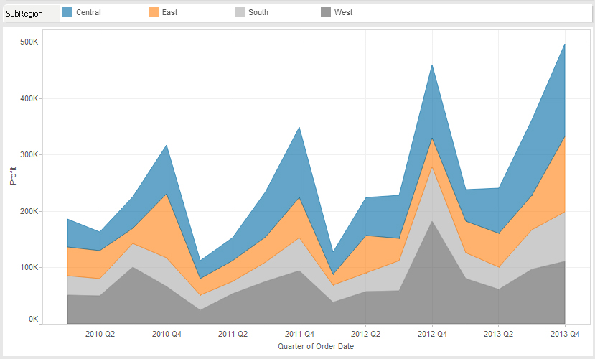
What We Will Cover:
Chapter 1 – Understanding the Basics
Chapter 2 – Connecting to Data
Chapter 3 – Data Transformation
Chapter 4 – Calculations in Tableau
Chapter 5 – More Calculations
Chapter 6 – Filters and Parameters
Chapter 7 - Sorting

Slide 5
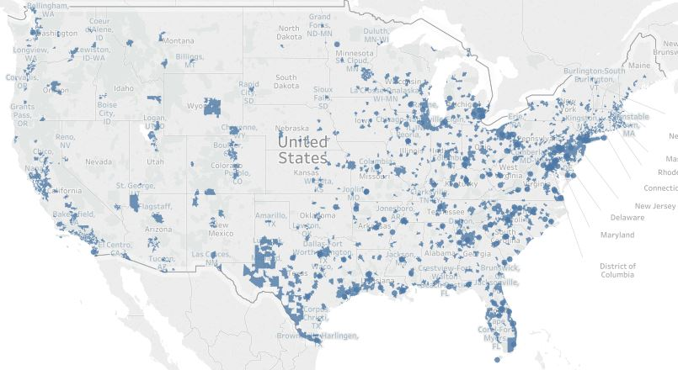
What We Will Cover:
Chapter 8 – Groups and Sets
Chapter 9 – Formatting
Chapter 10 – Creating Maps
Chapter 11 – Creating Visualizations
Chapter 12 – Dashboards and Visual Stories
Chapter 13 – Server Deployment

Slide 6
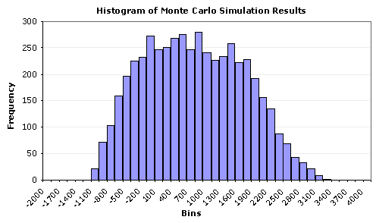
QUESTIONS?:

