Slide 1
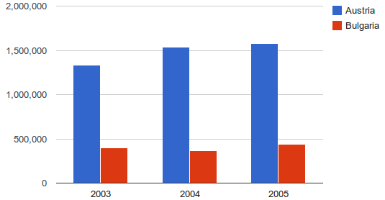
Welcome to: Tableau dATA VISUALIZATION

Slide 2
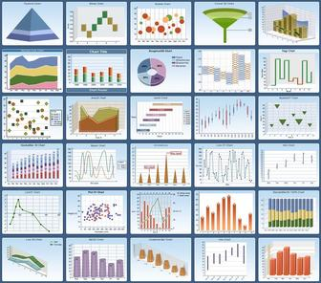
INTRODUCTIONS:
Name, Company Name, Title, Job Responsibilities
Does your company already use Tableau?
Have you used Pivot Tables in Microsoft Excel?
Which Data Sources will you be using at work?
Did you receive the book for class today?
(Book: Communicating Data With Tableau – Ben Jones)

Slide 3
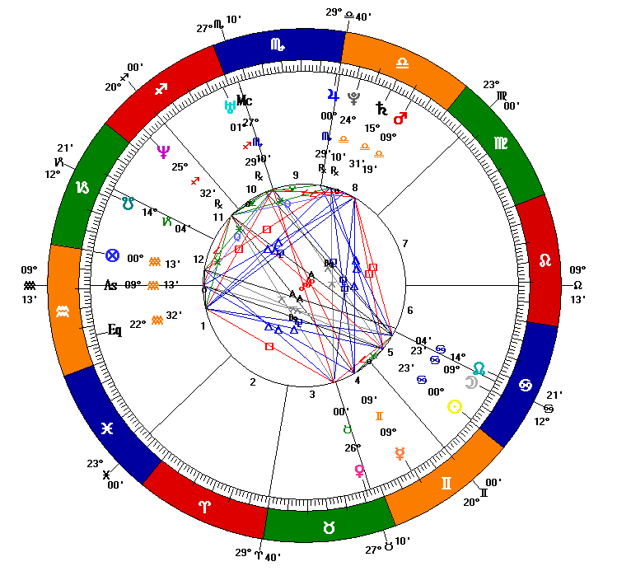
Logistics:
Class Hours (EST):
10:00AM – 4:45PM
Breaks:
Around 11:30AM
Around 3:30PM
Lunch: 12:15PM – 1:15PM
Wi-Fi – If your location has an ONLC Wi-Fi connection, the password is: 1234567890 (not all training centers have this connection. Please ask the office manager/receptionist if there is a building Wi-Fi

Slide 4
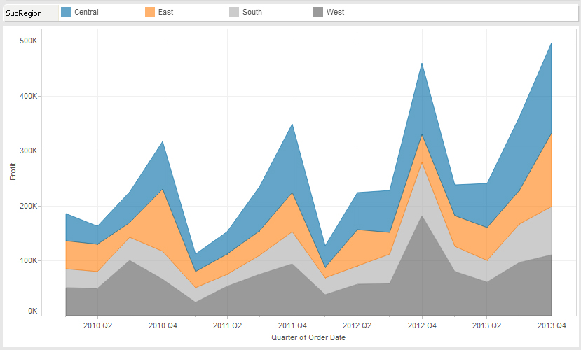
What We Will Cover:
Chapter 1 – Communicating Data
Chapter 2 – Tableau Introduction
Chapter 3 – How Much? How Many?
Chapter 4 – Ratios and Rates
Chapter 5 – Proportions and Percentages
Chapter 6 – Mean and Median
Chapter 7 – Variation and Uncertainty

Slide 5
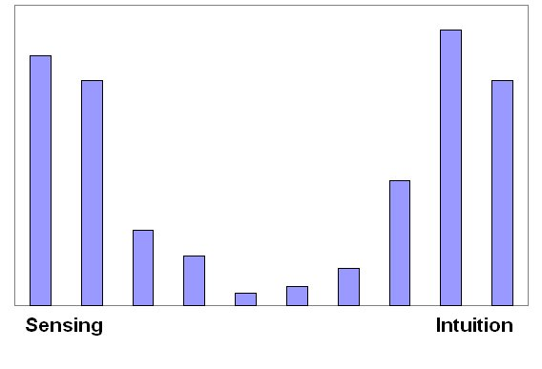
What We Will Cover:
Chapter 8 – Multiple Quantities
Chapter 9 – Changes Over Time
Chapter 10 – Maps and Location
Chapter 11 – Advanced Maps
Chapter 12 – The Joy of Dashboards
Chapter 13 – Building Dashboards
Chapter 14 – Advanced Dashboard Features

Slide 6
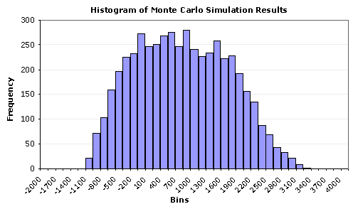
QUESTIONS?:

