Slide 1

Welcome to: Tableau desktop
Level 2

Slide 2

INTRODUCTIONS:
Name, Company Name, Title, Job Responsibilities
Does your company already use Tableau?
Did you attend the Desktop Level 1 class, or are you self-taught on Tableau Beginner?
Which Data Sources will you be using at work?
Did you receive the book for class today?
(Book: Practical Tableau: Author: Ryan Sleeper)

Slide 3
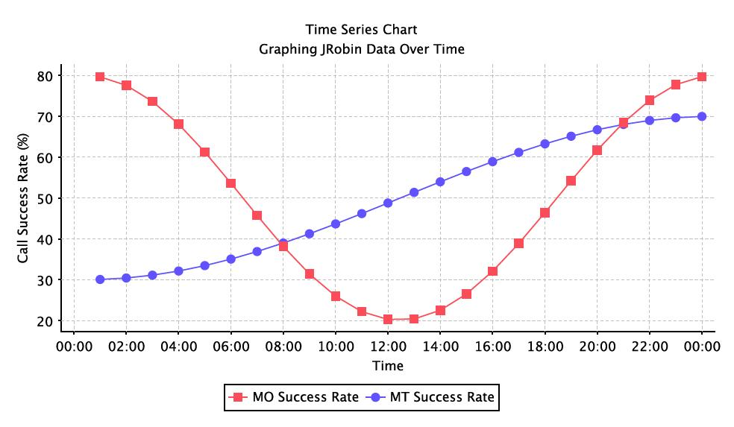
Logistics:
Class Hours (EST):
10:00AM – 4:45PM
Breaks:
Around 11:30AM
Around 3:30PM
Lunch: 12:15PM - 1:15PM
Wi-Fi – If your location has an ONLC Wi-Fi connection, the password is: 1234567890 (not all training centers have this connection. Please ask the office manager/receptionist if there is a building Wi-Fi

Slide 4
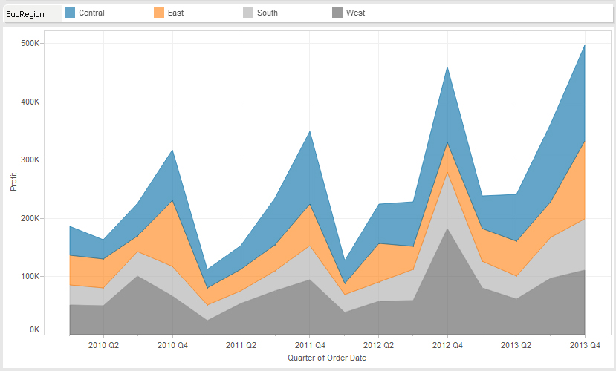
What We Will Cover:
Part 1 – Reviewing the Basics – Quick Review & Demos
Chapters 1-17
Part 2 – Chart Types – Solving Business Problems with LOADS of Visualizations
Chapters 18- 46
Part 3 – Tips and Tricks – Secrets to Take Your Visualizations Above and Beyond
Chapters 47-75

Slide 5
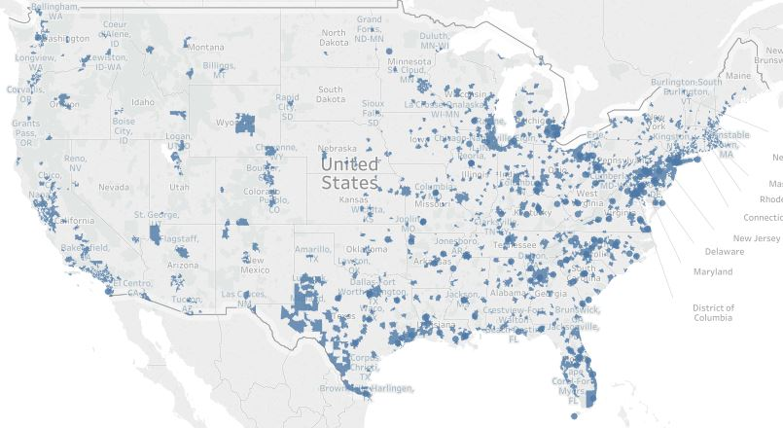
What We Will Cover:
Part 4 – Framework – The Cycle of Visualization
Chapters 76 - 83
Part 5 – Storytelling by leveraging Best Practice
Chapters 84-100

Slide 6
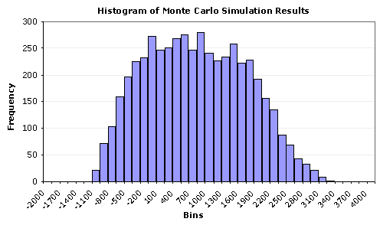
QUESTIONS?:

