Slide 1

Welcome to: Tableau Server Administration

Slide 2
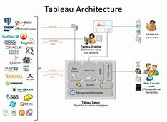
INTRODUCTIONS:
Name, Company Name, Title, Job Responsibilities
Does your company already use Tableau?
Have you used Pivot Tables in Microsoft Excel?
Which Data Sources will you be using at work?
Did you receive the book for class today?
(Book: Implementing Tableau Server – Chandraish Sinha)

Slide 3
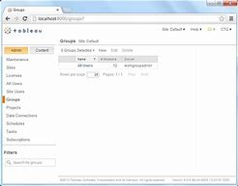
Logistics:
Class Hours (EST):
10:00AM – 4:45PM
Breaks:
Around 11:30AM
Around 3:30PM
Lunch: 12:15PM – 1:15PM
Wi-Fi – If your location has an ONLC Wi-Fi connection, the password is: 1234567890 (not all training centers have this connection. Please ask the office manager/receptionist if there is a building Wi-Fi

Slide 4
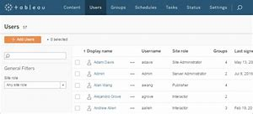
What We Will Cover:
Overview of Tableau Desktop, The Lingo of Tableau and Architecture of Tableau Server
Installing Tableau Server (and Configuring)
Workspaces in Tableau Server
Security
Managing Sites
Branding

Slide 5
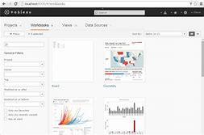
What We Will Cover:
7. Performance and Monitoring
Backup and Restore
Log Files
Command Line Utilities
JavaScript API
Managing Content

Slide 6
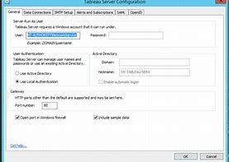
QUESTIONS?:

