Slide 1

Welcome to: Tableau desktop
Level 3

Slide 2

INTRODUCTIONS:
Name, Company Name, Title, Job Responsibilities
Does your company already use Tableau?
Have you used Pivot Tables in Microsoft Excel?
Which Data Sources will you be using at work?
Did you receive the book for class today?
(Book: Tableau 10 - Business Intelligence Cookbook)

Slide 3
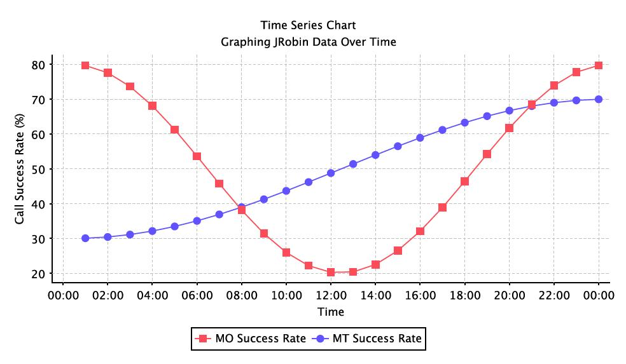
Logistics:
Class Hours (EST):
10:00AM – 4:45PM
Breaks:
Around 11:30AM
Around 3:30PM
Lunch: 12:15PM – 1:15PM
Wi-Fi – If your location has an ONLC Wi-Fi connection, the password is: 1234567890 (not all training centers have this connection. Please ask the office manager/receptionist if there is a building Wi-Fi

Slide 4
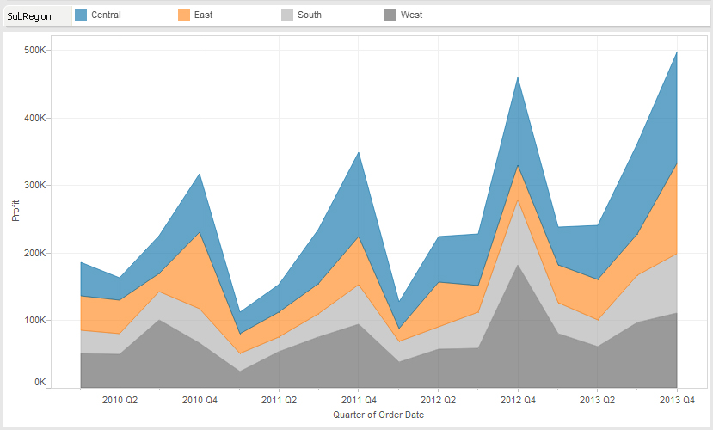
What We Will Cover:
Chapter 1 – Reviewing Basic Charts
Chapter 2 – Advanced Charts
Chapter 3 – Interactivity
Chapter 4 – Dashboards and Story Points
Chapter 5 – Maps and Geospatial Visualizations
Chapter 6 – Analytics
Chapter 7 – Data Preparation

Slide 5
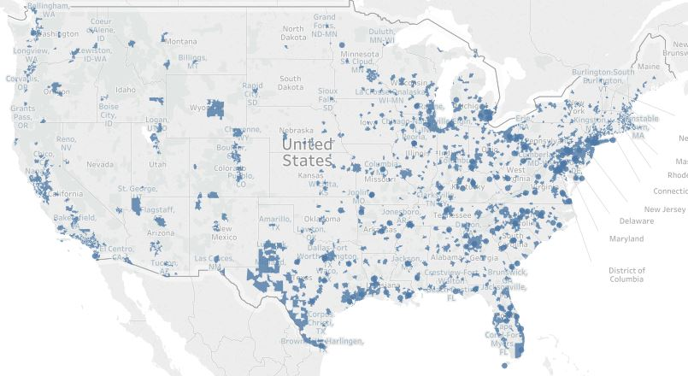
Appendixes:
Appendix A – Calculated Field Primer
Appendix B - Resources

Slide 6
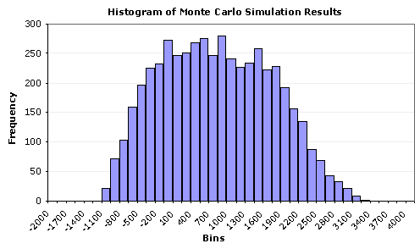
QUESTIONS?:

