Slide 1
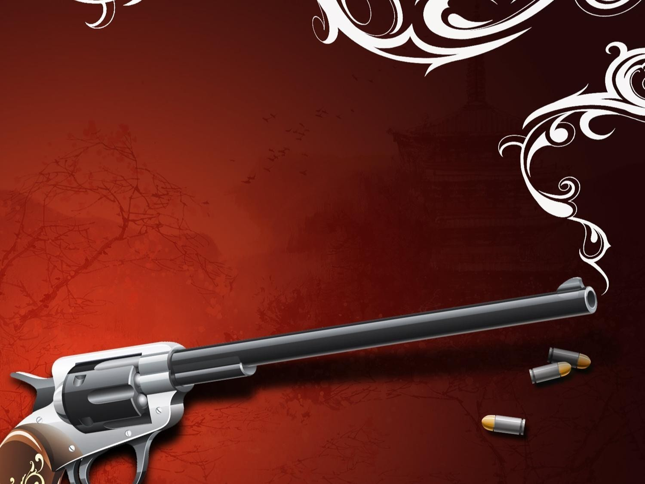
How They
Throw Out
a Challenge

Slide 2
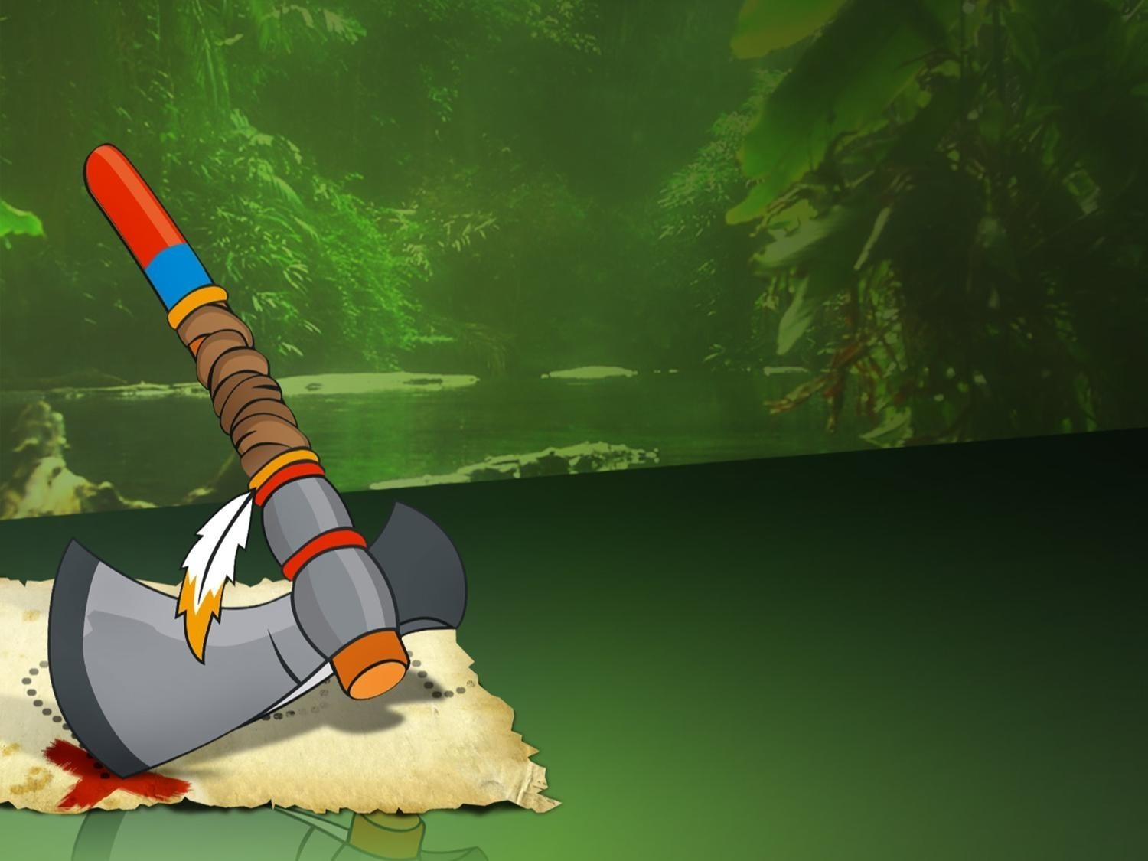
American Indians (XVII century)
put a tomahawk on the ground in the
rival's camp

Slide 3
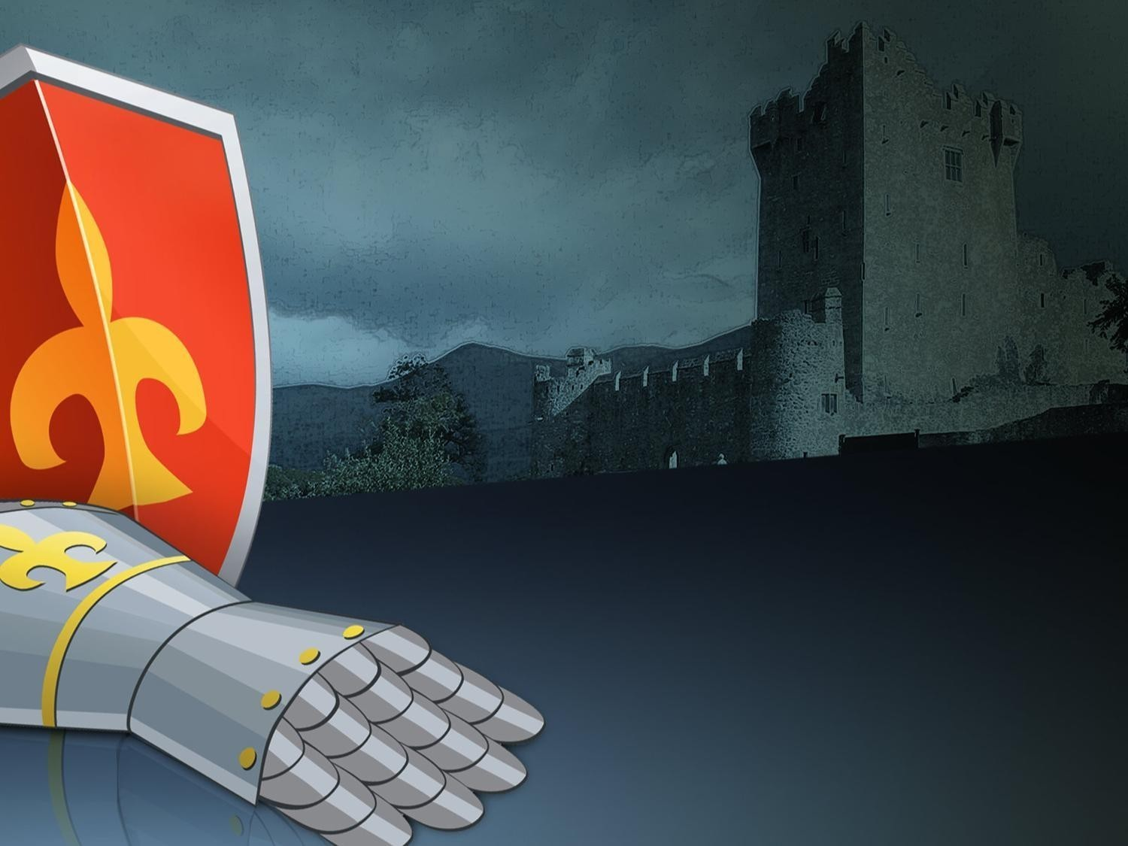
European Knights (XII-XVI centuries)
threw a glove
in the rival's face

Slide 4

OnlyOffice
stands for Peace

