Slide 1


Slide 2
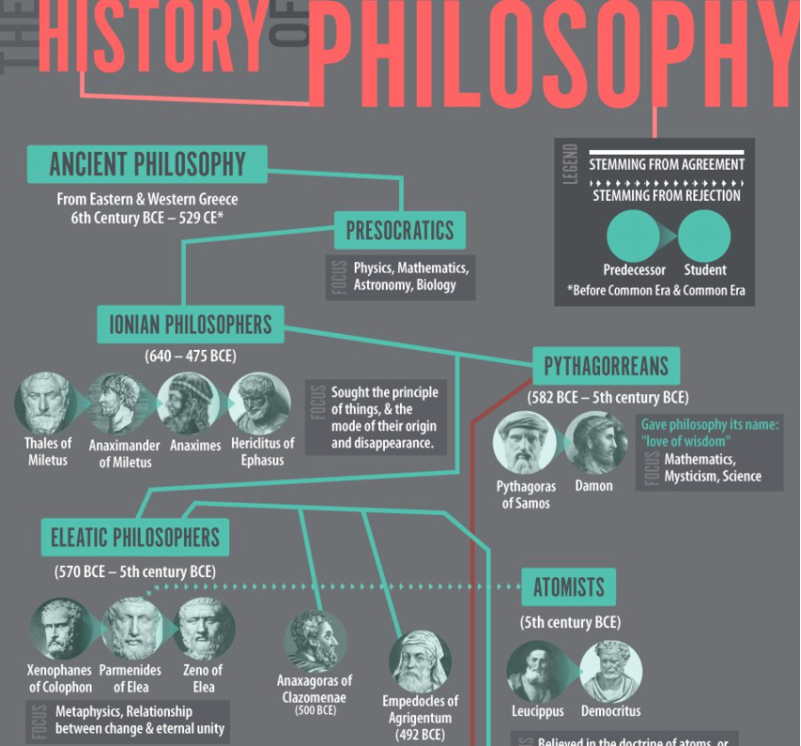
It would be difficult if not impossible to find two philosophers who would define philosophy in exactly the same way. Throughout its long and varied history in the West, philosophy has meant many different things. Some of these have been a search for wisdom (the meaning closest to the Latin philosophia, itself derived from the Greek philosopher, “lover of wisdom”); an attempt to understand the universe as a whole; an examination of humankind’s moral responsibilities and social obligations; an effort to fathom the divine intentions and the place of human beings with reference to them; an effort to ground the enterprise of natural science; a rigorous examination of the origin, extent, and validity of human ideas; an exploration of the place of will or consciousness in the universe; an examination of the values of truth, goodness, and beauty; and an effort to codify the rules of human thought in order to promote rationality and the extension of clear thinking.

Slide 3
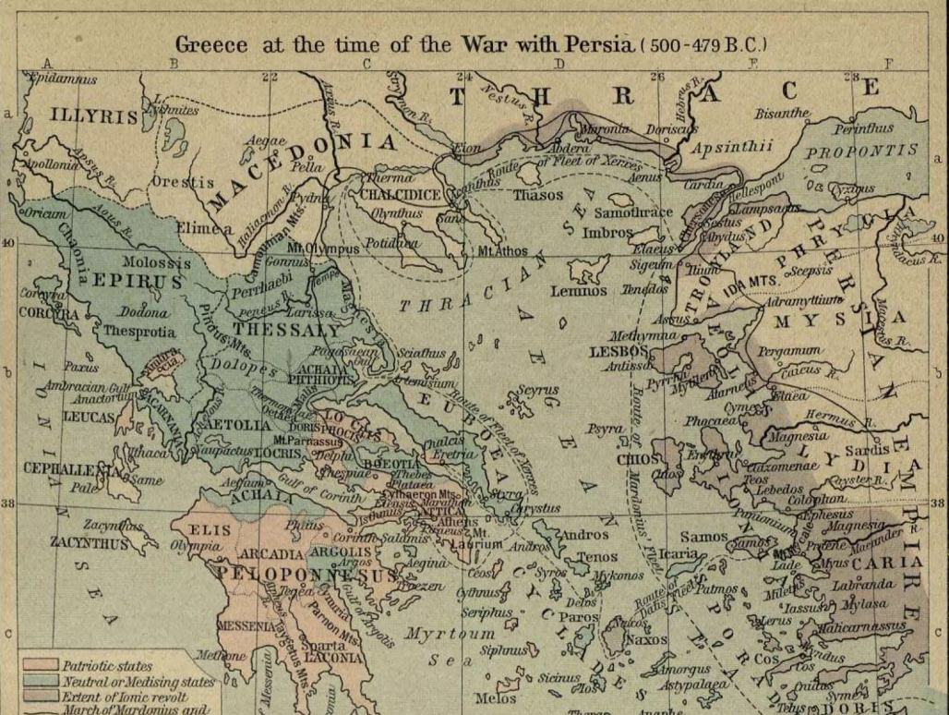
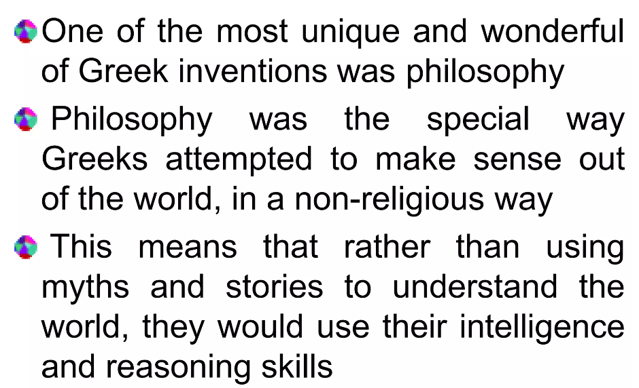
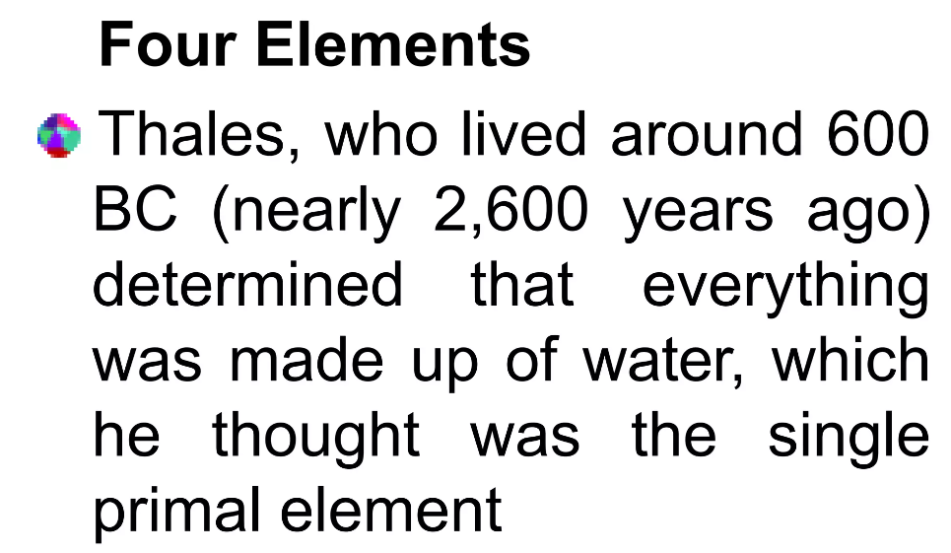
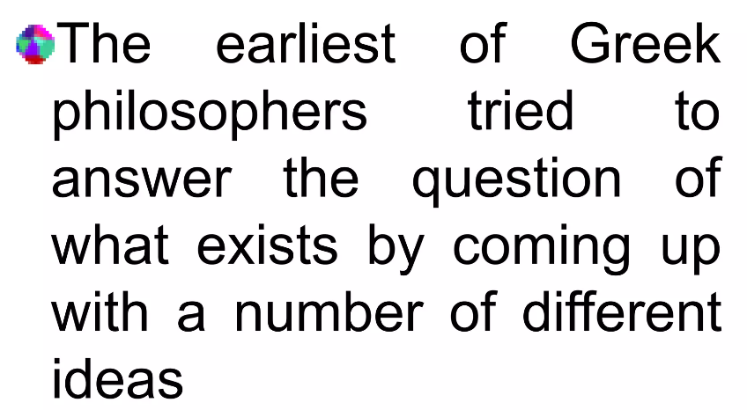

Slide 4
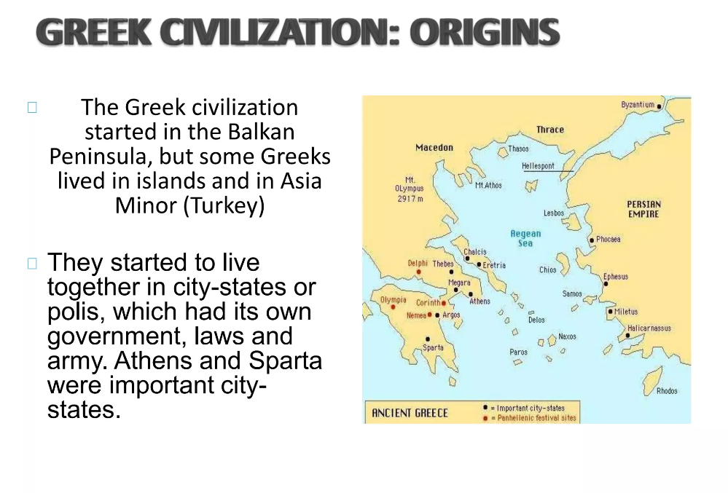

Slide 5
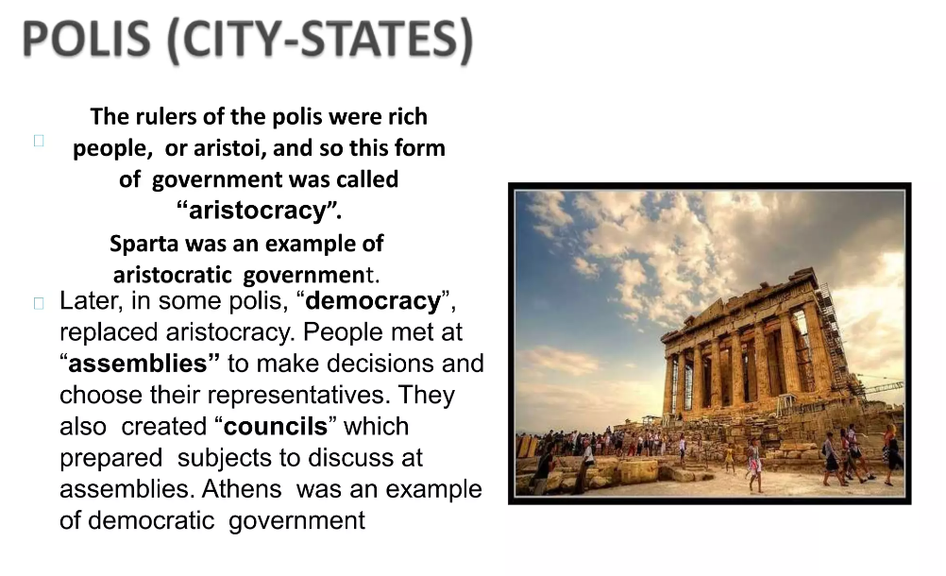

Slide 6
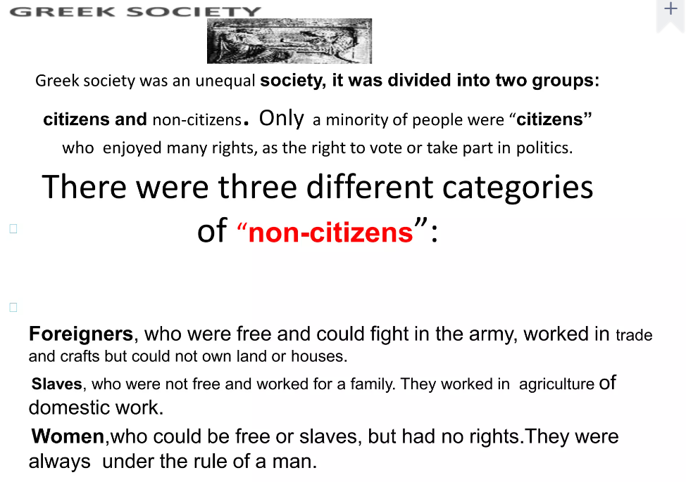

Slide 7
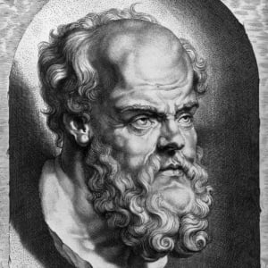
Socrates biorgraphy
Born circa 470 B.C. in Athens, Greece
Socrates's life is chronicled through only a few sources: the dialogues of Plato and Xenophon and the plays of Aristophanes.
Socrates was the son of Sophroniscus, an Athenian stonemason and sculptor, and Phaenarete, a midwife.

Slide 8
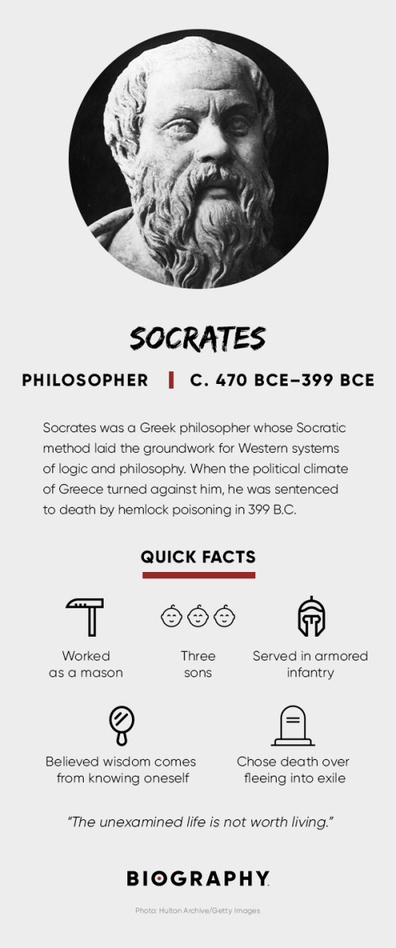
Socrates biorgraphy
Socrates served in the armored infantry — known as the hoplite — with shield, long spear and face mask
In 399 B.C., Socrates was accused of corrupting the youth of Athens and of impiety, or heresy. He chose to defend himself in court.

Slide 9
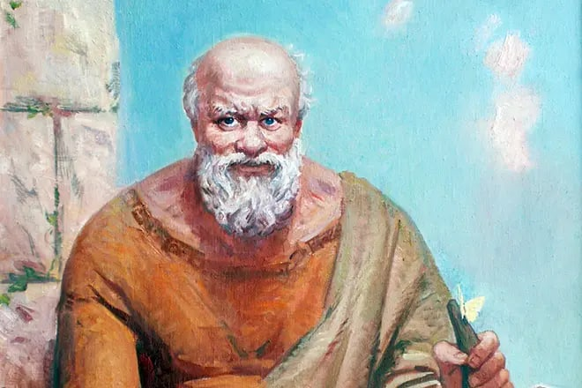
SOCRATES

Slide 10
According to various sources, the philosopher was born in 470-469 BC in Greek Athens, in the family of the sculptor Sofronisk and the midwife Fenareta. The future great thinker had an older brother, Patroclus, who inherited his father's property, but Socrates did not remain in poverty. This can be judged by the fact that the philosopher went to war with Sparta in the uniform of a heavily armed warrior, and only wealthy citizens could afford to pay for it. From this follows the conclusion that Socrates' father was a wealthy citizen and earned good money, wielding a chisel and other tools.

Slide 11

Philosophy
Socratic method:
Socratic priority of definition
Socratic ignorance
Socratic irony

Slide 12
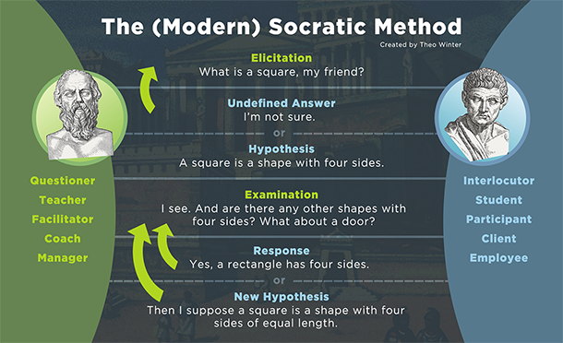

Slide 13
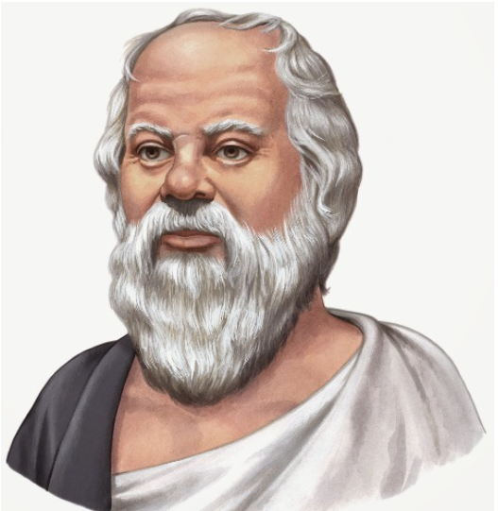
DEATH OF SOCRATES

Slide 14
The Death of Socrates was on a day in 399 BC. at dusk after sunset, Socrates, the wisest and best of men, hurried the glass of hemlock (a well common plant in our geographical area) that will produce death, in the presence of his close friends who desolate attend the moral fortitude with which he faces the judgment. Socrates was 70 or 71 years old. An unjust sentence, following the infamous complaints of three opportunist, envious and resentful citizens with their teacher, made in a favorable overall environment for it, killed the teacher and gave him everlasting fame that in no way could suspect his contemporaries.

Slide 15
The accusation came from the tragic poet Melet, the rich tanner Anita and the orator Lycon. The accuser was Melet, who stated that he was swearing to accuse Socrates that "he does not honor the gods that the city honors, but introduces new deities, and is guilty of corrupting youth; and the punishment for that is death"

Slide 16
Why was Socrates condemned to die?
Socrates was accused basically of three crimes:
to introduce new gods and to despise existing,
to transform with the art of the word the truth into falsehood without respecting the law,
to corrupt the youth.

Slide 17
Socrates’ spiritual reflection on death
Socrates continues explaining how the true philosopher must be prepared for death, which is only the separation of the soul from the body, wrap in which it is enclosed and imprisoned and that impedes access to the truth.

Slide 18
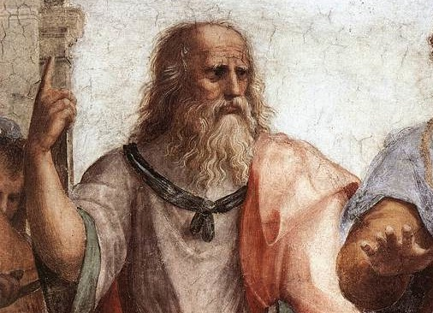
The influence of Socrates on philosophy
The wise man who wrote nothing down

Slide 19
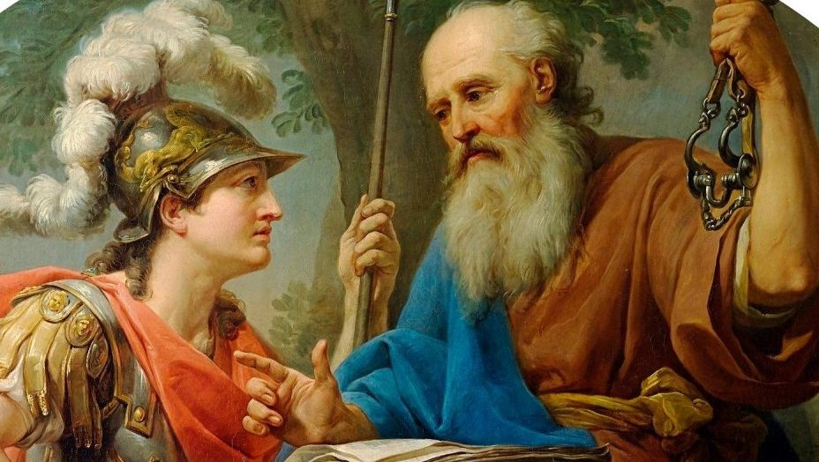
Because of his propensity for probing others, Socrates likens himself to a horsefly. He asked some straightforward but incisive questions. Socrates' goal in using questions was to expose what individuals believed they understood or the boundaries of their knowledge. But not for payment, he would give lectures. because he asserted ignorance.

Slide 20
